Slide 1
Wildlife Management and Vector Control for an FAD Response in Domestic Livestock
Overview
Adapted from the FAD PReP/NAHEMS
Guidelines: Wildlife Management and Vector Control for an FAD Response in Domestic Livestock (2014)
Notes:
In order to effectively control, contain, and eradicate a foreign animal disease (FAD) in domestic livestock, the response effort must consider the role that wildlife may play in disease transmission. In the event that wildlife play a role in an FAD outbreak, the Animal and Plant Health Inspection Service (APHIS), will cooperate with Federal, State, and Tribal agencies that have primary jurisdiction over wildlife. This presentation provides an overview of the role of wildlife management and vector control in responding to an FAD outbreak in domestic livestock or poultry. This presentation is guidance only, and does not provide prescriptive procedures. [This information was derived from the Foreign Animal Disease Preparedness and Response (FAD PReP)/National Animal Health Emergency Management System (NAHEMS) Guidelines: Wildlife Management and Vector Control for an FAD Response in Domestic Livestock.]

Slide 2
This Presentation
Definitions of relevant terms
APHIS Authorities
Significance of wildlife in an FAD
Roles and responsibilities
Wildlife management methods
and plans
Notes:
This information is intended to provide all responders with a common general understanding of how wildlife management and vector control would be conducted in an FAD incident in domestic livestock or poultry. This presentation addresses the following topics: the definition of relevant terms, APHIS authorities, the potential significance of wildlife in an FAD outbreak, and roles and responsibilities of responders within Incident Command. Additionally, it provides general information on methods to manage wildlife in an FAD response in domestic livestock, including the development of a wildlife management plan to mitigate wildlife involvement in an FAD outbreak. Additional presentations discussing these issues in greater detail are also are available.

Slide 3
Definitions - OIE
Wild animal: “an animal that has a phenotype unaffected by human selection and lives independent of direct human supervision or control”
Wildlife: “all free-ranging animals, including native and exotic wildlife species, as well as feral domestic animals”
Notes:
To begin, a few terms will be defined for this discussion. A wild animal, as defined by the World Organization for Animal Health (OIE) in the 2014 Terrestrial Animal Health Code, is “an animal that has a phenotype unaffected by human selection and lives independent of direct human supervision or control.” The use of the term “wildlife” for this presentation is further defined as “all free-ranging animals, including native and exotic wildlife species, as well as feral domestic animals” in the United States (APHIS VS Memorandum 573.1). This definition does not include privately-owned captive wildlife, whether native or exotic, nor does it include zoological collections, which are defined as captive animals. This presentation focuses on situations involving wild mammals (e.g., ungulates, carnivores, and rodents) and birds (e.g., waterfowl); these species are most likely to have important implications for disease transmission in an FAD outbreak.

Slide 4
Definitions cont’d
Feral: domestic animals not confined
Wildlife reservoir: free-ranging
species as a potential source of infection/infestation
Vector: any living organism that can carry disease agents
  Biological transmission: disease agent transfer from host to susceptible animal
  Mechanical transmission: disease agent transfer from host to susceptible animal via external body parts
Notes:
In an FAD outbreak, susceptible wild animal species may become infected, serve as a reservoir, or further spread the pathogen to domestic livestock or poultry. Terms describing these modes of involvement as used in this presentation are defined here.
Feral: domestic animals (e.g., cats, horses, pigs) that are not confined or under control.
Wildlife reservoir: any population of free-ranging or free-living species in which an infectious agent/vector has become established, lives and multiplies and is therefore a potential source of infection/infestation to other domestic and free ranging species; Veterinary Services (VS) recognizes that the initial source of infection of a wildlife reservoir may be an agricultural animal population (VS Memo 573.1).
Vector: any living organism, including, but not limited to arthropods, rodents, and scavengers, that can carry disease causing agents from an infected animal to a susceptible animal, either biologically (e.g., an arthropod bite) or mechanically (e.g., carrying microorganisms on the body, such as feet or fur).
Biological transmission: transfer of a disease agent from a host to a susceptible animal after the pathogen has undergone some part of its life cycle within the host (e.g., mosquito, feral swine).
Mechanical transmission: transfer of a disease agent to a susceptible animal via external body parts of a host species; the pathogen does not undergo any development or multiplication while on the host species (e.g., flies).

Slide 5
Definitions cont’d
FAD: animal disease or pest not known to exist in US or territories
Emerging disease: change or mutation in pathogenicity, communicability or zoonotic potential to become a threat
When livestock outbreak involves wildlife - USDA APHIS and authorities with jurisdiction over wildlife collaborate
Notes:
An FAD is a terrestrial animal disease or pest, or an aquatic animal disease or pest, not known to exist in the United States or its territories.
An Emerging animal disease may be any terrestrial animal, aquatic animal, or zoonotic disease not yet known or characterized, or any known or characterized terrestrial animal or aquatic animal disease in the United States or its territories, that changes or mutates in pathogenicity, communicability, or zoonotic potential to become a threat to terrestrial animals, aquatic animals, or humans.
An FAD or emerging animal disease may involve livestock, poultry, other animals, and/or wildlife. In the event of an FAD or emerging animal disease outbreak in domestic livestock that involves wildlife, USDA APHIS will work in close collaboration, communication, and coordination with State, Tribal and Federal wildlife agencies that have primary jurisdictional authority and subject matter expertise for wildlife.

Slide 6
USDA APHIS Authorities for Responding to an FAD Outbreak in Domestic Livestock
Notes:
APHIS is authorized by statutory and regulatory authorities to respond to FADs and other communicable diseases of livestock and poultry. Multiple APHIS units, including Wildlife Services, Veterinary Services, Animal Care, and International Services, all play a role in current wildlife disease activities. In an FAD incident and coordinated response, the Code of Laws of the United States of America (U.S.C.) and the Code of Federal Regulations (CFR) provide policy for the USDA, via statutes and regulations; interim regulations can be implemented—in the event of an outbreak—to prevent the spread of disease.

Slide 7
APHIS Authority
Animal Health Protection Act (AHPA)
  Authorizes Secretary of Agriculture
  Prevent, detect, control, eradicate
Title 9 of the CFR
  Regulations for disease control
VS Memo 573.1
  “Animal Health Policy in Relation to Wildlife”
Requires collaborative relationships between agencies of authority
Notes:
APHIS receives its permanent and general regulatory authority from the Animal Health Protection Act (AHPA), 7 U.S.C. 8301 et seq., enabling the Secretary of Agriculture to prevent, detect, control, and eradicate diseases and pests of animals, in order to protect animal health, the health and welfare of people, economic interests of livestock and related industries, the environment, and interstate and foreign commerce in animals and other articles. Several key sections of Title 9 of the CFR provide detailed USDA APHIS administrative regulations for the control and eradication of animal diseases in order to accomplish the agency’s mission: 9 CFR 71.2, 9 CFR 71.3, 9 CFR 53, 9 CFR 161. VS Memorandum 573.1 “USDA, APHIS, VS Animal Health Policy in Relation to Wildlife” provides guidance specifically for APHIS Veterinary Services in the event of an FAD outbreak in domestic livestock that has a wildlife component, given the authority granted to APHIS under the AHPA. Efforts to prevent, control, or eliminate transmission of infectious agents/diseases/vectors between animal agriculture populations and wildlife requires separation of livestock and wildlife, as well as collaborative relationships between agencies that have primary authority over wildlife.

Slide 8
Relevance of Wildlife in an FAD Outbreak in Domestic Livestock or Poultry
Notes:
As stated earlier, in an FAD outbreak, susceptible wild animal species may become infected, serve as a reservoir, or further spread the pathogen to domestic livestock or poultry. Wildlife species can be susceptible to many of the FADs that affect domestic livestock. For example, feral swine are susceptible to and can serve as a reservoir of classical swine fever and African swine fever viruses. This susceptibility can contribute to the epidemiology of the outbreak as well as have implications on the international trade of domestic livestock or poultry.

Slide 9
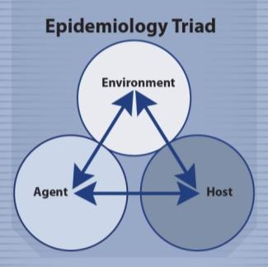
Epidemiological Factors
Interactions between host, agent, environment
Agent: range, resistance,
affinity, dose, mode of
transmission
Host: species, age,
immune/nutritional status
Environment: housing,
care, weather, vector
presence
Notes:
The epidemiology of any infectious disease involves the complex interaction between factors of the host, disease agent and environment. These factors further impact the distribution of the disease within a population. The interaction of these factors determines characteristics of the disease outbreak. Therefore, epidemiological parameters and considerations will need to be evaluated for an FAD situation involving wildlife species. These may include the following:
Agent factors: host range, environmental resistance, tissue affinity, dose, mode of transmission
Host factors: species, breed, age, nutritional status, immune status
Environment factors: husbandry, housing, climate/season, presence of vectors.
[This graphic shows the epidemiology triad of host, agent and environment interaction to establish disease. Graphic illustration by: Bridget Wedemeier, Iowa State University]

Slide 10
Epidemiological Factors cont’d
Immediately assess wildlife during an FAD
  Detect cases
  Understand disease characteristics
  Identify disease risks
  Provide information for control
  Evaluate effectiveness of control
  and adjust
  Ecological factors
Notes:
It is critically important to immediately assess the role of wild and/or feral animals in an FAD outbreak in order to identify and evaluate the best options for mitigating the role of wildlife related disease spread and transmission of an FAD pathogen to domestic livestock. In some diseases, wild animals may act as a reservoir for the disease and be a threat for the transmission of the FAD to domestic livestock. However, in other diseases, wildlife may simply be a reflection that the disease is already occurring in the domestic livestock in the area. Surveillance, epidemiology, and tracing techniques will be employed in an FAD outbreak to:
Detect new and existing cases (animals or premises).
Understand characteristics of the disease (e.g., clinical signs, incubation period, populations affected) and outbreak characteristics (e.g., sources, disease incidence patterns, geographic distribution, transmission dynamics, and reservoirs) and how they affect specific populations.
Identify risk factors associated with disease occurrence (e.g., age, production practices, species, wildlife, vectors).
Provide information for decision-making to design and implement control measures, as well as evaluate their effectiveness and determine adjustments.
Ecological factors such as wildlife distribution, population density, habitat, and social organization will influence the role that wildlife play in the spread and transmission of disease.

Slide 11
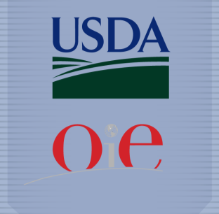
International Trade Implications
OIE distinguishes between wildlife infection and domestic infection for some diseases
  wildlife role in transmission,
  maintenance of agent
Not all countries will follow OIE guidelines
for trade
Notes:
In addition to the epidemiological implications of wildlife, there may also be international trade implications depending on whether or not wildlife are affected. For certain disease agents, the World Organization for Animal Health (OIE) Terrestrial Animal Health Code (2014) distinguishes between infection in wildlife and infection in domestic livestock for purposes of international trade. The OIE policy on diseases, which may involve both wildlife and domestic livestock, distinguishes whether or not the wild species plays an epidemiologically significant role in the transmission and maintenance of the disease agent in the domestic livestock population. Although wildlife may be affected or be the reservoir of the pathogen, it does not necessarily mean that domestic livestock for that country, region, or zone will also be affected. Nevertheless, the existence of the FAD in a wildlife population can make it more difficult to demonstrate disease-freedom. Importing countries may or may not follow the OIE guidelines for trade in animals or their products in the event of an FAD event in an exporting country. [This graphic shows the USDA and OIE logos. Graphic illustration by: Kate Harvey, Iowa State University]

Slide 12
Roles and Responsibilities
ICS, NIMS, Unified Command
Wildlife Cell, Vector Control Group
    Protect domestic animals and wildlife
All personnel have proper training
Wildlife Services coordinates with other agencies
  SERS, NWDP
Livestock owners, producers
Notes:
Response personnel involved in wildlife management and vector control have various roles and responsibilities in an FAD outbreak to efficiently control, contain, and eradicate the disease. The Incident Command System (ICS) and National Incident Management Systems (NIMS) are critical to controlling and managing an FAD outbreak scenario. APHIS will work in a Unified Command with other Federal and State agencies that have primary responsibility for wildlife. Within the Wildlife Cell (Planning Section) and Vector Control Group (Operations Section) there will be different positions based on function and responsibility; the number of personnel will vary depending on the size and the scope of incident. Objectives of the Wildlife Cell and Vector Control Group together include protecting both domestic animals and wildlife through prompt disease control, containment, and eradication. All operational/field personnel will be required to have the skills and experience to conduct wildlife-related activities. APHIS Wildlife Services will coordinate with VS and other Federal and State partners. Within Wildlife Services, the Surveillance and Emergency Response System (SERS) of the National Wildlife Disease Program (NWDP), serves as the primary emergency response contact point within APHIS. Livestock owners have an important role in protecting their herds and flocks from wildlife, both to prevent the introduction of diseases into domestic livestock as well as to prevent the spread of disease to wildlife.

Slide 13
Wildlife Management Methods and Plans in an FAD Outbreak in Domestic Livestock
Notes:
This section provides general information on wildlife management for an FAD outbreak in domestic livestock. This section reviews how wildlife involvement will be assessed, how a wildlife management plan will be developed, and the various activities that may occur during a wildlife and livestock response in an FAD outbreak.

Slide 14
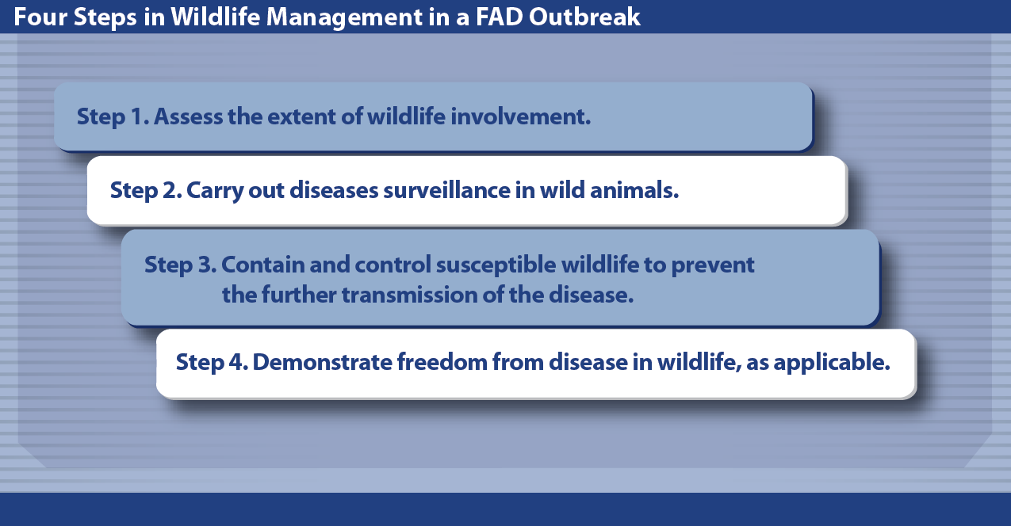
Steps of Wildlife Management
Notes:
The management of wildlife species during an FAD outbreak of livestock or poultry will involve four steps (adapted from AUSVET, 2011). The extent to which activities will be carried out under each of these four steps will depend on the specific outbreak situation; the order of the steps may be changed, and activities may occur simultaneously. Epidemiologists will need to quickly assess which wildlife species exist in the Control Area and determine whether they are infected with the FAD or pose a risk for disease transmission to domestic animals. Preventing disease transmission and demonstrating freedom from disease are also important steps. Many factors will be considered by epidemiologists and Incident Command, in addition to determining which wildlife species are present, and the susceptibility of the wildlife species to the FAD. These include their potential to spread the disease agent, and the level or likelihood of exposure and interaction between wildlife and domestic livestock. [This graphic shows the four steps in wildlife management in an FAD outbreak. Graphic illustration by: Kate Harvey, Iowa State University]

Slide 15
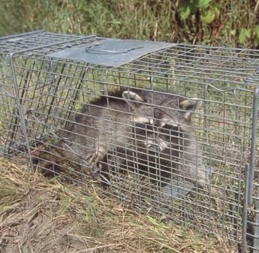
Assessing Wildlife
Population surveys
Visual inspection
  Ground surveys, aerial surveys
Local reports
Carcasses
Live animal capture
Sentinels
Notes:
As step one, epidemiologists will need to quickly assess which wildlife species exist in the Control Area and determine whether they are infected with the FAD or pose a risk for disease transmission (as biological or mechanical vectors) to domestic animals. Collecting data to assess the distribution, density, and involvement of wildlife in an FAD outbreak may be difficult. The list below provides brief descriptions of different ways that wildlife data can be obtained in an FAD outbreak.
Population surveys: to determine the size and location of wildlife populations.
Visual inspection: to find evidence of sick or dead animals. Visual inspection can be divided into ground and aerial surveys.
Local reports/knowledge: to obtain information on normal or abnormal characteristics of wild animals in the area, including wildlife morbidity and mortality. These reports may originate from land managers, wildlife biologists, hunters, and others.
Carcasses: to perform necropsies if carcasses are located rapidly after death. Carcasses may come from hunters and trappers, sharp shooters, carcass searches, and road-kill surveillance; these methods should be applied as determined appropriate by the Incident Command for the situation.
Live animal capture: to determine disease status in susceptible animals. In some instances, the capture of live animals may not be desirable or practical.
Sentinels: to detect the presence of the disease in animals placed deliberately in an environment, as determined by the Incident Command.
[This photo shows a raccoon in a live capture trap. Photo source: USDA APHIS]

Slide 16
Disease Surveillance
Presence, spread, and/or prevalence
Consider animal movement into and out of Control Area
Diagnostic sampling may be necessary
  Live capture, observation, carcass collection
Parameters should be outlined in surveillance plan
Notes:
Step two of managing wildlife is disease surveillance. A surveillance plan will help to demonstrate the absence, presence, spread, and/or prevalence of the FAD in a given wildlife population. Incident Command will consider many factors in developing a surveillance plan in wildlife. Because wildlife are likely to move into and out of the Control Area, this may pose challenges to developing an effective surveillance plan. In particular, it is important to survey the animal population to assess if the FAD has spread between wildlife and domestic livestock populations, and if so, the extent to which it has spread. Diagnostic sampling of wildlife may be necessary in order to detect or confirm the presence or absence of the FAD in a wildlife population during surveillance activities. Disease samples can be obtained by a number of different methods, including—but not limited to—live capture, observation, and carcass collection. Sampling parameters may be dictated by the availability of resources and feasibility of sampling wildlife. Sampling parameters should be described in detail for an effective surveillance plan, including the diagnostic laboratory to which samples will be sent.

Slide 17
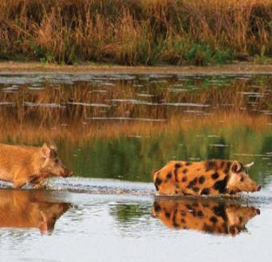
Contain and Control Wildlife
Manipulate populations, habitat, or other factors
Removal, relocation, dispersal, containment
Buffer zones
Monitor, surveillance
for effectiveness
Impacts evaluated
Notes:
Step three, the containment and control of wildlife to prevent further disease transmission may involve the manipulation of the wildlife population, the habitat, or factors affecting the disease agent and/or human behavior. In the event that wildlife infected with the FAD are detected, options to reduce the incidence of infection, and lower the risk of transmission to domestic animals may include the removal, relocation, or dispersal of such wildlife, and possibly the vaccination or treatment of animals depending on the disease agent. Containment of wildlife with natural or artificial barriers (fencing) can be a very difficult task and require careful planning and coordination. Habitat manipulation to eliminate the attractiveness of certain areas for wildlife, to create buffer zones between infected and uninfected wildlife, or to attract wildlife to areas away from the FAD outbreak is intended to change the distribution, density, and composition of wildlife populations. Habitat alteration activities include controlled burning, manipulation of water and water movements, cultivation of soil, and changing vegetation. Methods for manipulating wildlife populations may change as the outbreak response evolves. Monitoring and surveillance will be necessary in order to determine the effectiveness of the program. Some of the challenges involve wildlife’s ability to evade detection and disperse broadly. Short-term and long-term consequences must be evaluated for impacts on animal species and ecosystems in the area, as well as the potential effects on wildlife populations. [This photo shows two feral swine crossing a waterway. Photo source: USDA Forest Service]

Slide 18
Animal and Personnel Safety
Safety is a priority
  Trained and experienced personnel
Animal safety
  Minimize stress on animals
Personnel safety
  Chain of command with assigned duties
  Determine all animal procedures, equipment, safety plans ahead of time
Notes:
Containing and controlling susceptible animals may require the use of handling and restraint methods. Safety should be a priority in all aspects of the outbreak response. The handling and restraint of wildlife will differ depending on species of animal, skill level of responder and other personnel- and animal-safety considerations. For the safety of animals and personnel, handling and restraint should only be performed by trained personnel who have extensive experience and certification to perform these activities. Focus on minimizing distress and anxiety in the animals, such as avoiding loud noises and sedating wildlife, if appropriate. For personnel safety, develop a chain of command and assign each person to a specific duty. Determine ahead of time how the animal is to be released if necessary. Have all resources including equipment and personnel prepared and available ahead of time. Prior to any handling and restraint procedures, safety plans and protocols should be in place and communicated to all personnel present.

Slide 19
Demonstrating Disease Freedom
Reestablishing international trade
Wildlife-specific surveillance plan may need to be developed
Not always feasible, practical
for wildlife
FAD PReP/NAHEMS Guidelines: Surveillance, Epidemiology,
and Tracing
Notes:
The fourth and final step of wildlife management is to demonstrate freedom from disease. To reestablish international trade, a wildlife-specific surveillance plan for disease-freedom may need to be developed based on the wildlife species, disease agent, diagnostic tests available, and epidemiology of the outbreak. Proving freedom from disease in wildlife populations may not be feasible or practical. For further information on epidemiology and disease surveillance in general, and specifically for proof of disease-freedom, please see the FAD PReP/NAHEMS Guidelines: Surveillance, Epidemiology, and Tracing. It can be accessed at http://www.aphis.usda.gov/fadprep.

Slide 20
Developing a Wildlife Management Plan
Notes:
If the assessment of the outbreak indicates that wildlife may play an important role in the FAD outbreak, Incident Command, in coordination with the Wildlife Cell and Vector Control Group, will need to develop a wildlife management plan. The decision to implement control measures in wildlife will be based not only on the risk assessment and surveillance, but also the feasibility of conducting successful control measures. In all cases, the wildlife management plan must be conducted within local laws and regulations. In the short term, the foremost objective is to contain and control the outbreak. However, in the longer-term, depending on the FAD, the objective may be to eradicate the FAD from the wildlife species. This may require extended wildlife management activities. The wildlife management plan should specify whether demonstrating freedom from the FAD in wildlife is required for OIE-free status, and, if so, how to demonstrate freedom from disease in wildlife to national and international standards.

Slide 21
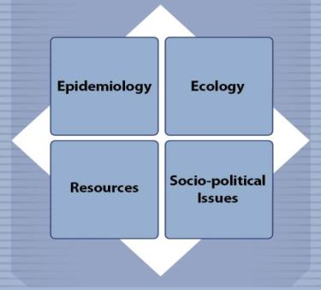
Factors to Consider
Epidemiology
  Study distribution of disease
  Data, observations of animals
Ecology
  Location, habitat, seasonal
  social/feeding behavior
Resources
  Availability, personnel,
  equipment
Socio-political
  Economy, law, regulation,
  public opinion, safety
Notes:
The epidemiological factors are critically important in creating a wildlife management plan for an incident. Such factors include the transmission pathways of the disease, the epidemiological importance of wildlife, disposal issues, and availability of veterinary countermeasures. However, other factors are also critically important to consider in the development of a wildlife management plan:
Epidemiology: the study of the distribution of disease in populations and of factors that determine its occurrence. Investigations involve observing animal populations and making inferences from data and observations.
Ecology: the location(s) of the disease outbreak, and habitat for wildlife. The season may also be important in terms of social and feeding behavior. Additionally, the presence of other susceptible species in the area, and the likely movement of susceptible animals should be considered. The current density of the wildlife population, as well as vulnerabilities should be weighed.
Resources: the availability of resources to complete the outbreak response should be fully evaluated. Depending on the scope and activities, the benefits and costs of properly trained personnel and needed equipment should be considered.
Socio-political Issues: issues such as the local, regional, and national economy may play a role in the wildlife management plan. Law, regulation, policy guidance at various jurisdictional levels, public opinion, and public safety should also be considered.
[This graphic shows factors to consider when developing a wildlife management plan. Graphic illustration by: Kate Harvey, Iowa State University]

Slide 22
Personnel, Equipment, Reporting
Personnel
  Understand biosecurity, safety protocols
  Hazard exposure may include zoonosis
  PPE, vaccination
  Safety Officer – safe work procedures
Equipment, cleaning and disinfection
Information collected, reported
  Manage, store, analyze, disseminate
Notes:
Effective planning will specify the personnel and equipment needed, and the locations in which activities will be conducted. All personnel should be properly trained, and fully understand biosecurity and safety requirements. Responders should avoid unnecessary exposure to all hazards and use protective measures, including personal protective equipment (PPE), especially if the FAD is zoonotic. Vaccinations for wildlife responders may be indicated, depending on the risk and the FAD, but may also include endemic wildlife diseases like rabies. While protecting the health and safety of response personnel is everyone’s responsibility, the Safety Officer’s duties include identifying current and potential hazards, establishing and training responders on safe work procedures, and preparing a Health and Safety Plan specific for the incident. Effective planning will also specify the equipment needed and biosecurity protocols (cleaning and disinfection). The use of all equipment (sedation agents, firearms, boats and vehicles) should be in compliance with local laws and regulations. A wildlife management plan details how information collected (population surveys, surveillance, diagnostic testing, and control measures) is managed, stored, analyzed, and disseminated to appropriate personnel throughout the relevant authorities. The preparation of routine reports, at intervals as specified by the Incident Commander, is an important part of developing and executing a wildlife management plan.

Slide 23
Vector Control in an FAD Outbreak in Domestic Livestock
Notes:
Vector control is an important consideration and component for an FAD response. Many FADs that are spread by arthropod vectors (e.g., biting midges, mosquitoes, ticks, and flies) affect domestic livestock as well as wildlife species. Vectors can transmit disease over relatively large distances, significantly complicating disease control efforts. Disease transmission by arthropod vectors can occur by mechanical or biological means.

Slide 24
Vector-borne FADs
Transmission of disease pathogen
  Mechanical
  Biological
Methods of vector control
  Understand life cycle and relationship to host and pathogen
  Focus on habitat reduction, minimizing contact, chemical/biological control
Notes:
Mechanical transmission involves the transfer of a pathogen by an external body part (e.g., legs) of the vector; the pathogen remains unchanged (i.e., does not replicate or develop further). Most species of flies serve as mechanical vectors. Biological transmission involves the alteration of the pathogen within the vector. The vector uptakes the pathogen–usually through a blood meal from an infected animal–and the pathogen undergoes further development or replication within the arthropod vector before being transferred to a susceptible animal, usually through a bite. Midges, ticks, and mosquitoes are common biological disease vectors. Vector control focuses on measures to prevent or eliminate vector populations. It begins with an understanding of the arthropod’s life cycle as well as the vector-pathogen-host relationship. Controlling the egg and larval stages of the arthropod vector is generally more efficient than controlling adults. Vector control measures generally focus on habitat reduction, minimizing contact, chemical control, and biological control.

Slide 25
Methods of Vector Control
Habitat reduction
  Change vector-required conditions
Minimizing contact
  Limit exposure to habitat or during activity
Chemical control
  Supplemental measure
  Apply to vector habitat, to animal, or
  feed as insect growth regulators
Biological control
  Release agents or natural predators
Notes:
Vector control, in an effort to reduce the spread of a vector-borne FAD, may involve one or more of these four methods.
Habitat Reduction: disrupting, eliminating or reducing specific conditions required by the vector to breed or develop can reduce population growth. Examples include minimizing stagnant water, agitating water sources, mowing vegetation, or disposing of manure or organic material.
Minimizing Contact: limiting animal exposure to arthropod vectors or their habitats can reduce infection risks. Excluding access of livestock (or wildlife) to vector habitat areas or avoiding exposure during peak vector activity times are examples.
Chemical Control: insecticides and chemicals may be some important (although least efficient) methods of vector control. Most often used as supplemental measures, some products are used in vector habitat areas, while others may be applied directly to animals. Additionally, insect growth regulators can be feed additives used to disrupt the life cycle of some vectors by making manure inhospitable to larval development. Some pesticides can be harmful or even deadly to humans; proper precautions must be used when handling or applying them. It is a violation of State and Federal Law to use a pesticide in a manner that differs from the product label. Use only according to label directions to preserve efficacy, and to avoid meat or milk residue hazards, environmental damage, and animal or human injury. Examples include environmental sprays, pour-ons, and ear tags.
Biological Control: biological agents or natural predators for the vectors may reduce vector populations. Examples include bacterial toxins (e.g., Bacillus thuringiensis), mosquitofish, parasitic wasps, dung beetles that feed on arthropod larvae, or the release of sterilized male screwworms that reduce breeding of these flies in efforts to control this vector.

Slide 26
Other Response Activities
Notes:
Many other critical activities will be ongoing at the same time as wildlife management and vector control as part of an FAD response. Many of these activities will intersect with wildlife management and vector control activities; there may be competing interests and priorities during the response effort. Resources need to be allocated appropriately, based on the goals and stated objectives of the outbreak response.

Slide 27
Response Activities
Movement control
  Adhere to Incident Command restrictions on movement and
  quarantine
Communication
  Public Information Officer will address public issues on outbreak
Biosecurity
  Prevent spread
  of disease on personnel, vehicles, equipment, etc.
  C&D
Euthanasia
  Must be treated humanely at all times
  Follow disposal protocols
Notes:
Quarantine and Movement Control
Upon detection of an FAD in livestock, a Control Area comprised of the Infected Zone and the Buffer Zone, will be established by Incident Command. In the event that wildlife are involved in the FAD outbreak in domestic livestock, hunting and other activities, such as field trials, should be identified to determine the risk. Wildlife personnel and any wildlife or wildlife product physically transported by personnel must adhere to the quarantine and movement control guidance provided by Incident Command.
Communication
Public support for FAD response activities is essential for success. The general public, including various constituency groups, will be affected by an FAD outbreak. The Public Information Officer will be responsible for providing information to the general public and the media as well as making any public statements. Specific information to justify wildlife response activities to media outlets will be developed by Incident Command, specifically the Public Information Officer in coordination with the Wildlife Cell and Vector Control Group.
Biosecurity
Biosecurity measures in an FAD response, work to prevent the introduction of the FAD to naïve animals, and also to ensure diseases are not transmitted onto or off of premises. Cleaning and disinfection procedures are used to remove, inactivate, reduce, or destroy contagious agents from contaminated premises, equipment, and vehicles in order to prevent the spread of pathogens. Cleaning and disinfection procedures may vary according to the FAD agent. Cleaning and disinfection policies and procedures will apply to all personnel, vehicles, equipment, and supplies.
Euthanasia/Depopulation
Euthanasia or depopulation of domestic livestock or poultry may occur in an FAD response. All animals must be provided with humane treatment at all times until animals are euthanized or depopulated. Regardless of the method selected, efforts to reduce pain and distress to the greatest extent possible should be taken. Only use humane, accepted methods for animal euthanasia and depopulation. Always follow proper carcass disposal protocols for the disease agent, taking local ordinances into consideration.

Slide 28
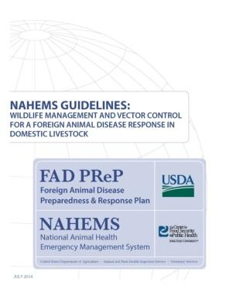
For More Information
FAD PReP/NAHEMS Guidelines: Wildlife Management and Vector Control for an FAD Response in Domestic Livestock
http://www.aphis.usda.gov/fadprep
Wildlife Management and Vector Control web-based training module
  Coming soon
Notes:
More details can be obtained from the sources listed on the slide, available on the USDA website (http://www.aphis.usda.gov/fadprep).
The Wildlife Management and Vector Control web-based training module is in development and coming soon.

Slide 29
Guidelines Content
Authors (CFSPH)
Glenda Dvorak, DVM, MS,
MPH, DACVPM
Nicole Seda, BS
Meghan Blankenship, BS
Heather Allen, PhD, MPA
Contributor (USDA)
Jonathan Zack, DVM
Notes:
The print version of the Guidelines document is an excellent source for more detailed information. In particular, the Guidelines document has listings of additional resources. This slide acknowledges the Guidelines’ authors and contributor. It can be accessed at http://www.aphis.usda.gov/fadprep.

Slide 30
Guidelines Content
Reviewers (USDA)
Randall Levings, DVM, MS
Randall Crom, DVM
Michael Messenger, PhD
Michael David MS, VMD, MPH
Wildlife Disease Steering Committee
Subject Matter Experts
Claudio L. Afonso
Samantha Gibbs, DVM, PhD
D. Scott McVey, DVM, PhD, DACVM
David Suarez, DVM
Notes:
This slide acknowledges those who assisted in the development of the print version of the Guidelines document.

Slide 31
Acknowledgments
Development of this presentation was by the Center for Food Security and Public Health at Iowa State University through funding from the USDA APHIS Veterinary Services
PPT Authors: Abbey Smith, Student Intern; Janice Mogan, DVM
Reviewers: Glenda Dvorak, DVM, MPH, DACVPM; Heather Allen, PhD, MPA
Notes:
Information provided in this presentation was developed by the Center for Food Security and Public Health at Iowa State University College of Veterinary Medicine, through funding from the US Department of Agriculture, Animal and Plant Health Inspection Service, Veterinary Services.

