Slide 1
Vaccination for Contagious Diseases
Handling and Transportation of Vaccines
Adapted from the FAD PReP/NAHEMS Guidelines: Vaccination for Contagious Diseases (2014)
Notes:
The control of a foreign animal disease outbreak may require large-scale vaccination of livestock and other domestic animals to minimize the impact on animal and public health, ensure continuity of the U.S. food supply, and minimize the economic impact on food producers. The principles discussed in this presentation are intended to provide general information to conduct large-scale vaccination of a variety of domestic animal species as may be required in an animal health emergency. Decisions regarding the choice of vaccine and the selection of animals to vaccinate will vary with the disease involved, species affected and the stage of the outbreak, and may change as the situation evolves. As always, it is important to evaluate each situation and adjust procedures to the risks present in the situation. [This information was derived from the Foreign Animal Disease Preparedness and Response (FAD PReP)/National Animal Health Emergency Management System (NAHEMS) Guidelines: Vaccination of Contagious Diseases (2014)].

Slide 2
This Presentation
Vaccine handling and storage
Vaccine packaging and transport
Cold Chain monitors
Preparation of lyophilized vaccine
Maintenance of sterility
Notes:
This presentation will discuss for following topics:
Proper vaccine handling and storage;
Vaccine packaging and transport to ensure efficacy;
Cold Chain monitors intended detect unsuitable temperature conditions;
Preparation of lyophilized vaccine prior to administration; and
Maintenance of sterility.

Slide 3
Vaccine Handling
Notes:
Requirements for individual vaccines vary, but understanding and following general principles of vaccine handling will maximize the likelihood that vaccines will perform as expected. Most vaccines do not exhibit any readily detectable changes in their appearance which would indicate that they have been mishandled, stored improperly, damaged, or lost efficacy. Should an emergency vaccination program be implemented as a response strategy in an FAD outbreak, vaccine supplies may need to be delivered to a central location, assembled into smaller lots, repackaged and transported to individual locations for administration to the animals. The vaccine may be reconstituted on site before administration. All conditions and handling of the vaccine will need to be appropriate to maintain efficacy. Always refer to the vaccine manufacturer’s recommendations for the specific handling requirements of each vaccine.

Slide 4
Vaccine Handling
Protect the potency and safety
Maintain the cold chain
Narrow temp range
During storage, transport, and handling
Lyophilized vaccine
Reconstitute only with diluent provided
Maintain sterility
Notes:
Inappropriate handling can damage a vaccine and reduce its potency or render it completely ineffective. Once potency has been lost, it can never be restored. To maintain potency, a vaccine must be maintained within a relatively narrow range of temperatures – from the time it leaves the manufacturer, until it is administered. Many vaccines arrive from the manufacturer as a lyophilized (dried powder) component, with an accompanying sterile diluent. The dried vaccine must be reconstituted with the diluent provided by the manufacturer for that specific vaccine lot number. To ensure each dose is safe and effective, it is important to maintain sterility. Sterile technique should be used to reconstitute and withdraw each dose. A new sterile needle should be used each time, and the rubber stopper should be wiped down with an alcohol swab or appropriate antiseptic before piercing.
.

Slide 5
Vaccine Storage
Notes:
The system used to ensure that vaccines stay within an appropriate temperature range from manufacturer to the point of administration is commonly called the cold chain. To ensure efficacy, vaccines must be maintained within the temperature range indicated by the manufacturer, as it appears on the vaccine label. Excessive heat or cold can damage a vaccine and reduce its potency or render it completely ineffective. Care should be taken to maintain the cold chain during storage, packaging, and transport.

Slide 6
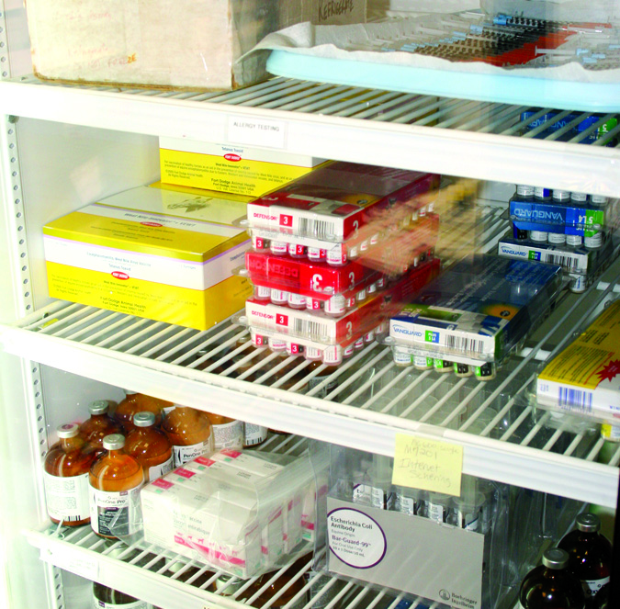
Vaccine Storage
Most require either refrigeration or freezing
Dedicated units
Ensure temperature range
Monitor and record temperature
Do not subject to freeze-thaw cycles
Notes:
Most vaccines require either refrigeration or freezing. In maintaining the cold chain, vaccines should be stored in refrigerators or freezers dedicated to their storage and not used for other purposes – such as the storage of food or beverages. Take precautions to ensure that the temperature in vaccination storage units is within the appropriate range. The temperature inside the storage unit should be measured with a calibrated internal thermometer and recorded at least daily. The temperature of circulating air inside of a refrigeration unit may not accurately reflect the temperature of packaged product. For more accurate readings, consider placing the bulb of the thermometer inside a container of simulated vaccine. Vaccines intended to be refrigerated should never be frozen, and no vaccine should be subjected to freeze-thaw cycles. [This photo shows vaccinations stored in a refrigerator. Photo source: Andrew Kingsbury, Iowa State University]

Slide 7
Vaccine Storage
Vaccines requiring a storage temperature of 35 to 46°F
Standard household or commercial refrigerator
Vaccines requiring a storage of 5° F
Standard or commercial freezer
Dormitory-style refrigerators are not acceptable for long term storage
Notes:
Vaccines requiring a storage temperature of 35 to 46°F (2 to 8°C) can be kept in the refrigerator compartment of a standard household or commercial refrigerator. Those requiring maintenance at 5° F (-15°C) or lower can be kept in a household or commercial freezer. The smaller dormitory-style refrigerators with an internal freezer compartment are not acceptable for the long-term storage of either refrigerated or frozen vaccines.

Slide 8
Vaccine Storage
Do not store vaccines in door or vegetable bin
Do not overfill cooling unit
Avoid impeding cold air circulation
Protect from light
Notes:
Vaccines should not be kept in the doors of refrigerators or freezers or in the vegetable bins of household refrigerators. Temperatures in these areas vary from the main compartment. Care must be taken to prevent overfilling of any type of cooling unit, since this impedes the circulation of cold air. Some vaccines are sensitive to light, so they should be stored in their box until they are needed.

Slide 9
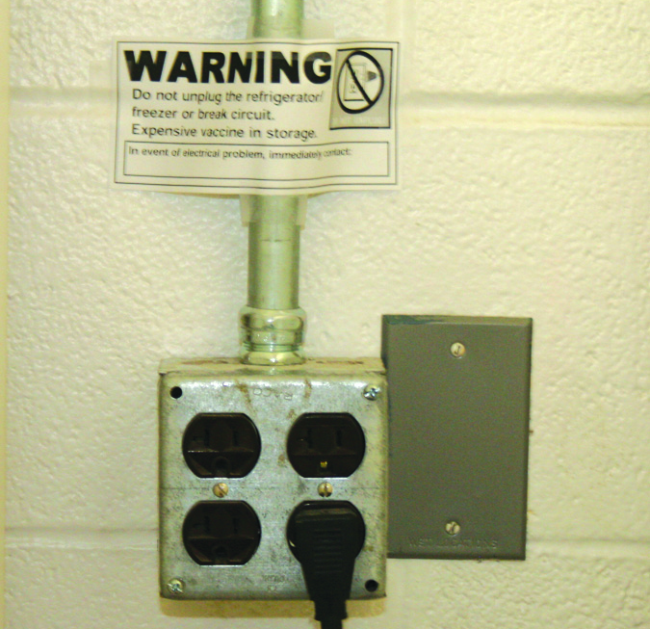
Vaccine Storage
Limit door opening
Properly close/seal doors
Avoid on/off switch
“Do not unplug” sign by the outlet
Emergency back-up power
Temperature alarm
Notes:
To avoid temperature fluctuations inside the unit, limit the number of times the door is opened, and do not leave the door open longer than necessary. Between times of access to the storage unit, ensure that the doors are properly closed and sealed – and especially at the end of each day. Do not plug a cooling unit into an outlet controlled by a wall switch or a power strip, as these switches may be turned off inadvertently. Consider placing a “Do not unplug” sign near the outlet and/or on the cooling unit. Label the circuit or fuse controlling the vaccine storage units so that these circuits are not shut off. If possible, cooling units should have an emergency backup power supply or generator to ensure the cold chain is maintained in the event of a power failure. Consider installing a temperature alarm on cooling units. [This photo depicts a “Do Not Unplug” sign near the outlet. Photo source: Andrew Kingsbury, Iowa State University]

Slide 10
Packaging Vaccine for Transport
Notes:
Minimize the number of times a vaccine is transported because transport increases the risk that a vaccine will be exposed to inappropriate conditions. If vaccines need to be transported to another location, the temperature range as recommended by the manufacturer and as indicated on the label should be maintained throughout the time of transportation. Thought needs to be given to packaging, whether the time in shipment may be brief or extended. Proper packaging can protect the potency with the goal to deliver a safe and efficacious vaccine for use.

Slide 11
Vaccine Packaging
To package a vaccine for transport:
1. Delay opening refrigerator or freezer until all preparations are made
2. Pack refrigerated vaccines first
3. Use properly insulated containers
Notes:
These guidelines are modified from the Centers for Disease Control and Prevention ‘Vaccine Storage and Handling Toolkit’ (http://www.cdc.gov/vaccines/recs/storage/toolkit/).
1. Delay opening the refrigerator or freezer door until you have made all preparations for packing.
2. Pack refrigerated vaccines first if you are transporting both refrigerated and frozen vaccines.
3. Use properly insulated containers. This may include the package the vaccines arrived in, a hard-sided plastic cooler, or a Styrofoam cooler with walls at least two inches thick.

Slide 12
Vaccine Packaging
4. Include enough packs to maintain the cold chain
5. Place insulating barrier between refrigerated/frozen packs and vaccines
Bubble wrap, paper, Styrofoam peanuts
Properly layer contents in container
Notes:
4. Include enough refrigerated/frozen packs with the vaccine to maintain the cold chain. Loose or bagged ice is not considered adequate. Refrigerated vaccines should use freezer packs, while vaccines that must remain frozen should use a minimum of six pounds of dry ice.
5. Place an insulating barrier between the refrigerated/frozen packs and the vaccines to prevent accidental freezing. This may include bubble wrap, crumpled brown packing paper, or Styrofoam peanuts. The container should be layered as follows inside the insulated container (from top to bottom):
Refrigerator/freezer packs
Barrier i.e. bubble wrap, crumpled brown packing paper, Styrofoam peanuts
Vaccines
Thermometer or cold chain monitoring device
Barrier
Additional refrigerator/freezer packs

Slide 13
Vaccine Packaging
6. Ship vaccines in original packaging
7. Thermometer or cold chain device should be placed next to vaccines
8. Note the packing time on outside of package
Notes:
6. Ship vaccines in original packaging. Do not remove vaccines from vials or boxes, and do not draw up vaccines in advance.
7. Thermometer or cold chain device should be placed next to the vaccines and not in direct contact with the refrigerator or freezer packs.
8. Note the packing time on the outside of the package so that the time vaccines spent in transit is known on arrival.

Slide 14
Vaccine Packaging
9. Clearly identify the contents as fragile and perishable on the outside of package
10. If travelling by car stow the packed vaccines in the passenger compartment, not in the trunk
Notes:
9. Affix labels to the outside of the package to clearly identify the contents as fragile and perishable.
10. If travelling by car stow the packed vaccines in the passenger compartment, not in the trunk of the vehicle. The temperature in the trunk of the vehicle is highly dependent on weather.

Slide 15
Vaccine Transport
Notes:
During an emergency vaccination program, vaccine supplies may need to be transported from a central location into the field for administration into the animals. It may be necessary to reassemble the vaccine into smaller lots, repackage and transport the vaccine to individual locations. During transportation, it is critical that appropriate temperatures are maintained to preserve the cold chain and thus vaccine efficacy. Care should be taken to properly package the vaccines, carefully transport the vaccines under the best conditions available, and inspect them upon arrival. Remember, once vaccine potency is lost it cannot be restored.

Slide 16
Vaccine Transport
Minimize the number of times a vaccine is transported
Check or monitor the temperature
Diluents should always travel with corresponding vaccines
Notes:
To maintain the cold chain, minimize the number of times a vaccine is transported to avoid the risk that a vaccine will be exposed to inappropriate conditions. A standard calibrated thermometer may be used to monitor temperature on delivery or a cold chain monitoring device may be used. Diluents should travel with their corresponding vaccines at all times.

Slide 17
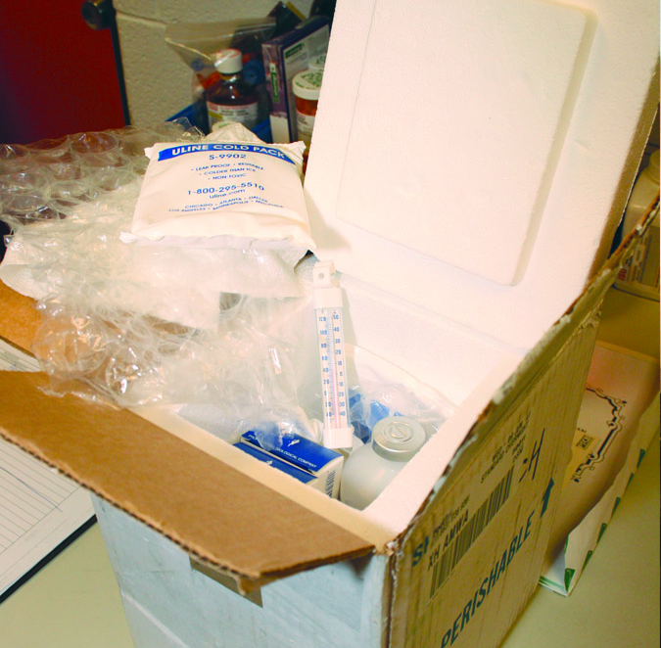
Vaccine Transport
Inspect upon arrival
Check for physical damage
Check expiration dates
Ensure proper diluent was shipped
Inspect cold chain monitors, if included
Notes:
Vaccine shipments should be inspected immediately upon arrival. Check the shipping container and contents for signs of physical damage. Ensure that the vaccines are not expired or close to their expiration date, and make sure that lyophilized vaccines have been shipped with sufficient diluent for their reconstitution. If cold chain monitors were included in the shipment, check them to determine if the vaccines have been exposed to temperatures outside the recommended range during transport. [This photo shows vaccines being received with ice packs around them demonstrating maintenance of the cold chain. Photo source: Andrew Kingsbury, Iowa State University]

Slide 18
Cold Chain Monitors
Notes:
Maintaining the cold chain is critical to maintaining the efficacy of the vaccine. Devices are available for shipment with vaccines to indicate that temperatures have either exceeded or dropped below recommended ranges.

Slide 19
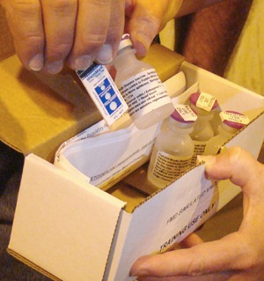
Heat Indicators
Intended for a single use, not over 48 hours
Will indicate
If temperature was over 50°F
How long temperature was over 50°F
Notes:
Heat indicators, also known as time and temperature indicators (TTIs), are made for a single use not exceeding 48 hours. Those appropriate for vaccine shipment indicate that temperatures have exceeded 50 degrees F, and also indicate how long (up to 48 hours) the time was above this temperature. Heat indicators should be pre-conditioned by placing them with the vaccines until they have equilibrated temperatures. Once they are in the shipment box with the vaccines and equilibrated, pull the activation tab to begin the monitoring process. [This photo shows a heat indicator being removed from a package of recently shipped vaccine. Photo source: Randy Schawang, David City, Nebraska]

Slide 20
Freeze Indicators
Intended for a single use
Do not indicate length of time items exposed to freezing temperatures
Indicate temperature has dropped below 32°F (0°C)
Notes:
Freeze indicators are for a single use. They do not indicate the length of time exposed to freezing temperatures. They indicate that the contents of a shipment have dropped below 32°F (0°C). Refer to the instructions for use for each type of freeze indicator.

Slide 21
If the Cold Chain is Broken
Any indication that proper temperature has not been maintained:
Mark the vaccine “DO NOT USE”
Contact supervisor or other authority for further instructions
Do NOT immediately discard the vaccine unless directed to do so
Notes:
If there is indication that a vaccine has been subject to temperature excursions beyond the acceptable range either during shipment or storage, clearly mark the vaccine “DO NOT USE” and immediately return it to proper storage conditions. DO NOT IMMEDIATELY DISCARD THE VACCINE, as vaccine supplies may be short in the event of an outbreak. Contact your supervisor, an APHIS VS official within Incident Command, or the Center for Veterinary Biologics program official for instructions on how to proceed.

Slide 22
Preparing to Administer Lyophilized Vaccine
Notes:
Care in handling is necessary during preparation to administer all vaccines. Vaccines should not be allowed to warm up before or during reconstitution, nor should live vaccines be exposed to light longer than necessary. In order to reduce disease spread or mishandling, multi-dose vials of vaccine should not be moved from one animal facility to another. Follow proper protocols to reconstitute lyophilized vaccines. Maintain sterility to protect safety and efficacy.

Slide 23
Lyophilized Vaccines
Reconstitute with diluent
Diluent is NOT interchangeable
Use diluent specified for vaccine
Diluents that do not require refrigeration can be stored in areas of the refrigerator that are not suitable for vaccine storage
Notes:
Many vaccines arrive from the manufacturer as a lyophilized (dried powder) component and an accompanying sterile diluent. The dried vaccine must be reconstituted with the diluent provided by the manufacturer for that specific vaccine. Diluents often do not require refrigeration, so unless a vaccine and its diluent are packaged together, they may be stored separately to save refrigerator or freezer space. Alternatively, diluents not requiring refrigeration can be stored in areas of the refrigerator or freezer that are not suitable for long-term vaccine storage, such as the doors or vegetable bins. Make sure that all personnel who will use the vaccine know where the appropriate diluent for each vaccine is kept and that diluents are never switched.

Slide 24
Reconstituting Vaccines
Reconstitute immediately prior to use
Check expiration date and match lot numbers
Mark vial with date of reconstitution
Transfer diluent with sterile needle and syringe
Administer promptly using new needle
Notes:
The following guidelines are modified from the Centers for Disease Control and Prevention ‘Vaccine Storage and Handling Toolkit.’ Lyophilized vaccines should be reconstituted immediately prior to use. Check that neither the diluent nor the vaccine has passed the expiration date, and the lot numbers of vaccine and diluent match. The diluents from different vaccines, vaccines produced by different manufacturers, and even different lot numbers of the same vaccine ARE NOT interchangeable. Always use the diluent provided for the specific vaccine lot. Mark each multi-dose vial with the date of reconstitution and discarded before the time interval indicated by the manufacturer. Wipe the rubber top with an alcohol swab. Using a sterile single-use syringe and needle, transfer all of the diluent into the lyophilized vaccine vial and mix by rotating or gentle agitation. Change to a new needle, and administer the vaccine promptly to minimize loss of potency.

Slide 25
Maintaining Sterility
Notes:
To ensure each dose is safe and effective, it is important to maintain sterility. During reconstitution, using proper technique will help to maintain sterility. Sterile technique should be used to withdraw each dose of vaccine. So to repeat, wipe down the rubber stopper with an alcohol swab. Only sterile needles should be inserted into the vial to draw a vaccine dose.

Slide 26
Maintaining Sterility
To maintain sterility in multi-dose vials:
Practice sterile technique
Never remove rubber stopper
Wipe stopper before piercing
Use a new sterile needle each time
Use ice packs to keep vaccines cool; do not submerge in water
Notes:
While many vaccines are packaged as a single dose, some vaccines, particularly livestock vaccines, are packaged in multi-dose vials. Prevent contamination of the bottle and store it as recommended by the manufacturer between uses. Use sterile technique to withdraw each dose of vaccine. The rubber stopper should never be removed from the bottle top; wipe the rubber stopper with an alcohol swab or appropriate antiseptic before piercing. Use only a new sterile needle to pierce the stopper. Self-contained ice-packs should be used to keep vaccines cool. Avoid placing vaccine vials directly into ice, as submerging the vial into partially melted ice or water can contaminate the rubber stopper.

Slide 27
Maintaining Sterility
Always mark multi dose vaccines with:
Date opened or reconstituted
Initials of the user
Dating the vials will help identify
Which vials should be used first
Which vials should be discarded
Notes:
Many multi-dose vials of vaccine expire within a specified time frame after they have been opened or reconstituted. This date will differ from the expiration date indicated on the vial by the manufacturer. Clearly mark multi-dose vials of vaccine with the date and time they were first opened or reconstituted and the initials of the user. This will help identify which vials of vaccine should be used first and when a vaccine should no longer be used.

Slide 28
Vaccine Handling Summary
Individual requirements vary
Refer to manufacturer’s recommendations
Proper handling is critical to protect potency and safety
May be no detectible changes if vaccine has been damaged
Notes:
Requirements for individual vaccines vary. Always refer to the vaccine manufacturer’s recommendations for the specific handling requirements of each vaccine. Proper handling is critical to maintain potency, efficacy and safety. This will be critical in the case of mass vaccination in an emergency disease situation. Most vaccines do not exhibit any readily detectable changes in their appearance which would indicate that they have been damaged or stored improperly.

Slide 29
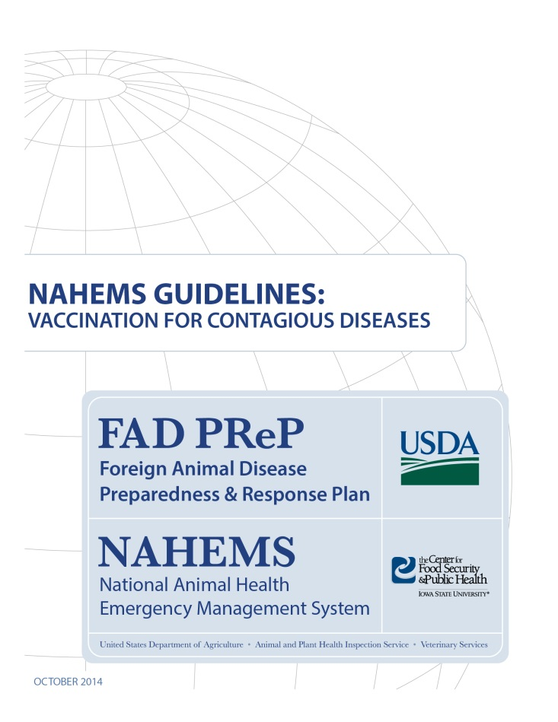
For More Information
FAD PReP/NAHEMS Guidelines: Vaccination for Contagious Diseases
http://www.aphis.usda.gov/fadprep
Vaccination for Contagious Diseases web-base training module
http://naherc.sws.iastate.edu/
Notes:
More details can be obtained from the sources listed on the slide, available on the USDA website (http://www.aphis.usda.gov/fadprep) and the National Animal Health Emergency Response Corps (NAHERC) Training Site (http://naherc.sws.iastate.edu/).

Slide 30
Guidelines Content
Authors (CFSPH)
Jim Roth, DVM, PhD, DACVM
Amber Stumbaugh, MS
Anna Rovid-Spickler, DVM, PhD
Danelle Bickett-Weddle, DVM, MPH, PhD, DACVPM
Janice Mogan, DVM
Heather Allen, PhD, MPA
Shaine DeVoe
Reviewers (USDA)
John Zack, DVM
Patricia Foley, DVM, PhD
R. Alex Thompson, DVM, PhD
John Wiemers, DVM, MS
Notes:
The print version of the Guidelines document is an excellent source for more detailed information. In particular, the Guidelines document has listings of additional resources. This slide acknowledges the authors and reviewers of the Guidelines document. It can be accessed at http://www.aphis.usda.gov/fadprep.

Slide 31
Acknowledgments
Development of this presentation was by the Center for Food Security and Public Health at Iowa State University through funding from the USDA APHIS Veterinary Services
PPT Author: Patricia Futoma, Veterinary Student
Reviewers: Cheryl L. Eia, JD, DVM, MPH; Janice Mogan, DVM
Notes:
Information provided in this presentation was developed by the Center for Food Security and Public Health at Iowa State University College of Veterinary Medicine, through funding from the US Department of Agriculture, Animal and Plant Health Inspection Service, Veterinary Services.

