Slide 1
Surveillance, Epidemiology, and Tracing
Tracing and Additional Operational Procedures
Adapted from the FAD PReP/NAHEMS Guidelines: Surveillance, Epidemiology, and Tracing (2014).
Notes:
An animal health emergency could have a detrimental effect on the nation's agriculture, food supply, and economy. Veterinary responders, animal health technicians, and other trained personnel may assist with surveillance, epidemiology, and tracing activities. In order to perform these job duties, a broad understanding of surveillance and epidemiological concepts is required. Tracing the spread of disease into populations of animals, and tracing exposure and potential spread out of populations is critical to disease control. This presentation reviews tracing concepts. Additional operational procedures for disease control and eradication (e.g., biosecurity, cleaning and disinfection, and quarantine and movement control, etc.) are also briefly covered. [This information was derived from the Foreign Animal Disease Preparedness and Response (FAD PReP)/National Animal Health Emergency Management System (NAHEMS) Guidelines: Surveillance, Epidemiology, and Tracing (2014).]

Slide 2
This Presentation
Overview of tracing
Identifies tracing sources & services
Transportation & import requirements
Additional tracing procedures
Notes:
This presentation provides an introduction to disease tracing activities that are implemented in a foreign animal disease (FAD) outbreak. It identifies tracing sources and services as well as transportation and import requirements, such as health certificates, permits, and tags. An overview of additional tracing procedures, such as biosecurity, PPE, and cleaning and disinfection are discussed.

Slide 3
Tracing
Notes:
Tracing is a critical part of an FAD response. Tracing is the ability to track the movements of an animal or group of animals during a specific time period. By tracking the movements of animals, tracing is intended to identify the source of the infection and identify potentially exposed animals that may be infected and have moved elsewhere. Tracing aids in controlling the spread of an FAD agent or a hazard, and limits the impact of an outbreak by detecting premises or animals that may be potentially infected. In the event of an FAD outbreak, all movements to and from the affected premises must be assessed.

Slide 4
Tracing
Trace-back
  Animals, animal products, fomites, people, vehicles, equipment, and possible vectors that have been moved onto an Infected Premises
  Establish the origin of the agent/hazard
Notes:
Trace-back seeks to identify the origin of all animals, animal products, fomites, people, vehicles, equipment, and possible vectors that have been moved onto an Infected Premises, in order to establish the origin of the agent/hazard.

Slide 5
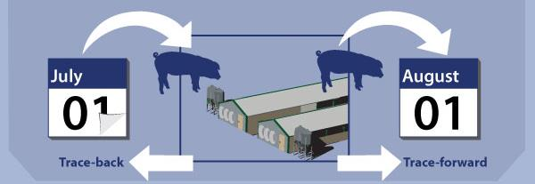
Tracing (cont’d)
Trace-forward
  Animals, animal products, fomites, people, vehicles, equipment, and possible vectors that have left the Infected Premises
Notes:
Trace-forward seeks to track all animals, animal products, fomites, people, vehicles, equipment, and possible vectors that have left the infected premises and could have possibly carried the agent to other animals. Animals located on exposed premises should be investigated and kept under surveillance and/or quarantine until additional data suggest they have remained unaffected.
[This graphic shows movement of a group of swine into and out of a production facility to illustrate trace-forward and trace-back. The illustration depicts swine moving into a production facility, and one month later being moved to another location. The origin and the destination of this group, or of an individual animal, may need to be traced. Illustration by: Katlyn Harvey, Iowa State University]

Slide 6
Tracing Sources
Owners/livestock producers
VS Surveillance Collaboration Services
Animal Disease Traceability Information System
Auction/market records
Test charts
Livestock transporters' manifests and
owner/shipper statements
Accredited veterinarians and health certificates
Import permit systems
Brand inspection records
Official identification devices
Notes:
Tracing information can be obtained from many sources. Epidemiologists and animal health officials are encouraged to use all available resources when completing FAD traces. The following slides describe these information sources, which include livestock owners, companies and associations, veterinarians, and the government.

Slide 7
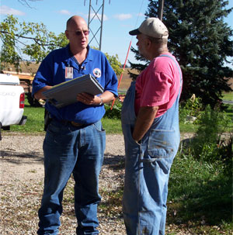
Livestock Owners
Important source of information on animal movements
Type, format and quality of farm records may vary
May be subject to confidentiality rules
Notes:
Livestock owners and producers are an important source of information on animal movements. In the 2001 FMD outbreak in the United Kingdom, owners/producers were a critical resource for animal tracing. The type, format, and quality of farm records and animal movement information may vary from operation to operation and may be subject to confidentiality rules. [This photo shows a responder interviewing a producer about livestock movements. Photo source: Center for Food Security and Public Health, Iowa State University ]

Slide 8
Surveillance Collaboration Services
Records details of:
  Persons (owners/agents), animals, lab tests
  Animal identification tag allocation and use
  Domains (premises and herds/flocks/tanks)
  Movements (individuals/groups/restrictions)
  Treatments and vaccinations for animals
  Graphical representation on digital maps
  Multi-species recording on the same database
  Activity scheduling
Notes:
Surveillance Collaboration Services (SCS) fulfills a management goal of providing comprehensive, coordinated, and integrated animal health surveillance and program management software that serves as the foundation for animal health, public health, food safety, and environmental health. SCS supports the function of managing data related to animal health surveillance and response to animal health events. Well managed surveillance data, some examples are listed on this slide, is the foundation for animal health activities that include domestic disease control and eradication programs, emergency preparedness and response, and trade.
When fully completed at all levels, SCS will contain/receive data from Mobile Information Management, spreadsheet uploads, the Laboratory Messaging System, the Veterinary Services Laboratory Submission System, as well as from data entry directly into SCS. SCS then outputs data to spreadsheets, as well as Business Intelligence and Reporting to assist in processing data for reports. SCS supports the administration of the location identifiers per the Animal Disease Traceability General Standards document.

Slide 9
Animal Disease Traceability
Animal Disease Traceability Information System (ADTIS)
Optional method for administering traceability activities
States and Tribes collect farm location and contact information at their discretion
Notes:
The Animal Disease Traceability Information System (ADTIS) is in place to support the animal disease traceability framework. This system is provided to States and Tribes as an optional method for administering traceability activities. States and Tribes collect farm location and contact information at their discretion. The premises module is capable of determining and recording the geolocation of each premises for future mapping purposes. Other modules within the ADTIS contain official identification and distribution records and other animal events. For more information on the USDA Animal Disease Traceability database, see http://www.aphis.usda.gov/traceability/.

Slide 10
Livestock Dealers or Auction Markets
Auction/market records
  Records maintained by commission firms, dealers, inspectors and veterinarians
Market test charts/records
  Official charts or forms used to record official testing data for program diseases
Notes:
Records from livestock dealers or auction markets may provide information on animals' movements before and after a sales transaction. The type, format, and quality of these records may be highly variable.
Auction/market records are maintained by commission firms, dealers, inspectors, and veterinarians, and often contain information on animal movements. The accessibility and quality of the data varies widely. Additionally, asking personnel employed by the market facility for information on their movements and contacts with other animals from the time they came into contact with the infectious agent may aid in the tracing process.
Market test charts/records refers to official charts or forms used to record official testing data for program diseases. Information on animals that undergo testing for USDA program diseases such as brucellosis and tuberculosis is recorded on test charts. These records may contain information such as animal identification, owner, and origin and destination, which can be used to trace animal movements.

Slide 11
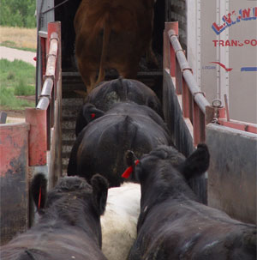
Transporters’ Manifests
A manifest or bill of lading must accompany all livestock shipments
  Carried by livestock transporter
Normally includes:
  Number and type of livestock
  Shipment origin and destination
Notes:
A manifest or bill of lading must accompany all livestock shipments and is carried by the livestock transporter. These documents usually include information about the number and type of livestock on board, and the shipment's origin and destination. Transportation firms may also maintain copies of these documents. In the event of an FAD outbreak, transportation enforcement officers may stop transport vehicles to verify compliance and can request to see the documentation. Owners transporting animals themselves to livestock markets or harvest facilities are often able to provide their own documentation of the animals on the owner/shipper statement. Documentation will be maintained at the market or harvest facility. [This photo illustrates livestock movement. A manifest of bill of lading must accompany all livestock shipments. Photo source: Renee' Dewell, Iowa State University]

Slide 12
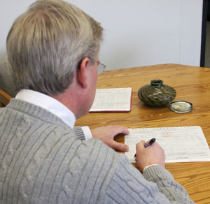
Health Certificates
Written by accredited veterinarians
Two types
  Federal
    Also known as International Health Certificates (IHC)
  State
    Certificates of Veterinary Inspection (CVI)
Notes:
Accredited veterinarians routinely write Certificates of Veterinary Inspection (CVI) to allow animals to move across state lines, within states, or to exhibitions. Health certificate information is available from the state of entry or destination. Properly completed health certificates are necessary to verify health status when inspecting, testing, and certifying animals for the purpose of controlling animal diseases and facilitating trade and travel. The information contained in CVIs documents the location of animals at the time of inspection. The usefulness of this information depends on how readily the CVI can be located. Some states' records are more automated than others. Federal health certificates are issued for international movement and referred to as International Health Certificates (IHC). (http://www.aphis.usda.gov/wps/portal/aphis/ourfocus/importexport) State health certificates are issued for interstate and some intrastate movement and referred to as Certificates of Veterinary Inspection (CVI). Individual State CVIs are available from the office of the State Animal Health Official. [This photo depicts a USDA employee endorsing a federal health certificate. Photo source: Dani Ausen, Iowa State University ]

Slide 13
Import Permit Systems
Live animals imported into the U.S. must have a valid permit
VS form 17-129, or APHIS ePermits system
Notes:
Live animals imported into the United States must have a valid permit. VS Form 17-129, Application for Import or In Transit Permit must be completed. Alternatively, APHIS' ePermits system may be utilized. Information documented on the permit includes the country from which the animal is to be shipped; description of the animal(s) (number, breed, species, sex, age, identification, etc.); planned route of travel; planned shipping and arrival dates; and port of entry. Individual states also have animal import systems.

Slide 14
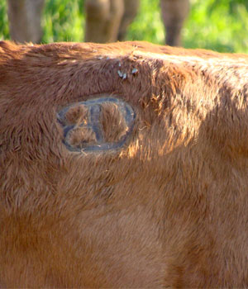
Brand Inspection Record
Some states require visual brand inspection for cattle
Ownership and transfer of ownership must be documented
Maintained by State’s brand inspection authority
Notes:
Livestock owners register personalized bands and apply them to livestock, such as cattle, to identify ownership. Some states, especially those in the western United States, require cattle and horses moving from one location to another to have a visual brand inspection. Ownership and transfer of ownership must also be documented. Documents generated from this inspection are generally maintained by the State's brand inspection authority. These documents, coupled with laws that facilitate registering specific brands, can be used to trace groups of cattle moving from one location to another. However, a brand is not a form of individual animal identification. [This photo shows a brand on a bovine. Brands are used to identify groups of cattle but are not individual forms of identification. Photo source: Beth Carlson, North Dakota Department of Agriculture]

Slide 15
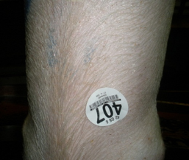
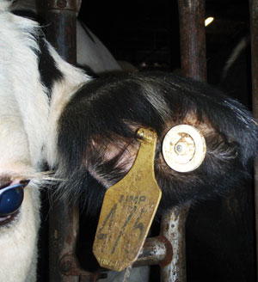
Backtags and Eartags
Backtags
  Temporary form of identification
  For animals moving through livestock dealer or auction market
Eartags
  State-issued
  Electronic or visually-inspected
Notes:
Backtags: Backtags are a temporary form of animal identification. They are applied with glue to identify animals moving through a livestock dealer or auction market. Records kept by the livestock dealer or auction market may provide information about the animal's consignor/seller and consignee/buyer. The type, format, and quality of dealer/market records may vary. Eartags: Official eartags may be used to identify individual animals. Breeding age cattle are generally identified with eartags; however, feeder cattle may not be required to be identified by individual eartags. There are a variety of different types of eartags. The simplest eartags are for visual inspection only (e.g., panel type eartag; see photo). Electronic eartags can be read by portable, hand-held, or stationary radio-frequency readers. The regulatory authority in each state issues identification devices (i.e., eartags). The range of numbers and characters comprising the identification is recorded. Regulatory authorities may assist with tracing activities.
[Top Image: A photo of a USDA backtag. Photo source: Stephen Lewis. Lower image: This photo shows a close up of a cow with a plastic dangle tag and a button Radio Frequency Identification (RFID) tag. The dangle tag may provide information specific to the farm. The RFID tag can provide both unique individual animal and standardized location information. Photo source: Pat Gorden, Iowa State University]

Slide 16
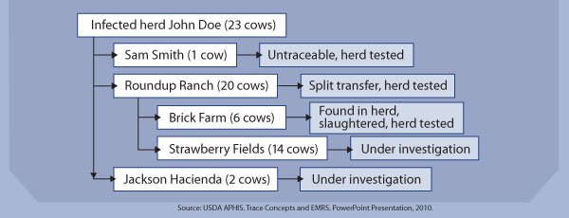
Tracing Databases
Animal movements may be complicated
Databases produce schematics
  Example: Emergency Management Response System (EMRS) 2.0
Notes:
Animal movements may be complicated and involve multiple points of sale or transfer. During an FAD response, the Emergency Management Response System (EMRS) 2.0, the USDA APHIS VS system of record, will be used to collect and report epidemiological data, including movement and tracing information, locally and nationally. Tracing databases, such as EMRS, have the capability to schematically represent trace results.
[This schematic shows trace-forward results of cattle that have left a herd originally belonging to John Doe. Source: USDA APHIS. Illustration by: Bridget Wedemeier, Iowa State University]

Slide 17
Electronic Data Management
EMRS essential for:
  Routine reporting of investigations
  Surveillance and control programs
  State-specific disease outbreaks
  National animal health emergency responses
Utilized by multiple groups within ICS
May undergo changes
Notes:
EMRS, for FADs and emerging disease incidents, is the official system of record used to track, summarize, and report all activities of the outbreak for all affected premises. EMRS was first developed in 2001. EMRS 2.0, which has recently been developed, provides a manageable repository for storing data on disease surveillance, intrastate and interstate animal movements, and FAD investigation. It is a secure, web-based application used by Federal, State, Tribal, and local animal health officials for surveillance and disease control programs. State-specific disease outbreaks, and national animal health emergency responses. EMRS also provides the structure and capabilities to manage the disease mitigation activities associated with these animals. EMRS manages this information in a secure environment, which gives the Incident Command (IC) the ability to evaluate tracing and associated activities, and assess the effectiveness of these activities on an incident, program, outbreak, or on a national basis. EMRS supports traceability through integration with other modules of the VS ADTIS. In the event of an FAD outbreak, several groups and/or cells within the ICS will utilize the EMRS for different purposes.

Slide 18
Additional Operational Procedures
Notes:
There are several additional operational procedures related to surveillance, epidemiology, and tracing activities that will be implemented in an FAD response.

Slide 19
Additional Procedures
Variety of strategies required to contain, control and/or eradicate an FAD:
  Biosecurity
  Health and safety
  Personal protective equipment
  Cleaning and disinfection
  Quarantine and movement control
Notes:
Additional operational procedures and protocols involve: biosecurity, health and safety, personal protective equipment, cleaning and disinfection, and quarantine and movement control. In the following slides, we will examine each of these more closely. For more information on these operational procedures and protocols, see the corresponding FAD PReP/NAHEMS Guidelines.

Slide 20
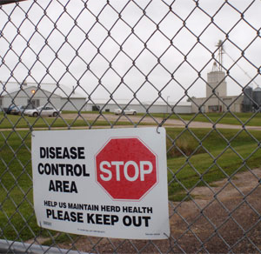
Biosecurity
Management practices
  Designed to prevent the introduction and spread of disease agents on an animal production facility
Utilized by responders entering or leaving a premises
Protocols must be followed at all times
Notes:
Biosecurity is a series of management practices designed to prevent the introduction and spread of disease agents on an animal production facility. Implementing biosecurity measures as a standard practice helps ensure that responders working with animals or coming into contact with them do not spread disease when they enter or leave a premises. Some personnel involved in surveillance, epidemiology, and tracing activities will be required to travel from premises to premises to work with animals. It is imperative that biosecurity protocols be followed at all times and on all premises, whether or not disease outbreaks have been reported on the premises. Biosecurity procedures are described in the FAD PReP/NAHEMS Guidelines: Biosecurity. [This is a photograph of a sign establishing a premises as a biosecure area. Photo source: Alex Ramirez, Iowa State University]

Slide 21
Health and Safety
Health and safety of personnel performing duties must be assured
Responders may encounter physical, environmental and or psychological hazards
Notes:
Responder health and safety is important during a response. Surveillance, epidemiology, and tracing are necessary activities, but the health and safety of personnel performing these duties must be assured. Responders may encounter physical, environmental, and/or psychological hazards and must be prepared to manage these hazards as well as emergency situations which may arise. Health and safety principles and protocols are described in the FAD PReP/NAHEMS Guidelines: Health and Safety.

Slide 22
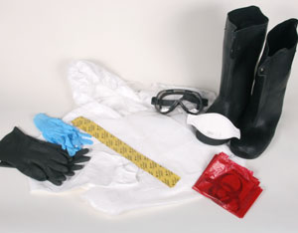
PPE
Special clothing and equipment that places a barrier between an individual and a hazard
Prevents the spread of hazards between animals or locations
Notes:
Personal protective equipment (PPE) refers to special clothing and equipment that places a barrier between an individual and a hazard.
In an animal health emergency, PPE serves two purposes:
1. Protects the responder against potentially harmful hazards (e.g., zoonotic disease, biological, chemical, and environmental hazards), and
2. Prevents the spread of hazards between animals or locations, with appropriate use and decontamination/disposal.
Personal protective equipment is described in the FAD PReP/NAHEMS Guidelines: Personal Protective Equipment. [This photo shows PPE which might be worn during an outbreak investigation. Photo source: Dani Ausen, Iowa State University ]

Slide 23
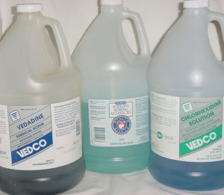
Cleaning and Disinfection
Cleaning
  Removal of organic material
Washing
  Removal of materials that can inhibit the action of disinfection
Disinfection
  Process that destroys most pathogenic and non-pathogenic microorganisms to an acceptable level
Notes:
Cleaning involves the removal of organic material (e.g., manure, bedding), and washing involves the removal of materials (e.g., oils, grease) that can inhibit the action of disinfectants. Disinfection is a process that destroys most pathogenic and non-pathogenic microorganisms to an acceptable level. Cleaning and disinfection procedures are used to remove, inactivate, reduce, or destroy contagious agents from contaminated premises and fomites and prevents the spread of pathogens. When surveillance and/or epidemiology/tracing personnel enter or exit a premises, they must follow all cleaning and disinfection procedures. Cleaning and disinfection procedures may vary according to the FAD agent. Cleaning and disinfection (C&D) procedures for vehicles, equipment, clothing, and personnel are described in the FAD PReP/NAHEMS Guidelines: Cleaning and Disinfection. [Bottles of disinfectants are shown in this photo. Photo source: Carla Huston, Mississippi State University]

Slide 24
Quarantine and Movement Control
Upon detection of an FAD in livestock, quarantine and movement controls will be established
  Restrictions on entering or leaving a premises, area, or region
  Control the movement of animals, animal products, and fomites in a Control Area
Notes:
Upon detection of an FAD in livestock, quarantine and movement controls will be established by State or Federal animal health officials. Quarantines impose stringent restrictions on entering or leaving premises, area, or region where disease is known to exist or is suspected. Movement controls then control the movement of animals, animal products, and fomites in a regulatory Control Area from non-infected premises. Any surveillance and/or epidemiology tracing activities conducted in these areas will be subject to the established quarantine and movement control procedures. Quarantine and movement control procedures are described in the FAD PReP/NAHEMS Guidelines: Quarantine and Movement Control.

Slide 25
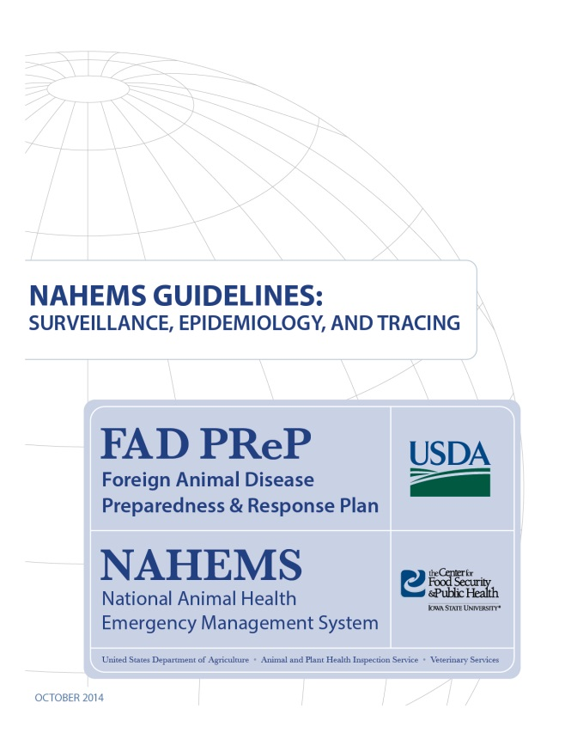
For More Information
FAD PReP/NAHEMS Guidelines: Surveillance, Epidemiology, and Tracing, and SOP: Surveillance
  http://www.aphis.usda.gov/fadprep
Surveillance, Epidemiology,
and Tracing web-based
training module
  http://naherc.sws.iastate.edu/
Notes:
More details can be obtained from the sources listed on the slide, available on the USDA website (http://www.aphis.usda.gov/fadprep) and the NAHERC Training Site (http://naherc.sws.iastate.edu/).

Slide 26

Guidelines Content
Authors (CFSPH)
Kerry Leedom Larson, DVM, MPH, PhD, DACVPM
Glenda Dvorak, DVM, MPH, DACVPM
Janice Mogan, DVM
Courtney Blake, BA
Reviewers (USDA APHIS VS)
Dr. R. Alex Thompson
Dr. Lowell Anderson
Dr. Steve Goff
Dr. Fred Bourgeois
Notes:
The print version of the Guidelines document is an excellent source for more detailed information. In particular, the Guidelines document has listings of additional resources. This slide acknowledges the authors and reviewers of the Guidelines document. It can be accessed at http://www.aphis.usda.gov/fadprep.

Slide 27
Acknowledgments
Development of this presentation was by the Center for Food Security and Public Health at Iowa State University through funding from the USDA APHIS Veterinary Services
PPT Authors: Patricia Futoma, Veterinary Student; Kerry Leedom Larson, DVM, MPH, PhD, DACVPM
Reviewers: Janice Mogan, DVM; Melissa Lang, BS
Notes:
Information provided in this presentation was developed by the Center for Food Security and Public Health at Iowa State University College of Veterinary Medicine, through funding from the US Department of Agriculture, Animal and Plant Health Inspection Service, Veterinary Services.

