Slide 1
Surveillance, Epidemiology, and Tracing
Surveillance Part 1:
The Surveillance Plan
Adapted from the FAD PReP/NAHEMS Guidelines: Surveillance, Epidemiology, and Tracing (2014).
Notes:
An animal health emergency could have a detrimental effect on the nation's agriculture, food supply, and economy. Veterinary responders, animal health technicians, and other trained personnel may assist with surveillance, epidemiology, and tracing activities. In order to perform these job duties, a broad understanding of surveillance and epidemiological concepts is required. This presentation is Part 1 in reviewing the process for developing a surveillance plan. [This information was derived from the Foreign Animal Disease Preparedness and Response (FAD PReP)/National Animal Health Emergency Management System (NAHEMS) Guidelines: Surveillance, Epidemiology, and Tracing (2014).]

Slide 2
This Presentation
Defines surveillance
Describes the development and components of a surveillance plan
Identifies stakeholders and data sources
Notes:
This presentation provides an introduction to surveillance and describes what components form a surveillance plan and the process required to develop a plan. It also identifies stakeholders that carry out surveillance activities and data sources that have contact with sick animals and provide information about the foreign animal disease (FAD) being investigated.

Slide 3
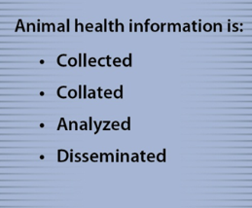
What is Surveillance?
Surveillance
  Intensive form of data recording
  Gathering, documenting, and analyzing
Surveillance systems
Routine surveillance
  Assesses level of endemic disease in populations
  Looks for presence of FAD agents
Notes:
Surveillance is an intensive form of data recording that encompasses gathering, documenting, and analyzing data to evaluate disease status for disease eradication or control. A surveillance system is designed to collect, collate, analyze, and disseminate animal health data. State and Federal organizations conduct routine surveillance to assess the level of endemic disease in animal populations or to look for the presence of foreign animal disease (FAD) agents in susceptible populations. Surveillance programs are currently in place for a number of animal diseases, such as: HPAI, brucellosis, classical swine fever, pseudorabies, and scrapie. [This graphic shows the purpose of a surveillance system. Illustration by: Bridget Wedemeier, Iowa State University]

Slide 4
Role of Surveillance
During an FAD outbreak, surveillance plays a key role in:
  Identifying the infectious agent
  Determining the scope of the outbreak
  Assessing the effectiveness of eradication and control efforts
  Demonstrating a return to disease free status
Notes:
In an FAD outbreak, surveillance activities play a key role in: identifying the infectious agent; determining the scope of the outbreak; assessing the effectiveness of eradication and control efforts; and demonstrating a return to disease free status.

Slide 5
The Surveillance Plan
Notes:
Surveillance activities begin with the development of the surveillance plan which describes how and where surveillance will be conducted.

Slide 6
Surveillance Plan
Purpose, rationale, objectives
Stakeholders
Sampling considerations
  Population, methods, diagnostic testing
Sampling techniques
Plans for data analysis
Implementation, budgeting, and evaluation plans
Notes:
The surveillance plan is developed by the Disease Surveillance Branch in collaboration with the Situation Unit. The surveillance plan functions as a framework describing the surveillance system and the roles and responsibilities of surveillance team members during the FAD response. The surveillance plan describes:
The purpose, rationale, objectives, and desired outcome of surveillance activities;
Identification of stakeholders and responsible parties;
Population to be sampled, sampling methods, diagnostic testing considerations;
Performance metrics - adequate sampling techniques;
Plans for data analysis, reporting, and presentation; and
Expected implementation, budgeting, and evaluation plans.

Slide 7
Surveillance Plan Elements
Disease description
Surveillance objectives
Stakeholders and responsible parties
Population description
Case definitions
Data sources
Sampling methods
Diagnostic tests
Notes:
Surveillance activities will continue and change throughout the course of an outbreak until the last area/zone is proven disease free. When developing a surveillance plan, the following factors must be taken into account:
Disease description;
Surveillance objectives;
Identifying stakeholders and responsible parties;
Population description;
Case definitions;
Data sources;
Sampling methods; and
Diagnostic tests.
We will look at these in more detail in the following slides.

Slide 8
Disease Description
Etiologic agent
Geographic distribution
Clinical signs
Pathological findings
Available laboratory tests
Epidemiology
Economic impact
Methods of control
Notes:
The following information about the FAD is included in the disease description section of the surveillance plan:
Etiologic agent;
Geographic distribution;
Clinical signs;
Pathological findings;
Available laboratory tests;
Epidemiology;
Economic impact; and
Methods of control.
Epidemiologists will use this information to develop the case definition. A case definition is a combination of clinical signs and/or laboratory tests required to categorize a case as suspect, presumptive positive, or confirmed positive. Case definitions are discussed later in this presentation.

Slide 9
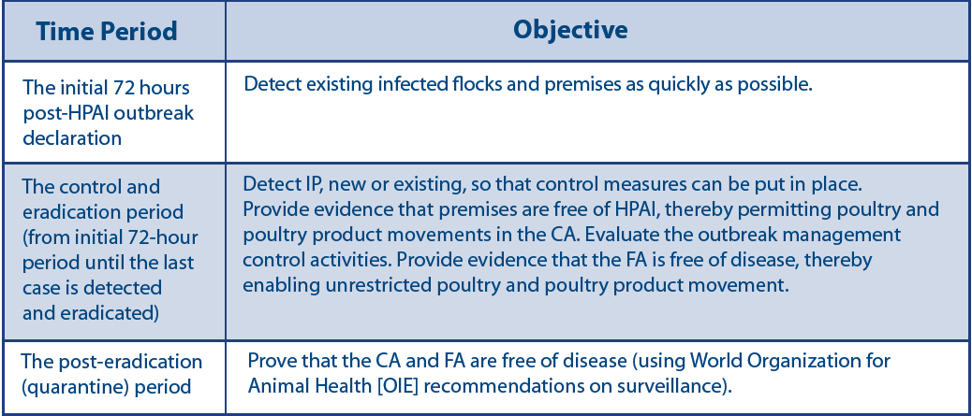
Surveillance Objectives
Goals to be achieved through the use of the surveillance system
Notes:
Surveillance objectives are the goals to be achieved through use of the surveillance system. The table shows examples of surveillance objectives which have been developed for high pathogenicity avian influenza (HPAI). Goals are expected to change throughout the course of an outbreak. Goals also relate to disease control zones, such as the Control Area (CA) and the Free Area (FA). Surveillance objectives for individual pathogens can be found in disease-specific SOPs. See FAD PReP SOP: Surveillance (e.g., FMD, HPAI). More information on the disease control zones can be found in the FAD PReP/NAHEMS Guidelines: Surveillance, Epidemiology, and Tracing. [This chart describes Surveillance Objectives by Time Period for HPAI. Content provided by: USDA. Illustration by: Bridget Wedemeier, Iowa State University]

Slide 10
Stakeholders
Stakeholders should be clearly identified
  May be included in surveillance planning and data collection activities
  May not specifically appear in the ICS
Anyone participating in surveillance activities must receive training
Notes:
The surveillance plan should clearly identify the stakeholders and the individuals responsible for designing, implementing, and managing the surveillance system. Industry stakeholders may be included in surveillance planning and data collection activities, although they may not specifically appear in the ICS structure. Anyone participating in surveillance activities must receive training to be successfully integrated into response activities.

Slide 11
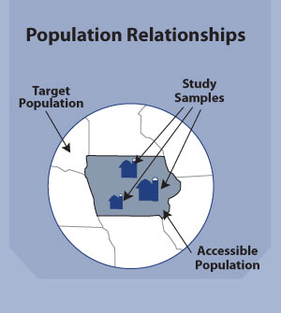
Population Description
Study population
  Subset of the target population
  Contains animals at risk of infection
  More than one may be identified
Notes:
The population to be sampled, also called the study population, is described in the surveillance plan. The study population is a subset of the larger target population which may include all animals affected by the FAD. In an FAD outbreak, the study population contains animals at risk of infection from the FAD and is further defined by factors such as species, breed or type, age, production phase or geographic location. More than one study population may be identified in the case of an FAD affecting multiple species. In the illustration, the target population is all the livestock in the Midwest. Of the target population, livestock in the State of Iowa are most accessible. Within the State of Iowa, a subset of livestock and premises may be chosen for FAD testing. This group becomes the study population. [This illustration depicts the relationships between a target population, the accessible population and study samples. Illustration by: Bridget Wedemeier, Iowa State University]

Slide 12
Case Definition Components
General disease and pathogen information
  Etiologic agent
  Distribution
  Clinical signs
  Incubation period
  Differential diagnosis
  Transmission and reservoir
  Epidemiology
Laboratory criteria
Reporting criteria
Control procedures
Surveillance procedures
Notes:
Clear case definitions must be developed for FAD cases under investigation. Case definitions must be consistent and specific so that all individuals identifying and reporting cases are able to properly count and categorize cases. The components of a case definition are listed on this slide. The components include information on the disease and pathogen, laboratory criteria, and control and surveillance procedures.

Slide 13
Case Definitions
Suspect case
  Animal showing clinical signs compatible with FAD
Presumptive positive case
  Animal with clinical signs consistent with FAD and positive test results
Confirmed positive case
  Agent has been isolated and identified using approved tests
Notes:
At least three case definitions are developed during an FAD outbreak. These definitions are likely to evolve as the outbreak progresses and include:
Suspect case: animal showing clinical signs compatible with the FAD.
Presumptive positive case: animal with clinical signs consistent with the disease in question, epidemiological links, and/or positive laboratory test results supporting current infection or exposure to the disease of concern.
Confirmed positive case: indicates the requirements including laboratory testing and other criteria that are required to unequivocally determine the presence of the FAD agent.
Case definitions for many high-consequence FADs have been developed by the National Surveillance Unit (NSU). The FAD PReP SOP: Case Definition Development Process available on the FAD PReP website (http://www.aphis.usda.gov/fadprep) provides additional information on how case definitions are derived.

Slide 14
Data Sources
Notes:
Data are facts such as observations, clinical signs and laboratory results collected from multiple sources by the surveillance system. Many sources of data are available to assist with surveillance efforts; they will be discussed further on the following slides.

Slide 15
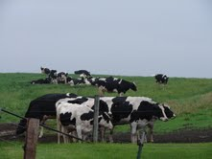
Livestock Producers
May be the first to notice sick animals
Maintain livestock records and production data
  Type, format and quality of farm data may vary from farm to farm
  Confidentiality issues
Notes:
Livestock producers may be the first to notice sick animals, so they play an important role in surveillance. Producers also maintain livestock records and production data which may provide useful data. Note that the type, format, and quality of farm record data may be highly variable and there may be confidentiality issues associated with access to these records. [This image depicts cows grazing and visual surveillance by a producer. Photo source: Danelle Bickett-Weddle, Iowa State University]

Slide 16
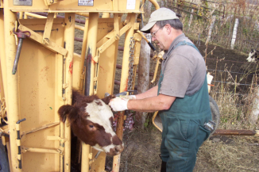
Veterinarians
Often have early contact with sick animals
  Routine veterinary activities
  Calls to examine ill animals
Medical records may be available
  Confidential documents
  Type, format, quality of information may vary
Notes:
Veterinarians often have early contact with sick animals through routine veterinary activities (i.e., herd reproductive exams, etc.) and calls to examine clinically ill animals. It may be possible to collect medical records from veterinarians in an FAD outbreak. Note that medical records are confidential documents and access may be limited. The type, format, and quality of information may vary from practice to practice. [This is a photo of a veterinarian examining a bovine patient. Photo source: Tri-vet]

Slide 17
Livestock Organizations
May be a source of data
  Number and distribution of animals owned by members
May also help disseminate FAD information from a response effort
Notes:
Livestock organizations may be a source of data regarding the number and distribution of animals owned by members. These groups may also serve as a conduit for disseminating FAD information from the response effort to group members.

Slide 18
Slaughter Plants
All animals undergo ante mortem and post mortem inspection
  Results recorded only for animals requiring disposition by FSIS
  Amount of information recorded varies
  May provide information in an FAD outbreak
Notes:
Infected animals may be slaughtered prior to the development of recognizable clinical signs. All livestock must undergo ante mortem inspection on the day of slaughter (in both Federally and State inspected plants); animals may be condemned based on inspection results. No further diagnostic inspection is performed on condemned animals, with the exception of testing for bovine spongiform encephalopathy in cattle with central nervous system signs. All slaughtered livestock are inspected post mortem. Examination results are recorded only for animals requiring disposition by a USDA Food Safety and Inspection Service (FSIS) veterinarian. The amount of information recorded varies widely and may only include notation of significant clinical lesions (e.g., peritonitis, pneumonia). As such, disposition records are not diagnostic reports or medical records; however, they may provide information in an FAD outbreak. They may also be subject to confidentiality rules.

Slide 19
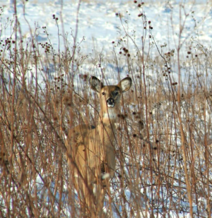
Wildlife Data
Potential data sources for wildlife
  Ground surveys
  Local reports
  Live animal capture
May be difficult
Consider wildlife density, movement patterns, and behavior
Notes:
For wildlife, potential data sources include ground surveys, aerial surveys, local reports from wildlife biologists and hunters, carcasses, and live animal capture. Data on wildlife populations may be more difficult to collect than livestock data. Surveillance of wildlife is difficult because wildlife populations move at-will across established zones. Consideration must be given to the density and distribution of wildlife, their movement patterns, home ranges and behavior when developing a surveillance plan. [This is a photo of a deer, an example of wildlife moving at-will. Photo Source: Karah Coolahan]

Slide 20
Sentinel Surveillance
May be used to periodically assess the health status of a population
Involves repeated sampling of a representative group of high risk animals
Considerations
  Herd/site selection and animal type
  Frequency of sampling
  Testing protocol
Notes:
Sentinel surveillance may be used to periodically assess the health status of a population. Although the term “sentinel” can be applied to populations, farms, or animals, the use of sentinels generally involves repeated sampling of a representative group of high risk animals. Considerations for establishing a sentinel surveillance program include: herd or site selection, animal selection, frequency of sampling, and testing protocol.

Slide 21
Other Data Sources
Auction/market records
Disease reporting systems
Disease control programs
Targeted testing/screening
Post mortem diagnostic specimen collection
Notes:
There are several additional data sources that may be used for surveillance. Records from livestock auctions or markets may help identify animal movements. This may be particularly helpful during tracing activities that occur in an FAD response. Information collected and reported during routine surveillance and disease control programs may be useful in the event of an FAD outbreak. Targeted testing/screening involves testing of animals with clinical signs similar to the suspected FAD, or populations with risk factors for disease. Post mortem inspections involve the collection of diagnostic specimens. Tissues, or other specimens, can be submitted for diagnostic testing, which varies according to the FAD agent suspected.

Slide 22
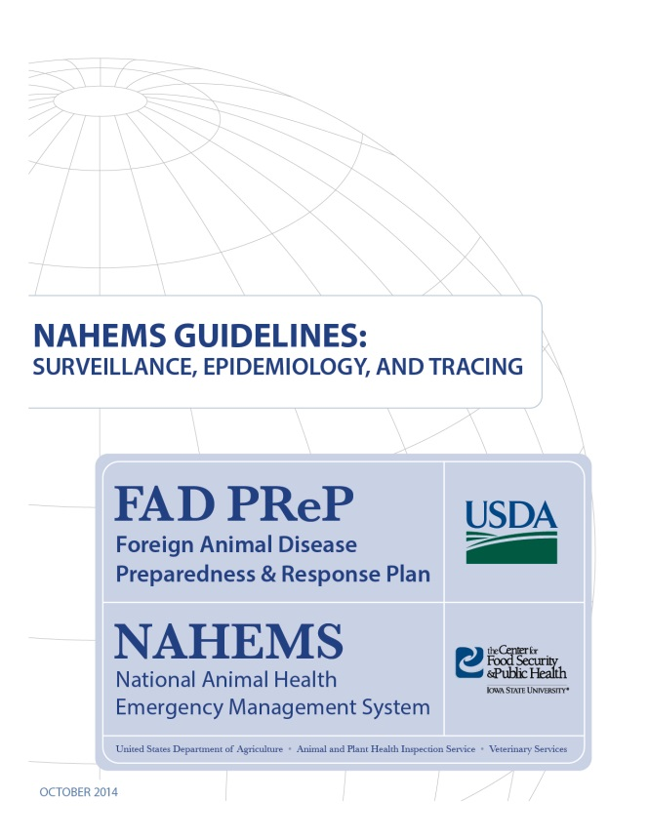
For More Information
FAD PReP/NAHEMS Guidelines: Surveillance, Epidemiology, and Tracing, and SOP: Surveillance
  http://www.aphis.usda.gov/fadprep
Surveillance, Epidemiology,
and Tracing web-based
training module
  http://naherc.sws.iastate.edu/
Notes:
More details can be obtained from the sources listed on the slide, available on the USDA website
(http://www.aphis.usda.gov/fadprep) and the NAHERC Training Site (http://naherc.sws.iastate.edu/).

Slide 23

Guidelines Content
Authors (CFSPH)
Kerry Leedom Larson, DVM, MPH, PhD, DACVPM
Glenda Dvorak, DVM, MPH, DACVPM
Janice Mogan, DVM
Courtney Blake, BA
Reviewers (USDA APHIS VS)
Dr. R. Alex Thompson
Dr. Lowell Anderson
Dr. Steve Goff
Dr. Fred Bourgeois
Notes:
The print version of the Guidelines document is an excellent source for more detailed information. In particular, the Guidelines document has listings of additional resources. This slide acknowledges the authors and reviewers of the Guidelines document. It can be accessed at http://www.aphis.usda.gov/fadprep.

Slide 24
Acknowledgments
Development of this presentation was by the Center for Food Security and Public Health at Iowa State University through funding from the USDA APHIS Veterinary Services
PPT Authors: Patricia Futoma, Veterinary Student; Kerry Leedom Larson, DVM, MPH, PhD, DACVPM
Reviewers: Janice Mogan, DVM; Melissa Lang, BS
Notes:
Information provided in this presentation was developed by the Center for Food Security and Public Health at Iowa State University College of Veterinary Medicine, through funding from the US Department of Agriculture, Animal and Plant Health Inspection Service, Veterinary Services.

