Slide 1
Surveillance, Epidemiology, and Tracing
Epidemiology Part 2:
Epidemiology in an FAD Outbreak
Adapted from the FAD PReP/NAHEMS Guidelines: Surveillance, Epidemiology, and Tracing (2014).
Notes:
An animal health emergency could have a detrimental effect on the nation's agriculture, food supply, and economy. Veterinary responders, animal health technicians, and other trained personnel may assist with surveillance, epidemiology, and tracing activities. In order to perform these job duties, a broad understanding of surveillance and epidemiological concepts is required. This presentation reviews epidemiology in an FAD outbreak focusing on the investigation and response. [This information was derived from the Foreign Animal Disease Preparedness and Response (FAD PReP)/National Animal Health Emergency Management System (NAHEMS) Guidelines: Surveillance, Epidemiology, and Tracing (2014).]

Slide 2
This Presentation
Describes the epidemiology investigation and response
Descriptive phase
Analytic phase
Intervention phase
Overview of epidemiology principles
Notes:
This presentation provides a description of epidemiology investigation and response implemented in the event of a foreign animal disease (FAD) outbreak. It defines the three phases of the epidemiology investigation, the descriptive, analytic, and intervention phases. An overview of epidemiological principles is also discussed.

Slide 3
Epidemiology Investigation and Response
Notes:
Once an animal is presumed positive for an FAD, or an FAD agent has been isolated and identified, appropriate national measures will be mobilized in support of the local response. Surveillance, epidemiology, and tracing components of an FAD response must be implemented quickly. They provide a real-time understanding of the situation and enable the earliest possible and most appropriate intervention strategies to be implemented (e.g., quarantine, movement control, vaccination, stamping-out, etc.).

Slide 4
Phases of Investigation
Generally, disease outbreaks are investigated in three phases:
Descriptive phase
Analytic phase
Intervention phase
Notes:
Generally, disease outbreaks are investigated in three phases: the descriptive phase, the analytic phase, and the intervention phase. These three phases of disease investigation may occur simultaneously in an FAD response. The next few slides will provide more information on these phases.

Slide 5
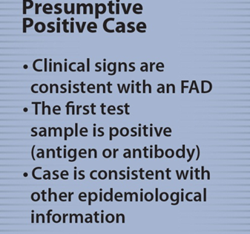
Descriptive Phase
Information collected
Case chronology, geography, and demography
Case definitions established
May later be modified
Herd and environmental history considered
Notes:
The following activities occur during the descriptive phase of the disease investigation:
Information is collected on case chronology, geography, and demography.
Working case definitions are established within 24 hours of the first presumptive or confirmed positive case or index case. These may be modified over time based on additional information or changing needs of the emergency response effort.
Herd and environmental history are considered.
[This graphic reviews the definition of a presumptive positive case. Illustration by: Bridget Wedemeier, Iowa State University]

Slide 6
Descriptive Phase (cont’d)
Diagnostic testing
Helps epidemiologists locate new cases
Premises with negative test results in the Control Area
Retested until quarantine removed
Free Premises (in the Free Area)
Testing demonstrates Free Area is free of disease.
Notes:
During the descriptive phase, diagnostic testing is performed on a census or statistical sample of animals/premises. While testing cannot ensure 100 percent freedom from infection, it helps epidemiologists locate new cases. All premises that undergo diagnostic testing will be quarantined if diagnosed as infected. Premises with negative test results in the Control Area will be retested until the quarantine is removed. Testing on Free Premises (in the Free Area) will be used to demonstrate that the Free Area is free of disease. Diagnostic samples will be collected and delivered to designated laboratories for testing in this phase.

Slide 7
Analytic Phase
Descriptive data and corresponding laboratory data are used to determine:
Disease risk factors
Associations between suspected risk factors and disease status
If possible, the FAD agent and source
Notes:
During the analytic phase, descriptive data and corresponding laboratory results are used to determine disease risk factors, associations between suspected risk factors and disease status are examined, and, if possible, the FAD agent and source are determined.

Slide 8
Analytic Phase (cont’d)
Within 96 hours of identifying the index case
Characterize the nature of the outbreak
Identify risk factors
Develop mitigation strategies
Within 6 hours of identifying a potential Infected Premises
Assign a premises classification
Assign a priority of investigation
Notes:
Within 96 hours of identifying the index case, epidemiologists should:
Characterize the nature of the outbreak;
Identify risk factors; and
Develop mitigation strategies.
Within 6 hours of identifying a potential Infected Premises or Contact Premises through tracing activities, epidemiologists should:
Assign a premises classification and a priority of investigation.

Slide 9
Analytic Phase (cont’d)
Epidemiological investigation reports are generated containing:
Information related to the origin of the outbreak
Total number of positive animals/premises
Total number of states with confirmed positive animals
Tracing information
Notes:
During the analytical phase, epidemiological investigation reports are generated at intervals as specified by Incident Command, and contain:
Information related to the origin of the outbreak;
Total number of positive animals/premises;
Total number of states with confirmed positive animals; and
Tracing information.

Slide 10
Intervention Phase
Addresses disease control measures
Considers preventive options
Assesses economic benefits and consequences of control measures
Notes:
The intervention phase addresses disease control measures, considers preventive options, and assesses the economic benefits and consequences of control measures. Disease control measures implemented by other operational groups may include;
Quarantine and movement controls;
Enhanced biosecurity practices;
Vaccination (to stop the production of the FAD agent by infected or exposed animals and to increase the disease resistance of susceptible animals); and
Mass euthanasia and disposal.

Slide 11
Epidemiological Principles
Prevent contact between the FAD agent and susceptible animals
Quarantine, movement controls, biosecurity procedures, target depopulation
Stop production of FAD agent by infected or exposed animals
Slaughter or mass depopulation
Increase the disease resistance of susceptible animals to the FAD agent
Emergency vaccination
Notes:
Data collected by surveillance efforts is utilized by epidemiologists in an FAD outbreak. Three basic epidemiological principles form the foundation for response strategies for containing, controlling, and/or eradicating a contagious FAD.
Prevent contact between the FAD agent and susceptible animals. This is accomplished through quarantine of infected animals and movement controls in Control Areas, through biosecurity procedures to protect non-infected animals, as well as accelerated depopulation of animals at risk, as warranted.
Stop the production of the FAD agent by infected or exposed animals. This is accomplished by slaughter or mass depopulation (and disposal) of infected and potentially infected animals.
Increase the disease resistance of susceptible animals to the FAD agent or reduce the shedding of the FAD agent in infected or exposed animals. This is accomplished by strategic emergency vaccination, if a suitable vaccine is available and can be administered in a timely manner.
During an FAD outbreak epidemiologists use data collected during surveillance to design plans to achieve these goals.

Slide 12
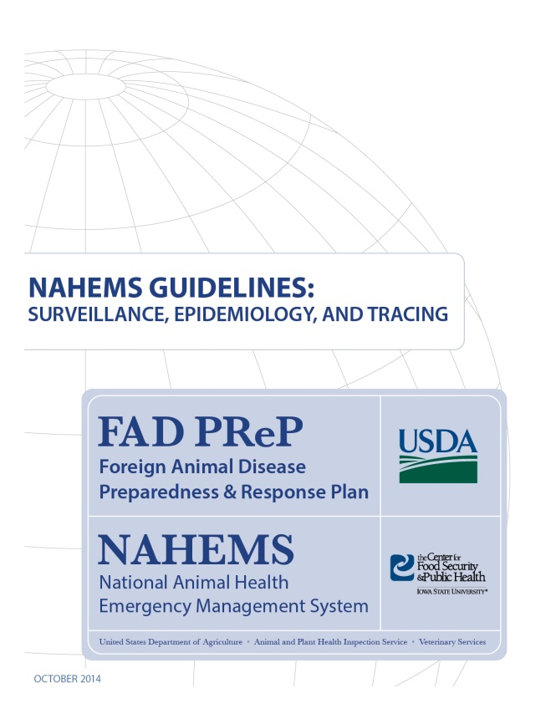
For More Information
FAD PReP/NAHEMS Guidelines: Surveillance, Epidemiology, and Tracing, and SOP: Surveillance
http://www.aphis.usda.gov/fadprep
Surveillance, Epidemiology, and Tracing web-based training module
http://naherc.sws.iastate.edu/
Notes:
More details can be obtained from the sources listed on the slide, available on the USDA website (http://www.aphis.usda.gov/fadprep) and the NAHERC Training Site (http://naherc.sws.iastate.edu/).

Slide 13
Guidelines Content
Authors (CFSPH)
Kerry Leedom Larson, DVM, MPH, PhD, DACVPM
Glenda Dvorak, DVM, MPH, DACVPM
Janice Mogan, DVM
Courtney Blake, BA
Reviewers (USDA APHIS VS)
Dr. R. Alex Thompson
Dr. Lowell Anderson
Dr. Steve Goff
Dr. Fred Bourgeois
Notes:
The print version of the Guidelines document is an excellent source for more detailed information. In particular, the Guidelines document has listings of additional resources. This slide acknowledges the authors and reviewers of the Guidelines document. It can be accessed at http://www.aphis.usda.gov/fadprep.

Slide 14
Acknowledgments
Development of this presentation was by the Center for Food Security and Public Health at Iowa State University through funding from the USDA APHIS Veterinary Services
PPT Authors: Patricia Futoma, Veterinary Student; Kerry Leedom Larson, DVM, MPH, PhD, DACVPM
Reviewers: Janice Mogan, DVM; Melissa Lang, BS
Notes:
Information provided in this presentation was developed by the Center for Food Security and Public Health at Iowa State University College of Veterinary Medicine, through funding from the US Department of Agriculture, Animal and Plant Health Inspection Service, Veterinary Services.

