Slide 1
Quarantine and
Movement Control
Authorities
Adapted from the FAD PReP/NAHEMS Guidelines: Quarantine and Movement Control (2016)
Notes:
In a foreign animal disease (FAD) incident, control and containment of the disease agent is essential to eradication and recovery. Quarantine and movement control (QMC) are critical activities to protect animal health, by helping to prevent the disease agent from being transmitted to non-infected livestock and poultry populations. QMC stops and controls movements in a regulatory Control Area. This presentation focuses on diseases spread by direct and indirect contact rather than vector-borne diseases, as QMC is not particularly effective at preventing the movement of mobile insect vectors. However, QMC activities can still prevent the movement of infected hosts, which may be important in vector-borne FAD incidents. In an incident, quarantines and movement controls are handled through Unified Incident Command, following local, State, and Federal laws/regulations. [This information was derived from the Foreign Animal Disease Preparedness and Response (FAD PReP)/National Animal Health Emergency Management System (NAHEMS) Guidelines: Quarantine and Movement Control (2016)].

Slide 2
This Presentation
Definition of relevant terms
Goals of FAD response
Goals of quarantine and movement control (QMC)
Authority of responsible agencies
FAD response activities
  Introduction to a Control Area
Notes:
This presentation will present some definitions of terms that may be used when referring to quarantine and movement control (QMC) in an emergency situation regarding an FAD outbreak. It will also discuss the goals of an FAD response and of quarantine and movement control, explain the authority of agencies responsible for dealing with animal and product movement during an FAD outbreak, and briefly present general information applicable to an FAD response, including an introduction to a regulatory Control Area.

Slide 3
Definitions
Quarantine
  Stringent restrictions
  Prohibits movement from specified premises, area, or region
Hold order
  Temporary, during investigation
  Usually under State authority
Standstill notice
  Temporary, prohibits new movement
  Federal authority/official notice
Notes:
For the purpose of this document, the following terms and definitions will be used:
Quarantine refers to imposing stringent restrictions on entering or leaving a premises, area, or region where disease is known to exist or is suspected. During an FAD outbreak, a quarantine broadly prohibits the movement of animals, animal products, and fomites (e.g. equipment, vehicles, clothing, footwear) from a specified premises, area, or region. Consideration is given to critical movements like feed trucks.
Hold order is a temporary order, similar in effect to a quarantine, typically implemented while additional diagnostics or investigation is conducted. Hold orders are usually, but not always, under State authority: definition, scope, and terminology may vary by State.
Standstill notice is the temporary prohibition of the initiation of any new movement of the susceptible species in a defined area. A standstill notice is typically implemented at a Federal level, put into effect through an official notice and subsequent publication in the Federal Register.

Slide 4
Definitions cont’d
Movement control
  Controls movement in Control Area
  Movement from premises with no evidence of infection
  Permits based on meeting criteria
Continuity of business (COB)
  Managed movement for specific commodity
Notes:
A continuation of these definitions include:
Movement control refers to controlling the movement of animals, animal products, and fomites in a regulatory Control Area. These movements are from non-infected premises, require permits, and are based on meeting specific criteria to ensure that such movement poses a negligible risk of pathogen transmission.
Continuity of business (COB) is a specific type of movement control known as managed movement. COB typically focuses on a specific commodity and is intended to mitigate the economic effects of a regulatory Control Area.

Slide 5
FAD Response Goals
Detect, control, and contain the disease in animals as quickly as possible;
Eradicate the disease using strategies that seek to stabilize animal agriculture, the food supply, and the economy and that protect public health and the environment; and
Provide science- and risk-based approaches and systems to facilitate continuity of business for non-infected animals and non-contaminated animal products.
Notes:
QMC activities are a critical component of a response effort. Three response goals for an FAD outbreak in the United States as outlined in the APHIS Foreign Animal Disease Framework: Response Strategies (FAD PReP Manual 2-0) are:
Detect, control, and contain the disease in animals as quickly as possible;
Eradicate the disease using strategies that seek to stabilize animal agriculture, the food supply, and the economy and that protect public health and the environment; and
Provide science- and risk-based approaches and systems to facilitate continuity of business for non-infected animals and non-contaminated animal products.

Slide 6
FAD Response Goals cont’d
Achieving these three goals will allow individual livestock facilities, States, Tribes, regions, and industries to resume normal production as quickly as possible.
They will also allow the United States to regain disease-free status without the response effort causing more disruption and damage than the disease outbreak
itself.
Notes:
Achieving these three goals will allow individual livestock facilities, States, Tribes, regions, and industries to resume normal production as quickly as possible. The objective is to allow the United States to regain disease-free status without the response effort causing more disruption and damage than the disease outbreak itself. Biosecurity plays a vital role in each of these goals.

Slide 7
Goals of QMC
Preparedness goals
  Develop effective QMC plans for
  affected locations
  Develop effective movement control and permit plans for non-infected locations
Response goals
  Establish a Control Area within 6 hours
  Implement QMC in the Control Area quickly
  Consider competing priorities -
  disease transmission vs. critical movements
Notes:
The QMC-specific goals support overall FAD response goals.
The preparedness goals are as follows:
To work with stakeholders to develop effective plans and processes for affected premises, areas, and regions.
To work with stakeholders to develop effective managed movement plans for non-infected premises, areas, and regions.
The response goals are as follows:
Through a Unified Incident Command, coordinate the establishment of an Infected Zone and a Buffer Zone (a Control Area) within 6 hours of identifying the index case.
Once a Control Area has been established, implement QMC in the Control Area as rapidly as possible.
Ensure QMC considers competing priorities, weighing the risk of disease transmission against the need for critical movements (e.g., feed trucks) and business continuity.

Slide 8
Authorities
Notes:
Both Federal and State agencies have authority to protect against and respond to animal disease. The Code of Laws of the United States of America (U.S.C.) and the Code of Federal Regulations (CFR) are codified authorities representing different stages of the legislative process. The U.S.C. provides the general and permanent statutes of the United States, which are passed by Congress and signed by the President. Executive branch agencies then interpret the U.S.C., developing detailed regulations in the CFR. The CFR is developed through a public rulemaking process, where the public is allowed to comment. In an FAD incident response, the U.S.C. and CFR provide policy, via statutes and regulations, for USDA; interim regulations can be implemented—in the event of an outbreak—to prevent the spread of disease.

Slide 9
USDA Authority for FAD
FAD
  Terrestrial disease not known to exist in the US or its territories
Emerging animal disease
  Not yet known
  Or known, that changes/mutates to become a threat to terrestrial animals, aquatic animals, or humans
Notes:
An FAD is a terrestrial animal disease or pest, or an aquatic animal disease or pest, not known to exist in the United States or its territories. An emerging animal disease may be any terrestrial animal, aquatic animal, or zoonotic disease not yet known or characterized, or any known or characterized terrestrial animal or aquatic animal disease in the United States or its territories that changes or mutates in pathogenicity, communicability, or zoonotic potential to become a threat to terrestrial animals, aquatic animals, or humans.

Slide 10
USDA Authority for FAD cont’d
FAD or emerging animal disease
  May involve livestock, poultry, or wildlife
  If wildlife, USDA APHIS will collaborate with agencies with primary jurisdiction and subject matter expertise
  Consult APHIS VS Proposed Framework for Response to Emerging Animal Diseases in the United States
Notes:
An FAD or emerging animal disease may involve livestock, poultry, other animals, and/or wildlife. In the event of an FAD or emerging animal disease outbreak in domestic livestock that involves wildlife, USDA APHIS will work in close collaboration, communication, and coordination with State, Tribal and Federal wildlife agencies that have primary jurisdictional authority and subject matter expertise for wildlife. For more information, consult APHIS VS Proposed Framework for Response to Emerging Animal Diseases in the United States for responding to such incidents.

Slide 11
Animal Health Protection Act
APHIS authority through AHPA Act
Secretary of Agriculture is authorized to:
  Prevent, detect, control, and eradicate diseases and pests of animals
  Protect animal health, human health
  and welfare, economic interests
  Prohibit importation, entry or interstate movement throughout US
  Prevent the introduction or dissemination of disease
Notes:
APHIS receives its permanent and general regulatory authority from the Animal Health Protection Act (AHPA), 7 U.S.C. 8301 et seq. The AHPA enables the Secretary of Agriculture to prevent, detect, control, and eradicate diseases and pests of animals, including foreign animal and emerging diseases, in order to protect animal health, the health and welfare of people, economic interests of livestock and related industries, the environment, and interstate and foreign commerce in animals and other articles. The Secretary is specifically authorized to carry out operations and measures to detect, control, or eradicate any pest or disease of livestock, which includes poultry, 7 U.S.C. 8308, and to promulgate regulations and issue orders to carry out the AHPA (7 U.S.C. 8315). The Secretary may also prohibit or restrict the importation, entry, or interstate movement of any animal, article, or means of conveyance to prevent the introduction into or dissemination within the United States of any pest or disease of livestock (7 U.S.C. 8303‑8305).

Slide 12
Code of Federal Regulations
9 CFR 71.2: Rule governing quarantine, interstate movement of diseased animals, poultry
9 CFR 71.3: Interstate movement of diseased animals, poultry, prohibited
9 CFR 53: Certain communicable diseases of livestock or poultry
9 CFR 161: Standards for accredited veterinarians, revocation
  CDC, per Public Health Service Act
    Authority against source of infection
Notes:
Title 9 of the CFR provides detailed USDA APHIS regulations for the control and eradication of animal diseases, including FADs and emerging animal diseases. Following are several key sections of the CFR to safeguard public health, animal health, animal products, interstate commerce, and international trade:
9 CFR 71.2
Secretary (of Agriculture) to Issue Rule Governing Quarantine and Interstate Movement of Diseased Animals, Including Poultry
9 CFR 71.3
Interstate Movement of Diseased Animals and Poultry Generally Prohibited
9 CFR 53
Foot-and-Mouth Disease, Pleuropneumonia, Rinderpest, and Certain Other Communicable Diseases of Livestock or Poultry
9 CFR 161
Requirements and Standards for Accredited Veterinarians and Suspension or Revocation of Such Accreditation.
Interstate is defined in 9 CFR 71.1 as follows: From one State into or through any other State.
In addition, the Centers for Disease Control and Prevention (CDC) has the authority, per the Public Health Service Act, and 42 CFR 70.2 to “take such measures to prevent such spread of diseases as he/she deems reasonably necessary, including inspection, fumigation, disinfection, pest extermination, and destruction of animals or articles believed to be sources of infection.”

Slide 13
State Authority for FAD
Initially, State, Tribal, local authorities and resources
Authority granted to SAHO varies
Quarantine
  May be issued based on FAD detection or suspicion
  Scope based on specific authority
  Intended to control disease intrastate
  Become familiar with your State’s laws
Notes:
Initial FAD response and enforcement of QMC will involve State, Tribal, and local authorities and resources. Authority granted to the State Animal Health Official (SAHO) varies from State to State. Legal authority is granted via statute by a legislating body, and regulations are promulgated by an executive agency under this statutory authority. Quarantine on a premises—or movement restrictions—within a Control Area may be issued, based on an FAD detection or a suspected FAD. These may include quarantines of an individual pen, herd, flock, premises, county, section, or area, depending on the specific State authority. State quarantines are used to stop and control the spread of an infectious or contagious disease within a State. Since statutes and regulations vary by State, it is important to become familiar with and follow the laws, regulations, and terminology of your State, Tribal Nation, and/or locality.

Slide 14
Extraordinary Emergency
Declared by US Secretary of Agriculture
Federal government authorized to control intrastate movement
  In addition to interstate and international movement
No Extraordinary Emergency declared during HPAI outbreak in US (2014-2015)
Regulatory intervention
  By Unified Incident Command
Notes:
While typically States control intrastate movements, it is important to recognize that if the United States Secretary of Agriculture declares an Extraordinary Emergency, the Federal government is then authorized to control intrastate movement, in addition to interstate movement and international movement. Please note in the highly pathogenic avian influenza (HPAI) outbreak in 2014–2015, the largest animal health incident ever in the United States, there was no Extraordinary Emergency declaration. Additionally, an FAD outbreak in the United States may result in emergency regulatory intervention by State, Tribal Nations, and Federal authorities via a Unified Incident Command.

Slide 15
Responding to an FAD: General Information
Notes:
General information that applies to an FAD emergency response includes epidemiological principles, simultaneous activities, and the establishment of regulatory Control Areas.

Slide 16
  Epidemiological Principles
Prevent contact
  Quarantine, movement controls, biosecurity, depopulation
  Avoid risk of mechanical vectors
Stop production of disease agent
  Depopulation (and disposal) of infected and potentially infected animals
Increase disease resistance or
reduce shedding
  Emergency vaccination, if suitable vaccine, administered in timely manner
Notes:
The need for QMC activities is based on the three basic epidemiological principles of response. These three principles form the foundation of any FAD response strategy to contain, control, and ultimately eradicate the disease in the U.S. domestic livestock or poultry population.
1. Prevent contact between the disease and susceptible animals.
This is accomplished through quarantine of infected animals, movement controls in the Infected Zone(s) and Buffer Zone(s) (Control Areas), and biosecurity procedures to protect non-infected animals.
Certain circumstances may warrant accelerating the depopulation of animals at risk for exposure to the disease to decrease the population density of susceptible animals.
There is a serious but lesser transmission risk posed by people, material, conveyances, and non-susceptible animals that may have been in contact with the disease and serve as mechanical vectors. Contact with susceptible animals should be prevented and transmission risk mitigated through biosecurity and cleaning and disinfection measures.
2. Stop the production of the disease agent. This is accomplished by the slaughter or mass depopulation (and disposal) of infected and potentially infected animals.
3. Increase the disease resistance of susceptible animals or reduce the shedding of the disease agent in infected or exposed animals. This can be accomplished by emergency vaccination if a suitable vaccine is available and can be administered in a timely manner.

Slide 17
Critical Activities
Critical Activities and Tools for Containment, Control, and Eradication
Public awareness campaign
Swift imposition of effective QMC
Rapid diagnosis and reporting
Epidemiological investigation and tracing
Increased surveillance
COB measures for non-infected animals and non-contaminated animal products
Biosecurity measures
Cleaning and disinfection measures
Effective and appropriate disposal procedures
Mass depopulation and euthanasia (as response strategy indicates)
Emergency vaccination (as the response strategy indicates)
Notes:
During an FAD response, many activities must be conducted simultaneously to achieve the goals of an FAD response. This chart lists some of the critical activities which occur in an FAD outbreak, including QMC. Other activities, such as surveillance, diagnostic testing, COB, disposal, and vaccination will also help to rapidly and effectively control, contain, and eradicate the disease. [Critical Activities and Tools for Containment, Control, and Eradication. Content provided by: USDA]

Slide 18
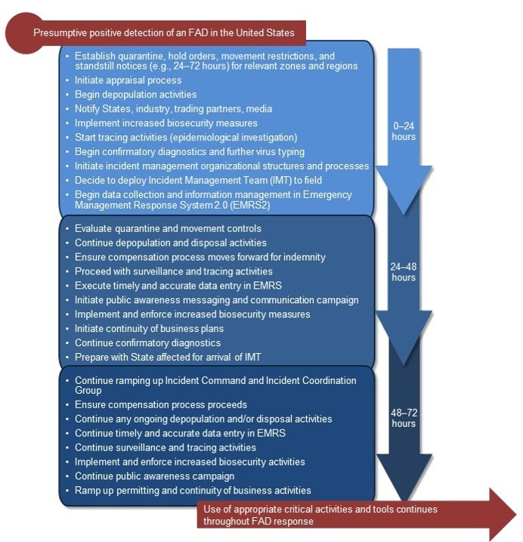
Activities in First 72 Hours
Notes:
This figure shows the critical activities that will take place within the first 72 hours of an outbreak, beginning with the detection of an FAD in domestic livestock. Many of these activities that are initiated in the first 72 hours continue throughout the response, such as quarantine and movement controls, biosecurity, surveillance, and tracing. These critical tasks are fundamental to the rapid control and containment of the disease. [Critical Activities in the First 72 Hours of an FAD Outbreak. Content provided by: USDA]

Slide 19
Zone, Area, Premises Designations
Control Area =
  Infected Zone + Buffer Zone
Quarantines in Control Area
  Infected Premises
  Contact Premises
  Suspect Premises
Response zones/areas likely to change over the course of the incident
Notes:
Immediately after an FAD detection, a regulatory Control Area, comprised of an Infected Zone and Buffer Zone, will be designated. Quarantines will be implemented for Infected, Contact, and Suspect Premises in this regulatory Control Area. As the epidemiological investigation continues, the incident may become more complex, demanding additional resources. Response zones and areas are likely to change and be redefined over the course of an incident.

Slide 20
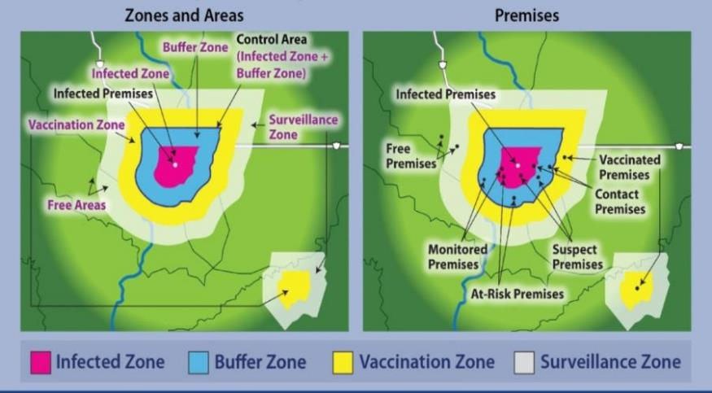
Zones, Areas, Premises
Notes:
During an FAD outbreak, geographic locations are classified or designated according to specific criteria related to disease or disease-free status. These designations help to associate specific response activities with specific locations. These figures show examples of zones and areas on the left, and examples of the locations of premises that have been designated with specific classifications on the right. QMC activities focus on the Control Area - comprised of the (dark pink) Infected Zone depicted in the center of the map, which surrounds all known Infected Premises, plus the (blue) encircling Buffer Zone. As mentioned in the last slide, quarantines are implemented for Infected, Contact, and Suspect Premises in the Control Area. It is important to note that these figures are examples, and are not to scale. More detail on designations of zones, areas, and premises, and the factors considered in determining their size is explained in the FAD PReP/NAHEMS Guidelines; Quarantine and Movement Control document, and in the Zones, Areas and Premises PowerPoint presentation associated with this series. [Example Zones, Areas, and Premises. Diagrams provided by: USDA; Graphic illustration by: Dani Ausen, Iowa State University]

Slide 21
Authority Coordination
Quarantine and movement control
  Federal – interstate and international
  State – intrastate
Continuity of Business (COB)
  Management movement
  Negligible risk of pathogen transmission
  Minimize significant disruptions
Coordination authority, resources, and expertise
Notes:
Quarantine and movement control activities are important interventions to control and contain an FAD. Usually Federal quarantines and movement restrictions are instituted to control interstate and international movement of infected animals and contaminated animal products; States may restrict the intrastate movement of animals, animal products, equipment, and other items. Under certain circumstances, Federal authorities may be able to also limit intrastate movement. Continuity of business (COB), also referred to as management movement, helps to ensure that such movement poses negligible risk of pathogen transmission, yet is intended to minimize significant disruptions in business operations and avoid severe economic consequences that may result. A highly contagious FAD will involve Federal authority, resources, and expertise closely coordinated with State, local, and Tribal government authority and resources.

Slide 22
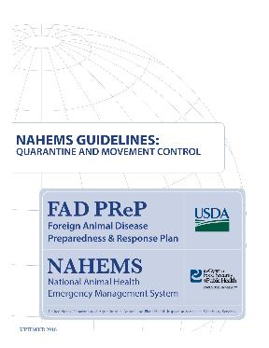
For More Information
FAD PReP/NAHEMS Guidelines: Quarantine and Movement Control
  http://www.aphis.usda.gov/fadprep
Quarantine and Movement Control web-based training module
  http://naherc.cfsph.iastate.edu/
Notes:
More details can be obtained from the sources listed on the slide, available on the USDA website (http://www.aphis.usda.gov/fadprep) and the National Animal Health Emergency Response Corps (NAHERC) Training Site (http://naherc.cfsph.iastate.edu/).

Slide 23
Guidelines Content
Authors (CFSPH)
Janice P. Mogan, DVM
Heather Allen, PhD, MPA
Kristen Bretz, MS
Reviewers (USDA)
Randall Crom, DVM (Retired)
Jonathan Zack, DVM
Notes:
The print version of the Guidelines document is an excellent source for more detailed information. This slide acknowledges the Guidelines’ authors and reviewers. It can be accessed at http://www.aphis.usda.gov/fadprep.

Slide 24
Acknowledgments
Development of this presentation was by the Center for Food Security and Public Health at Iowa State University through funding from the USDA APHIS Veterinary Services
PPT Authors: Janice Mogan, DVM; Logan Kilburn
Reviewers: Kristen Bretz, MS
Notes:
Information provided in this presentation was developed by the Center for Food Security and Public Health at Iowa State University College of Veterinary Medicine, through funding from the US Department of Agriculture, Animal and Plant Health Inspection Service, Veterinary Services.

