Slide 1
Personal Protective Equipment
Types and Levels
Adapted from the FAD PReP/NAHEMS
Guidelines: Personal Protective Equipment (2011)
Notes:
Veterinary responders are needed in emergency situations that threaten animal health, such as the natural occurrence or intentional introduction of a highly contagious foreign animal disease. This presentation will provide an overview of types and levels of Personal Protective Equipment (PPE) utilized in an animal disease emergency. The considerations for selection and use of PPE are dependent on the specific situation. It is the responsibility of the veterinary responder to understand the required PPE and use it correctly. [This information was derived from the Foreign Animal Disease Preparedness and Response (FAD PReP)/National Animal Health Emergency Management System (NAHEMS) Guidelines: Personal Protective Equipment (2011) and also the web-based training module.]

Slide 2
Types of PPE
Notes:
This presentation describes various types and levels of personal protective equipment (PPE) that may be utilized in an animal disease outbreak. PPE is intended to protect an individual from inhalation, dermal or physical exposures that may cause injury based on the hazard assessment. PPE refers to special clothing and equipment designed to act as a barrier between an individual and a hazard that could cause injury. In an animal disease emergency such as a foreign animal disease (FAD) outbreak, PPE has two important purposes: to protect the responder from potential hazards, and to prevent the spread of disease agents. This presentation will focus on protecting the responder. A thorough understanding of the types of PPE available is essential in order to select the appropriate PPE for the situation, hazard, task, etc.

Slide 3
Types of PPE
Respiratory
Eyes/Face
Hands
Body
Feet
Head
Hearing
Notes:
A variety of clothing and equipment is available to protect all parts of the body. PPE can be chosen to protect the respiratory system, eyes and face, hands, body, feet, head, and hearing from inhalation, dermal or physical exposures. The selection of PPE is based on the hazard and the specific situation, including the assignment, extent of physical work, and environmental conditions. [This photo shows a responder donned in a chemical-resistant hooded suit, full-face air purifying respirator, chemical-resistant boots, and three pairs of gloves. Photo source: Tegwin Taylor, Iowa State University]

Slide 4
Respirators
Protect the respiratory system from inhalation of harmful agents
Covers nose and mouth (at least)
Medical evaluation/clearance
Fit testing, if respirator forms a seal against the face
Notes:
Starting with PPE to protect the respiratory system, we will first discuss respirators. A respirator is a device that is worn on the face, covers at least the nose and mouth, and is used to reduce the wearer’s risk of inhaling hazardous agents. Medical clearance, involving a medical evaluation by a qualified health professional, is required before any respirator can be used. Fit testing is required for those respirators that form a tight seal against the face, to ensure that harmful agents are unable to reach the respiratory system. Not all respirators that may be used in an animal disease emergency are intended to form this tight seal. The information in the following section was taken in large part from the National Institute for Occupational Safety and Health (NIOSH) respirator web sites http://www.cdc.gov/niosh/topics/respirators and http://www.cdc.gov/niosh/npptl/topics/respirators/disp_part/RespSource.html.

Slide 5
Respirators
Air-purifying respirator (APR)
  Remove contaminants from the air
  Particles, chemical, gases
Self-contained breathing apparatus (SCBA)
  Provides own air supply
Notes:
Respirators protect the user from inhaling airborne particles (such as dust particles and infectious agents), gases, or vapors. Respirators provide protection in either of two basic ways, by either purifying the air or supplying clean air. The first type of respirator removes contaminants from the air prior to inhalation using filters or cartridges, and is known as an air-purifying respirator (APR). APRs include particulate respirators which filter out airborne particles, and also include "gas masks” which remove harmful chemicals, gases, and vapors. Responders requiring respiratory protection in a highly contagious foreign animal disease outbreak will most likely be provided with APRs to remove particles; therefore these will be the focus in this presentation. The second type of respirator, the self-contained breathing apparatus, supplies clean, non-contaminated air through its own air supply for use in high-risk environments.

Slide 6
Respirators
Air-purifying respirators (APR)
  Disposable particulate filtering
  Elastomeric respirators
  Powered air-purifying respirators (PAPRs)
Notes:
Air-purifying respirators (APR) that filter particles, such as bacteria and viruses, may be the most common type of respirator utilized during an livestock disease emergency. The classification of particulate respirators that purify air can be further subdivided into three categories:
1. Particulate filtering facepiece respirators – Sometimes referred to as disposable respirators because the entire respirator is discarded when it becomes unsuitable for further use due to considerations of hygiene, excessive resistance, or physical damage. A common type with which you may be familiar is referred to as an “N95.”
2. Elastomeric respirators – Sometimes referred to as reusable respirators because the facepiece is cleaned and reused. The filters or cartridges that provide the filtering capacity are discarded and replaced when they become unsuitable for further use.
3. Powered air-purifying respirators (PAPRs) – A battery-powered blower moves the air flow through filters.

Slide 7
APR: Particulate Filtering
Disposable
Commonly stockpiled
Filter efficiency
  95, 99, or 100
Oil protection
  N,R,P
No protection against gases or vapors
Notes:
Disposable ARPs are simple, relatively inexpensive, and least protective of the particulate filtering facepiece respirator types. The entire respirator facepiece is comprised of filter material. This is the most common type of respirator being stockpiled by State and Federal agencies to issue to animal health responders if a surge of emergency personnel is required for a livestock or poultry disease. These respirators come in three primary filtering efficiencies, which filter out at least 95%, 99%, and 99.97% of penetrating airborne particles, respectively. These respirators are also rated for their protection against oils:
N- Not resistant to oil;
R- Somewhat resistant to oil; and
P- Strongly resistant or oil proof.
These respirators protect against particulates only (which includes viruses and bacteria). They do not protect against gases or vapors, and are intended only for low hazard levels. [This photo depicts an N95 disposable respirator with an exhalation valve. Photo source: Dani Ausen, Iowa State University]

Slide 8
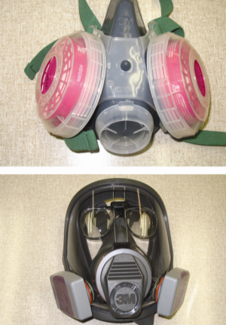
APR: Elastomeric
Reusable facepiece
  Half or full face
Disposable filter cartridges
Effective against:
  Particulates
  Gases
  Vapors
Notes:
Elastomeric respirators are capable of filtering particles, but depending on the filter or cartridge used, may be used to filter specific gasses. They are sometimes referred to as reusable respirators because the molded facepiece can be cleaned, decontaminated, and reused. The filter cartridges are discarded and replaced as needed. The half-face piece (top photo) covers the mouth and nose and must be used in conjunction with goggles to protect the eyes from exposure. The full-face respirator (bottom photo) purifies air like the half-face respirator, but offers a higher level of protection than the half-face respirator as it covers the entire face—protecting the eyes as well. [This photo shows a half-face (top) and full-face (bottom) APR. Photo source: Tru Twedt, Iowa State University]

Slide 9
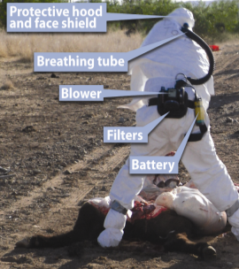
APR: PAPR
Battery powered blower
HE filter for particulates
  Viruses and bacteria
Check battery/air-flow
Half or full facepiece or hooded face shield
High degree of protection
Notes:
This is may be an appropriate type of respiratory protection for some zoonotic infectious agents. A PAPR utilizes a battery powered blower to pull air through filters that trap harmful agents, and then move the filtered air to the wearer’s facepiece for clean air to be inhaled. For respiratory protection against airborne particulates, such as viruses and bacteria, the PAPR must be equipped with HE (high-efficiency particulate air) filters. Before entry into the hazardous environment, PAPR blower units should be checked before each use to ensure that the battery is fully charged, and the blower is providing the air flow rate identified in the NIOSH approval for the configuration being used. PAPRs can be configured with a half-facepiece, full-facepiece or a hooded covering. PAPRs incorporate several hood configurations and styles. Different configurations provide different levels of filtering efficiency. [This photo shows a veterinarian wearing a hooded PAPR with parts labeled. Photo source: John Wenzel, New Mexico State University; labels by Andrew Kingsbury, Iowa State University]

Slide 10
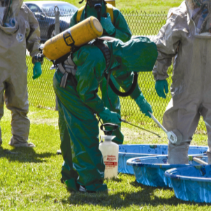
SCBA: Self-contained
Equipped with its own air supply
Used in high-risk
environments
Advanced training
Most FAD responses will not require this level of protection
Notes:
Where the first type of respirators purify ambient air, this second type of respirator, the self-contained breathing apparatus, abbreviated as SCBA, supplies clean, non-contaminated air through its own air supply for use in high-risk environments. It protects a responder when concentrations of respiratory hazards are unknown or above the specified concentration for effective use of other respirators, or there is an environment that is immediately dangerous to life and health (e.g., chlorine spill, low ambient oxygen). Although SCBA offers the greatest respiratory protection from the outside environment compared to other respirators, its use requires advanced training. Most foreign animal disease responses will not require this higher level of protection. [This photo shows a responder wearing a SCBA decontaminating another responder. Photo source: Federal Emergency Management Agency (FEMA)]

Slide 11
Minimizing Body Exposure
Notes:
In addition to protecting the respiratory system, minimizing skin exposure is one of the most important reasons for using PPE. At a minimum, long sleeves and long pants should be worn in the field. Additional body protection can be provided by wearing coveralls or an apron. PPE selection is based on possible risks and task assignment, and may include protection of other body parts. It may also include protection from environmental and physical hazards such as loud noises and crushing blows. Many field tasks in an animal health event will expose responders to contaminated or caustic material via aerosolization, splash, or direct contact with contaminated hands. Proper protective outwear will serve to protect the responder as well as prevent the spread of disease.

Slide 12
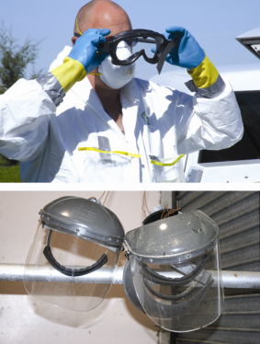
Eye/Face Protection
Exposure to caustic or contaminated materials
  Aerosolization, splash, direct contact
Perform risk assessment
Options for protection:
  Safety glasses
  Splash-proof goggles
  Face shield
Notes:
To prevent materials such as livestock manure, dust, mud and contaminated biological tissue from entering the eyes, nose, and mouth, eye/face protection should be worn based on the risk assessment. As an example, eye protection consisting of safety glasses, goggles, or a face shield should be used when conducting field necropsies or collecting tissue samples. Goggles will protect a responder’s eyes from cleaning and disinfection fluids splashed during C&D activities. A face shield should be used if C&D fluids are caustic or irritating to the skin. Selection of appropriate PPE should be based on a risk assessment. A higher level of eye/face protection may be required for zoonotic diseases depending on transmission. Selection will be detailed in the incident specific Health and Safety Plan. [These photos show a veterinarian donning goggles (top), and reusable face shields (bottom). Photo sources: Top: Travis Engelhaupt, Iowa State University; Bottom: Dani Ausen, Iowa State University]

Slide 13
Hand Protection
Disposable gloves recommended for clinical use in the field
  Latex
  May substitute other materials if appropriate
Cut-resistant gloves essential for necropsies and tissue collection
Notes:
Standard disposable latex gloves are recommended for clinical use in the field. Gloves made from other materials (such as nitrile, butyl, PVC, and neoprene) may be substituted for latex gloves under certain conditions if appropriate. A suitable type of glove will need to be substituted for those with an allergy to latex. Cut-resistant gloves made of materials such as steel mesh, Kevlar®, and Surgipath® are essential for personnel who are conducting necropsies, and collecting and cutting tissue specimens in the field. These gloves should be worn as essential PPE on both hands over the latex or other waterproof gloves. Different colored gloves help users visualize a break in the outer glove. [The top photo shows a responder wearing nitrile gloves. The bottom photo shows a responder wearing cut-resistant gloves. Photo source: Top: Center for Food Security and Public Health, Iowa State University; Bottom: Rick Stammer, USDA]

Slide 14
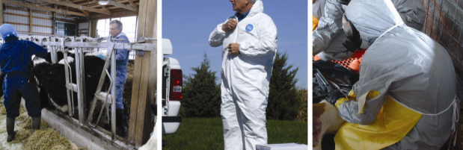
Body Protection
Long sleeves and long pants
Coveralls/Tyvek®
Waterproof, cut-resistant apron
Situation-specific (heat, cold)
Notes:
Coveralls are a protective outer layer of clothing that should be worn over appropriate undergarments as an initial form of body protection. In many cases, it’s appropriate to use a clean, washable, long-sleeved one-piece cloth coverall suit. Higher risk situations require a clean, disposable, long-sleeved one-piece Tyvek® coverall suit. A waterproof, cut-resistant apron should be available as needed for field necropsies or for collecting and cutting tissues which may be contaminated with a disease agent of high zoonotic risk. Some situations may require more specific body protection. Brightly colored high-visibility vests should be worn when working around vehicles and traffic, such as a quarantine checkpoint. If the weather is warm, a cooling vest may be used under the coveralls. Cold weather operations may require additional insulated underclothing. [The left photo shows a veterinarian wearing cloth coveralls. The middle photo shows a veterinarian wearing a tear resistant suit. And the right photo shows a responder in waterproof coveralls and a tear resistant apron. Photo sources: Left: Danelle Bickett-Weddle, Iowa State University; Middle: Travis Engelhaupt, Iowa State University; Right: Tegwin Taylor, Iowa State University]

Slide 15
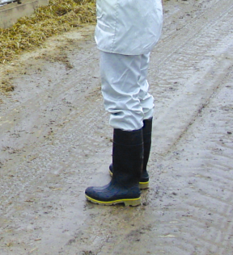
Foot Protection
High pull-on boots recommended
Rubber or waterproof material
Flexible steel toes and midsoles prevent puncture or crushing
Notes:
For field use, high pull-on boots worn over stocking feet are preferable to overshoes or overboots. To permit thorough cleaning and decontamination, the boots should be made of rubber or waterproof material with shallow treads. Safety boots with flexible steel toes and midsoles, which provide extra protection from puncture wounds and crushing, are especially recommended for use in the field. Boots must fit well and be comfortable, or the user will be less agile and not comply with wearing them. It’s expected that field responders will spend much of their working time on their feet. [This photo shows high boots with steel toes and midsoles. Photo source: Danelle Bickett-Weddle, Iowa State University]

Slide 16
Head/Hearing Protection
Hard hat for working around heavy machinery or equipment overhead
Hearing
  Baseline audiogram
  Hearing Conservation Program
  Ear muffs, ear plugs
  Consider biosecurity if reusing
Notes:
Under certain circumstances, a hard hat and hearing protection may be recommended. Working around heavy machinery or working with equipment or items overhead, such as in a supply area, may require hard hats. For emergency situations where hearing protection is required, as with routine situations, the employee should have had a baseline audiogram and should be enrolled in the Hearing Conservation program. Specially designed ear muffs and ear plugs, both disposable and reusable, are examples of PPE used to protect responders from noises above safe levels. The choice of hearing protection should consider the effectiveness and the cost, as well as biosecurity issues if intended to be reused.

Slide 17
Levels of PPE
Notes:
The Occupational Safety and Health Administration (OSHA) classifies PPE into four levels of protection. The levels range from D (the lowest level of protection) to A (the highest level of protection).

Slide 18
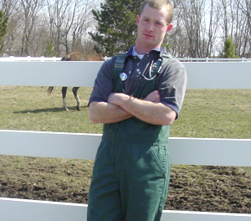
Level D PPE
Lowest level of protection
Protects against nuisance contamination
Basic work uniform
  Coveralls
  Disposable gloves
Notes:
Level D is the lowest level of protection and consists of a basic work uniform to protect against nuisance contamination. For example, Level D with coveralls and protective boots and gloves may be sufficient for responding to a non-zoonotic, vector-borne animal disease in the absence of a respiratory hazard. [This photo shows a veterinarian in cloth coveralls. Photo source: Danelle Bickett-Weddle, Iowa State University]

Slide 19
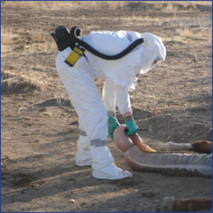
Level C PPE
Required when:
  Concentration and types of airborne substances are known
  Criteria for using APRs are met
Appropriate for veterinary responders in most situations
  E.g., HPAI outbreak
Notes:
Level C is used when the concentration and types of airborne substances are known and the criteria for using air purifying respirators are met. Level C is a higher level of protection than Level D, based on the need for respiratory protection. Level C would be recommended when responding to a highly pathogenic avian influenza (HPAI) outbreak. General agreement exists that Level C PPE would be adequate protection for veterinary responders in most situations – for both the protection of the responder and for biosecurity purposes. [This is a photo of a veterinarian in a PAPR performing a necropsy on a horse. Photo source: John Wenzel, New Mexico State University]

Slide 20
Additional PPE Levels
Level B PPE
  Highest level of respiratory protection
  Used when both zoonotic and biosecurity risks are high
    E.g. Nipah virus outbreak
Level A PPE
  Highest level of skin, respiratory, and eye protection
  Not likely needed for FAD response
    Used in chemical spills
Notes:
Level B PPE is used when the highest level of respiratory protection is necessary, but a lesser level of skin protection is needed than in Level A. Both Level B and the higher level of protection - Level A, include the use of the self-contained breathing apparatus, abbreviated as SCBA, as the indicated respiratory protection. Level B is required when both zoonotic and biosecurity risks are high; for example, in a Nipah virus outbreak. Level A PPE is selected when the greatest level of skin, respiratory, and eye protection is required. This level would be required would be when responding to a large chlorine spill. Emergency response activities in which veterinary responders are involved will almost never necessitate the use of Level B or Level A PPE.

Slide 21
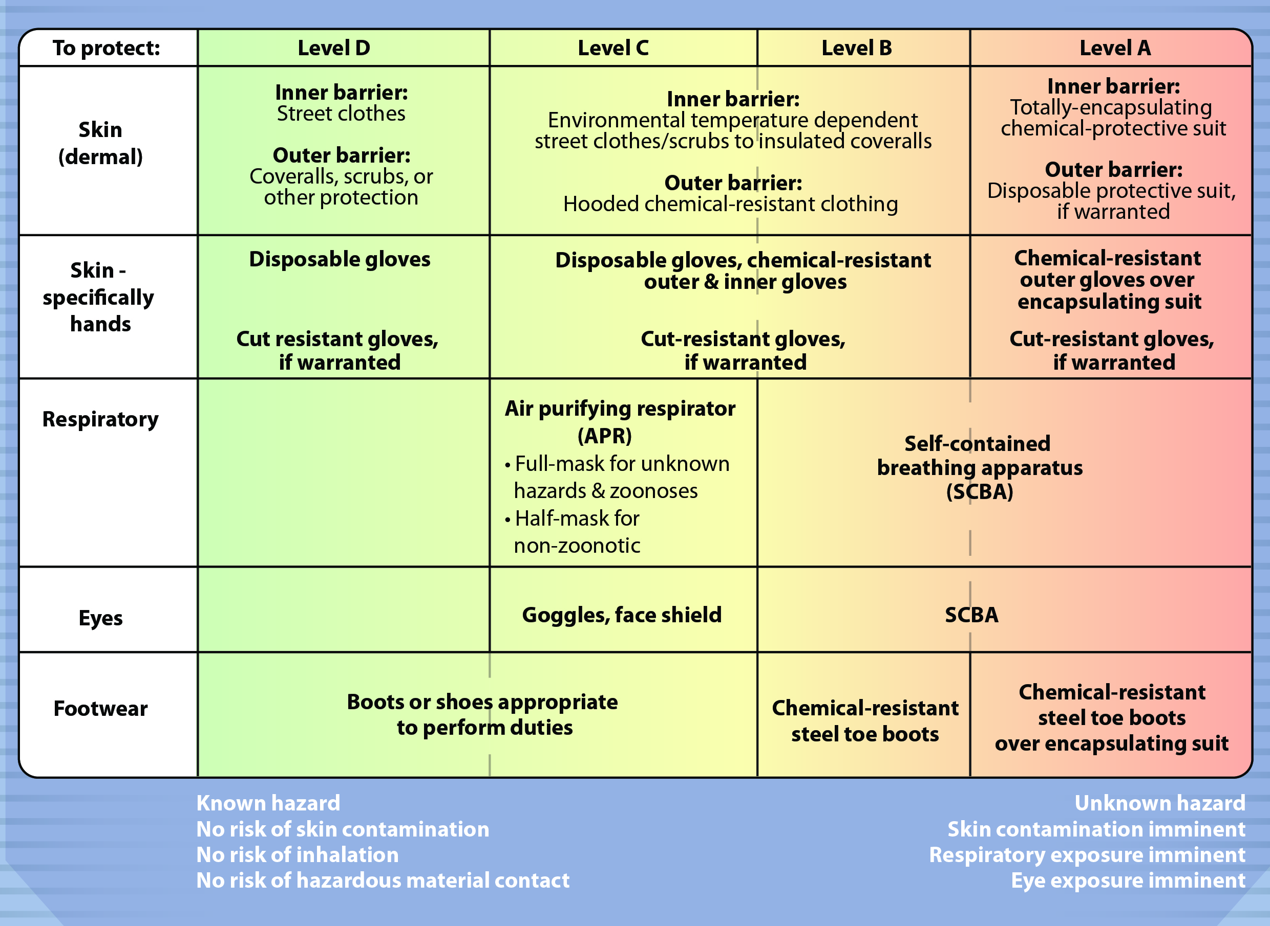
PPE Levels
Notes:
As stated previously, the Occupational Safety and Health Administration (OSHA) classifies PPE into four levels of protection. The levels range from D (lowest level of protection) to A (highest level). This table lists the four levels of PPE protection and the equipment appropriate to provide that level of protection. A basic familiarity with all levels of PPE protection will expedite onsite training in an actual animal health emergency. [This chart illustrates the protective equipment based on PPE level. Illustration by: Andrew Kingsbury, Iowa State University]

Slide 22
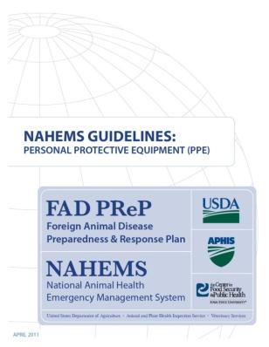
For More Information
FAD PReP/NAHEMS Guidelines & SOP: Personal Protective Equipment (2011)
  http://www.aphis.usda.gov/animal_health/emergency_management/
Personal Protective Equipment web-based training module
  http://naherc.sws.iastate.edu/
Notes:
More details can be obtained from the sources listed on the slide, available on the USDA website (http://www.aphis.usda.gov/animal_health/emergency_management/) and the NAHERC Training Site (http://naherc.sws.iastate.edu/).

Slide 23

Guidelines Content
Authors (CFSPH)
Janice Mogan, DVM
Gayle B. Brown, DVM, PhD
Elizabeth Wormley, Junior Veterinary Student
Reviewers (USDA)
Peter A. Petch, RPIH, CIPS,
CIMT, CHS-V
Stephen Goff, DVM
Notes:
This slide acknowledges the authors and reviewers of the Guidelines document.

Slide 24
Acknowledgments
Development of this presentation was by the Center for Food Security and Public Health at Iowa State University through funding from the USDA APHIS Veterinary Services
PPT Authors: Dawn Bailey, BS; Kerry Leedom Larson, DVM, MPH, PhD, DACVPM
Reviewers: Glenda Dvorak, DVM, MS, MPH, DACVPM; Patricia Futoma, Veterinary Student;
Janice Mogan, DVM
Notes:
Information provided in this presentation was developed by the Center for Food Security and Public Health at Iowa State University College of Veterinary Medicine, through funding from the US Department of Agriculture, Animal and Plant Health Inspection Service, Veterinary Services.

