Slide 1
Personal Protective Equipment
Overview
Adapted from the FAD PReP/NAHEMS
Guidelines: Personal Protective Equipment (2011)
Notes:
Veterinary responders are needed in emergency situations that threaten animal health, such as the natural occurrence or intentional introduction of a highly contagious foreign animal disease. This presentation will provide an overview of Personal Protective Equipment (PPE) utilized in an animal disease emergency. The considerations for selection and use of PPE are dependent on the specific situation. It is the responsibility of the veterinary responder to understand the required PPE and use it correctly. [This information was derived from the Foreign Animal Disease Preparedness and Response (FAD PReP)/National Animal Health Emergency Management System (NAHEMS) Guidelines: Personal Protective Equipment (2011) and also the web-based training module.]

Slide 2
This Presentation
Clarify what is meant by “PPE”
Purpose of PPE
Hazard assessment, control and
cost-benefit analysis
PPE education and training
PPE selection based on risk
Notes:
This presentation will clarify what is meant by “Personal Protective Equipment.” In addition, it will also cover the purpose of PPE in an animal disease emergency, hazard assessment, hazard control, cost-benefit analysis, PPE education and training, and PPE selection based on risk. In an animal disease emergency such as an FAD outbreak, PPE has two important purposes: to protect the responder from potential hazards, and to prevent the spread of disease agents. For PPE to be effective, it is important that it is properly selected and implemented. Additional presentations addressing these issues in greater detail are also are available.

Slide 3
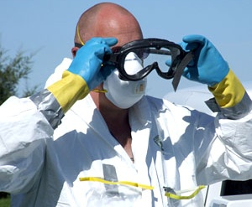
What is PPE?
Special clothing and equipment places a barrier between an individual and a hazard
Protects the body
  Eyes, ears, face, head
  Hands and feet
  Respiratory protection
National Veterinary
Stockpile
Notes:
The phrase “personal protective equipment,” or PPE, refers to special clothing and equipment designed to act as a barrier between an individual and a hazard that could cause injury. The primary purpose is to protect the responder from harm. PPE protects the body, such as coveralls and high visibility reflective vests, and includes protection for the eyes, ears, face, and head, such as goggles, face shields, and ear plugs. Items of PPE also protect the hands and feet. Respiratory protection is provided by a variety of respirators, chosen based on the hazard. The National Veterinary Stockpile (NVS), maintained by the National Center for Animal Health Emergency Management (NCAHEM) through USDA APHIS, is the nation’s repository of veterinary countermeasures and commercial support services. PPE is included in the inventory to be deployed in an emergency animal disease outbreak. [This photo shows a veterinarian wearing a variety of PPE: a tear-resistant suit, a disposable respirator, and chemical-resistant gloves. He is also putting on goggles. Photo source: Travis Engelhaupt, Iowa State University]

Slide 4
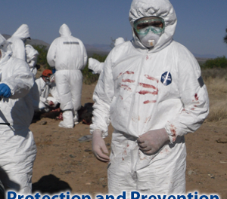
Purpose of PPE
In an animal disease emergency PPE:
  Protects responders from potentially harmful hazards
  Prevents spread
  of hazards between
  animals or locations
Notes:
As mentioned, in an animal disease emergency, personal protective equipment serves two purposes:
To protect the responder against potentially harmful hazards, such as zoonotic diseases or chemical exposures.
To prevent the spread of disease agents between animals and locations.
The proper selection and use of PPE serves as a biosecurity tool to help isolate a pathogen, protecting the responder, the animals, and the public. PPE must be used, decontaminated, and disposed of properly to serve these purposes. These purposes must be taken into consideration when selecting PPE for a disease emergency. [This photo shows a veterinary responder in a hooded Tyvek suit with an air purifying respirator. Photo Source: John Wenzel, New Mexico State University]

Slide 5
Hazard Assessment
Notes:
Personal protective equipment is essential for protecting a responder from a hazard and preventing the spread of disease agents. However, there are many things to consider and understand before PPE is selected and used.

Slide 6
Hazard Assessment
Evaluate risk of hazard exposure
Proper selection/management of PPE
  Biological
  Chemical
  Environmental
Poor PPE selection may result in:
  Enhanced risk of disease spread
  Impaired job performance
  Risk of injury, illness, or death
Notes:
The risk of exposure to hazards must be assessed before the appropriate safety measures and PPE can be implemented. The hazard assessment is used to evaluate the nature of the health risk and its relationship to the work environment, the biosecurity risks, and type of protection needed. All potential hazards must be assessed in order to choose appropriate PPE to protect responders. Consider the biological threats of the animal disease, potential chemical exposures, and risks posed by the tasks and the working environment. Selecting PPE unsuited to the hazards of the work environment may result in:
Enhanced risk of spreading the disease;
Impaired job performance; and
Most importantly, risk of responder injury, illness, or death.

Slide 7
Hazard Assessment
Risk assessment establishes:
  Composition, magnitude of hazard
  Length of time PPE will perform at known level of protection
  Exertion level, extent of physical work to be performed while wearing PPE
Performed by Incident Commander or Safety Officer
Notes:
It is necessary to properly match the type and degree of risk with the selection of a given protective measure. The first step in making this match is to conduct a thorough risk assessment. An effective risk assessment establishes:
The composition and magnitude (or concentration) of the biological and/or physical hazard;
The length of time the equipment or device will be expected to perform at a known level of protection; and
The exertion level and extent of the physical work to be performed while using the equipment.
Based on the information provided by the risk assessment, the Incident Commander (IC) and/or Safety Officer (SO) can make educated decisions and take the appropriate actions to ensure responder safety during a response.

Slide 8
Hazard Controls
Notes:
Personal protective equipment may be essential for protecting a responder from a hazard. However, there are many things to consider and understand before PPE is selected and used. It is also essential to prevent, reduce, or eliminate the responder’s exposure to a hazard, and not rely only on PPE. Let us take a look at several different methods. The Occupational Safety and Health Administration (OSHA) requires the use of PPE to reduce employee exposure to hazards when engineering and administrative controls and work practices are not feasible or effective in reducing these exposures to acceptable levels.

Slide 9
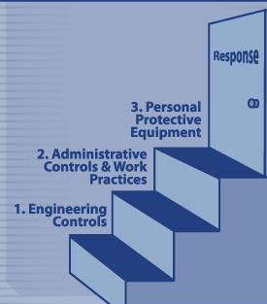
Hazard Controls
PPE is not a first line of defense
Initial steps to eliminate hazards must be taken first
  Engineering controls
  Administrative controls and work practices
Notes:
Personal protective equipment is not the first line of defense for a responder. It is imperative to reduce or eliminate hazards within the environment to prevent responder exposure, first. Two different steps to eliminate hazards are:
Engineering controls; and
Administrative controls and work practices.
[This illustration depicts the steps that can help eliminate the hazard BEFORE PPE is implemented. Illustration by: Andrew Kingsbury, Iowa State University]

Slide 10
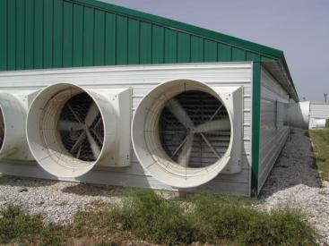
Hazard Controls
Engineering controls
  Contain or remove a hazard through:
    Isolation
    Enclosure
    Ventilation
    Substitution
  Prevent or reduce responder exposure
Notes:
Engineering controls are measures that contain or remove a hazard through isolation, enclosure, ventilation, substitution, or other process changes. These controls isolate or decrease the hazard in the environment, and prevent or reduce the responder’s exposure. An example of engineering control is local exhaust ventilation. An exhaust ventilation system controls responder exposure to a hazardous substance at the source, and operates effectively without direct responder involvement. [This is a photo of an exhaust fan removing harmful gasses from the building. Photo source: Alex Ramirez, Iowa State University]

Slide 11
Hazard Controls
Administrative controls
  Regulate responders’ exposure to hazards through:
    Initiated policies
    Directives
    Other measures
  Example: Responders exposure to a hazard is limited to less than length of work shift
Notes:
Administrative controls refer to administratively initiated policies, directives, or other measures that regulate responders’ exposure to a hazard. An example of administrative control is limiting the time of hazard exposure to less than a work shift, or reduction in the number of responders in a hazardous area. APHIS has developed an emergency deployment Health and Safety Plan (HASP) Template to help personnel who are responsible for the safety and health of responders in an animal health emergency response quickly develop a specific plan to protect them.

Slide 12
Hazard Reduction Training
Implement training to reduce hazard exposure
IC determines when a hazardous situation must be entered
  Need for animal health personnel varies according to the emergency type
  Less likely to respond to chemical or radiological emergency
Must be aware of your role
Notes:
Providing responders with training to reduce hazard exposure is part of a responder safety program. The assignment of personnel to respond in an animal disease emergency is situation specific. The Incident Commander (IC) will determine when it is necessary for animal health responders to enter a hazardous situation. In a chemically or radiologically hazardous situation, for example, specially trained responders and/or the appropriate State Emergency Management Agencies—rather than agricultural personnel—typically would provide emergency response leadership. Although agricultural personnel might serve as valuable resources, especially if the situation involved animal care or other aspects of agriculture, their role would be advisory and their exposure to the chemical or radiological hazard may be prevented or minimized. In addition, safety training includes information concerning the event and the responder’s role. Awareness and exposure-reduction strategies related to hazards in the environment, the tasks to be performed, and risks associated with the use of PPE are covered.

Slide 13
Cost-Benefit Analysis
Hazard control measures based on:
  Need, feasibility, efficacy
  Benefits of protecting human health
  Total costs of PPE
If PPE is deemed too costly, responders will not enter the hazardous area or perform work
Notes:
The selection of hazard control measures should be based on the need for hazard deduction and the feasibility and efficacy of the control. A cost-benefit analysis can help authorities determine which types of PPE and devices are a sound investment as a means of hazard control. The benefits of effectively protecting human health and preventing the spread of disease should weigh heavily in the analysis. It is also important to recognize that the initial cost of PPE program start-up represents only a fraction of the total maintenance expense of continuing a PPE program operation over time. An example of such expense is seen in the fixed costs of equipment, plus maintenance, repair, and replacement. These expenditures, often significant, are essential to maintaining the effectiveness of the operation. In most cases, however, the time, effort, and expense involved in administering an effective and comprehensive PPE program are amply justified. If the PPE is deemed too costly, then responders should not be allowed to enter or perform work in the hazardous area.

Slide 14
PPE Education and Training
Notes:
Thorough training of administrators and responders in the use of PPE will also help reduce hazard exposure. To be successful, a PPE training program must have the full participation and commitment of supervisors who administer it and the personnel it’s designed to protect.

Slide 15
PPE Education and Training
Training on PPE use reduces responder hazard exposure
Effective training programs combine multiple approaches
  Cognitive, affective, applied
Remember, PPE is only effective when it is worn and used properly!
Notes:
Responders must be sufficiently knowledgeable and confident in the use of PPE so that even in stressful situations (e.g., involving compromised PPE) their training will help keep them safe. Training programs should include an optimal mix of cognitive (information-based), affective (attitudinal), and applied (laboratory practice) approaches. A comprehensive training program is critical in ensuring responders understand how to wear PPE appropriately thus providing optimal protection when working. Some PPE is of simple design, and its use is easy to learn. The apparent design simplicity of some PPE, however, may result in an attitude of complacency regarding training and its use.
Personal protective equipment is effective only when it is actually taken out of the box or storage container and worn or used properly!

Slide 16
PPE Education and Training
PPE training programs should include:
  Role of PPE and benefits of use
  Precautions and limitations of PPE
  Recognizing signs of cold/heat stress
  Appropriate PPE selection
  Importance of proper fitting
Notes:
A comprehensive PPE training program should include the following topics:
The role of PPE as one among several hazard-control methods;
The benefits of PPE use in a hazardous situation and the consequences of unprotected exposure to a hazard;
The precautions and limitations of PPE, particularly in emergency situations, and possible ways to overcome these limitations – such as donning multiple sets of gloves in case an outer pair is breached;
Recognizing the signs of overheating or cold stress and how to respond;
Selection of appropriate PPE for various hazardous situations, with clear explanations of how the PPE protects against these hazards; and
The importance of properly fitting PPE and the basic criteria for a proper fit.

Slide 17
PPE Education and Training
PPE training programs should include:
  Donning, doffing, and the buddy system
  Detection of damaged/broken PPE
  Sourcing of physicians/locations that can manage zoonotic diseases
  Stress-management techniques
  Decontamination, storage, maintenance, and disposal
Notes:
A comprehensive PPE training program should also include:
Techniques for donning, respirator seal-checking, wearing, and doffing of PPE properly, as well as the use of the buddy system in cooperative completion of tasks;
Recognition of damaged or failed PPE and the importance of retreating to a clean area to remove and replace damaged PPE;
Methods of minimizing adverse consequences of PPE failure;
Identification of local health facilities with the personnel and equipment required to effectively evaluate exposure to and illness from zoonotic diseases;
Stress-management techniques; and
Techniques for safely decontaminating, storing, maintaining, disposing, and repairing PPE.

Slide 18
PPE Selection
Based on Risk
Notes:
The complex process of PPE selection for management of disease exposure and spread must include consideration of the zoonotic and biosecurity risks of the agent in the absence of PPE. Diseases that are transmissible between animals and humans are referred to as zoonotic. The action taken to prevent the spread of disease to other animals or locations is referred to as biosecurity. The zoonotic and biosecurity risks can be divided into low, moderate, and high risks.

Slide 19
PPE Selection
Zoonotic risk
  Low: little/no risk to human health
  Moderate: non-life-threatening risk
  High: life-threatening risk
Biosecurity risk
  Low: non-contagious or vector-borne
  Moderate: contagious, low survival
  High: highly contagious, high survival
Notes:
The zoonotic risk is
Low when a disease agent represents little or no danger to human health;
Moderate when a disease agent represents non–life-threatening danger to human health; and
High when a disease agent is life-threatening and represents significant danger to human health.
For more detailed information on zoonotic diseases, see the Centers for Disease Control and Prevention web site, http://www.cdc.gov/nczved/.
The biosecurity risk is based on the survivability of the agent outside the live host. The biosecurity risk is
Low when a disease agent is non-contagious or vector-borne (spread by the bite of an insect or arachnid);
Moderate when a disease agent is contagious but does not survive outside the host; and
High when a disease agent is highly contagious and survives outside the host.

Slide 20
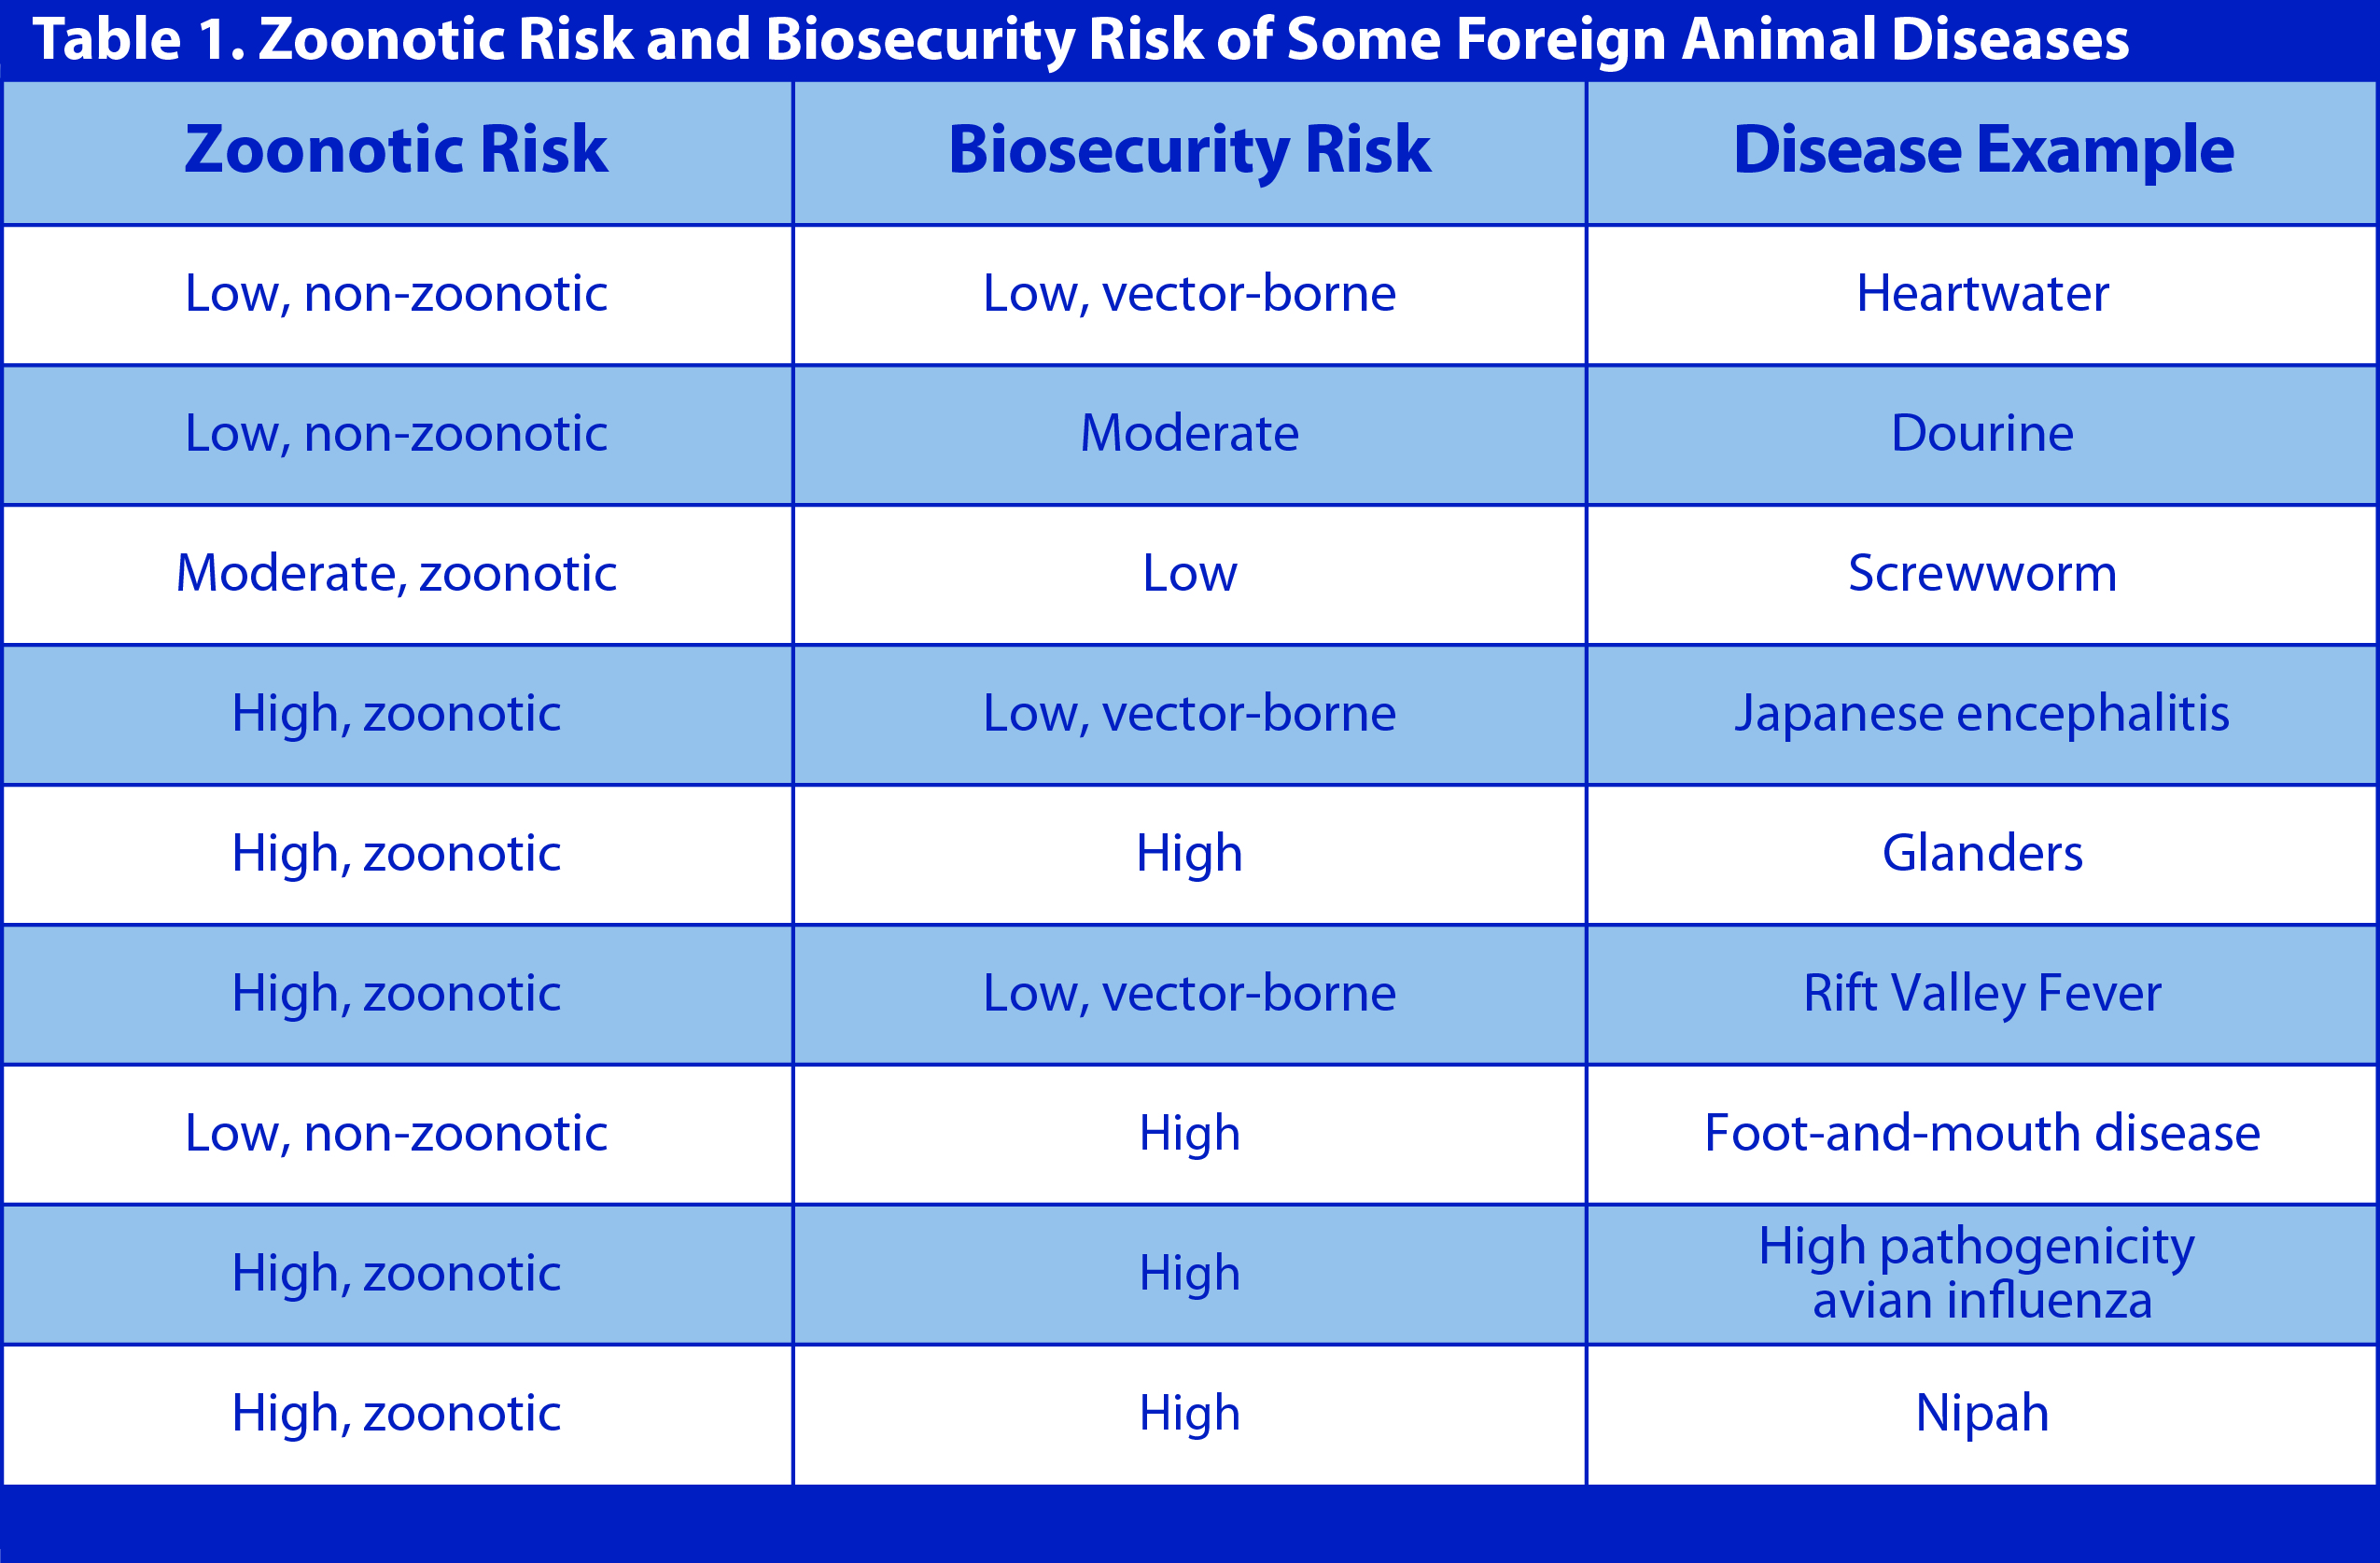
PPE Selection
Notes:
This table illustrates the zoonotic risk and the biosecurity risk of some examples of foreign animal diseases. Be aware that with some diseases, the major source of disease transmission between animals may be by vector, creating a low biosecurity risk. However, if zoonotic, responders may risk exposure to the disease agent in tissues through diagnostic sampling or necropsy. [This table illustrates the zoonotic risk and biosecurity risk of some foreign animal diseases. Illustration by: Katlyn Harvey, Iowa State University]

Slide 21
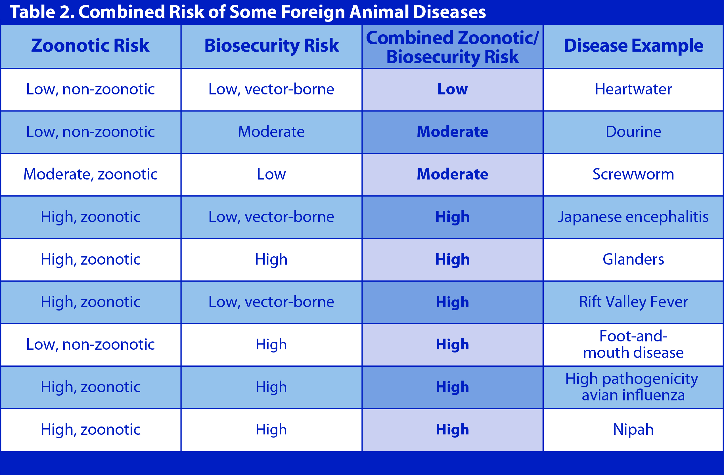
PPE Selection
Notes:
The Incident Commander and Safety Officer need to consider both types of risks in the hazard assessment. A risk category can be determined based on a combination of zoonotic (transmission to humans) and biosecurity (transmission to other animals) risk. Where the zoonotic risk of a disease is greater than its biosecurity risk, zoonotic risk takes precedence. The appropriate PPE and protective measures are based on the category of risk as well as specific factors about the disease. For zoonotic diseases, the potential method of exposure is also considered. This is especially true with the degree of respiratory protection needed. Table 2 illustrates risk categories based on the zoonotic risk as well as the biosecurity risk of example diseases. [This table illustrates the combined zoonotic and biosecurity risk of some foreign animal diseases. Illustration by: Katlyn Harvey, Iowa State University]

Slide 22
Additional PPE Factors
PPE selection must consider:
  Tasks assigned
  Exertion level, extent of physical work
  Temperature, humidity, and time worn
  Classification of premises
Many things to consider, but preparation and training are essential to a safe and successful response
Notes:
In addition to the zoonotic and biosecurity risks, other factors influence the selection of PPE veterinary responders should wear. These include
Tasks that individuals must perform such as surveillance, depopulation, disposal, and cleaning and disinfection;
Exertion levels and the extent of physical work at a premises;
Ambient temperature, relative humidity, and the length of time PPE must provide a specific level of protection; and
Classification of the premises.
In summary, there are many things to consider when trying to minimize risks and provide a safe and successful work environment for veterinary responders. Preparation and training are essential to a safe and successful response.

Slide 23
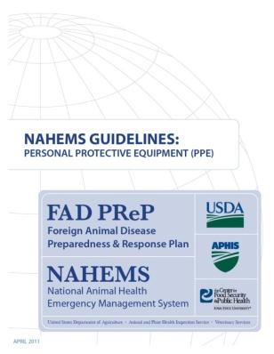
For More Information
FAD PReP/NAHEMS Guidelines & SOP: Personal Protective Equipment (2011)
  http://www.aphis.usda.gov/animal_health/emergency_management/
Personal Protective Equipment web-based training module
  http://naherc.sws.iastate.edu/
Notes:
More details can be obtained from the sources listed on the slide, available on the USDA website (http://www.aphis.usda.gov/animal_health/emergency_management/) and the NAHERC Training Site (http://naherc.sws.iastate.edu/).

Slide 24

Guidelines Content
Authors (CFSPH)
Janice Mogan, DVM
Gayle B. Brown, DVM, PhD
Elizabeth Wormley, Junior Veterinary Student
Reviewers (USDA)
Peter A. Petch, RPIH, CIPS,
CIMT, CHS-V
Stephen Goff, DVM
Notes:
This slide acknowledges the authors and reviewers of the Guidelines document.

Slide 25
Acknowledgments
Development of this presentation was by the Center for Food Security and Public Health at Iowa State University through funding from the USDA APHIS Veterinary Services
PPT Authors: Dawn Bailey, BS; Kerry Leedom Larson, DVM, MPH, PhD, DACVPM
Reviewers: Glenda Dvorak, DVM, MS, MPH, DACVPM; Patricia Futoma, Veterinary Student;
Janice Mogan, DVM
Notes:
Information provided in this presentation was developed by the Center for Food Security and Public Health at Iowa State University College of Veterinary Medicine, through funding from the US Department of Agriculture, Animal and Plant Health Inspection Service, Veterinary Services.

