Slide 1
Mass Depopulation
& Euthanasia
Swine Euthanasia
Adapted from the FAD PReP/NAHEMS
Guidelines: Mass Depopulation and Euthanasia (2015)
Notes:
The purpose of this presentation is to describe general methods and techniques that might be selected for euthanasia of swine during an animal health emergency. This information was derived from the Foreign Animal Disease Preparedness and Response (FAD PReP)/National Animal Health Emergency Management System (NAHEMS) Guidelines: Mass Depopulation and Euthanasia (2015).

Slide 2
Euthanasia and Depopulation
Euthanasia
  Transitioning painlessly and stress-free as possible
Mass Depopulation
  Large numbers, quickly and efficiently
  Consideration to welfare as practicable
  Terms used interchangeably here
Notes:
It is important to understand that USDA APHIS recognizes a difference between euthanasia and depopulation. Euthanasia involves transitioning an animal to death as painlessly and stress-free as possible. Mass depopulation is a method by which large numbers of animals must be destroyed quickly and efficiently with as much consideration given to the welfare of the animals as practicable. However, for the purposes of this document, the terms mass depopulation and euthanasia may be used interchangeably or simply be referred to as “euthanasia,” regardless of whether they are actually considered euthanasia or depopulation.

Slide 3
Euthanasia and Depopulation
May be practiced during an animal health emergency
Goals of Euthanasia
  Provide humane treatment
  Select acceptable method
  Minimize negative emotional impact
  Safeguard food chain
  Prevent or mitigate disease spread
Notes:
Euthanasia and depopulation may be practiced during an animal health emergency, such as a major disease outbreak or a foreign animal disease (FAD), to help prevent or mitigate the spread of the disease through the elimination of infected, exposed, or potentially exposed animals. It also serves to remove contaminated livestock from the food supply, protect the nation‘s agricultural and national economy, and safeguard public health. The overall goals of euthanasia are to: provide humane treatment of animals at all times until they are euthanized; select and use an acceptable method of depopulation/euthanasia to be executed as quickly, efficiently, and humanely as possible; minimize the negative emotional and psychological impact on animal owners, caretakers, and the public; prevent adulterated or potentially adulterated meat products from entering the food chain; and prevent or mitigate disease spread in the event of the introduction of a FAD within the U.S.

Slide 4
Handling
Goal: Humane Treatment
  Decrease animal stress, excitement
  Do not force animals to travel quickly
  Avoid electric prods
    Sorting boards
    Human body position
    Flight zones
    Flags and plastic paddles
  Handle animals quietly
Notes:
One of the overall goals in conducting euthanasia is to provide humane treatment of animals at all times until they are euthanized. Decreasing stress and excitement during movement and handling will ultimately increase swine welfare and increase human safety and efficiency. From a practical standpoint, as well as a humane consideration, swine must not be forced to travel faster than normal walking speed. The use of electric prods must be kept to an absolute minimum. Instead of electric prods or whips, use moveable partitions as well as sorting boards, flags, plastic paddles, or sticks with plastic ribbons attached to them as much as possible to move animals. Animals handled in a rough or hurried manner will become excited, making further handling unnecessarily difficult. As a humane consideration, and if human safety will not be compromised, non-ambulatory or disabled animals should be euthanized where they are and moved to the disposal site after death.

Slide 5
General Handling
Flight Zone, Point of Balance, Blind Spot
Notes:
Animal handlers should be trained to use behavioral principles such as flight zone and point of balance to make moving and handling the animal much easier, safer and less stressful. In general, an animal will turn towards the handler and will be inclined to stop moving when the handler is standing outside the flight zone (position A in the illustration), and will move away when the handler steps into the flight zone (position B). Invading an animal's flight zone too deeply can result in unpredictable behavior and possible injury to both the handler and animal. The size of the flight zone varies depending on the animal’s temperament and the extent of past handling. Most species have blind spots directly behind their shoulders where an animal may not see a handler, causing the animal to be startled. These are principles that can be applied to many species, not just the pig. [This illustration depicts a pig’s flight zone. Illustration source: Transportation Quality Assurance, National Pork Board]

Slide 6
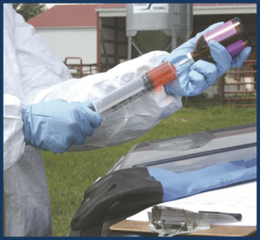
Acceptable Methods
Acceptable: noninhalant injectable
Acceptable for all
classes of pigs
    Barbiturates
    Barbituric acid
    derivatives
Notes:
Acceptable and conditionally acceptable methods of euthanasia have been outlined in the American Veterinary Medical Association (AVMA) Guidelines for the Euthanasia of Animals: 2013 Edition. For swine, the AVMA has stated that the use of non-inhalants such as injectable barbiturates or barbiturate derivatives are acceptable means of euthanasia for all classes of pigs. Although these procedures may need to be adapted for field conditions, they should be followed as closely as possible. [This photo shows chemical euthanasia being drawn up in a single use-syringe. Photo source: Andrew Kingsbury, Iowa State University]

Slide 7
Conditionally Acceptable Methods
Physical
  Captive bolt
    Penetrating- mature and grower-finisher
    Non-penetrating- nursery, suckling
  Gunshot (mature, grower-finisher)
  Electrocution (mature, grower-finisher, nursery, suckling >10 lbs)
  Blunt force trauma (suckling pigs)
  Inhaled agents
Notes:
Conditionally acceptable methods of euthanasia have been outlined in the AVMA Guidelines for the Euthanasia of Animals: 2013 Edition. Conditionally acceptable methods of euthanasia for swine include physical methods such as a penetrating captive bolt or gunshot for mature or grower/finisher swine. The use of a purpose built non-penetrating captive bolt is also acceptable for nursery pigs less than 70 pounds and for suckling pigs. Electrocution is also appropriate for all classes of pigs including suckling pigs over 10 pounds. Although blunt force trauma is approved for suckling pigs, it is not likely for mass euthanasia and depopulation. Inhaled agents are also conditionally acceptable methods for mature, grower-finisher, and nursery pigs.

Slide 8
Adjunct Methods
If primary euthanasia fails, personnel should be prepared to apply an adjunct measure such as:
  Pithing
  Exsanguination
  Second shot
Notes:
If the primary euthanasia measure fails to cause rapid death, personnel should be prepared to immediately apply an adjunct measure. A second gunshot or application of the captive bolt is an acceptable adjunct method. The AVMA has also listed the pithing and exsanguination. Pithing could also be employed to ensure rapid death and prevent the possibility of a stunned animal regaining consciousness. Exsanguination is also an approved option but may present significant biosecurity risks since the disease of interest may be blood borne. With the exception of the second shot, these methods must only be used on swine that are already stunned.

Slide 9
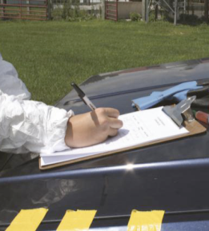
Chemical Agents
Usually impractical
  Individual handling/restraint
  Expensive
  Carcass disposal
  Recordkeeping
May be used if
animal is hand-raised
Notes:
The use of injectable euthanasia agents, although very effective, is a less practical mass euthanasia method for swine since the process requires a veterinarian to perform each euthanasia, and it entails prolonged individual handling and restraint. In addition, this method is comparatively expensive and may make carcass disposal a hardship. Unless a Drug Enforcement Agency (DEA) unscheduled product (e.g. T-61) is made available, the adoption of a protocol utilizing injectable euthanasia agents in swine is unlikely. Even if carcass disposal were not an issue, the necessary recordkeeping and special requirements of scheduled substances is a strong deterrent to using this method during an animal health emergency. Injectable products are much more practical for use on small swine than adults because restraint problems are minimal in young animals. Injectable products might be considered when animal numbers are few or animals have been hand-raised (e.g., 4-H projects); particularly when the owner of a hand-raised animal insists on being present during euthanasia. [Careful records must be maintained when using controlled substances. Photo source: Center of Food Security and Public Health, Iowa State University]

Slide 10
Chemical Agents
Major drawbacks
  Volume of agent required
  Difficulty of suitable venous access
  Carcass disposal issues
  Prolonged restraint time needed
Notes:
Major drawbacks of using injectable euthanasia agents in swine include the large volume of euthanasia solution required, the relative difficulty of suitable venous access, and the potential carcass disposal issues of animals containing barbiturates or other anesthetic agents. For chemical euthanasia in animals over 100 lbs it is strongly suggested that euthanasia solution be injected into the anterior vena cava. This technique requires training and practice, and the potential for inadvertent extravascular administration of the agent is high. The prolonged restraint period may not be practical or safe in some field settings.

Slide 11
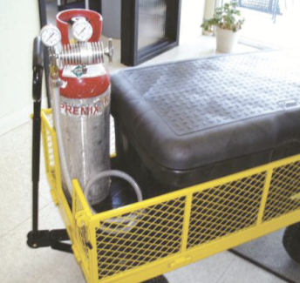
Physical- Carbon Dioxide
Protocols under development
Endorsed for smaller swine
  Up to 70lbs (32kg)
Impractical for
larger animals/farms
Safety of personnel
  Training
  Equipment
Notes:
Carbon dioxide (CO2) can be used to euthanize swine. Protocols are currently being developed for on-farm mass depopulation of swine using CO2 gas. The National Pork Board and American Association of Swine Veterinarians endorse CO2 for smaller swine (i.e., weighing up to 70 lbs or 32 kg) and have provided detailed guidelines for euthanasia. The weight limitation is applied because euthanasia of larger animals with CO2 is not typically practical in a farm situation. This euthanasia method requires purchase or construction of special equipment and containers designed to handle swine. Although the skill level required of personnel to euthanize swine with CO2 is low to moderate, human fatalities are still possible. Personnel must be provided with appropriate safety training. Suitable respirator equipment (e.g., a self-contained breathing apparatus and oxygen equipment) should be available on site. All equipment must be used according to guidelines established by the Safety Officer. [This photo shows a homemade CO2 chamber used to euthanize piglets. Photo source: Scanlon Daniels, Circle H LLC]

Slide 12
Physical- Captive Bolt
Use appropriate restraint
Methods
  Young pigs
    Firm holding, body sling
    Lifting with two contact points
  Larger pigs
    Center-line conveyor
    Snaring individually
Notes:
Euthanasia of swine by means of a penetrating captive bolt is both humane and efficient. Animals must be properly restrained to minimize potential for improper stunning or human injury. For suckling and younger nursery pigs, they can be restrained by firmly and securely holding them, using a body sling, or lifting them using a two points of contact (such as one hand on their leg and one on their flank). Larger pigs can be restrained using specific restraining systems such as a center-line conveyor or snaring individually.

Slide 13
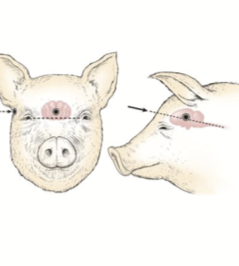
Aiming Captive Bolt
Pigs <300 lbs
  Middle of forehead; 0.5-1 in. above eyes
Mature pigs: sows, boars
  Adjust target area
  Use correct size bolt,
  charge
Adjunct method
on hand
Notes:
Correctly aiming the penetrating captive bolt is essential. For pigs weighing less than 300 pounds, the penetrating captive bolt should be placed firmly against the skull and directed at the midline of the forehead and half an inch above the eyes, even with the eyebrows. Aim the bolt at the brain and direct the bolt toward the tail. For more mature pigs with a thicker skull structure, adjust the targeted point of entry to about an inch above the eyebrow line. Move the target slightly to one side of the skull ridge. If time permits, it is advisable to draw landmarks to increase efficacy of placement, as illustrated at right. There are significant differences between skulls of growing and adult swine; therefore, it is important to use an appropriate sized bolt to ensure penetration for larger sows and boars. Breed differences may make proper placement more challenging. Different charges are required depending on bolt length. Refer to the operating manual for information about charge for the particular captive bolt being utilized. Many variables can affect the energy a captive bolt imparts to the skull to produce unconsciousness or death in an animal. An adjunct method of euthanasia (e.g., exsanguination or pithing) is recommended to ensure death if traditional captive bolts are used. Preliminary research indicates that for the captive bolts no adjunct methods are indicated if the correct combination of muzzle and cartridges of penetrating captive bolts are utilized. [This illustration shows the proper aiming point for a captive bolt or gunshot euthanasia in swine. Photo source: JK Shearer, Iowa State University]

Slide 14
Single Step Captive Bolt
Under development
Euthanizes in one step
Interchangeable captive bolts for different size animals
  Various lengths, thicknesses, charges
Notes:
A new era of penetrating captive bolts has been developed and, when used correctly, these produce enough damage to the brain including the brain stem they can be used as a single-step euthanasia device. These new captive bolts systems have several interchangeable captive bolts with varying lengths and thicknesses as well as several cartridges of varying strengths. The correct combination of captive bolt size and cartridge are determined based on pig size, age, and type. See the FAD PReP Guidelines: Mass Depopulation and Euthanasia for more information.

Slide 15
Non-Penetrating Captive Bolt
Lethal concussive trauma
Up to 12 lbs – primary euthanasia
Up to 70 lbs – use with adjunct step
  Lethal concussive trauma
  Positioning same as captive bolt
Not recommended >70 lbs
Notes:
Non-penetrating captive bolt devices deliver a lethal blow through concussive trauma. The placement of the device on the animal’s skull is identical to the placement used for traditional penetrating captive bolts. This method is approved for use on nursery pigs up to 70 pounds, with the use of an adjunct step such as pithing or exsanguination. Non-penetrating captive bolts are not recommended for euthanasia of pigs over 70 pounds due to increased skull thickness.

Slide 16
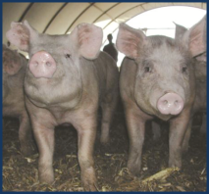
Captive Bolt: Effects
Immediate collapse, postural rigidity, gradual relaxation
Involuntary kicking and paddling
Insensible pigs:
  Lack corneal reflex
  No deliberate movement
  No rhythmic breathing
If in doubt: re-stun, adjunct method
Notes:
Use of a captive bolt device, whether penetrating or non-penetrating, typically produces immediate collapse followed by a period of postural rigidity and then gradual relaxation. Often, correctly “bolted” pigs will have a period of involuntary kicking and paddling. Pigs that are rendered insensible should demonstrate signs such as lack of a corneal reflex, no deliberate movements, and no rhythmic breathing. If there is doubt as to whether a pig is insensible, the animal should be immediately re-stunned or an adjunct euthanasia method should be applied. [This photo shows young swine in a typical hoop building. Photo source: Alex Ramirez, Iowa State University]

Slide 17
Physical- Gunshot
Trained, experienced personnel
  Follow safety guidelines
At close range, same point of entry as captive bolt
  Muzzle NEVER in contact with head
  Mature animal skulls may be more difficult to penetrate
  Use appropriate ammunition
Notes:
Due to the potential for uncontrolled incidents, the use of gunshot with species-appropriate ammunition is a conditionally acceptable, rather than acceptable, method of euthanasia for swine under the AVMA’s guidelines. Only personnel with the appropriate skills, training, and experience in gunshot should perform the procedure. Safety guidelines jointly developed and agreed to by local law enforcement and the Safety Officer should be strictly followed. The preferred gunshot ammunition for swine is a slug, due to reduced chance for ricochet, lack of stray shot, and improved accuracy and consistency. In the case of firearms used at close range, the aiming point for entrance of the projectile is the same as for the penetrating captive bolt. The operator should be aware that the swine brain is located very high when considering the total mass of the skull. Persons unfamiliar with the anatomy of the swine skull should receive instruction with sectioned swine heads. When used at close range to place a bullet through the brain of an animal, the firearm should NEVER be placed in contact with the head of the animal. Position the muzzle of the firearm 2-10 inches from the intended entry point. Large or aged adult swine typically have very thick skulls that may be difficult to penetrate with some projectiles. Thus, it is critical to use projectiles specifically engineered for extreme penetrating ability to avoid human injury or unnecessary animal suffering.

Slide 18
Physical- Gunshot (cont’d)
Long range gunshot generally unacceptable
If necessary
  Point of entry between eye and base of ear
  Do not target chest, neck
Risk of free bullets and human injuries
Notes:
It is generally unacceptable to use firearms to kill swine at a distance farther than a few feet from the firearms operator. This method may be considered in very unusual and unique circumstances. If it is necessary to use a firearm to kill swine at long range, an aiming point is located half way between the eye and the base of the ear. This can be dangerous because the projectile may have sufficient energy to exit through the same point on the opposite side of the skull. Thus, the increased likelihood of free bullets and subsequent human injury makes this a hazardous method. As a safety reminder, with the use of firearms for euthanasia, all nonessential personnel should be excluded from the site. Use extreme caution to avoid damage or injury to property or persons in the background beyond the animal.

Slide 19
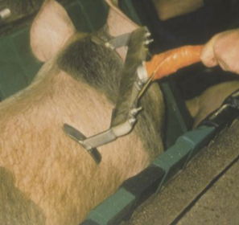
Physical- Electrocution
Method has been successfully used
Stunning and death
  Electric current directly
  through head and heart
  15 seconds to achieve death
Head stunning
  Electrodes on sides of head
  2-3 seconds for proper stun
  Unconscious for 30 sec
  Adjunct method within 15 sec
Notes:
Electrocution was successfully used during the Accelerated Pseudorabies Eradication Program (EPAP) operations and it is also extensively used in the slaughter industry. The USDA is investigating the use of portable high-throughput mass electrocution units designed to simultaneously stun and deliver a lethal charge to swine as they pass under the electrode. Stunning with simultaneous cardiac arrest can be achieved by placing the electrodes on the animal so that the current crosses the brain and heart. This method requires a restraining device so that the animal does not fall away from the electrodes before a complete shock and stun occurs. Current must be applied for 15 seconds to achieve death. Head stunning involves placing electrodes on both sides of the head like earmuffs, or on the forehead. Electrical current must be applied for a full 2-3 seconds for a proper stun. The animal will remain unconscious for up to 30 seconds. Use an appropriate secondary kill method such as exsanguination or captive bolt within 15 seconds to avoid the risk of the animal regaining consciousness. If the head-to-heart method is used, the current must be applied for 15 seconds to achieve death. [This photo shows the proper placement of an electrocution device on a pig. Photo source: Temple Grandin]

Slide 20
Confirmation of Death
Confirmation of death can be difficult
  Sustained lack of heartbeat and respiration
  Rigor mortis
  Evaluate by competent, experienced personnel
Notes:
Following the application of a euthanasia method, death must be confirmed. Lack of a heartbeat and respiration (at least 10 minutes) as well as onset of rigor mortis are indicators that death has occurred. Animals should be evaluated for confirmation of death by competent and experienced personnel.

Slide 21
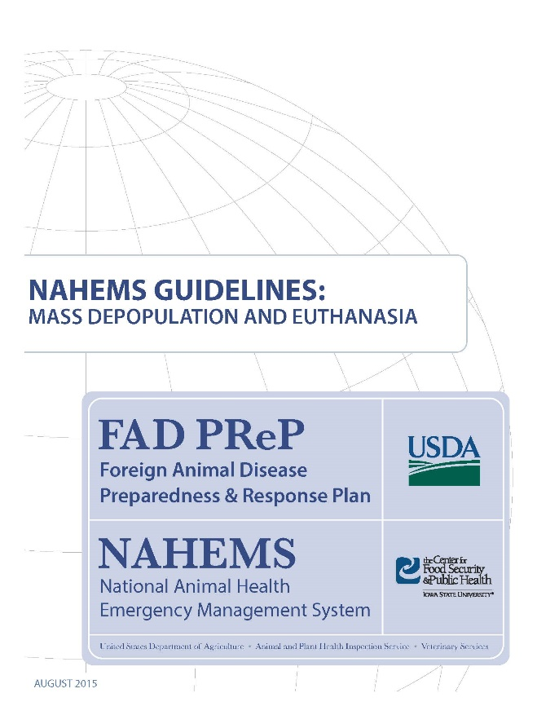
For More Information
FAD PReP/NAHEMS Guidelines: Mass Depopulation and Euthanasia (MDE) (2015)
  http://www.aphis.usda.gov/fadprep
MDE web-based training module
  http://naherc.sws.iastate.edu/
Notes:
More details can be obtained from the sources listed on the slide, available on the USDA website (http://www.aphis.usda.gov/fadprep) and the NAHERC Training Site (http://naherc.sws.iastate.edu/).

Slide 22
Guidelines Content
Authors (CFSPH):
Reneé Dewell DVM,MS
Nichollette Rider, Veterinary Student
Significant contributions to the content were provided by
USDA APHIS VS:
Lori P. Miller, PE
Darrel K. Styles, DVM, PhD
Notes:
This slide acknowledges the authors and those who made a significant contribution to the content of the FAD PReP/NAHEMS Guidelines: Mass Depopulation and Euthanasia document. Please see the Guidelines document for others who also provided additional assistance with content development.

Slide 23
Acknowledgments
Development of this presentation was by the Center for Food Security and Public Health at Iowa State University through funding from the USDA APHIS Veterinary Services
PPT Authors: Dawn Bailey, BS; Kerry Leedom Larson, DVM, MPH, PhD, DACVPM
Reviewers: Glenda Dvorak, DVM, MPH, DACVPM: Cheryl L. Eia, JD, DVM, MPH, Patricia Futoma, BS, Veterinary Student, Reneé Dewell DVM,MS
Notes:
Information provided in this presentation was developed by the Center for Food Security and Public Health at Iowa State University College of Veterinary Medicine, through funding from the US Department of Agriculture, Animal and Plant Health Inspection Service, Veterinary Services.

