Slide 1
Mass Depopulation & Euthanasia
Equine Euthanasia
Adapted from the FAD PReP/NAHEMS Guidelines: Mass Depopulation and Euthanasia (2015)
Notes:
The purpose of this presentation is to describe general methods of equine euthanasia. This information was derived from the Foreign Animal Disease Preparedness and Response (FAD PReP)/National Animal Health Emergency Management System (NAHEMS) Guidelines: Mass Depopulation and Euthanasia (2015).

Slide 2
Euthanasia and Depopulation
Euthanasia
Transitioning painlessly and stress-free as possible
Mass Depopulation
Large numbers, quickly and efficiently
Consideration to welfare as practicable
Terms used interchangeably here
Notes:
It is important to understand that USDA APHIS recognizes a difference between euthanasia and depopulation. Euthanasia involves transitioning an animal to death as painlessly and stress-free as possible. Mass depopulation is a method by which large numbers of animals must be destroyed quickly and efficiently with as much consideration given to the welfare of the animals as practicable. However, for the purposes of this document, the terms mass depopulation and euthanasia may be used interchangeably or simply be referred to as “euthanasia,” regardless of whether they are actually considered euthanasia or depopulation.

Slide 3
Euthanasia and Depopulation
May be practiced during an animal health emergency
Goals of Euthanasia
Provide humane treatment
Select acceptable method
Minimize negative emotional impact
Safeguard food chain
Prevent or mitigate disease spread
Notes:
Euthanasia and depopulation may be practiced during an animal health emergency, such as a major disease outbreak or a foreign animal disease (FAD), to help prevent or mitigate the spread of the disease through the elimination of infected, exposed, or potentially exposed animals. It also serves to remove contaminated livestock from the food supply, protect the nation‘s agricultural and national economy, and safeguard public health. The overall goals of euthanasia are to: provide humane treatment of animals at all times until they are euthanized; select and use an acceptable method of depopulation/euthanasia to be executed as quickly, efficiently, and humanely as possible; minimize the negative emotional and psychological impact on animal owners, caretakers, and the public; prevent adulterated or potentially adulterated meat products from entering the food chain; and prevent or mitigate disease spread in the event of the introduction of a FAD within the U.S.

Slide 4
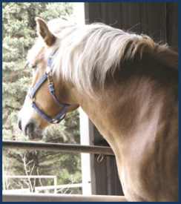
Handling
Goal: Humane Treatment
Decrease animal stress, excitement
Do not force animals to travel quickly
Avoid electric prods, whips
Human body position
Flight zones
Flags
Plastic paddles
Handle animals quietly
USDA APHIS and CFSPH
Notes:
One of the overall goals in conducting euthanasia is to provide humane treatment of animals at all times until they are euthanized. Decreasing stress and excitement during movement and handling will increase equine welfare and increase human safety and efficiency. From a practical as well as a humane consideration, equids must not be forced to travel faster than normal walking speed. The use of whips and prods must be kept to an absolute minimum, i.e. only used when an animal refuses to enter a restrainer or other area. The use of electric prods is not recommended as many horses may react violently to their use, risking injury to themselves and personnel. Instead of electric prods or whips, use moveable partitions as well as hazing with flags, plastic paddles, or sticks with plastic ribbons attached to them as much as possible to move animals. Handle horses and other equids as quietly as possible on non-slip surfaces. Avoid shouting and screaming. Restrain animals in a manner that does not elicit undue risk of injury or pain to themselves or personnel. Animals handled in a rough or hurried manner will become excited, making further handling unnecessarily difficult. As a humane consideration, euthanize non-ambulatory or disabled animals where they are and move them to the disposal site after death. [This photo shows a draft horse looking out of an enclosure. Photo source: Nichollette Rider, Iowa State University]

Slide 5
Sedation
May not be practical in emergency response
May complicate disposal
Methods of sedation
Intravenous
Intramuscular via pole syringe
Notes:
In an emergency response effort, sedation or tranquilization of equines before euthanasia may not be possible due to time constraints. In addition, the use of chemical sedation may complicate carcass disposal. In some cases, such as for particularly fractious horses, sedation may be beneficial. If the horse can be approached safely, an intravenous dose of a tranquilizer may be administered. If a horse cannot be approached safely, a pole syringe can be used to administer an intramuscular agent to provide sedation.

Slide 6
Euthanasia Methods
Acceptable (noninhalant injectable)
Barbiturates
Barbiturate derivatives
Conditionally Acceptable (physical)
Penetrating captive bolt
Gunshot
Adjunct methods
KCL
Notes:
Acceptable and conditionally acceptable methods of euthanasia have been outlined in the American Veterinary Medical Association (AVMA) Guidelines for the Euthanasia of Animals: 2013 Edition. For equids, the AVMA has stated that the use of noninhalants such as injectable barbiturates or bariturate derivatives are acceptable means of euthanasia. Conditionally acceptable methods of euthanasia for equids include physical methods such as a penetrating captive bolt or gunshot. The use of potassium chloride, or KCl, can be used as an adjunct method but only if animal is in determined to be in a surgical plane of anesthesia.

Slide 7
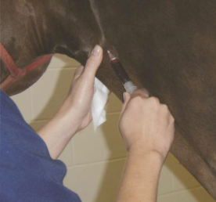
Noninhalant Injectables
Used if animal considered companion
Practical for tractable equines, but slow process
Barbiturates most common
Sedation prior to euthanasia highly recommended
Chemical residue concerns
Notes:
The use of injectable products should be strongly considered when dealing with equids that are considered companion animals. This is particularly true if the owner insists on being present during euthanasia. The sound associated with a gunshot or captive bolt may result in unnecessary emotional distress to the owner. Injectable anesthetics would be practical for tractable equines but the process will be necessarily somewhat slow because it requires individual handling and restraint. In addition, carcass disposal of equines euthanized with injectable agents may be problematic. Major concerns in the use of injectable agents, particularly barbiturates, are the presence of residual chemicals in the carcass which may complicate carcass disposal and the issues of being a controlled substance. Sedation prior to administration of barbiturates is highly recommended. [This photo shows a horse receiving an IV injection. Photo source: Reneé Dewell, Iowa State University]

Slide 8
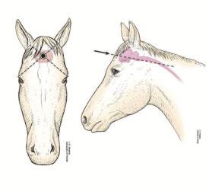
Physical- Captive Bolt
Appropriate restraint
Sedate animals as needed
Ensure proper bolt position
Bolt Position
Place flat against forehead
45° angle from horizontal
Have adjunct measure available
Notes:
Use of a penetrating captive bolt with adequate restraint is considered humane and an acceptable method to euthanize equines according to AVMA guidelines. Adequate restraint is critical in order to ensure operator safety and accuracy in bolt placement. Sedate fractious equines prior to euthanasia if at all possible. On equines, the point of entry for the penetrating captive bolt is at the intersection of two imaginary lines drawn from the base of the ear to the lateral canthus of the opposite eye. It is advisable to draw the point using a livestock marker to increase precision of the captive bolt, but this may be impractical in a large scale depopulation effort. The end of the penetrating captive bolt device should be placed firmly but gently flat on the forehead of the animal so that the bolt is aimed toward the foramen magnum. With the head of the animal in a normal postural position, the captive bolt gun will be at approximately a 45º angle to the horizontal. When properly administered, an extended length penetrating captive bolt is usually fatal. An adjunct method such as KCL should be available. The point of entry as illustrated here is the same for a free bullet, but euthanasia by gunshot has significant differences as discussed on the next slide. [This illustration shows the proper aiming point for a captive bolt or gunshot euthanasia in a horse. Photo source: JK Shearer, Iowa State University]

Slide 9
Physical- Gunshot
Conditionally acceptable
Species-appropriate ammunition, appropriate caliber weapon
Proper training, skills, experience
At close range, same point of entry as captive bolt
Muzzle should not contact head
USDA APHIS and CFSPH
Notes:
The use of gunshot is considered a conditionally acceptable, rather than an acceptable, method of equine euthanasia under the AVMA Guidelines because of the potential for human injury. Gunshot may be considered a less desirable form of euthanasia for horses due to their companion animal status and reaction to gunshot. When using firearms at close range, the anatomical site for entrance of the projectile is the same as for the penetrating captive bolt. For safety reasons it is imperative that the trajectory of the bullet should be such that it travels through the brain and down the neck in order to minimize the chance of the bullet exiting the animal. When using a firearm at close range to place a bullet through the brain of an animal, the firearm should NEVER be placed in contact with the head of the animal. Position the muzzle of the firearm 2-10 inches from the intended entry point. As a safety reminder, with the use of firearms for euthanasia, all nonessential personnel should be excluded from the site. Use extreme caution to avoid damage or injury to property or persons in the background beyond the animal.

Slide 10
Adjunct Methods
If primary euthanasia measure fails to cause rapid death, adjunct measure must be applied
Examples for equids include:
IV KCl solution
IV narcotics
Pithing
Notes:
If the primary euthanasia measure fails to cause rapid death, then an adjunct measure must be immediately applied. The AVMA has listed the injection of a saturated solution of potassium chloride either IV or intracardially. Though not specifically recommended, an overdose of narcotics (disposal and control issues must be addressed), or pithing could also be employed to ensure rapid death and prevent the possibility of a stunned animal regaining consciousness. These methods must only be used on equids in a deep surgical plane of general anesthesia.

Slide 11
Confirmation of Death
Confirmation of death can be difficult
Sustained lack of heartbeat and respiration
Rigor mortis
Evaluate by competent, experienced personnel
Notes:
Following application of the euthanasia technique, a veterinarian or technician will need to verify death by brief examination. Lack of a heartbeat and respiration (at least 10 minutes) as well as onset of rigor mortis are indicators that death has occurred. Animals should be evaluated for confirmation of death by competent and experienced personnel.

Slide 12
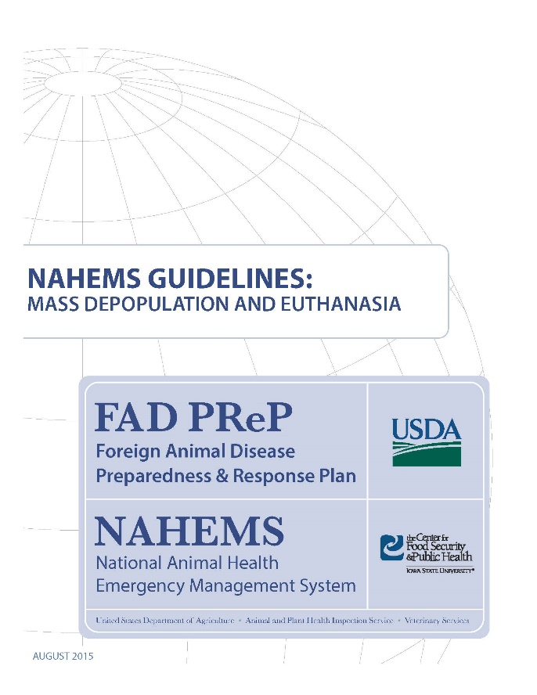
For More Information
FAD PReP/NAHEMS Guidelines: Mass Depopulation and Euthanasia (MDE) (2015)
http://www.aphis.usda.gov/fadprep
MDE web-based training module
http://naherc.sws.iastate.edu/
Notes:
More details can be obtained from the sources listed on the slide, available on the USDA website (http://www.aphis.usda.gov/fadprep) and the NAHERC Training Site (http://naherc.sws.iastate.edu/).

Slide 13
Guidelines Content
Authors (CFSPH):
Reneé Dewell DVM,MS
Nichollette Rider, Veterinary Student
Significant contributions to the content were provided by USDA APHIS VS:
Lori P. Miller, PE
Darrel K. Styles, DVM, PhD
Notes:
This slide acknowledges the authors and those who made a significant contribution to the content of the FAD PReP/NAHEMS Guidelines: Mass Depopulation and Euthanasia document. Please see the Guidelines document for others who also provided additional assistance with content development.

Slide 14
Acknowledgments
Development of this presentation was by the Center for Food Security and Public Health at Iowa State University through funding from the USDA APHIS Veterinary Services
PPT Authors: Dawn Bailey, BS; Kerry Leedom Larson, DVM, MPH, PhD, DACVPM
Reviewers: Glenda Dvorak, DVM, MPH, DACVPM: Cheryl L. Eia, JD, DVM, MPH, Patricia Futoma, BS, Veterinary Student, Reneé Dewell DVM,MS
Notes:
Information provided in this presentation was developed by the Center for Food Security and Public Health at Iowa State University College of Veterinary Medicine, through funding from the US Department of Agriculture, Animal and Plant Health Inspection Service, Veterinary Services.

