Slide 1
Mass Depopulation & Euthanasia
Bovine Euthanasia
Adapted from the FAD PReP/NAHEMS Guidelines: Mass Depopulation and Euthanasia (2015)
Notes:
This purpose of this presentation is to outline general methods of bovine euthanasia that may be appropriate during a response to an animal health emergency. This information was derived from the Foreign Animal Disease Preparedness and Response (FAD PReP)/National Animal Health Emergency Management System (NAHEMS) Guidelines: Mass Depopulation and Euthanasia (2015) .

Slide 2
Euthanasia and Depopulation
Euthanasia
Transitioning painlessly and stress-free as possible
Mass Depopulation
Large numbers, quickly and efficiently
Consideration to welfare as practicable
Terms used interchangeably here
Notes:
It is important to understand that USDA APHIS recognizes a difference between euthanasia and depopulation. Euthanasia involves transitioning an animal to death as painlessly and stress-free as possible. Mass depopulation is a method by which large numbers of animals must be destroyed quickly and efficiently with as much consideration given to the welfare of the animals as practicable. However, for the purposes of this presentation, the terms mass depopulation and euthanasia may be used interchangeably or simply be referred to as “euthanasia,” regardless of whether they are actually considered euthanasia or depopulation.

Slide 3
Euthanasia and Depopulation
May be practiced during an animal health emergency
Goals of Euthanasia
Provide humane treatment
Select acceptable method
Minimize negative emotional impact
Safeguard food chain
Prevent or mitigate disease spread
Notes:
Euthanasia and depopulation may be practiced during an animal health emergency, such as a major disease outbreak or a foreign animal disease (FAD), to help prevent or mitigate the spread of the disease through the elimination of infected, exposed, or potentially exposed animals. It also serves to remove contaminated livestock from the food supply, protect the nation‘s agricultural and national economy, and safeguard public health. The overall goals of euthanasia are to: provide humane treatment of animals at all times until they are euthanized; select and use an acceptable method of depopulation/euthanasia to be executed as quickly, efficiently, and humanely as possible; minimize the negative emotional and psychological impact on animal owners, caretakers, and the public; prevent adulterated or potentially adulterated meat products from entering the food chain; and prevent or mitigate disease spread in the event of the introduction of a FAD within the U.S.

Slide 4
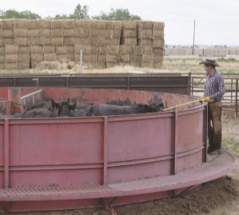
Handling
Goal: Humane Treatment
Decrease animal stress, excitement
Do not force animals to travel quickly
Avoid electric prods
Human body position
Flight zones
Flags
Plastic paddles
Handle animals quietly
Notes:
One of the overall goals in conducting euthanasia is to provide humane treatment of animals at all times until they are euthanized. Decreasing stress and excitement during movement and handling will increase bovine welfare and increase human safety and efficiency. In large-scale depopulation efforts conveyors will likely be used to deliver cattle efficiently to captive-bolting stations. The use of the conveyors will reduce stress and increase efficiency of euthanasia activities. Conveyors may be modified to create a tunnel electrocution system. If a conveyor system is not used, euthanasia personnel will move the cattle to the restrainer. Do not force cattle to travel faster than normal walking speed. Keep the use of electric prods to an absolute minimum, i.e. only used when an animal refuses to enter a holding pen, restrainer or other area. Instead of electric prods or sticks, use human body position and flight zones as well as flags or plastic paddles or sticks with plastic ribbons attached to move animals. Handle cattle as quietly as possible on non-slip surfaces. Restrain animals in a manner that does not elicit injury or undue pain. Animals handled in a rough or hurried manner will become excited, making further handling unnecessarily difficult. As a humane consideration, euthanize non-ambulatory or disabled animals where they are and move them to the disposal site after death. [This photo shows appropriate use of a livestock chute to move cattle. Photo source: Reneé Dewell, Iowa State University]

Slide 5
Euthanasia Methods
Acceptable (noninhalant injectable)
Barbiturates
Barbiturate derivatives
Conditionally Acceptable (physical)
Penetrating captive bolt
Gunshot
Electrocution
Notes:
Acceptable and conditionally acceptable methods of euthanasia have been outlined in the American Veterinary Medical Association (AVMA) Guidelines for the Euthanasia of Animals: 2013 Edition. For cattle, the AVMA has stated that the use of noninhalants such as injectable barbiturates or barbiturate derivatives are acceptable means of euthanasia. Conditionally acceptable methods of euthanasia for cattle include physical methods such as a penetrating captive bolt or gunshot. Electrocution, although not recommended by the AVMA, is a euthanasia method that is currently being considered for euthanasia during an animal health emergency.

Slide 6
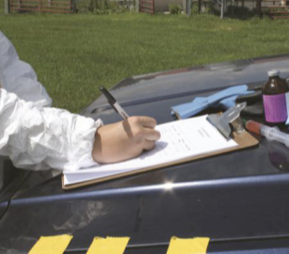
Noninhalant Injectable
Usually impractical
Slow process
Expensive
Carcass disposal
Recordkeeping
May be used if animal is considered to be pet/companion
Notes:
The use of injectable anesthetics (noninhalants) is usually impractical, even for very small numbers of cattle. The process will be necessarily slow because it requires prolonged individual handling and adequate restraint. In addition, this method is comparatively expensive and may make carcass disposal a hardship. Even if carcass disposal were not an issue, the required record keeping and special requirements of scheduled substances are strong deterrents to using this method for euthanasia during an animal health crisis. For livestock considered by the owner to be a pet or companion, the use of injectable products may be considered, particularly when the owner insists on being present during euthanasia. [This photo shows records being maintained when using controlled substances. Photo source: Center of Food Security and Public Health, Iowa State University]

Slide 7
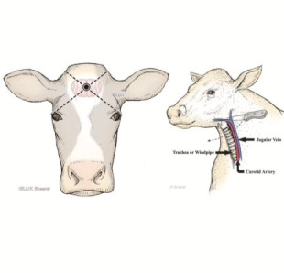
Physical- Captive Bolt
Fatal blow in one procedure
Use appropriate restraint
Have adjunct measure available
Bolt positions
Horned animal
Developed horned base
Polled animal
Notes:
Euthanasia of bovids by means of a penetrating captive bolt is both humane and efficient. Appropriate restraint must be used to ensure that the method is also safe for personnel. In a depopulation setting, this method will employ a modern extended captive bolt device in an attempt to deliver a fatal blow with one procedure. An adjunct measure must be available to ensure that the animal is humanely destroyed if the use of the captive bolt fails to produce near-immediate death. In a horned bovid, the ideal site for entry of a captive bolt is at the intersection of two lines each drawn from the lateral canthus (or back of the eye) to the base of the opposite horn, as shown in the illustration on the slide. In an animal with a developed horn base, the line should originate from the center of the horn base. In a polled animal, closely estimate the anatomical site where the horn base would be present and draw a line from that point to the opposite lateral canthus (back of eye). If time permits, it is recommended that this reference point be drawn onto the head of the animal using a livestock-marking crayon or paint to increase the probability of proper bolt placement. Firmly place the muzzle of the penetrating captive bolt device flat against the forehead of the animal so that the bolt is aimed toward the foramen magnum which is equivalent to aiming the bolt along the animal‘s spine in the neck region. The point of entry as illustrated here is the same for a free bullet, but euthanasia by gunshot has significant differences as discussed on the next slide. [This illustration shows the appropriate aiming point for captive bolt gun or gun in a bovine. Photo source: JK Shearer, Iowa State University]

Slide 8
Physical- Gunshot
Conditionally acceptable
Species-appropriate ammunition, appropriate caliber weapon
Proper training, skills, experience
Close range, same point of entry as captive bolt
Muzzle 2-10 inches from entry point
In older animals, avoid midline
Move aiming point 1 inch to either side
Notes:
According to AVMA Guidelines, the use of gunshot with species-appropriate ammunition and weapons of the appropriate caliber is considered a conditionally acceptable, rather than an acceptible, method of euthanasia for bovids. Gunshot should be performed only by personnel with the appropriate skills, training, and experience. Safety guidelines jointly developed and agreed to by local law enforcement and the Safety Officer should be strictly followed. Consider the application of silencers to firearms whenever possible to reduce noise and associated stress for both animals and people. For firearms used at close range, the point of entry for the projectile is identical to that just described for a penetrating captive bolt. Do not place the firearm in contact with the head of the animal when using a firearm at close range. Some automatic handguns will not discharge if any pressure is put on the muzzle of the weapon. Excess gas and particles will exit between the cylinder and barrel of revolvers if the muzzle is obstructed by placing it against the animal’s head, possibly resulting in serious human injury. Position the muzzle of the firearm 2-10 inches from the intended entry point on the bovine‘s head. In mature cattle and bulls, ossification of the skull may deflect some projectiles, decreasing the efficacy of the method and increasing the hazard to personnel. For these animals, it is desirable to move the aiming point an inch to either side of the midline while maintaining the path of the projectile toward the foramen magnum.

Slide 9
Physical- Gunshot (cont’d)
Gunshot at long range generally unacceptable
If necessary
Aim between eye and base of ear
Do not target chest or neck region
Safety reminder!
Notes:
It is generally unacceptable to use firearms to kill bovines at a distance farther than a few feet from the firearm’s operator. However, gunshot at a distance may have to be used in some circumstances such as feedlots, rangeland, or when animals are stranded due to flooding. A protocol is currently being developed to use firearms to euthanize cattle at an estimated distance of 30 feet. If long range use of a firearm becomes necessary to kill cattle which cannot be restrained or otherwise handled, an aiming point half way between the eye and the base of the ear may be used. The projectile’s path should cause it to exit through the same point on the opposite side of the skull if the projectile has sufficient energy. Do not target the chest or neck region. As a safety reminder, with the use of firearms for euthanasia, all nonessential personnel should be excluded from the site. Use extreme caution to avoid damage or injury to property or persons in the background beyond the animal.

Slide 10
Electrocution
Not practical field method for bovines
Animal handling is difficult
If used:
Tranquilize or sedate first
Electric current through brain to stun
Ear to ear, poll to muzzle
Electric current through heart
Sides of animal over heart
Notes:
With current technology, electrocution would be very difficult, and potentially dangerous, to apply to the bovine species as a method of euthanasia in the field. The amount of handling necessary to use this method on individual adult bovids makes this an unwieldy technique that should only be considered if there is no other practical method available. Personnel who administer this form of euthanasia are advised to tranquilize or sedate each bovid before attempting to attach the electrodes for euthanasia. The electrodes must be positioned to ensure that the electric current passes directly through the brain to achieve stunning. This can be accomplished either by positioning the electrodes from ear to ear or from poll to muzzle. After stunning, the electrodes would be repositioned to pass current through the heart and produce fibrillation. The electrodes would be positioned on the sides of the animal over the heart or on the anterior and posterior portions of the body. Development of an electrocution tunnel using a center-line conveyor to efficiently and humanely move animals is being currently being considered. If successfully developed, electrocution will be a much more feasible method to euthanize cattle during an animal health emergency.

Slide 11
Adjunct Methods
Second shot
IV potassium chloride or magnesium sulfate
Pithing
Exsanguination
Notes:
If the primary euthanasia measure fails to cause rapid death, personnel should be prepared to immediately apply an adjunct measure. A second gunshot or application of the captive bolt is an acceptable adjunct method. The AVMA has also listed the IV injection of a saturated solution of potassium chloride or magnesium sulfate. Pithing could also be employed to ensure rapid death and prevent the possibility of a stunned animal regaining consciousness. Exsanguination is also an approved option but may present significant biosecurity risks since the disease of interest may be blood borne. Pithing could also result in aerosolizing brain tissue (potential Transmissible Spongiform Encephalopathy [TSE] exposure). The fourth method listed here, exsanguination, is not suited to the environment of a mass depopulation setting due to the potential for spreading infectious material, polluting the site, and creating a slipping hazard for responders.

Slide 12
Confirmation of Death
Confirmation of death can be difficult
Sustained lack of heartbeat and respiration
Rigor mortis
Evaluate by competent, experienced personnel
Notes:
Following the application of a euthanasia method, death must be confirmed. Lack of a heartbeat and respiration (at least 10 minutes) as well as onset of rigor mortis are indicators that death has occurred. Animals should be evaluated for confirmation of death by competent and experienced personnel.

Slide 13
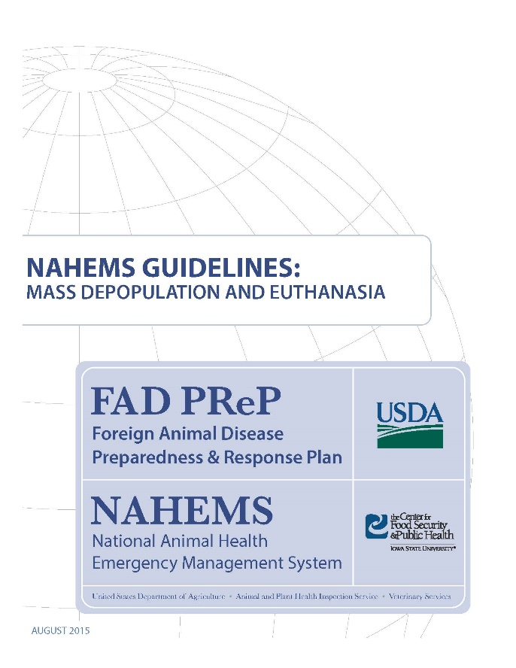
For More Information
FAD PReP/NAHEMS Guidelines: Mass Depopulation and Euthanasia (MDE) (2015)
http://www.aphis.usda.gov/fadprep
MDE web-based training module
http://naherc.sws.iastate.edu/
Notes:
More details can be obtained from the sources listed on the slide, available on the USDA website (http://www.aphis.usda.gov/fadprep) and the NAHERC Training Site (http://naherc.sws.iastate.edu/).

Slide 14
Guidelines Content
Authors (CFSPH):
Reneé Dewell DVM,MS
Nichollette Rider, Veterinary Student
Significant contributions to the content were provided by USDA APHIS VS:
Lori P. Miller, PE
Darrel K. Styles, DVM, PhD
Notes:
This slide acknowledges the authors and those who made a significant contribution to the content of the FAD PReP/NAHEMS Guidelines: Mass Depopulation and Euthanasia document. Please see the Guidelines document for others who also provided additional assistance with content development.

Slide 15
Acknowledgments
Development of this presentation was by the Center for Food Security and Public Health at Iowa State University through funding from the USDA APHIS Veterinary Services
PPT Authors: Dawn Bailey, BS; Kerry Leedom Larson, DVM, MPH, PhD, DACVPM
Reviewers: Glenda Dvorak, DVM, MPH, DACVPM: Cheryl L. Eia, JD, DVM, MPH, Patricia Futoma, BS, Veterinary Student, Reneé Dewell DVM,MS
Notes:
Information provided in this presentation was developed by the Center for Food Security and Public Health at Iowa State University College of Veterinary Medicine, through funding from the US Department of Agriculture, Animal and Plant Health Inspection Service, Veterinary Services.

