Slide 1
What you didn’t know you needed to know about USAS Onboarding!!
January 2020

Slide 2
A new hire isn’t a surprise visitor from out of town:
Plan for each person’s arrival
Notes:
Our BPI team looked at the APHIS onboarding process – its existing state and ways it might be better.
At a minimum, we want to ensure that new hires don’t arrive to an empty cube and start to forage through corridors in search of a computer and the bare necessities of office life.

Slide 3
Touch Points in the Process
Discussion of the Selection with Staffing Specialist
Receipt of the Tentative Selection Notice (TSN) email
Receipt of the Fingerprint email
Receipt of Suitability Determination email
Discussion of the Entry on Duty (EOD) Date with Staffing
Receipt of the Official Offer email
Receipt of the Day One/Benefits email
Tracking entries in eTracker
Notes:
There are many places in the process where Non MRPBS HR people have an opportunity to know what’s happening in the process. During the recruitment consultation (but really at any phase of the process) customers can talk to their servicing HR Staffer and ask that they are included as CC’s for all the notifications distributed in the USAS Onboarding process.
Notification Contacts within eTracker need to be identified at the time the SF52 is being created and authorized.

Slide 4
Fingerprint Requirement
In an effort to align the requirements of the two factor authentication (2FA) with our new APHIS employees, there have been some changes in the Onboarding process and Hiring Managers are key to the success of this process.
HRD will set the EOD date and issue the Final Offer Letter ONLY AFTER the Tentative Selection Notice (TSN) has been accepted, the Information Security Awareness (ISA) test is finished, all onboarding documents (including official transcripts and any required medical screening/drug testing) are received, a fingerprint Special Agency Check (SAC) is completed and a favorable suitability determination has been made.
Completion of these steps prior to the entry on duty date (EOD) ensures that the New Hire can receive their eAuthentication and their Linc Pass within the 30 day grace period allowed by ITD.
Notes:
Please!!!
Help your New Hires navigate the fingerprinting process. You should have a stock of fingerprint cards AND you should know what police stations or electronic Live Scan locations are nearest to you. The delays in obtaining and submitting fingerprint cards simply result in a delay in getting your New Hire onboard.

Slide 5
Each New Hire may be Different
Recruitment Process may be Different
Competitive Hire – Announce & Apply through USA Jobs
Excepted Hire or Limited Appointment Hire – there is no announcement or application thru USA Jobs
Internal movement within Team/Program/Agency
Fingerprinting Options may be Different
Ability to use the Live Scan machines if located near MD/DC or MN or IA or NC or CO
There is no cost to the New Hire
Must provide fingerprint cards and send to local Police Station or UPS or TSA Office
Often there is a cost for fingerprinting
Fingerprints are on file because of employment with another Agency
Use of the automated Onboarding Application may be Different
Permanent Full Time New to the Government Hires, Transfers & Students typically use Onboarding
Temporary, Term, Intermittent, Seasonal may not use the Onboarding Application
Employees moving internally within their own Program or Agency may receive the Official Offer only
IT Process for requesting Equipment & Network access may be Different by Agency
Notes:
There are many factors that determine HOW a new hire will ultimately come into our Agencies. No two New Hires may have exactly the same experience. All of the items on this slide identify potential differences in experiences for the New Hire.
If you have any questions about the tasks your specific New Hire has to accomplish, please talk to your servicing HR Staffer

Slide 6
Hiring Manager’s Role - Pre-Boarding
Obtain Fingerprints (two sets)
Send Fingerprint Cards & HRO 1197 to HR PSS in Minneapolis
Request Equipment
Configuration can occur once the New Hire’s AD account is enabled
Submit the Network Access form to ITD
Submit a 30 day PIV Exception Request via the Service Now Portal
Confirm Medical Screening or Drug Testing is Completed
Notes:
These are the roles the Hiring Manager/Hiring Office/Selecting Official or Supervisor has in the Pre-Boarding Process

Slide 7
Hiring Manager’s Role – Week One
Confirm with the New Hire that they have received and responded to the registration email messages coming from eAuthentication and HSPD12 (Linc Pass)
The eAuth message will come from eems.support@ocio.usda.gov Employees need to follow the instructions in the message to Register their account
The Linc Pass message will come from HSPD12Admin@usaccess.gsa.gov Employees need to make an appointment to Enroll at nearest Enrollment Station
Ensure that the New Hire has the equipment needed to perform their duties
Provide the New Hire the time needed to complete their e-QIP (electronic Questionnaire for Investigation Processing)
Notes:
In the New Hire’s first work week – please check in with them often to ensure they have what they need to perform the work you hired them to do.
Within their first work week – they should have received their eAuthentication Invitation and their Linc Pass enrollment message via Email. If they have not – reach out to HRD or ITD
eQIP typically doesn’t happen in the first week – but we wanted to include it as when the New Hire gets that message, they will require ample time to complete the questionnaire and we wanted Hiring Managers to know that it is a requirement for Federal employment.
If the New Hire doesn’t respond in 30 days the Supervisor is notified of the non compliance
If the New Hire doesn’t respond in the next 30 days, the Supervisor and the Deputy Administrator are notified of the non compliance
If the New Hire doesn’t respond in the next 30 days, Employee Relations and the Administrator’s Office are notified of the non compliance and removal actions may be started

Slide 8
Human Resources Operations (HRO) Role
Establish an EOD date after all documents have been returned & suitability has been determined
Provide ITD the required information to establish a Government email upon receipt of the ISA completion certificate
Process the Personnel Action Request (PAR) within 7 days of the New Hire’s Entry on Duty date
Sponsor and Adjudicate the New Hire for their Linc Pass
Update AgLearn with the New Hire’s ISA completion date if they took the course through the Public Portal
Notes:
These are the tasks that Human Resources will perform

Slide 9
Onboarding Business Process Improvement
The APHIS Administrator’s Office requested a BPI group consisting members from all Programs be formed to look at the Onboarding process, especially how employees are handled from Day One through their first year.
Supervisory Responsibilities (Resource Guides, Checklists, POC Listings, Creation of Additional Materials to be included in FHRM Training)
New Employee Resources (Points of Contact, Checklists, etc.)
Day One Orientations
APHIS wide materials will need to be supplemented with Program/District/State/Lab specific information
Offboarding
Intermediate Leadership Development Program (ILDP) has a project looking at PPQ Onboarding
https://www.aphis.usda.gov/aphis/ourfocus/business-services/new_employee_orientation/before-you-start
https://help.usastaffing.gov/NewHire/index.php?title=Welcome_New_Hire
Notes:
There have been and continue to be initiatives around onboarding being carried out within the Agencies

Slide 10
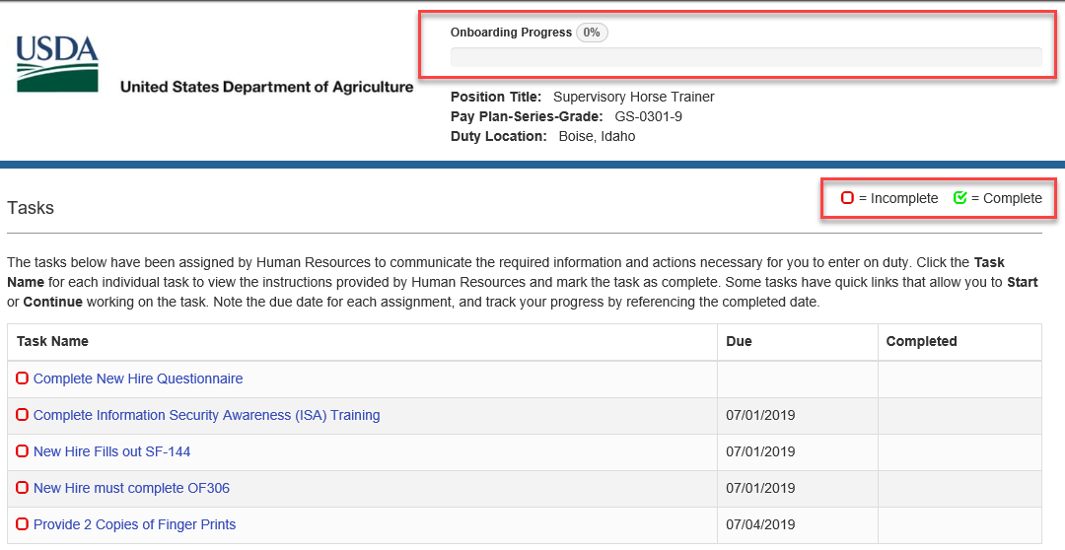
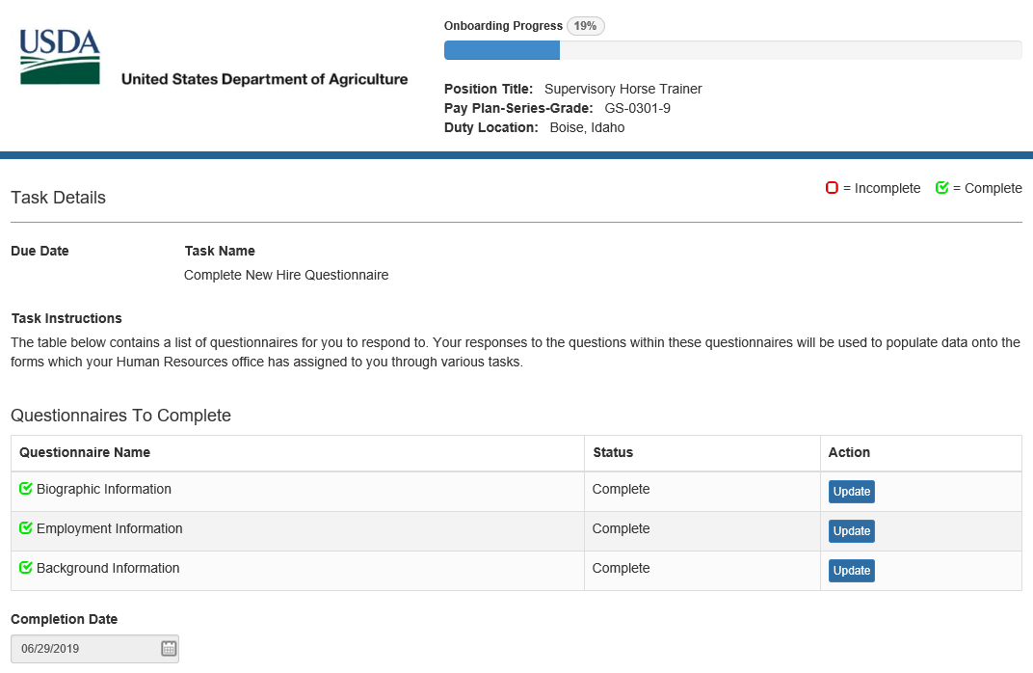
Questionnaires drive what information is populated on the forms.
You must return to the questionnaires in order to change any information on a form
New Hire has a To Do List
Clicking on each one will display more information.
Completion Dates will appear and the red around the task will turn green when completed
Notes:
Here is what USAS Onboarding looks like for the New Hire
On the left – this shows the To Do List for the New Hire. There are Incomplete (red) and Complete (green) tasks for them to do. At the top they can see a progress bar
On the right – this is what the “Complete New Hire Questionnaire” looks like for the New Hire. Similar to Turbo Tax – the New Hire answers a series of questions that are stored and populated on the appropriate forms. If a New Hire needs to make a change to an answer on a Form – just like Turbo Tax – they can not make that on the form. They MUST return to the Questionnaire and update the response there

Slide 11
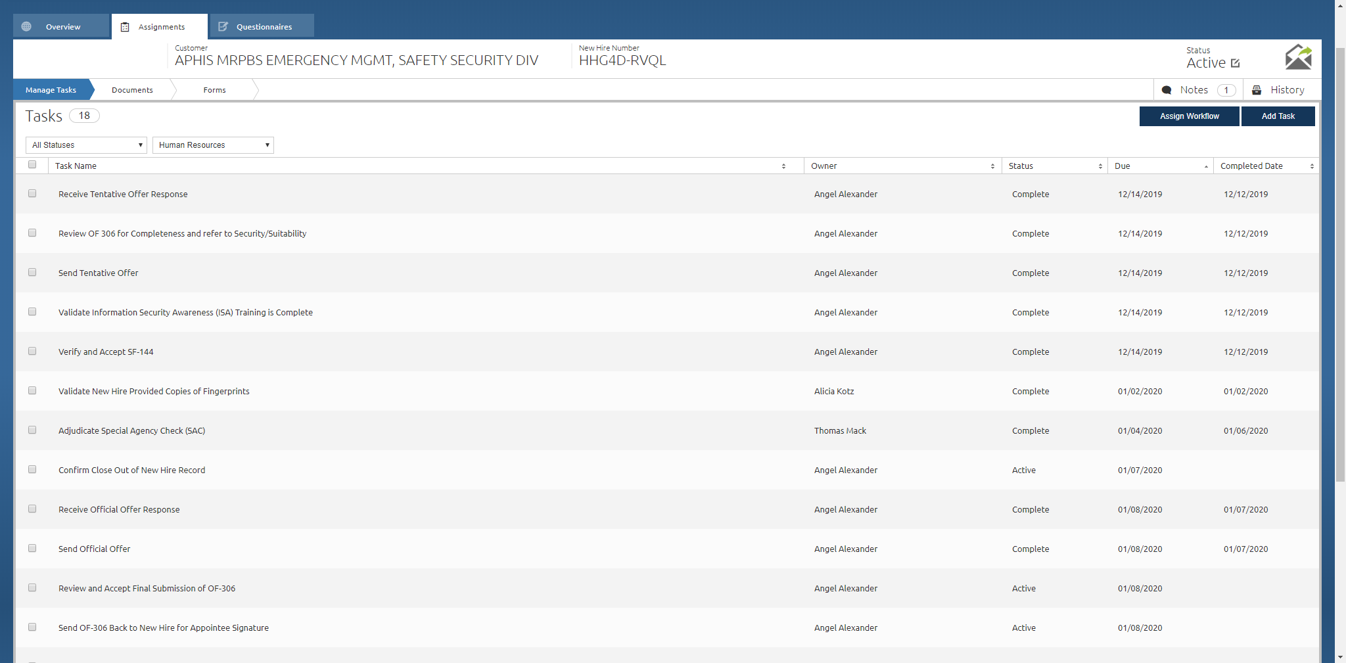
USAS Onboarding from the HR Staffing Perspective
Notes:
This is a quick peek at what USAS Onboarding looks like from the Human Resources perspective.
Again a To Do list of tasks with assignments and due dates

Slide 12
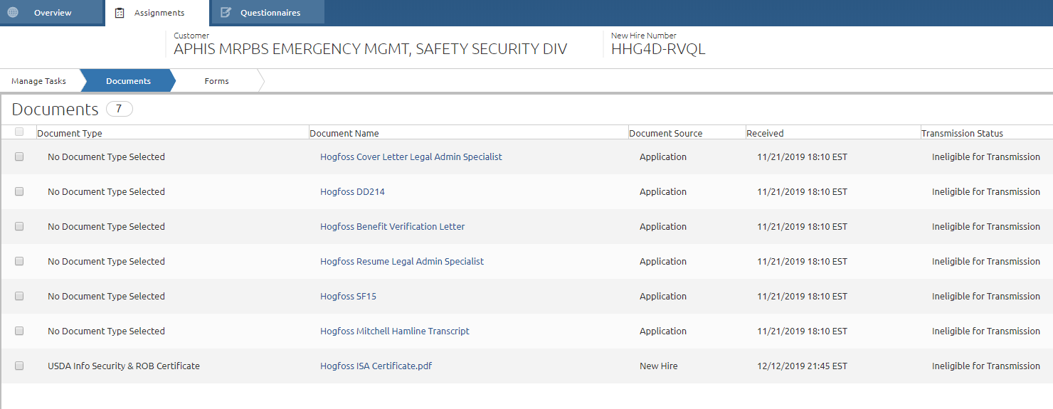
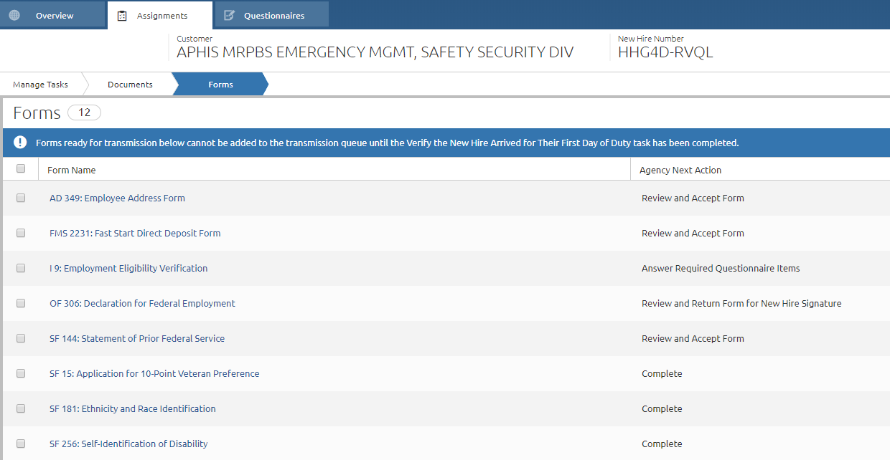
Are available in USAS Onboarding for HR Review
Documents Uploaded and Forms Completed
Notes:
Again this is an HR perspective –
This is how the HR Service Providers see completed or uploaded documents and forms inside USAS Onboarding. As appropriate – documents can uploaded into USAS Onboarding by the New Hire. Any forms completed in USAS Onboarding are available to be reviewed and printed by the New Hire before submission to Human Resources

Slide 13
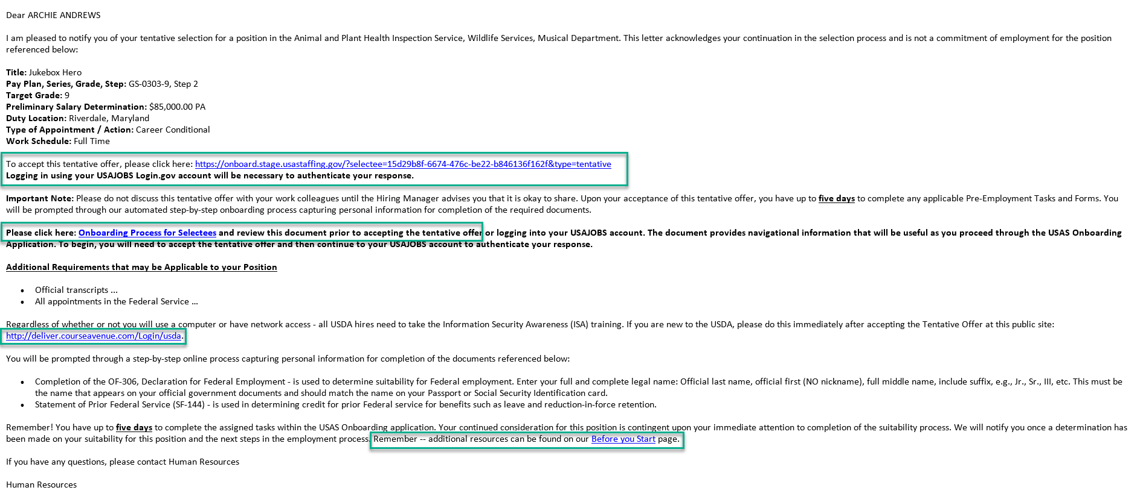
Tentative Offer
Notes:
This is a sample of a Tentative Offer sent to a New Hire.
Please Note:
Hiring Managers (or whomever the Program identifies) is CC’d on correspondence with the New Hire
The New Hire is provided a Link to log in and accept or decline the offer
The New Hire is asked to read an informational document called “Onboarding Process for Selectees”, this document walks the New Hire helps them navigate USAS Onboarding. Encourage them to read it
The New Hire is provided with a link to take the Information Security Awareness (ISA) Test
The New Hire is provided with a link to a web site “Before you Start” that provides a great deal of information

Slide 14
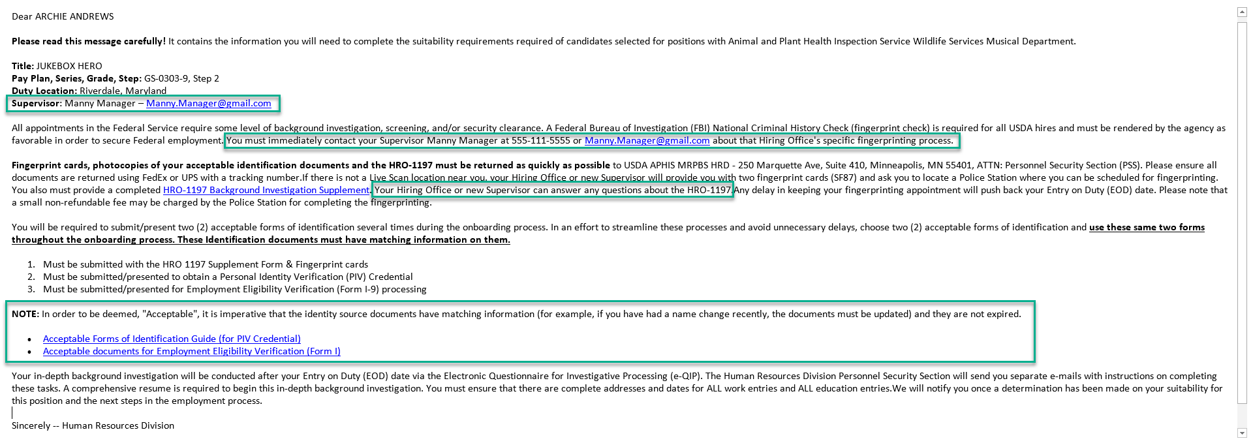
Fingerprinting
Notes:
This is a sample of a Fingerprint Email sent to the New Hire
Please Note:
Hiring Managers (or whomever the Program identifies) is CC’d on correspondence with the New Hire
The Supervisor is specifically identified in this email
The New Hire is asked to contact the Supervisor as quickly as possible to obtain information about how to get fingerprinted
The New Hire is told that the Hiring Office will help them with the HRO1197. Much of the information on the HRO1197 is information that the USDA Office should know
The New Hire is provided with information about what identification documents are acceptable

Slide 15
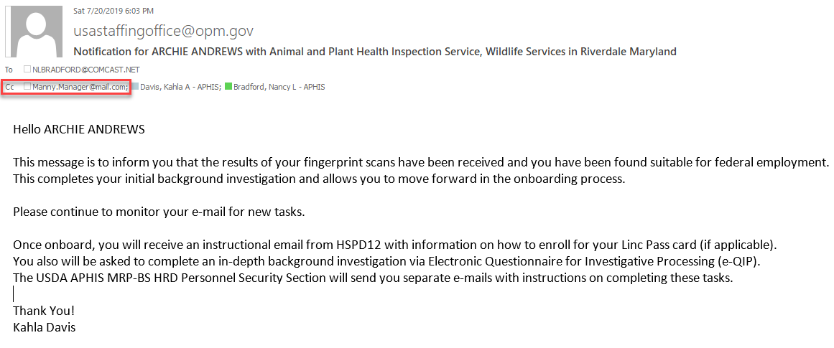
Suitability
Notes:
Once the fingerprints, OF306 and HRO1197 have been received by Personnel Security, they will request the Special Agreement Check (SAC) from the FBI.
When the results are returned and “read” by a Personnel Security Specialist – the New Hire will be adjudicated. This means that they have been found to be suitable for federal employment. This email message is what is sent when that suitability determination has been rendered.
It is only after this – that a conversation about Entry on Duty (EOD) date can be sent or the Official Offer can be sent to the New Hire

Slide 16
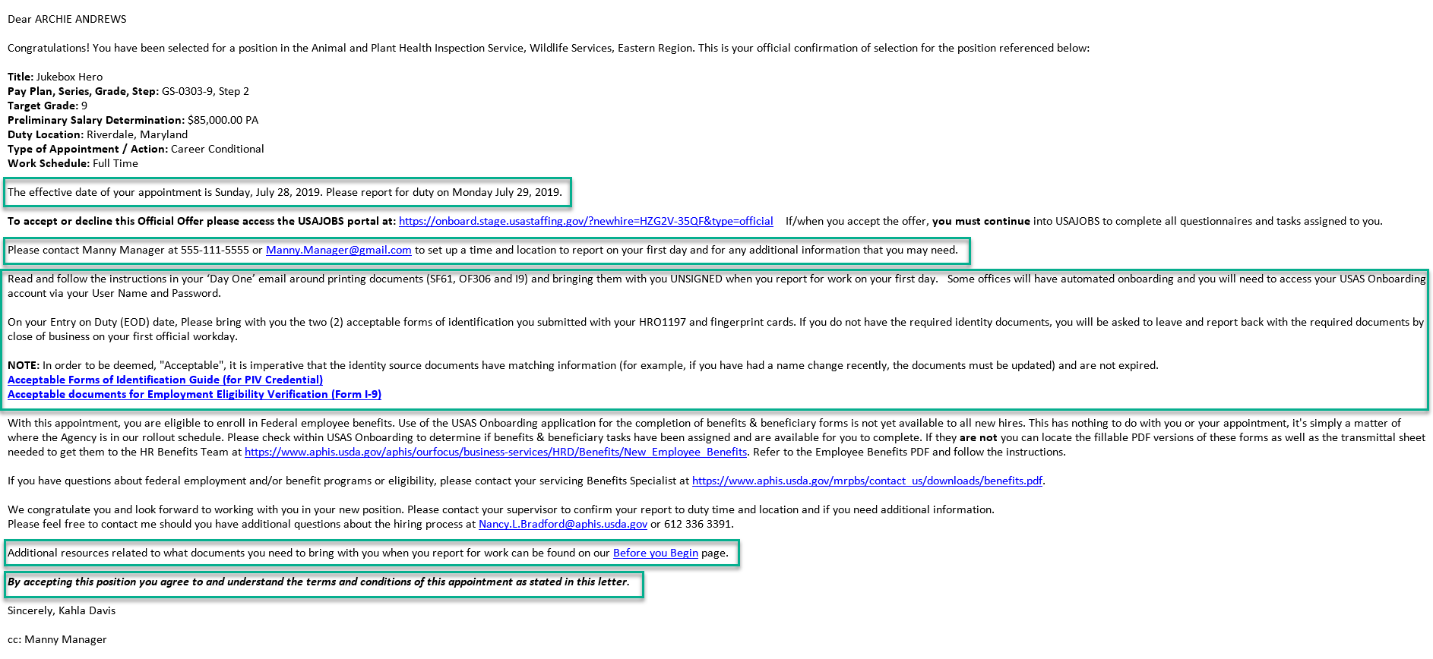
Official Offer
Notes:
This is a sample of an Offical Offer sent to a New Hire.
Please Note:
Hiring Managers (or whomever the Program identifies) is CC’d on correspondence with the New Hire
The Entry on Duty date is identified to the New Hire
The New Hire is asked to contact the Supervisor as quickly as possible to obtain information about where and when to report for their first day of work
The New Hire is asked to follow instructions about what to do and what to bring with them on Day One
The New Hire is provided with a link to a web site “Before you Start” that provides a great deal of information
The New Hire is reminded that accepting this position means they agree and understand all terms and conditions stated in this letter

Slide 17
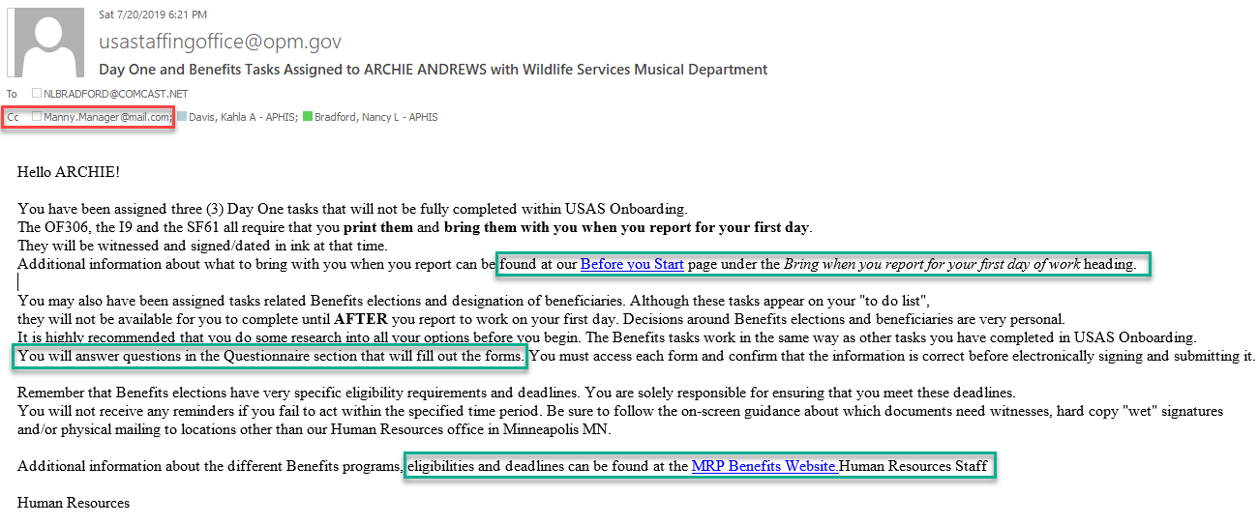
Day One
Notes:
In this “Day One” message the New Hire is alerted to the three Day One tasks that will be completed outside of USAS Onboarding and what they need to do to complete them.
They are again referred to the Before you Start page where information about Day One can be found
Finally they are reminded about Benefits and there eligibilities/timelines.

Slide 18
Touch Points in the Process
Discussion of the Selection with Staffing Specialist
Receipt of the Tentative Selection Notice (TSN) email
Receipt of the Fingerprint email
Receipt of Suitability Determination email
Discussion of the Entry on Duty (EOD) Date with Staffing
Receipt of the Official Offer email
Receipt of the Day One/Benefits email
Tracking entries in eTracker
Notes:
Again – there are many places in the Onboarding process where Hiring Managers – Hiring Offices – Resource Mgmt Staffs – Supervisors can be informed about where the New Hire is in the process

Slide 19
Hiring Manager’s Role – Day One
Obtain Second Signature on OF306
If there are updates on the OF306 between the first time is was signed and this second time – ask for those updates on a separate piece of paper
Provide the Oath of Office
Obtain Signed SF-61
Verify Identification Documents
Complete I9
Return all Day One Documents to HR Processing Team
Notes:
These are Day One tasks that the Hiring Manager – Hiring Office – Resource Management Staff – Supervisor need to ensure are completed and documents sent to the HR Processing Team

Slide 20
Quick Reference
Linc Pass Tracker: https://hspd12.usda.gov/lit/
Linc Pass Enrollment: https://app3.timetrade.com/tc/login.do?url=usaccess
Ordering Fingerprint Cards: https://www.gsaadvantage.gov or www.bsc.usda.gov
SF87 – Fingerprint cards for Federal Hires or FD### for Contractors or Third Party Students
ATAC: Help@aphis.usda.gov or Service Now https://help.aphis.usda.gov/asm/services.do
Network & Computer Set-up for APHIS New Hires
30 Day or Single Day PIV Exception Process
Linc Pass not working in the Computer
eAuthentication Help
Contact HRD Personnel Security: lincpass.security@aphis.usda.gov
Lost/Damaged/Stolen Linc Pass
Linc Pass PIN Reset: https://app3.timetrade.com/tc/login.do?url=usaccess
If you enter your PIN incorrectly more than 3 times – a “Linc Pass is Blocked” message with display. You must make an appointment at a Linc Pass office to have the PIN reset
ISA Public Portal: https://deliver.courseavenue.com/Login/usda
Notes:
Some resources

Slide 21
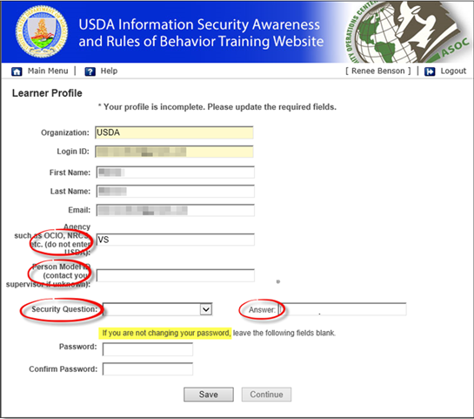
ISA – Public Portal
Notes:
This is a sample of what the Information Security Awareness (ISA) Website looks like. Any person can access this site from any device
Please note that the Person Model ID is not a mandatory field. It can be left blank. If New Hires will not believe this – tell them to use 123456

Slide 22
Questions

