Slide 1


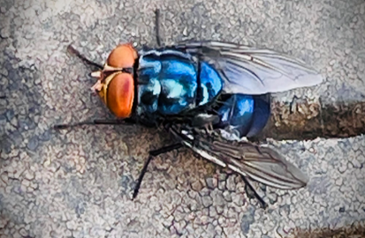
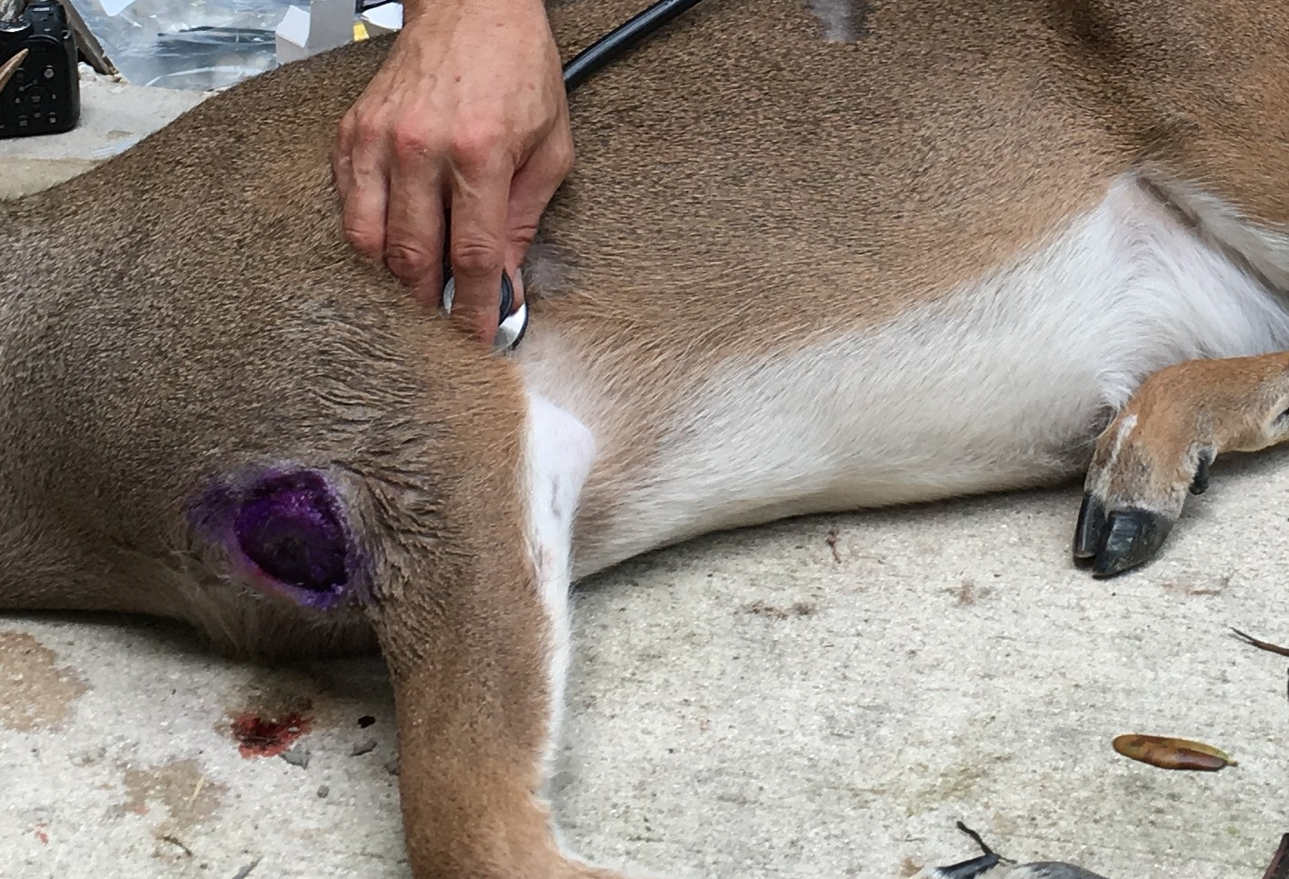
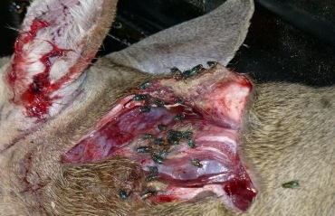
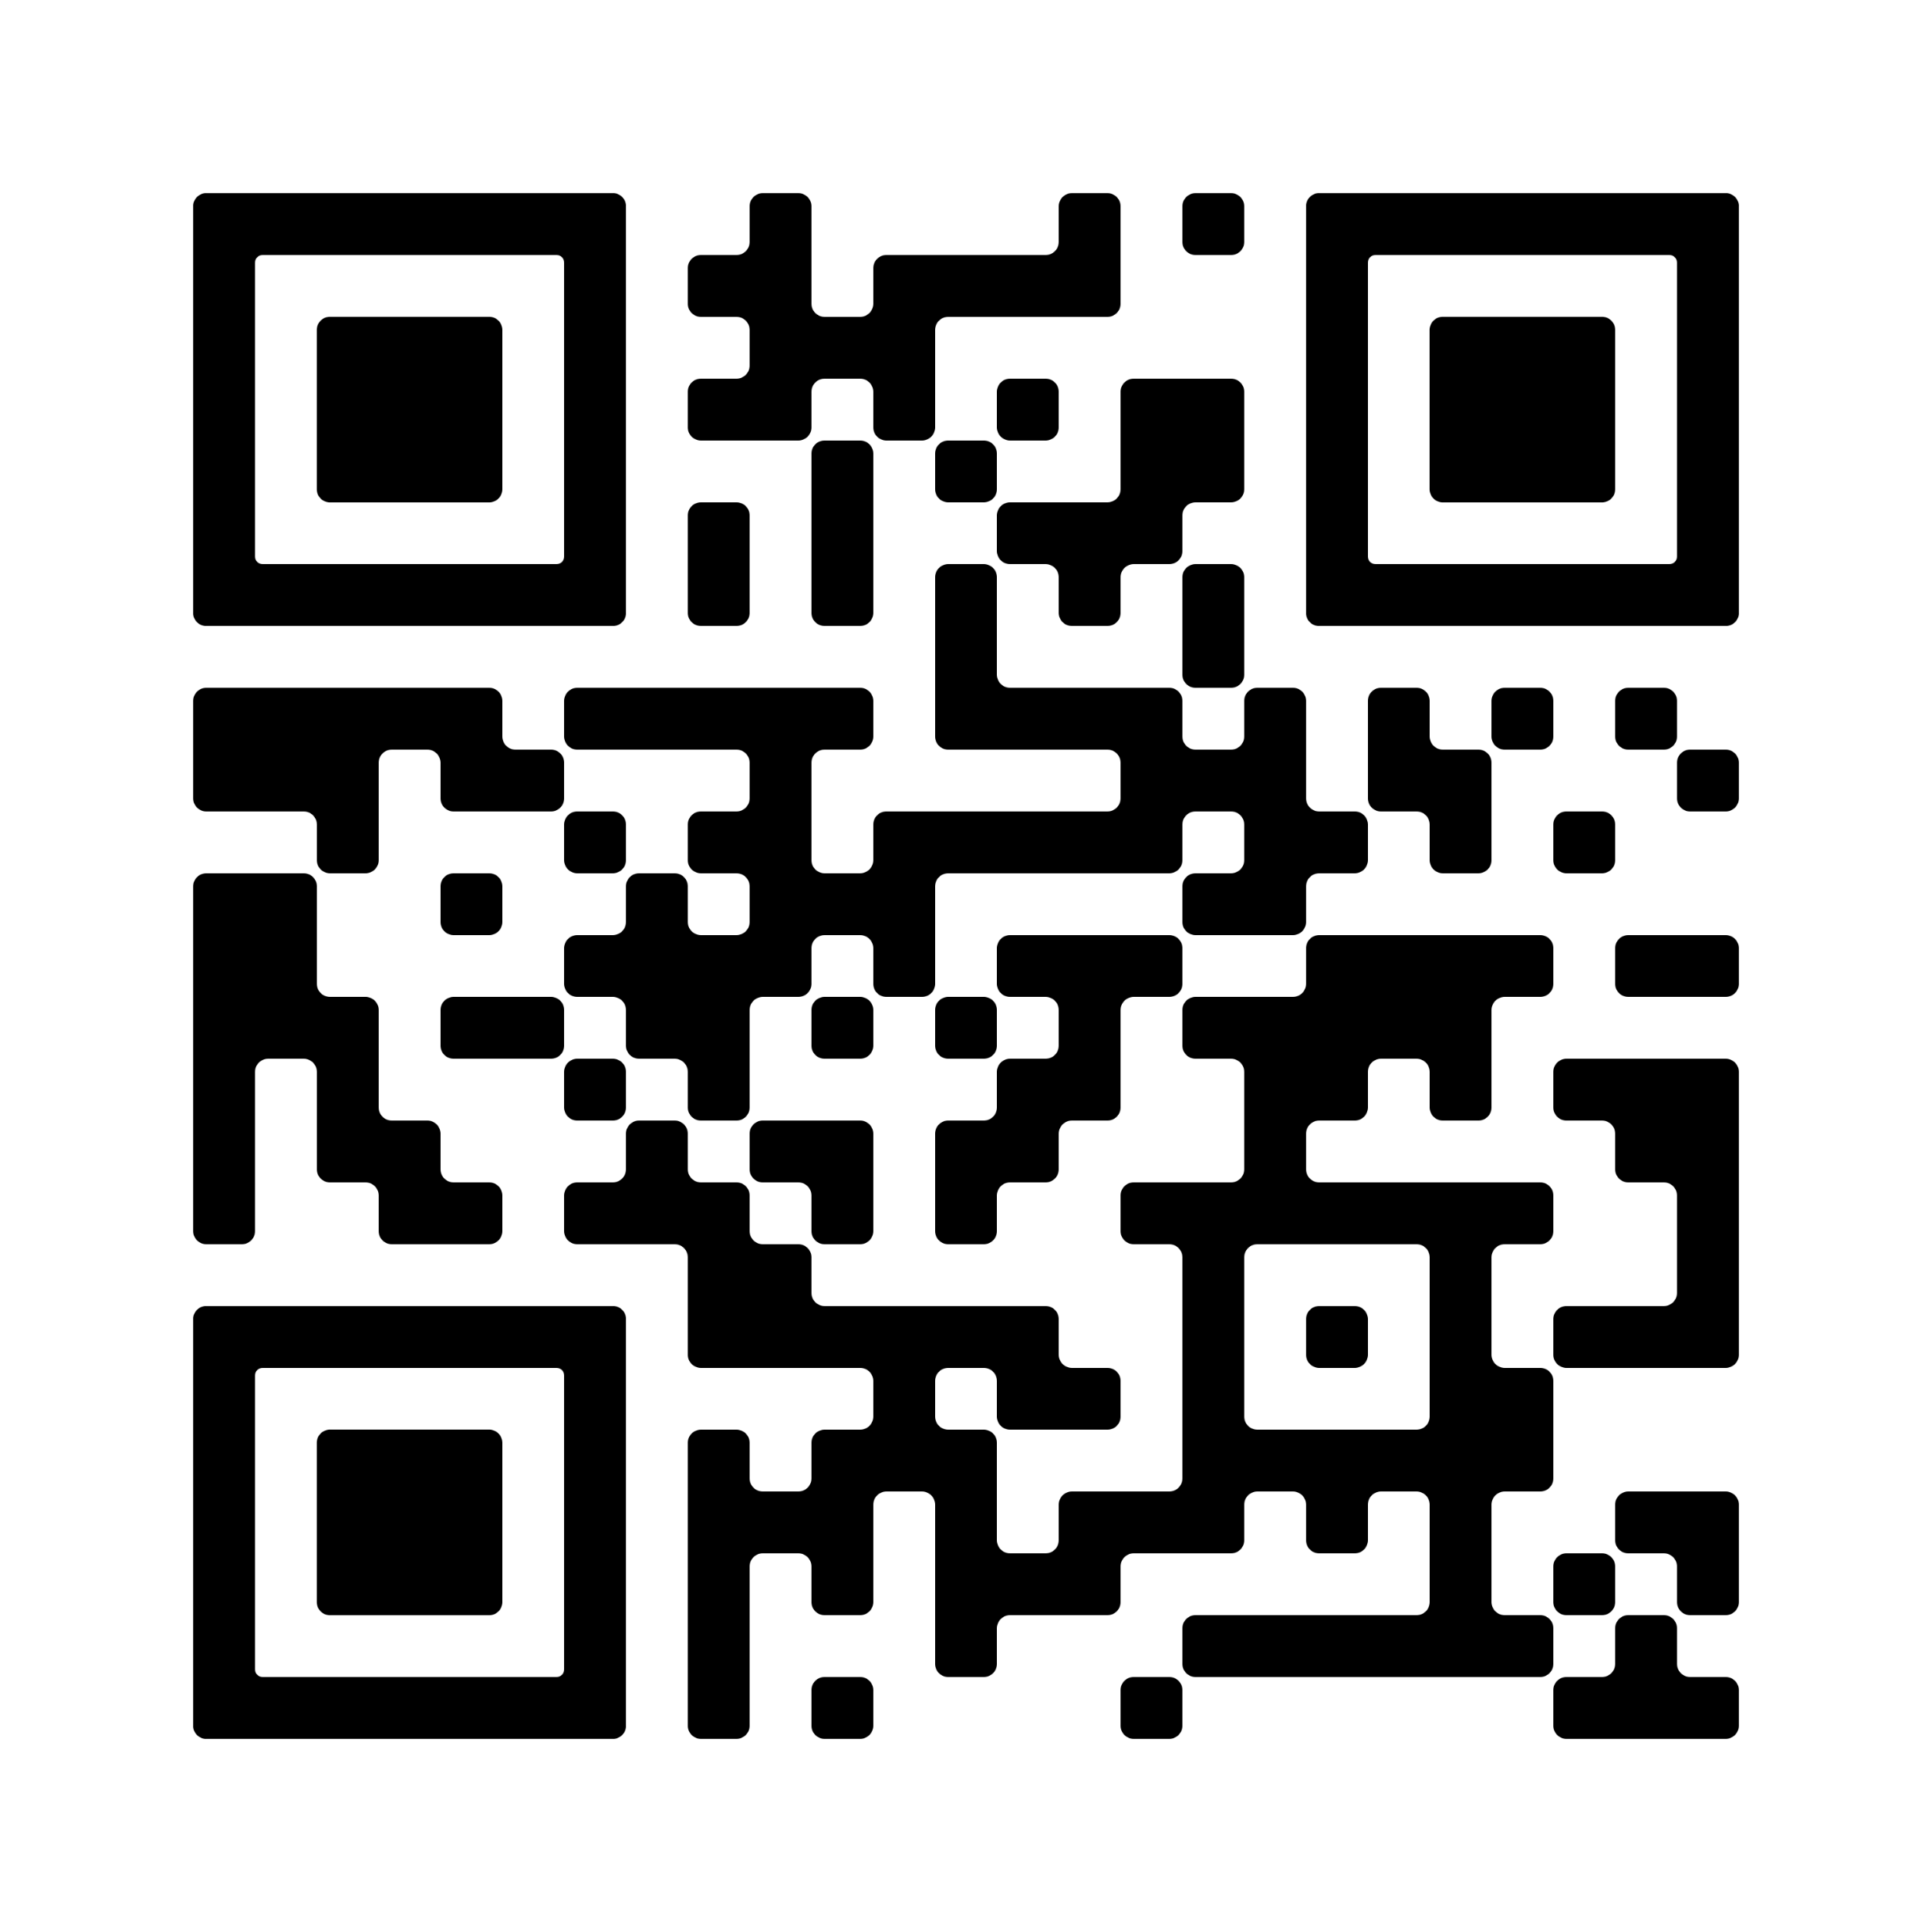

Protect Wildlife.
Stop New World Screwworm.
New World screwworm (Cochliomyia hominivorax, NWS) is a pest that poses a serious threat to wildlife and other animals by feeding on living tissue. Hunters, conservationists, and outdoor enthusiasts can play a critical role in monitoring NWS. Whether you’re hunting, conducting research, or working with wildlife, your observations help protect U.S. animals.
Inspect. Report. Protect.
Not all maggot infestations in tissue (myiasis) are caused by NWS, but any maggots on living animals should be treated as suspicious and reported immediately.
Stay Alert
An adult screwworm fly is slightly larger than a housefly, with red eyes, metallic blue-green body, and three black stripes on its back. Photo by USDA.
Observe wildlife for signs of infestation.
Inspect harvested game for maggots or unusual wounds.
Avoid unintentionally spreading screwworm if the animal has suspicious wounds and maggots or you are hunting in an NWS-affected area.
Always wear gloves or wash hands after handling affected animals; NWS is not contagious, but wounds can be infected with bacteria.
NWS flies lay eggs in open wounds or body openings of animals. When the eggs hatch, the larvae (maggots) feed on living tissue, causing a severe infestation called myiasis.
Learn the Signs: Knowing What To Look for Can Help Protect Wildlife
NWS does not spread directly from animal to animal or from animals to people. Affected animals and people can recover if treated promptly.
Visible maggots (larvae) or white egg masses in wounds or body openings like nose, ears, genitalia, or the navel of newborn animals.
Wounds that ooze or have a strong, foul smell.
Animals that look in pain or are lethargic, unusually aggressive, or isolating themselves.
Report Suspicious Wounds or Infestations
Document the location (using GPS if possible), date, species, and wound description.
Take photos or videos of the wound when possible.
Contact local wildlife authorities or USDA Wildlife Services at 866-4USDA-WS (866-487-3297) immediately.
Wildlife Are Counting on You!
For more information, visit screwworm.gov.
Severe infestations in animals. In severe cases of NWS infestation, animals may have visible maggots; wounds with bloody discharge; a strong, unpleasant odor; and other insects attracted to the affected area. Photo by USDA.

