Slide 1
Plant Protection Act Section 7721 Plant Pest and Disease Management and Disaster Prevention Program
FY 2024 Process:
Suggestion Submission
PPA 7721 PPDMDPP Team:
Julie Van Meter
Glorimar Marrero
Feridoon Mehdizadegan
Lindsey Thiessen
Kelsey Bakken
Notes:
Welcome and thank you for joining us today to learn more about the Plant Protection Act 7721 Suggestion Submission process for the Plant Pest and Disease Management and Disaster Prevention Program (PPDMDPP).
My name is Julie Van Meter, PPA NPM for PPDMDPP, and I’m joined by other members of the PPDMDPP CFWG, who will now introduce themselves.

Slide 2
Agenda
Overview of the National Program Guidance
Six Goal Areas
Objectives
NEW - ServiceNow Platform for PPA 7721 Suggestion Submissions
Tips for a high-quality Suggestion
Questions & Answers
Notes:
Today we will provide a program overview, to include the six goal areas and their objectives
We will run through the new ServiceNow platform for submitting suggestions
And we will review tips for submitting high-quality suggestions.
Please use the chat for asking questions. We will also have time for questions at the end of the presentation.

Slide 3
Overview - PPA 7721
APHIS PPA 7721 website:
https://www.aphis.usda.gov/aphis/resources/ppa-projects
Be sure to review:
FY2024 PPA 7721 Implementation Plan
Each Goal Area
Objectives
Strategies
FY2024 Suggester Help Session Webinar slides
Frequently Asked Questions (FAQs) document
Additional Questions? Ppa-Projects@usda.gov
Notes:
Here is the link to the APHIS Plant Protection Act Section 7721 website, which also includes info about both the PPDMDPP and the National Clean Plant Network, which supports efforts to ensure certified clean propagative material for production
You are encouraged to visit this site and familiarize yourself with the resources available, including
The Implementation Plan
Suggestor help Session webinar slides
Guidance document for using ServiceNow
Guidance document for submitting suggestions
FAQs
The FY24 Implementation Plan is key to aligning suggestions to the correct Goal Area, and you are strongly encouraged to read through it for more details about the goals, objectives and strategies.
During the Open period, or really any time, if you have questions about PPA, please send those questions to the PPA-projects@usda.gov email.

Slide 4
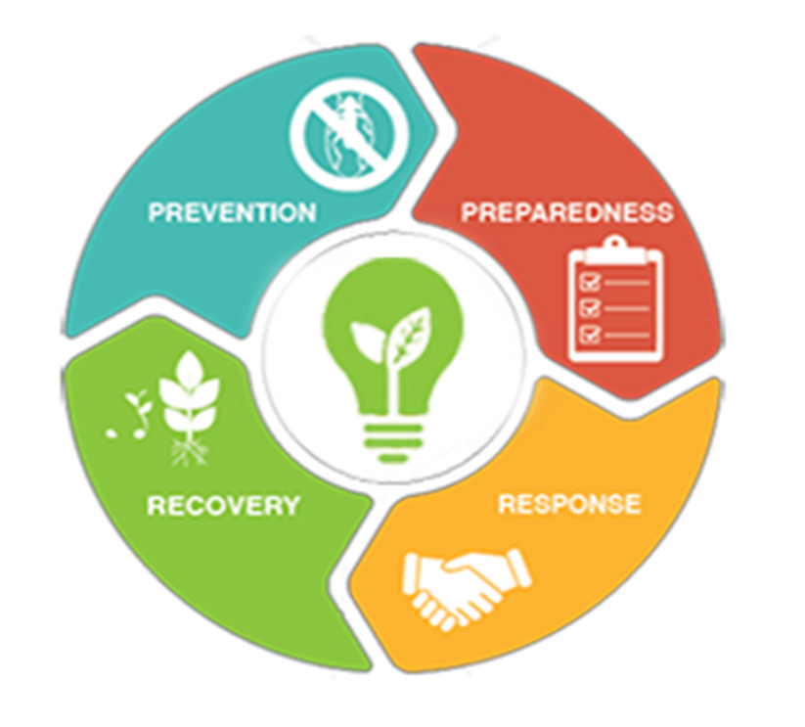
PPA 7721 Goal Areas
Plant pest and disease survey or analysis
Domestic interstate inspection
Pest ID and diagnostic technology
Protecting nursery production
Public outreach and education
Pest mitigation and rapid response
Notes:
We will now review the six goal areas for PPDMDPP suggestions
Reminder to review the Implementation Plan prior to developing a suggestion, to ensure it strongly aligns with the goals, objectives and strategies..

Slide 5
Goal Area 1A & 1S Objectives
Goal 1: Analysis | Identify risk factors for high-risk pests and high-risk pathways through analysis of available data. Develop risk-based models and decision support algorithms, approaches, or tools to reduce the entry, establishment, and spread of plant pest species.
Goal 1: Survey | Conduct national priority pest surveys in support of all agriculture crops, specialty crops, trade, and identified program surveys. Target multiple high-risk pathways for exotic pest introduction across the United States.
Notes:
Goals 1A & 1S
Goal 1 Analysis
Use science to analyze available data to make informed decisions, develop risk-based models. To help inform future survey activity.
Goal 1A is not intended to fund experimental work, surveys/monitoring, or observational studies to generate data.
Goal 1 Survey
Conduct survey activity to monitor high-risk pathways, for early detection of plant pests, or to mitigate pest risk and promote trade.

Slide 6
Goal Areas 2 & 3 Objectives
Goal 2: Target domestic inspection activities at vulnerable points in the safeguarding continuum | Promote and expand inland inspections of containers and mail facilities, where possible. Expand the use of canine teams for domestic inspection activities (excluding domestic survey/detection activities). Promote increased levels of inspection for regulated articles for interstate movement.
Goal 3: Enhance and strengthen pest identification and technology | Improve all aspects of early detection technologies and resources. Develop or improve detection tests and identification tools and methods for species in a wide range of taxonomic groups containing high priority pests.
Notes:
Goals 2-3
Goal 3 – Pest ID and Technology
Develop and improve traps and lures, increasing efficiency and effectiveness, quality control
Improve taxonomic ID capacity, including accuracy and speed of identification, or by developing training materials
Develop novel or improve existing identification tools, with a focus on field-deployable or lab-ready diagnostic tools.

Slide 7
Goal Areas 4 & 5 Objectives
Goal 4: Safeguard nursery production | Develop science-based best management practices and risk mitigation practices to exclude, contain, and control regulated pests from the nursery production chain. Develop and nationally harmonize audit-based nursery certification programs, including the harmonization of different certification programs (both inter- and intra-state), audit and inspection training for cooperators, and program launching.
Goal 5: Conduct outreach and education to increase understanding, acceptance, and support of plant pest and disease eradication programs and control efforts | Provide education and encourage behaviors that enhance safeguarding. Increase the number of people actively looking for and reporting high-consequence pests at vulnerable points along high-risk pathways. Increase public acceptance and support of APHIS high priority plant pest and disease eradication programs and increase acceptance of control efforts.
Notes:
Goals 4-5
Goal 5 – Outreach and Education
Provide education and information to key groups, such as producers, first detectors, travelers, consumers, and the public about pests and pathways.
Develop and implement volunteer programs to support pest detection.

Slide 8
Goal Area 6 Objectives
Goal 6: Enhance mitigation capabilities and rapid response | Develop or adapt new control technologies, tools, and treatments for use in plant health emergencies. Improve the knowledge base, response options and capabilities prior to the onset of a plant health emergency. Support the use of existing tools and initial response protocols for the overarching goals of containment, control, and/or eradication of plant pests.
Notes:
Goals 6 – Pest Mitigation and Rapid Response
Provide initial or short-term funding to quickly implement programs for containment, control, or eradication during a plant health emergency
Provide technical assistance through the development of New Pest Response Guidelines (NPRG) and Rapid Response Action Plans for a plant health emergency
Note: Remind audience that if they have questions regarding the goal areas, objectives, or strategies to put them in the chat so we can discuss afterwards
Transition to next presenter- now to give you more details and a walkthrough of ServiceNow

Slide 9
ServiceNow Platform
Cloud-based tool; more user-friendly experience
ServiceNow works best with Chrome, Microsoft Edge Chromium, Firefox or Safari
Other browsers may NOT work properly, especially if running on an operating system other than Microsoft Windows.
Turn off pop-up blockers
30-minute time out with no activity
Plan to complete the submission in one sitting
No ‘Save’ function available
Review fields in the suggestion form in the ServiceNow training guidance
Notes:
ServiceNow is a cloud-based tool that ​offers a more user-friendly experience for users during the suggestion submission process.
For best results, when using the ServiceNow platform for suggestion submission, use recommended browsers such as Chrome, MS Edge Chromium, Firefox or Safari.
To avoid possible service interference, it is recommended that users turn off pop-up blockers while using the ServiceNow portal.
Emphasize- ServiceNow has a default time out after 30 minutes of inactivity, therefore we highly recommend composing the content of your suggestion in a word processing program beforehand, then pasting the text into the form—especially for fields such as the abstract, purpose, milestones, etc.
Emphasize- You cannot ‘Save’ your work and come back and finish it later. It is highly recommended that submitters are prepared to complete the suggestion submission process in one sitting.
Submitters should review the ServiceNow training guidance for a walk-through of every field to be familiar with expected information within the suggestion form.

Slide 10
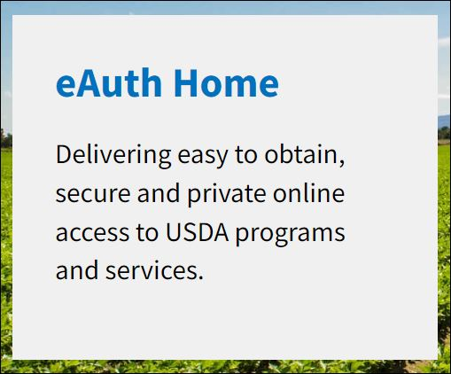
ServiceNow Access - eAuthentication
Suggesters must have an eAuthentication (eAuth) account to use ServiceNow
External cooperators will need eAuth level-1 (i.e., no identity verification req’d)
USDA employees will need eAuth level-2
https://www.eauth.usda.gov/eauth/b/usda/home
Notes:
eAuthentication allows customers and employees to view or conduct official business via the internet with USDA and is a requirement for use of ServiceNow. This is similar to the use of Metastorm, which also required eAuthentication.
While most individuals returning to submit a suggestion will already have an eAuthentication account, we want to make sure that first time suggestion submitters are aware that they need to register for an eAuthentication account before starting the suggestion submission process.
Registering for an account is easy and will probably take no more than an estimated 10-15min. External cooperators will need eAuthentication level 1 (which doesn't require identity verification), whereas all USDA employees will need eAuthentication level 2 (which most already have). Anyone who already has an eAuthentication account will not need to register again to use ServiceNow.
To register for eAuthentication you can visit the site listed here or search for USDA eAuthenication in your favorite browser.

Slide 11
eAuthentication - Registration
1
2
3
4
Register for a ‘Customer’ eAuth Account
Respond to confirmation link and fill in required information
Create a password
Access and submit suggestions in ServiceNow
Notes:
Registration for eAuthentication is easy. Suggesters will start by visiting the eAuthentication homepage and selecting 'Create an Account'. Then they should select 'customer' for the type of account, followed by responding to a confirmation email. The confirmation email will contain a link to a form where the user will submit some personal information, then they'll be asked to create a password. Once they've created their eAuthentication account they are ready to visit the PPA 7721 ServiceNow Portal to start the suggestion submission process!

Slide 12
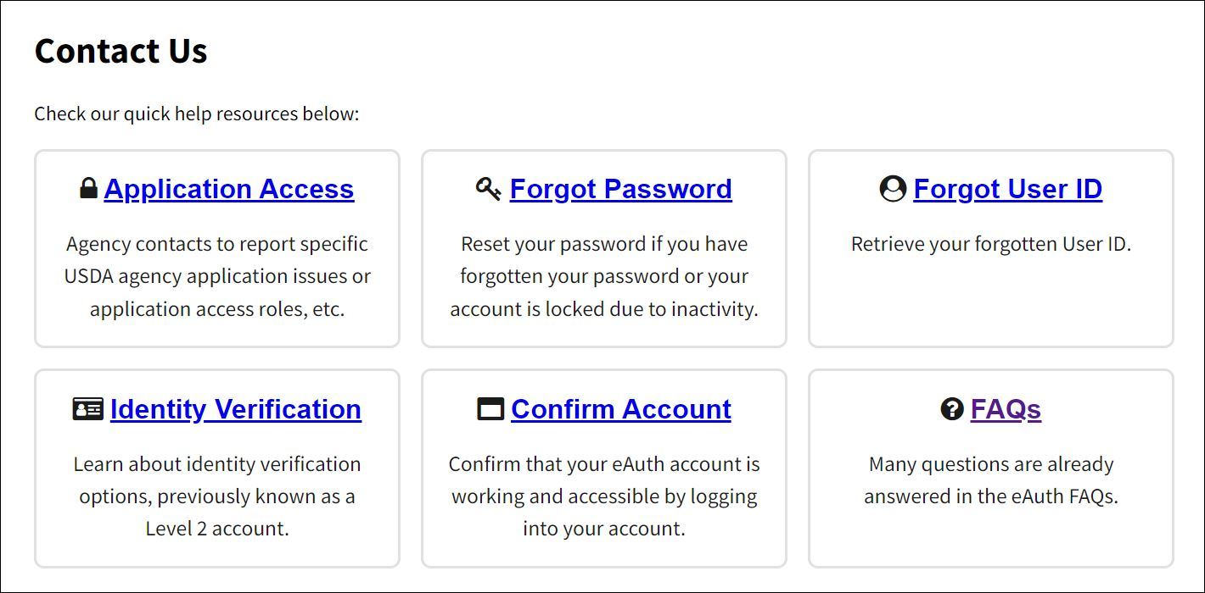
eAuthentication – Tips
Register early–
Check your spam folder
Do not submit multiple requests
For assistance visit- https://www.eauth.usda.gov/eauth/b/usda/contactus
Notes:
We want to leave you with some tips for the Registration process:
Register early!!! This is an easy step that can and needs to be taken care of anytime before you start the suggestion process.
Check you spam folder to make sure that the confirmation email didn't get sent to this folder by mistake.
Do not submit multiple requests for an eAuthentication account. The account is created using a unique email that will serve as your User ID, therefore you should only have one email tied to your personal information.
If you need assistance, use the information provided under the 'Contact Us' link through the eAuthentication webpage at the following site.

Slide 13
eAuthentication – Assistance
Expired, Lost or Forgotten eAuth Username or Passwords?
Contact the eAuthentication Help Desk at: https://www.eauth.usda.gov/eauth/b/usda/helpdesk
Or
https://www.eauth.usda.gov/eauth/b/usda/contactus
E-mail help@usda.gov
ONLY the MRP IT Help Desk can reset passwords or usernames for eAuthentication
Notes:
The previous slide focused on providing tips and guidance for new users that register for eAuthentication. For users who already have an eAuthentication account, but need support with their credentials because they forgot a username and/or password, customer assistance information is provided through the eAuthentication help desk or can also be found under the 'Contact Us' link through the eAuthentication webpage. You can also email help@usda.gov for assistance, but we recommend that users try the Help Desk or the links on the Contact Us eAuthentication page first.
Only the MRP IT help desk can assist with eAuthentication; the PPA 7721 cannot provide assistance for eAuthentication.

Slide 14
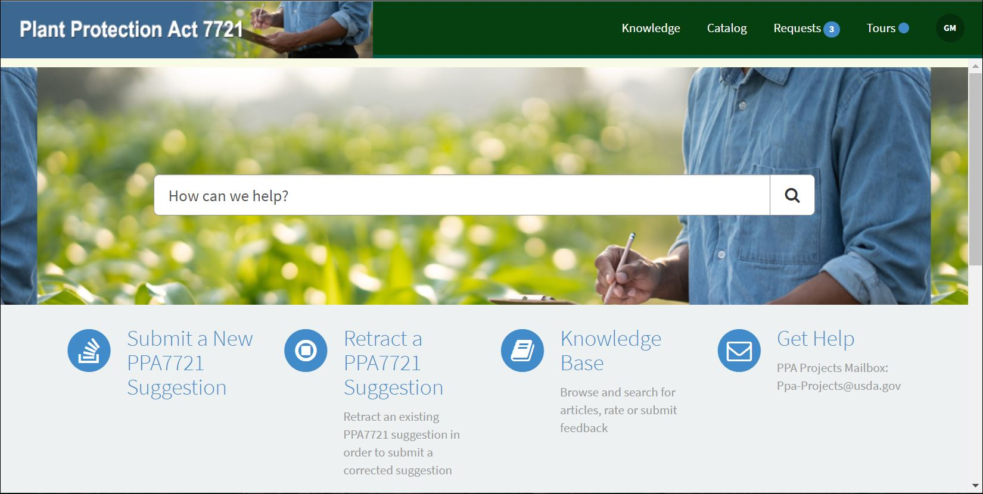
ServiceNow – PPA 7721 Suggestion Portal
A
B
C
Plant Protection Act 7721 (PPA 7721) Suggestion Submission Guidance
https://help.aphis.usda.gov/ppa7721
Notes:
From the ServiceNow PPA 7721 Suggestion Submission Portal, also referred to as the PPA 7721 suggestion portal, you’ll see several sub-links and icons. Submitters will use the ‘Submit a New PPA 7721 Suggestion’ icon to start the suggestion process. However, we also point out that there are sub-links in the banner (identified as A in the image), a search bar (identified as B), and additional icons (identified as C) with functions that are explained in the ServiceNow PPA 7721 Suggestion Submission Guidance document. Suggesters should refer to the document for a more detailed walk-through of all the features available in ServiceNow’s PPA 7721 Suggestion portal.

Slide 15
ServiceNow – Entering a Suggestion (1 of 9)
Enter the ServiceNow Suggestion portal https://help.aphis.usda.gov/ppa7721
Click the ‘Submit a New PPA 7721 Suggestion’ icon
Start filling in the Suggestion Form
Notes:
To enter a suggestion, from the PPA 7721 suggestion portal landing page click the icon at the bottom of the page called ‘Submit a New PPA 7721 Suggestion’. A new page will open to the suggestion form for all goal areas.

Slide 16
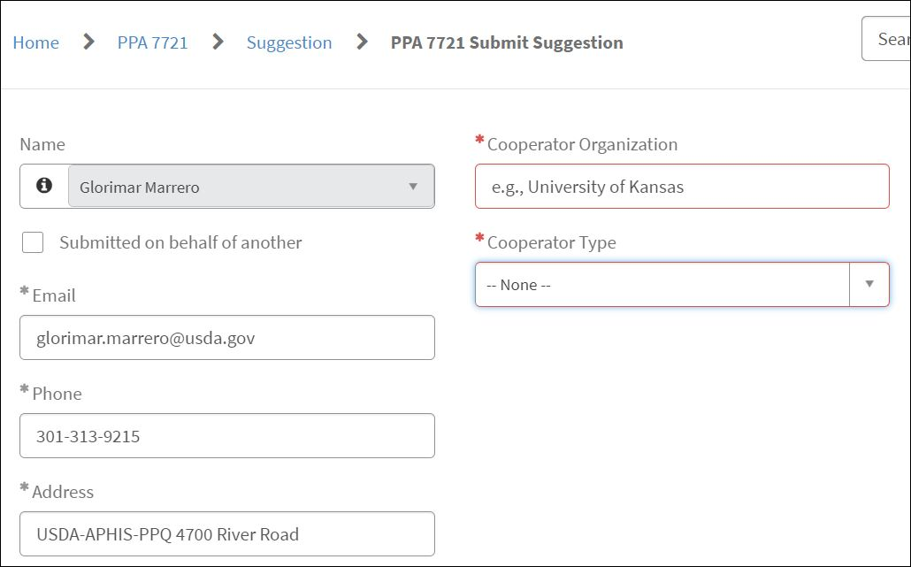
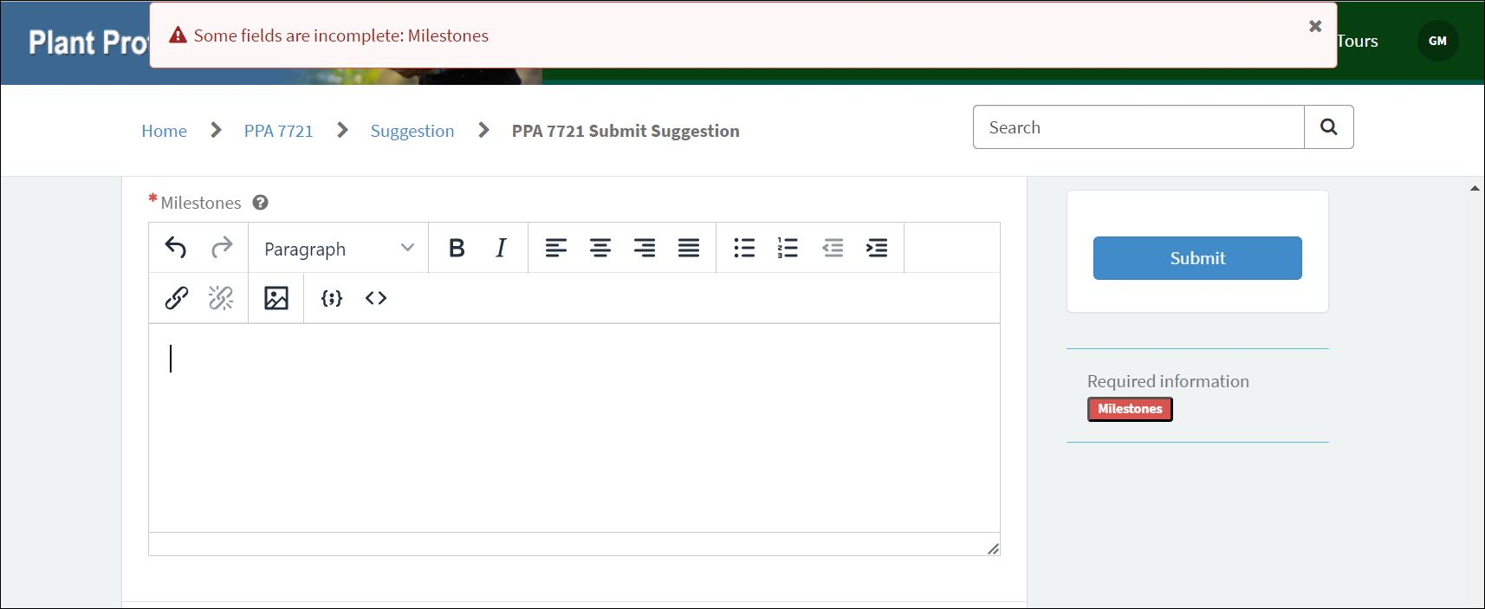
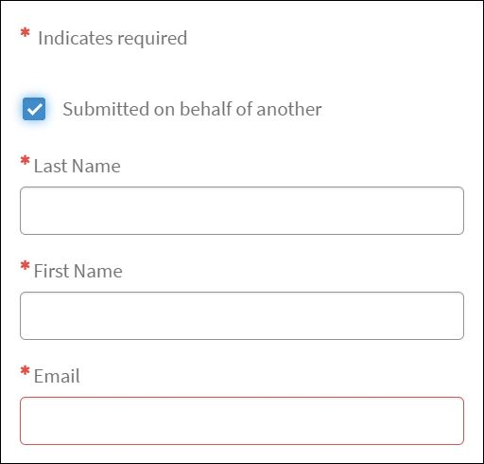
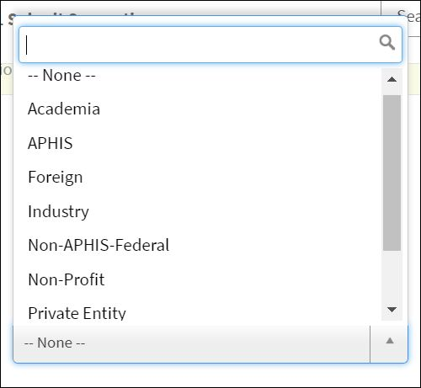
ServiceNow – Entering a Suggestion (2 of 9)
eAuth information will autopopulate certain fields
Required fields are marked with an asterisk
Error message = a required field is empty
Notes:
Information from a submitter’s eAuthentication account will be used to autopopulate certain fields. These fields are indicated in grey and can be changed, if necessary, except for the ‘Name’ field. If your name appears differently or has changed recently, you must contact the PPA mailbox and request assistance for this change. If a submitter is submitting a suggestion on behalf of another person, you’ll need to click in the ‘Submitted on behalf of another’ checkbox and provide the requested information.
There are several fields within the suggestion form which include checkboxes, drop down fields, and rich text boxes. All required fields are marked with an asterisk and need to be filled before the suggestion can be successfully completed.
If a field is left empty during the submission process, an error message will appear at the top of the page and identify the field with missing information. This is also indicated in red by the ‘Submit’ button. Next, we’ll discuss some of the fields in more detail.

Slide 17
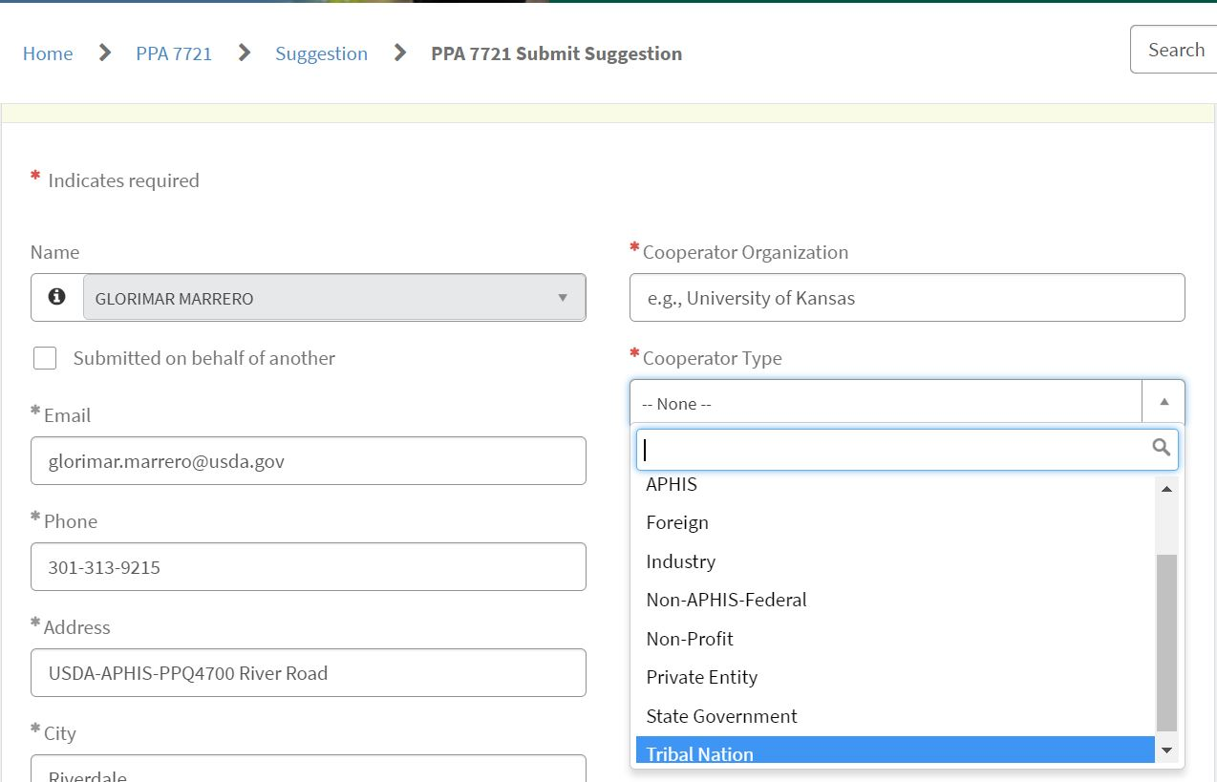
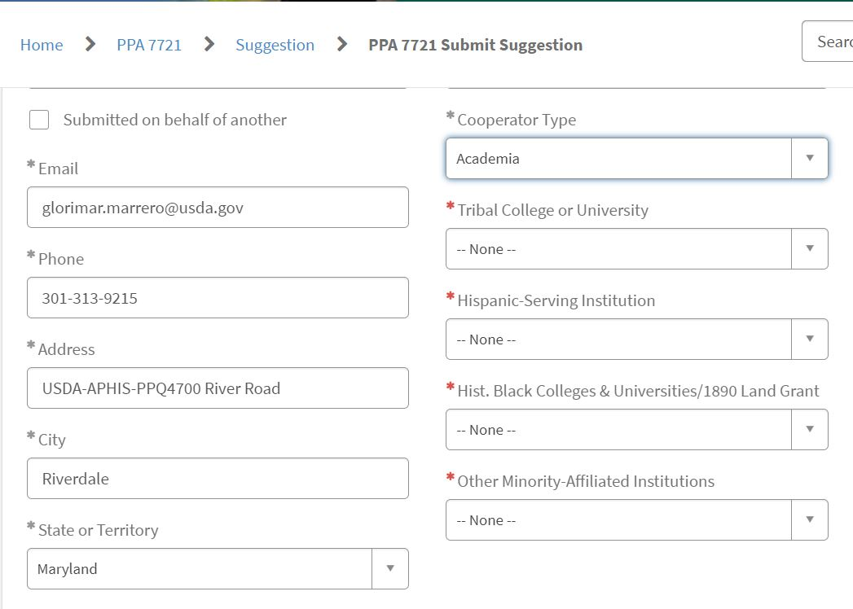
ServiceNow – Entering a Suggestion (3 of 9)
Notes:
After entering and/or reviewing the autopopulated general information such as name, phone number, and address details, the submitter should enter the ‘Cooperator Organization’ and select the appropriate ‘Cooperator Type’ for their suggestion.
If selecting ‘Academia’ as the cooperator type, four new fields will open for which submitters will need to answer yes/no. We’ll explain these fields in more detail.

Slide 18
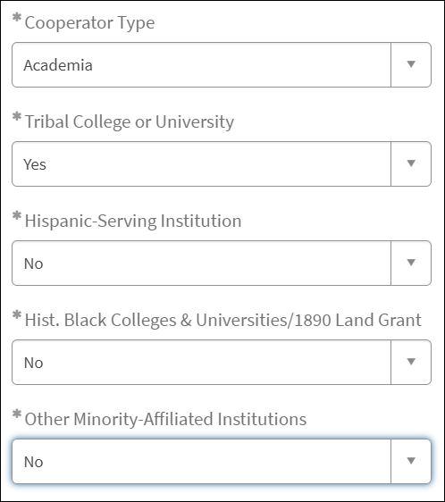
Information on Academic Attributes
Tribal Colleges and Universities
Hispanic-Serving Institutions
Public institutions of higher education charted by federally recognized Indian tribes or the federal government, with majority Native American or Alaska Native student enrollment.
An academic institution, whether college or university, where Hispanic students comprise at least 25% of the full-time equivalent student body, according to the U.S. Department of Education, and is certified as a Hispanic Serving Institution by the U.S. Department of Education.
Up to $4M to support Tribes, Tribal organizations and universities, as well as other minority-affiliated organizations.
HBCUs & 1890 Land Grant Institutions
Other Minority Affiliated Institutions
Minority Serving Institutions are institutions of higher education that serve minority populations. They are unique both in their missions and in their day-to-day operations.
Any historically black college or university (HBCU) that was established prior to 1964, whose principal mission was, and is, the education of black Americans and includes those historically black universities that were established under the Second Morrill Act of 1890.
Notes:
In FY 24 APHIS will set aside up to $4 million in Plant Protection Act Section 7721 funding to support Tribes, Tribal organizations and universities, as well as other minority-affiliated organizations.
For Tribal Colleges and Universities, Hispanic-Serving Institutions, Historically Black Colleges and Universities along with 1890 Land Grant Universities, and Other Minority Affiliated Institutions these categories are defined by the United States Department of Education; the USDA National Institute of Food and Agriculture (NIFA) also keeps a list of 1890 Land Grant Institutions on their website. Additional information and details about these categories should be reviewed on the Department of Education or NIFA website, as appropriate, and should be used to answer the yes/no questions related to the ‘Cooperator Type’-associated fields for Academia.

Slide 19
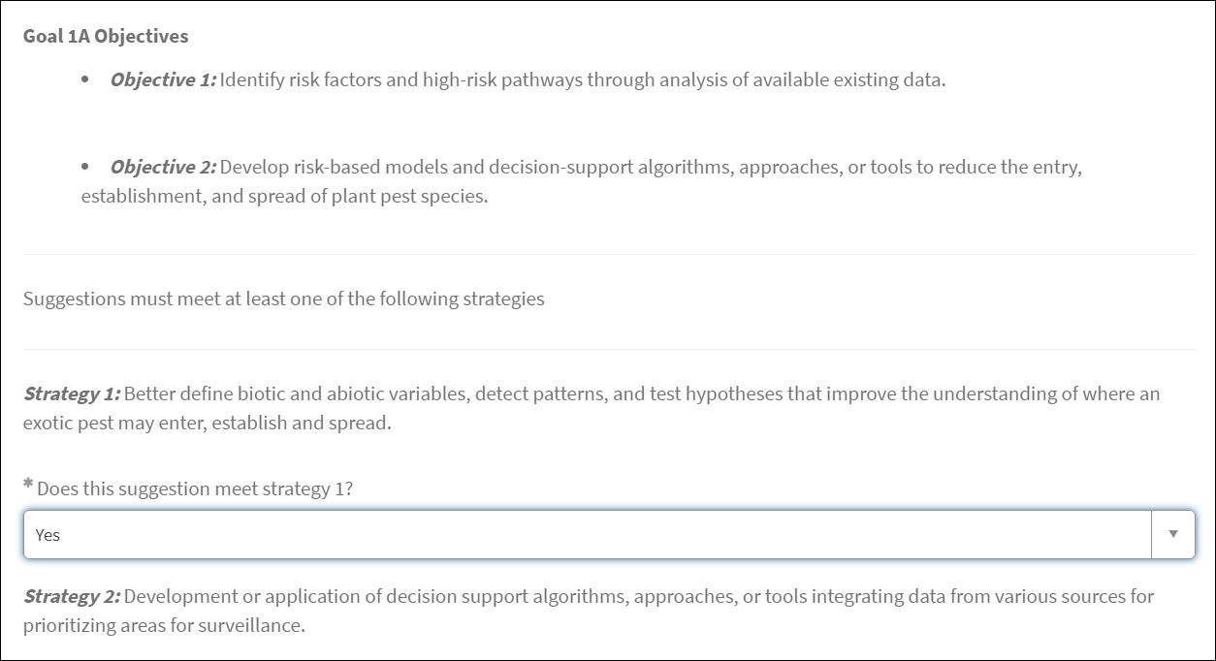
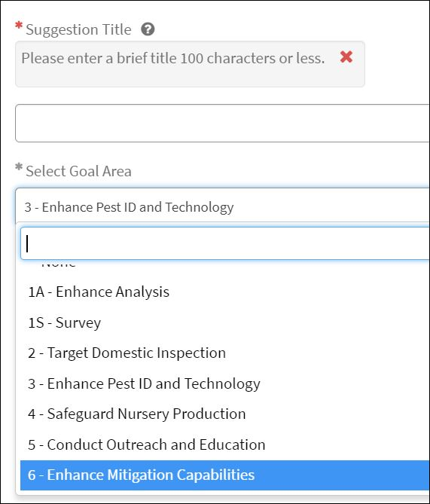
ServiceNow – Entering a Suggestion (4 of 9)
Reminders:
Suggestion Title – 100 characters or less
Suggestion alignment with Goal Area strategies and objectives
Reminders:
Suggestion Title – 100 characters or less
Reminders:
Review FY 24 Implementation Plan
Notes:
Following the fields for Cooperator Organization and Type, we start providing details of the suggestion. Start by entering a title for the suggestion. Give a concise title representative of the suggestion – make sure it’s 100 characters or less.
Then select the Goal Area. The suggestion content must align with Goal Area strategies and objectives. After selecting the Goal Area, specific Objectives and questions for strategies will appear. Make sure that you can answer yes to at least one of the strategy questions.
Note: An error will appear if a suggester selects ‘No’ to all of the questions for strategies, in which case we highly recommend reviewing the FY 24 Implementation Plan and selecting a goal area that most appropriately aligns with your suggestion before proceeding.

Slide 20
ServiceNow – Entering a Suggestion (5 of 9)
Project Pest or Plant Disease
PPA 7721 Attributes
Notes:
The fields for ‘Project Pest or Plant Disease’ and ‘PPA 7721 Attributes’ follow the questions for Goal Area alignment with Objectives and Strategies. These fields have associated drop down menus for which multiple selections can be made.
For ‘Project Pest or Plant Disease’, if your suggestion isn’t associated with the items listed in the drop down menu, select ‘Other Pest’. Another field will open where you can enter the common name or category/group of pests (for example, citrus viroids).
For ‘PPA 7721 Attributes’, this field helps make the assignment of suggestions easier during the Review process. This field doesn’t confer an advantage/disadvantage to a suggestion, therefore if your suggestion isn’t associated with one of the attributes, click on the checkbox for ‘Attributes not applicable’ and move on to the next field.

Slide 21
ServiceNow – Entering a Suggestion (6 of 9)
Select Yes or No for IT component
Select the State/Territory where work will be primarily conducted
Select ‘National Project’ if appropriate
Notes:
After the PPA Attributes is the yes/no question asking if the suggestion has an information technology component, followed by selecting the state or territory from the dropdown list of where the project work will be primarily conducted. If the project is considered a national project, then click the ‘National Project’ checkbox. For example, if the suggestion is for the National Honey Bee survey, then you would select ‘National Project’.
Only APHIS can designate whether a project is national in scope. For questions pertaining to what is considered a national project, please reach out the PPA 7721 team.

Slide 22
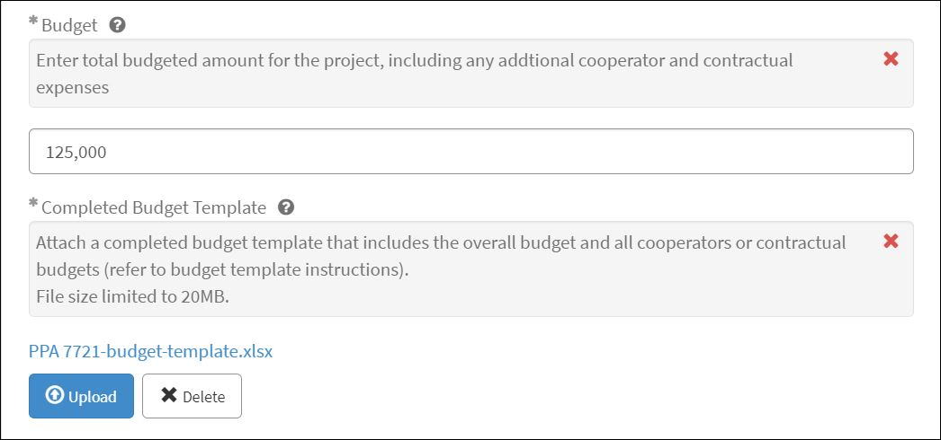
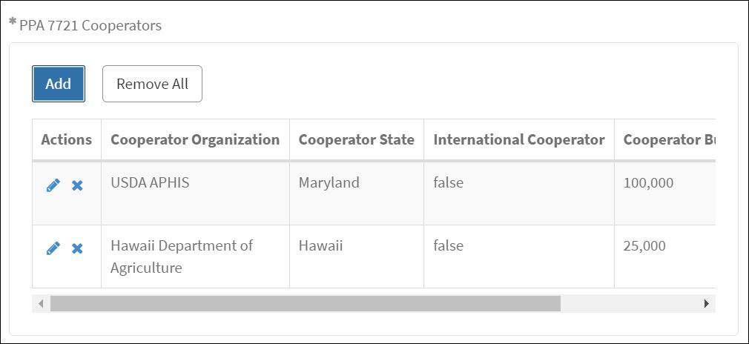
ServiceNow – Entering a Suggestion (7 of 9)
Budget = $ dollar amount for entire suggestion (including all cooperator budgets)
Upload completed Budget Template
Cooperator budgets must add up to the budget total
Notes:
In the ‘Budget’ field suggesters will provide the dollar amount for the total budget (which includes all cooperator and contractual budgets). Budgets of project collaborators and partners, for example those that don’t receive funds directly through a Cooperative Agreement with APHIS, should not be included in the budget.
Suggesters will then be asked to upload a completed budget template . This is consistent for all Goal Areas, except for Goal 1S which has budget details included in the Survey Template.
If the suggestion has multiple cooperators, answer ‘Yes’ to the question asking about additional cooperators and use the ‘Add’ feature to provide information about additional cooperators. Again, Collaborators and partners do not need to be listed in the suggestion if they are not receiving funds directly from APHIS. Note that the sum of the budgets for all cooperators must be equal to the total budget listed for the suggestion.

Slide 23
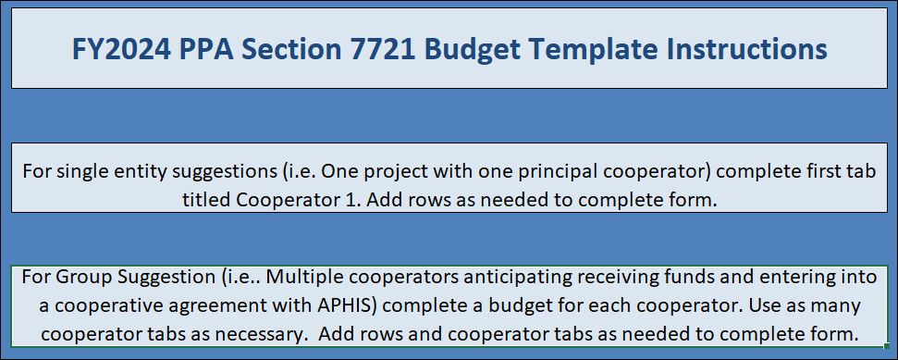
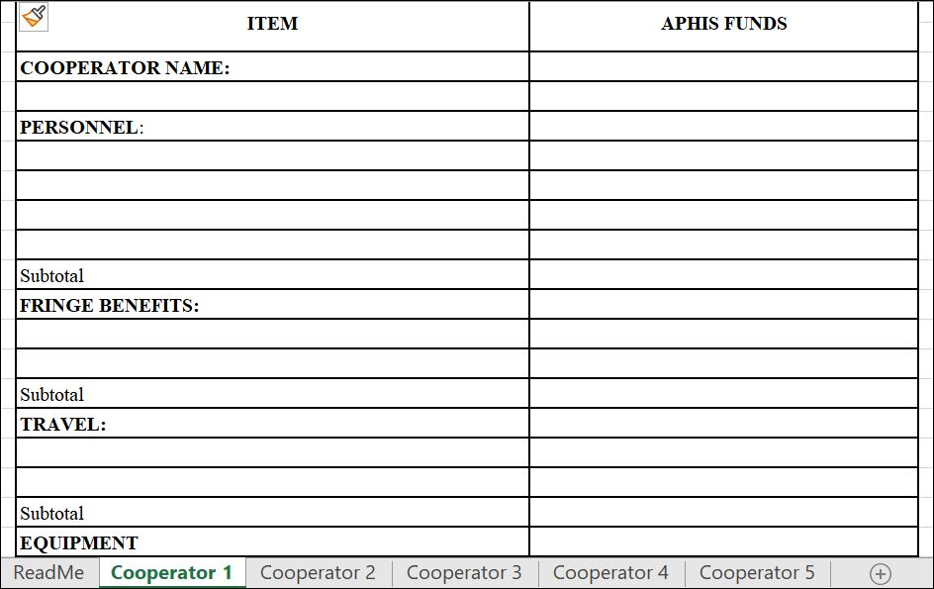
ServiceNow – Uploading a Budget Template
Budget template is available on the PPDMDPP website
Download and complete the template before initiating the suggestion process
Include budgets for all cooperators who will receive funding
Notes:
The budget template for Goals 1A and 2-6 are provided on the APHIS PPA 7721 website. This template needs to be downloaded and completed prior to uploading in the suggestion submission form.
The budget template accommodates multiple cooperator budgets for group suggestions. New tabs can be added. For each cooperator that would receive their own cooperative agreement, if funded, a detailed budget should be included here.

Slide 24
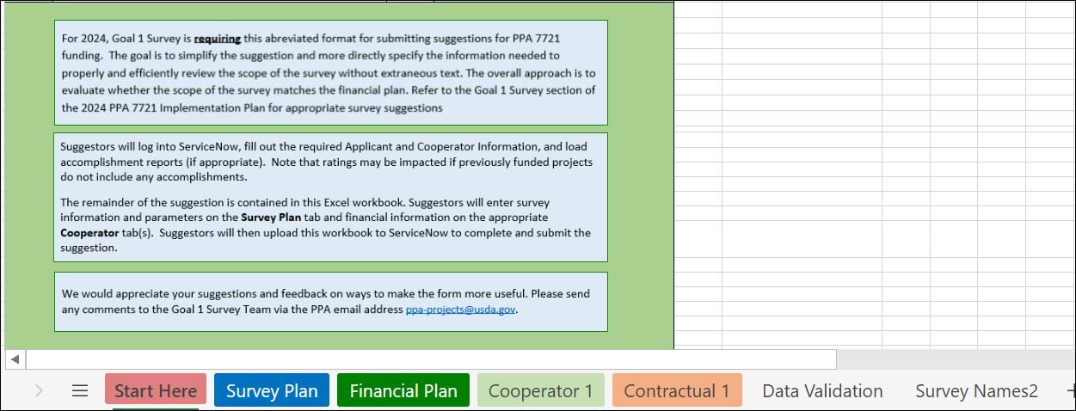
ServiceNow – Goal 1 Survey Suggestions
Notes:
Now, for those submitting a suggestion for Goal Area 1: Survey, the template has not been changed from last year, and MUST be used with all Goal 1S submissions.
The Goal 1 Survey Template spreadsheet is found on the APHIS PPA 7721 PPDMDPP website and includes tabs for the budget/financial plan for the suggestion; it should be downloaded and completed, and then uploaded in the appropriate field.
Be sure to read directions carefully, found at the ‘Start Here’ tab, when filling out the template.
This template makes it easy for reviewers to see that the pest targeted, approach planned, and budget are aligned.
Suggesters must also fill all required fields and answer the Goal related questions within ServiceNow

Slide 25
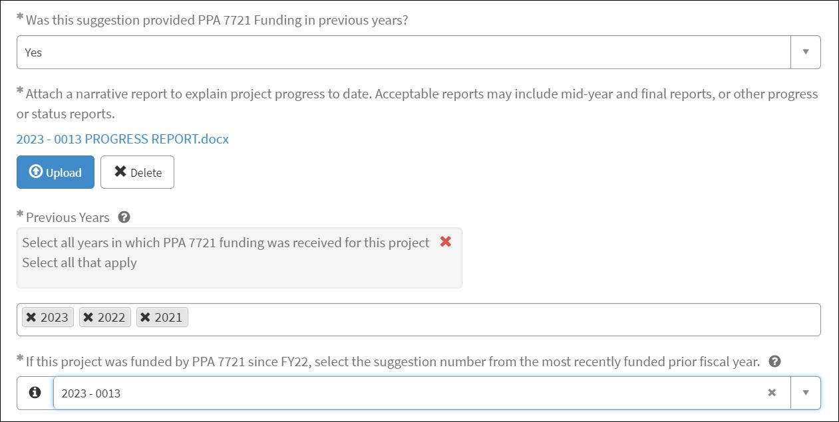
ServiceNow – Entering a Suggestion (8 of 9)
For projects that were provided funding in FY22 or FY23, select the suggestion number from the most recent prior fiscal year (found on the PPDMDPP webpage)
Notes:
Following the budget questions, a suggester will be asked if the suggestion was provided funding in previous years (for example, if the suggestion is in Year 2 of a multi-year suggestion, then answer ‘Yes’).
A field will open requesting that the suggester upload the most recent Progress Report or Accomplishment Narrative for the prior year suggestion. An uploaded Progress/Accomplishment Report is a requirement.
This field is followed by selecting all the years for which the suggestion has been provided funding. Multiple years can be selected from the drop down menu; therefore, add all years that apply.
New for this year, if the suggestion was provided funding in FY 22 or FY 23, then select the suggestion number from the most recently funded prior fiscal year in the drop down list. Suggestion numbers for projects funded in FY 22 or FY 23 can be found on the PPDMDPP webpage under ‘Resources for Suggesters’.

Slide 26
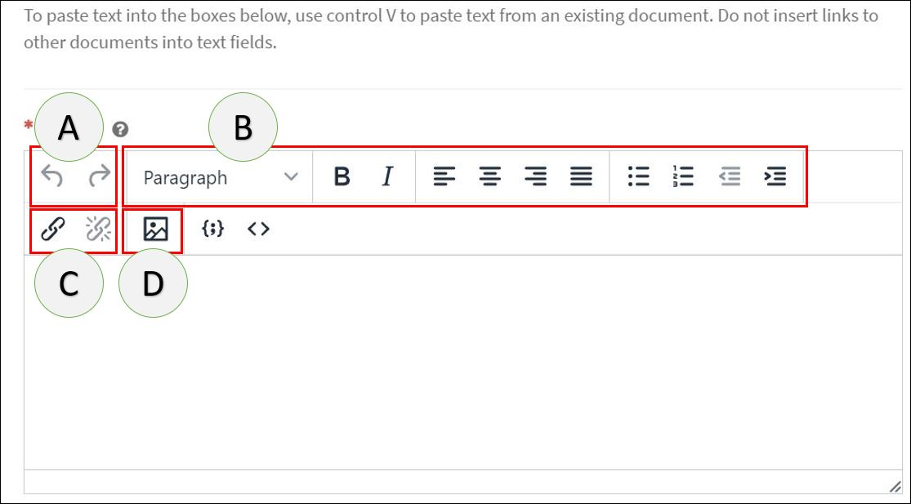
ServiceNow – Entering a Suggestion (9 of 9)
A – Redo/Undo typing | B – Text formatting options
C – Add/Remove links | D – Add image
Use Ctrl – V to paste information in rich text boxes
Rich text boxes used for capturing the Abstract, Purpose, Technical Approach, Past Performance/Best Practices/Innovations, and Milestones for Goals 1A and 2-6.
Notes:
Rich text boxes are used for capturing the Abstract, Purpose, Technical Approach, Past Performance/Best Practices/Innovations, and Milestones for Goals 1A and 2-6.
For Goal 1S, rich text boxes are available to capture the Abstract, Past Performance/Best Practices/Innovations, and Milestones. The Technical Approach and Purpose are captured as questions specific to Goal 1S in the survey template.
Rich text boxes allow for easier formatting and viewing and have the same utility as common text editors. Images can also be attached to support, for example, the Technical Approach write up.
The letters indicated refer to the following functions:
A- redo/undo typing
B- Text formatting options
C- add/remove hyperlinks
D- Add image
If using the add/remove hyperlinks, do not link it to any files on your personal computer. This feature only works for adding hyperlinks to functionally pre-existing webpages from the web as an accompaniment to submitted content.
Note: Only the rich text box for ‘Abstracts’ has a character limit of 500 words or less; other fields with rich text boxes such as the milestones have a larger character limit.

Slide 27
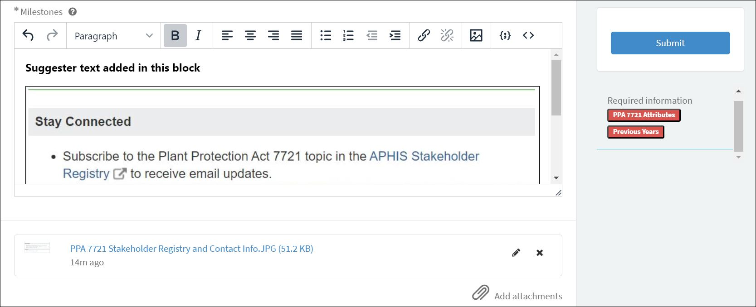
ServiceNow – Submission Final Check
Final check:
Confirm uploaded attachments (budget or survey template, narrative report, etc.)
No missing information
Hit ‘Submit’
IMPORTANT – AFTER SUBMISSION NO EDITS CAN OCCUR!
Notes:
After completing all the fields, but before submitting the suggestion, applicants should do a final check. This check should include reviewing all attachments, if included, which are shown at the bottom of the page. If a suggester wants to add attachments, such as recently published articles, pertinent to the suggestion, they would do so using the ‘Add attachments’ icon. Do not add any attachments that you don’t want to be reviewed or are not relevant to the suggestion. Next, make sure there’s no missing information. Fields with missing information will be shown in red under the ‘Submit’ button.
Lastly, click the submit button. It’s important to note that once a suggestion is entered into ServiceNow, no further edits can be made. Therefore, make sure the suggestion includes everything you want reviewers to see before clicking submit.

Slide 28
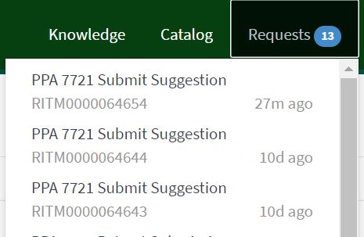
ServiceNow – Suggestion Completion
What happens when you complete a submission:
A unique ServiceNow and suggestion number is assigned
Recommend saving these numbers for your records
The information in the suggestion form is saved
Notes:
What happens when you complete a submission:
An email will be sent confirming that you’ve completed the submission process.
A unique ServiceNow number (called the RITM number) and a suggestion number are assigned when the suggestion has been successfully submitted. We recommend saving these numbers for your records, especially if you’re submitting several suggestions during the open period.
The information, including all attachments, in the suggestion form are saved at this time in ServiceNow.
The ServiceNow RITM number and the suggestion number can be used to identify a submitted suggestion, in the event that a suggester wishes to review details of their submission. This can be done by clicking on ‘Requests’ in the top green banner and selecting your suggestion.
Users will see all suggestions submitted under their eAuthentication account, populated under ‘Requests’. This includes suggestions from anyone of the six goal areas they submit.

Slide 29
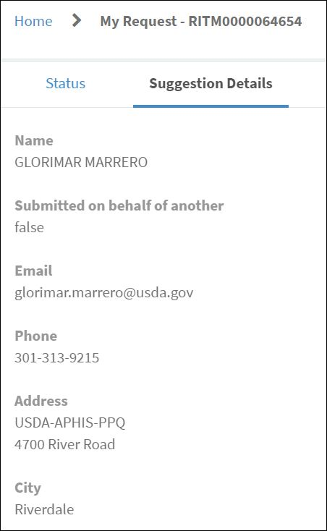
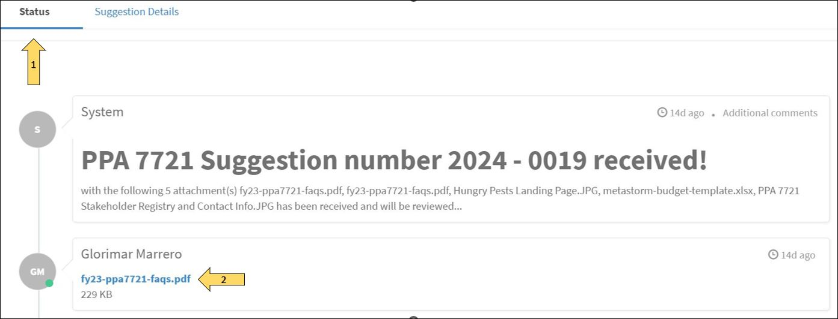
ServiceNow – Reviewing a Suggestion
Notes:
All information pertaining to a submitted suggestion is visible when a user clicks ‘Requests’ on the ServiceNow Suggestion Submission portal as was previously mentioned.
A new page will open with two tabs, ‘status’ and ‘suggestion details’. Under ‘Status’ the suggester will be able to see a quick glimpse of all the attachments included with the suggestion. A submitter can then view and download the attachments if desired.
Under ‘Suggestion details’ a suggester can view their responses to the fields in the suggestion form. Editing the suggestion is not possible once it’s been submitted.
It's important to review the details of the submitted suggestion before the end of the Open Period, and preferably right after submission, to guarantee that you have all the information entered properly and all attachments are the ones that submitters expect to be available during the Review process of their suggestion.

Slide 30
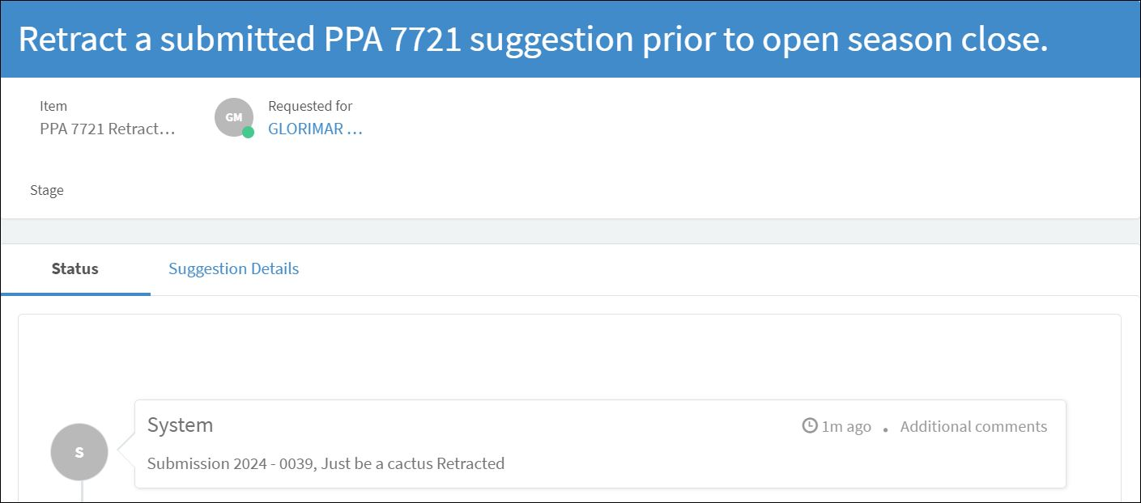
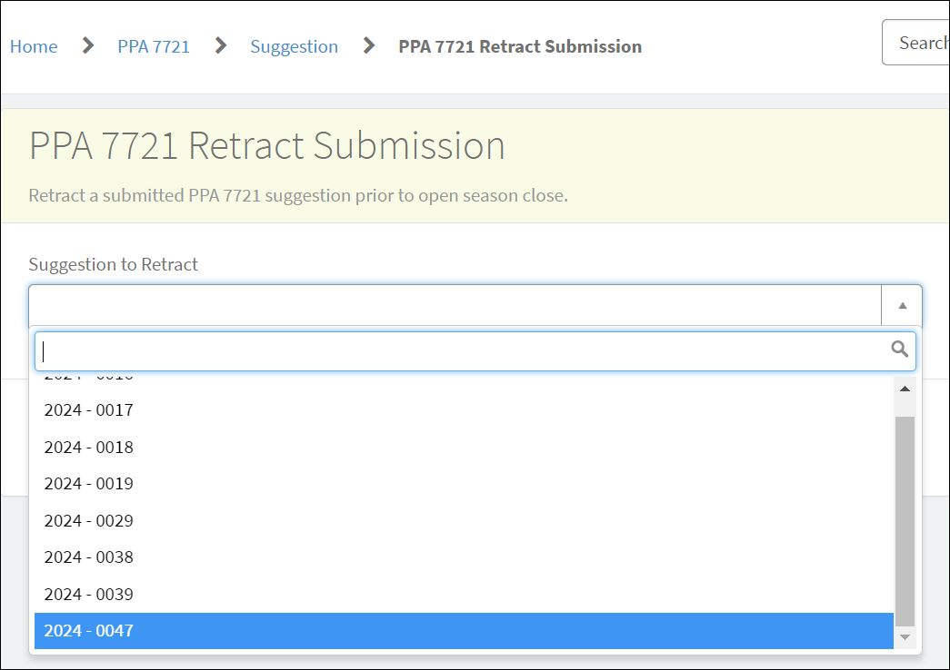
ServiceNow – Retracting a Suggestion
No email will be sent to users who have retracted a submission
Notes:
If a suggester wishes to retract their submission, they can do so from the Suggestion Submission Portal landing page by clicking on the icon entitled ‘Retract a PPA 7721 Suggestion’.
A new page will open where the user will be asked to select the suggestion they want to retract by the Suggestion Number they received earlier.
After clicking submit, a new page will appear confirming that the suggestion has been retracted.
If a suggestion is retracted, but the submitter wants to submit a new suggestion, they will need to follow the previous steps in filling out a new suggestion form.

Slide 31
Review: ServiceNow Suggestion Tips
Start early
Have completed materials ready at the start
Prepare to complete the submission in one sitting
Check all details before clicking ‘Submit’
Retract before the end of the open period
For assistance or questions related to
ServiceNow email: Ppa-Projects@usda.gov
Notes:
Helpful tips when using ServiceNow:
Start the suggestion process early in the open period
Have all materials such as templates and the body/narrative of the suggestion completed before starting the process
Prepare to complete the submission in one sitting to avoid timing out in ServiceNow due to inactivity (remember that the system will time out after 30min of no activity to the server)
Check the details- review all responses and attachments before clicking submit
If you need to retract your suggestion, do so before the close of the Open Period
For assistance or questions related to ServiceNow email Ppa-Projects@usda.gov

Slide 32
Suggestions: Things to Consider
Strategic Alignment
Does the suggestion align with the strategic objectives of PPA’s Sec. 7721?
Impact/Outcome
Will the project make an impact and produce results as defined by the individual goal area?
Feasibility
Can the project be accomplished based on key factors such as resources, collaborative partnerships, and clearly defined process?
Past Performance, Best Practices and Innovation Will the project be successful based on previous experience in similar endeavors or to the extent in which the project utilizes best practices and innovation to achieving success?
Notes:
Remember to refer to the FY 24 Implementation Plan for more information on individual goals, including objectives and strategies.

Slide 33
Tips for a high-quality Suggestion (1 of 4)
Review the annual Implementation Plan first!
Be concise in your writing
Lead with the purpose of your project in the Abstract
Clearly state objectives and deliverables
Articulate the following in the Suggestion Body
Purpose, Benefits, and Accomplishments
Prior Experience, Best Practices, and/or Innovations
Budget
Technical Approach
Milestones
Notes:
Pause and Emphasize: If you have questions, don’t forget to drop them in the chat.

Slide 34
Tips for a high-quality Suggestion (2 of 4)
Purpose, Benefits, and Accomplishments should include:
Problem/Opportunity and Objective statement
Project importance – alignment to Goal Area
Scope – reasonable for one year of funding
Return on investment
Prior Experience, Best Practices, and/or Innovation should include:
Clear accomplishments achieved
Demonstration of best practices, innovations, and subsequent outcomes achieved
Notes:
Goal Statement – What is the specific benefit of this project to the state, region or nation? ​
Alignment to goal area – is the suggestion aligned with a specific goal area? Again, see the goals outlined in the Implementation Plan​
One Year scope - Funding is for one year from start of cooperative agreement. Must re-apply for additional years of funding. Projects should be written for a one-year time-frame, with clear goals, objectives and metrics to be accomplished within that year.​
Prior experience - Include clear description or examples of past performance relevant to this project.

Slide 35
Tips for a high-quality Suggestion (3 of 4)
Budget
Reasonable for one year of funding
Allocate majority of funds for direct action (operations, research, products)
Minimize funds for ancillary activity (travel, logistics, etc.)
Technical Approach
Define methodology to be used and why
Identify tasks and how they advance objectives
Include well-defined performance measures
Milestones
Outline project duration, progression steps, and benchmarks
Notes:
Budget - Again, funding is for one year from start of cooperative agreement. Allocate the majority of funds for direct action including operations, research, and products​
Methodology - Provide enough detail to evaluate the project, and include well-defined performance measures and milestones​

Slide 36
Tips for a high-quality Suggestion (4 of 4)
Cooperators
Identify:
Roles and responsibilities
Expertise and capabilities
Prior experience
Define how each cooperator benefits the suggestion and advances its goals
Notes:
Identify the roles and responsibilities of cooperators in suggestions, making sure to highlight how cooperators will advance suggestion goals

Slide 37
Frequent Suggestion Mistakes
Missing Accomplishment Reports or Status Updates for previous years
Confusing or unreasonable Budgets
Unclear Approach, deliverables, and/or Performance Measures
Poorly defined Milestones
Notes:
In the past the PPA 7721 team and reviewers have commented on frequent suggestion mistakes which could include submitting to the wrong goal area, providing an unjustified budget, vague goals and objectives, or an unrealistic time for completion of work, etc.
We'll discuss a little further, for instance:
Missing accomplishment reports or status updates for previous years
This is relevant if a suggestion is submitted for subsequent years
2. Confusing or unreasonable budgets
The attached budget is unclear in who, what, and where the requested funding is going to
3. Unclear approach, deliverables, and/or performance measures
Suggestion submissions should include specifics like defining who the audience is, which pests or pathways you are addressing, and how, specifically, you know that the project will be successful
4. Poorly defined milestones
Define clearly when each major task will be accomplished, including specifics like delivering presentations, developing materials, and more

Slide 38
Review Process: Evaluation Criteria
Strategic Alignment
Plant Protection Act Section 7721
Impact/Outcome
Project Results
Feasibility
Resources, partnerships, process
Past Performance, Best Practices and Innovation
Budget
Notes:
Here we'll go through some of the evaluation criteria that is used when reviewing suggestions:​
Strategic Alignment – Does the suggestion align with the strategic objectives of PPA 7721?
Impact/Outcome – Will the project make an impact and produce results as defined by the individual goal area? How does it support or advance our current knowledge, tools, and/or capabilities?
Feasibility – Can the project be accomplished based on key factors such as resources, collaborative partnerships, and clearly defined process?
Past Performance, Best Practices and Innovation – Will the project be successful based on previous experience in similar endeavors or to the extent in which the project utilizes best practices and innovation to achieving success?

Slide 39
Contacts & Staying Connected
Group Email: Ppa-Projects@usda.gov
Subscribe to the Stakeholder Registry - PPA 7721 topic at: http://bit.ly/aphisupdates
Or go to the APHIS Web site http://www.aphis.usda.gov and click APHIS Stakeholder Registry sign up
Notes:
Questions about the PPA 7721 program should be directed to the PPA-Projects@usda.gov email address.
We encourage you to subscribe to the stakeholder registry to receive updates on the PPA 7721 program. More detailed information on how to subscribe can be found within the FAQs document.

Slide 40
Questions?
Ppa-Projects@usda.gov
Notes:
Please type any questions you may have into the chat.
For persons that are calling in, please unmute your mic and share your question(s).

