Slide 1
Disposal
Thermal Disposal and Other Methods
Adapted from the FAD PReP/NAHEMS
Guidelines: Disposal (2012)
Notes:
Effective disposal of animal carcasses and associated materials is a critical component of a successful response during an animal health emergency, such as a major disease outbreak or a foreign animal disease (FAD). During an animal health emergency, disposal measures are implemented to prevent the introduction of or mitigate the spread of the pathogen through the elimination of infected, or potentially infected, animal carcasses and associated materials. Disposal also serves to remove potentially contaminated feed or food products from the animal feed and human food supply, protect the nation’s agricultural and national economy, and also - if the disease is zoonotic, safeguard public health. This presentation describes specific methods including thermal disposal, and novel methods such as alkaline hydrolysis, anaerobic digestion, gasification, and plasma vitrification. [This information was derived from the Foreign Animal Disease Preparedness and Response (FAD PReP)/National Animal Health Emergency Management System (NAHEMS) Guidelines: Disposal (2012)].

Slide 2
Thermal Disposal Methods
Notes:
This section describes thermal disposal methods, such as fixed-facility incineration, open-air/uncontrolled burning, and air-curtain incineration.

Slide 3
Thermal Methods Overview
High-temperature combustion
  Diesel fuel, propane, furnace, waste oils
  Do NOT use gasoline
Transmissible Spongiform Encephalopathy (TSE) agents rendered non-infectious by
  Minimum 1560ºF for 15 minutes
  Higher temperatures (1830ºF) ideal
Notes:
Thermal methods use high-temperature combustion to destroy animal carcasses, associated animal materials, as well as most pathogens. Incineration is a method that has been used historically as a disposal option and continues to be utilized in some circumstances. Various fuel sources are used to start and accelerate combustion and include diesel fuel, propane, and furnace or waste oils. Gasoline or other highly explosive accelerants should not be used. To effectively render Transmissible Spongiform Encephalopathy (TSE) agents noninfectious, materials must be subjected to very high temperatures - at least 1,560° Fahrenheit (850° Celsius) for at least 15 minutes. If possible, a higher temperature of 1,830° F (1000° C) should be reached.

Slide 4
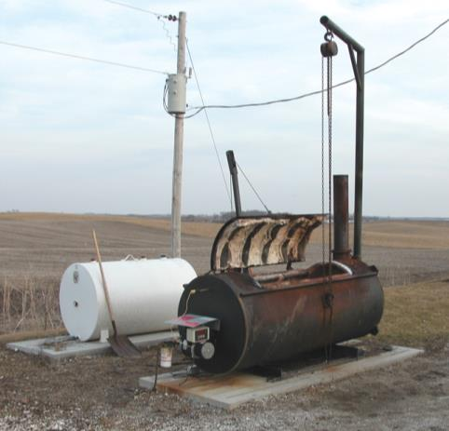
Fixed-Facility Incineration
Contained environment
Fueled by diesel,
natural gas, propane
Emissions controlled
Highly efficient
Little residue (ash)
High fat carcasses burn more quickly
Notes:
Fixed-facility incineration takes place in a completely contained environment and is usually highly controlled. Fixed-facility incinerators are typically fueled by diesel, natural gas, or propane and have emission control devices installed as part of an environmental protection plan. This method can be highly efficient and produces little residue as carcasses and associated materials are reduced to inert ash, which is usually acceptable for landfill disposal. The type of species has a large influence on the speed at which carcasses are incinerated; the greater the percentage of animal fat, the more efficient the carcass will burn. Swine burn more quickly than other species. This incineration method has been successfully used in the United Kingdom (UK) to dispose of Bovine Spongiform Encephalopathy (BSE) infected cattle. [This is a photo of a fixed-facility incinerator. Photo source: Iowa State University Veterinary Diagnostics and Production Animal Medicine]

Slide 5
Fixed-Facility Incineration
On-site incinerators
  Large animal production facilities, vet schools/diagnostic laboratories, etc.
  Limited continuous capacity
Other waste incineration facilities
  Municipal solid waste facilities, etc.
  Unlikely to accept animal carcasses
    Batch feed, and low heating value
Notes:
Large scale animal production facilities as well as veterinary schools and diagnostic laboratories may have on-site incinerators. However, it is unlikely that private incinerator facilities would have sufficient continuous capacity to handle large emergency losses. The concept of incinerating carcasses in large incinerators for hazardous waste, municipal solid waste, and in power plants has also been suggested. However, large-scale whole-carcass disposal would be problematic given the batch-feed requirements at most biological waste incineration plants. Animal carcasses may be refused due to a low heating value and high water content, which requires substantial addition of fuel to maintain an appropriate temperature for incineration. Additional issues in accepting pathological waste include lack of capacity to dispose of the additional waste and problems with acceptability of processing pathological wastes.

Slide 6
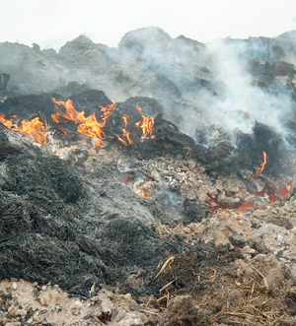
Open-Air Burning
History of used
“Uncontrolled”
  Fuel and air inputs
  not controlled
Incomplete/smoky,
low-temp combustion
Lengthy process
May be prohibited by States
Notes:
Historically, open-air or uncontrolled burning has been used to thermally destroy animal carcasses and associated materials during animal health crises. Open-air burning may be termed “uncontrolled” burning because it has the least opportunity for inputs to be monitored. Because neither the fuel nor air inputs can be controlled, the result of open-air burning is often an incomplete and relatively low-temperature combustion. Open-air burning can emit smoke, odors, hydrocarbons, heavy metals and metal salts, fuel specific chemicals, nitrous particles, sulfur dioxide, nitrogen dioxide, dioxins and other pollutants into the air. Many states allow for incineration of carcasses on-farm but specifically prohibit burning them in the open. Open-air burning is the most lengthy of all incineration processes. As with fixed-facility incineration, the type of species burned influences the length of time. [This photo shows a burning pyre. Photo source: Dennis Darnell, USDA]

Slide 7
Open-Air Burning
Negative public perception
  Use isolated areas
  Use trained personnel
  Involve fire authorities
Open fields, pyres
Combustible materials
  Hay, straw, dry timbers
  Ash disposal / pathogen escape
Notes:
Public perception of open-air burning is overwhelmingly negative. Open-air burning should be conducted far away from the public by properly trained and credentialed personnel with input from local fire authority. If environmental regulations permit, carcasses can be burned in open fields, on combustible heaps called pyres, or with other burning techniques that are unassisted by incineration equipment. To promote thermal production, combustible materials such as hay, straw, dry timbers, and usually some type of diesel or other fuel may be added to the pyre. The volume of ash generated by open-air burning can be significant and must also disposed of. Temperatures in the burn may not be consistent, so pathogens may not be inactivated and could be dispersed in smoke particles.

Slide 8
Air-Curtain Incineration
Combination of forced air and fuel used to burn carcasses or waste
  Increased temperature
  Accelerated combustion (up to 6x faster than open-air burning)
Fan/manifold delivers high-velocity air into metal box or burn pit
Mobile or fixed technology
Notes:
Air–curtain incineration combines forced air and fuel (such as wood, coal or diesel) to increase the temperature and accelerate combustion to burn carcasses and/or associated materials. It burns materials outside, but can be up to six times faster than open-air burning. Large-capacity fans (manifolds) driven by diesel engines deliver the high-velocity air down into either a metal refractory box or burn pit (trench). The use of metal refractory boxes is particularly useful when soil type makes trench digging difficult or when higher water tables are an issue. This method may be either a mobile technology or fixed technology. Resources associated with using air-curtain incineration are generally portable. Transportation and placement would be limited by terrain or other environmentally limiting factors.

Slide 9
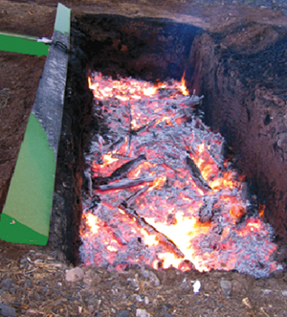
Air-Curtain Incineration
Systems vary in size and speed of throughput
Can produce noise
Require fuel
  Dry wood
  Coal
  Diesel (fire and fan)
Produces ash
Notes:
Air-curtain systems vary in size according to the carcass mass to be incinerated. The incinerator can produce significant noise and should be located away from residential centers and the general public to avoid producing a noise nuisance. This process is extremely fuel-intensive. Dry wood or coal for fuel is essential for air curtain incineration and plays a critical role in ensuring a proper air/fuel mixture. Diesel may also be used to fuel the fire as well as the air-curtain fan. Speed of throughput depends on the manufacturer, design, and management of the air-curtain system. Air-curtain incineration, like other combustion processes, yields ash. [This is an image of burning waste material using an air-curtain incinerator. High velocity air flow comes from the fan at the left of the photo. Photo source: Norman Fuhrmann, Air Burners, LLC]

Slide 10
Other Disposal Procedures
Notes:
This section describes novel disposal methods such as alkaline hydrolysis, lactic acid fermentation, gasification, and in situ plasma vitrification. Currently, these disposal options are expensive and are typically used only by highly specialized operations such as veterinary schools or large research facilities. They are typically sized for routine operations rather than emergencies.

Slide 11
Alkaline Hydrolysis
Process
  High temperatures (steam heat), pressure, and pH (strong base)
Solid by-products and sterile aqueous solution produced
On-site or fixed location
Low carcass capacity, but effective against pathogens such as TSEs
Notes:
Alkaline hydrolysis uses high temperature (such as steam heat), pressure and pH (usually strong base like potassium hydroxide or sodium hydroxide) to process carcasses and associated materials. Using this technology, solid by-products and a sterile aqueous solution are the products of the conversion of lipids, proteins, and nucleic acids. This technology can take place on-site or at a fixed-facility. Alkaline hydrolysis is limited by low carcass material capacity, and is also time consuming, requiring at least 3 hours to kill microbial pathogens and 6-8 hours to deactivate transmissible spongiform encephalopathy (TSE) prions. However, because it is one of only a few technologies that can inactivate prions, it remains a viable disposal method. Alkaline hydrolysis also results in significant quantities of potentially hazardous liquid waste.

Slide 12
Anaerobic Digestion
Lactic acid fermentation
  Ground carcasses mixed with lactic acid bacteria and fermentable carbohydrates
  Produces water, methane, CO₂
Does not inactivate prions
Process takes 7-10 days
Produces odors, store in sealed and controlled-vented containers
Notes:
Lactic acid fermentation is a type of anaerobic carcass digestion that reduces carcasses mainly to water, methane, and carbon dioxide. Ground carcasses and associated materials are mixed in fermenting tanks with lactic acid bacteria and fermentable carbohydrates such as whey, corn, or sucrose. This process produces lactic acid as well as odors from ammonia, carbon dioxide and other organic smells. To reduce odors, digested carcass material should be stored in sealed and controlled-vented containers. The process may take 7-10 days to complete. Once the carcass material has undergone sufficient fermentation, the material may be stored in sealed and controlled-vented vats and transported to a rendering facility. This process does not inactivate prions, but is effective against viruses and bacterial diseases.

Slide 13
Gasification
Emerging thermal technology
  Slow heating occurs in containers
    Gasification and combustion chambers
  Batch or continuous process
Converts carcasses into gasses and ash
  Carbon dioxide, carbon monoxide, methane
Process takes up to 12 hours
Notes:
Gasification is an emerging thermal technology that converts carcasses into gasses—mainly carbon dioxide, carbon monoxide, methane and hydrogen. Some ash is also produced and can be managed using methods outlined for incineration, such as burial in a landfill. The conversion, which takes up to 12 hours, requires the use of slow heating (1,100-1,900 ° F) in containers that contain primary (gasification) and secondary (combustion) chambers. Some of the produced gas may be used for heat energy to further the gasification process. There are two types of gasification systems: batch and continuous. Continuous gasifiers, still under development, are advantageous because they are more efficient when compared to batch systems.

Slide 14
Plasma Vitrification
Electrically generated heat used to ionize compressed air
High temperatures (7000°C +)
Water is vaporized
Reduces biomass by 97%
Converts carcasses to rock-like solid residue
  Resistant to leaching
Notes:
In situ plasma vitrification, or simply vitrification, is an emerging technology that is still being studied. This process uses electrically generated heat to ionize compressed air. All gaseous emissions resulting from the procedure are captured and treated. This process results in temperatures in excess of 7000°C in the torch and, when carcasses are subjected to the high temperatures in the vicinity of the torch, water is completely vaporized. Still in an experimental phase, this method may produce sufficient heat to inactivate BSE prions and mobile configurations are possible. One advantage of this method is that it reduces the biomass of the original substance by about 97%. It also produces a rock-like solid residue that is highly resistant to leaching with no requirement for hazardous waste disposal. A disadvantage is that transportation of carcass material is required if a mobile configuration is not utilized, thus increasing the risk of spreading infection.

Slide 15
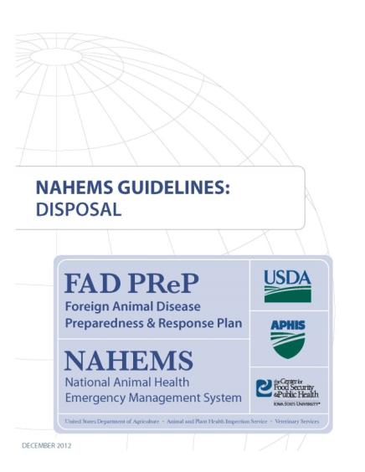
For More Information
FAD PReP/NAHEMS Guidelines & SOP: Disposal (2012)
  http://www.aphis.usda.gov/animal_health/emergency_management/
Disposal web-based training module
  http://naherc.sws.iastate.edu/
Notes:
More details can be obtained from the sources listed on the slide, available on the USDA website (http://www.aphis.usda.gov/animal_health/emergency_management/) and the NAHERC Training Site (http://naherc.sws.iastate.edu/).

Slide 16

Guidelines Content
Authors
Reneé Dewell, DVM, MS (CFSPH)
Tom Glanville, PhD (Iowa State University)
Significant contributions to the content were provided by
USDA APHIS VS:
Lori P. Miller, PE
Darrel K. Styles, DVM, PhD
Notes:
This slide acknowledges the authors and those who made a significant contribution to the content of the FAD PReP/NAHEMS Guidelines: Disposal document. Please see the Guidelines document for others who also provided additional assistance with content development.

Slide 17
Acknowledgments
Development of this presentation was by the Center for Food Security and Public Health at Iowa State University through funding from the USDA APHIS Veterinary Services
PPT Author: Kerry Leedom Larson, DVM, MPH, PhD, DACVPM
Reviewers: Janice Mogan, DVM; Reneé Dewell DVM, MS
Notes:
Information provided in this presentation was developed by the Center for Food Security and Public Health at Iowa State University College of Veterinary Medicine, through funding from the US Department of Agriculture, Animal and Plant Health Inspection Service, Veterinary Services.

