Slide 1
Disposal
Composting, Rendering, and Burial
Adapted from the FAD PReP/NAHEMS
Guidelines: Disposal (2012)
Notes:
Effective disposal of animal carcasses and associated materials is a critical component of a successful response during an animal health emergency, such as a major disease outbreak or a foreign animal disease (FAD). During an animal health emergency, disposal measures are implemented to prevent the introduction of or mitigate the spread of the pathogen through the elimination of infected, or potentially infected, animal carcasses and associated materials. Disposal also serves to remove potentially contaminated feed or food products from the animal feed and human food supply, protect the nation’s agricultural and national economy, and also - if the disease is zoonotic, safeguard public health. This presentation describes specific disposal methods including composting, rendering, and permitted landfill/burial. [This information was derived from the Foreign Animal Disease Preparedness and Response (FAD PReP)/National Animal Health Emergency Management System (NAHEMS) Guidelines: Disposal (2012)].

Slide 2
Composting
Notes:
During a large scale animal health emergency, it is likely that more than one disposal method will be utilized. This section will cover the process of composting, as well a specific applications.

Slide 3
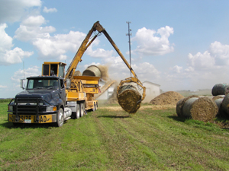
Composting Overview
Aerobic decomposition method
  Carcasses placed between layers of carbon rich organic materials
  Nitrogen provided by carcasses
  Carbon provided by plant materials (co-compost/
  cover materials)
Notes:
Composting promotes aerobic decomposition through placement of carcasses between layers (approximately two feet thick) of carbon-rich organic materials. Decomposition requires nitrogen, carbon, oxygen, and moisture for optimal tissue breakdown. In carcass composting, carcasses serve as the source of nitrogen. They can be composted whole or, to speed the process, can be ground prior to pile formation. The addition of high carbon plant material, such as ground cornstalks, straw, sawdust, and wood shavings (referred to as co-compost or cover material), serves to meet the carbon requirement, absorb excess moisture, and retain heat/sustain high internal temperatures necessary for rapid decomposition and pathogen suppression. The decomposition process and underlying scientific principles are similar for indoor and outdoor composting. [This photo depicts round forage bales which are a common material for co-compost and cover material. Photo source: Tom Glanville, Iowa State University.]

Slide 4
Composting Process
First phase
  Desired core temperature of pile reaches 135-140ºF within 15 days
    May be delayed in cold seasons
    May be difficult to reach and maintain
  Ideally maintained for 3-12 weeks
  Heat and other factors destroy pathogens
  Avoid dispersal of the pathogen
Notes:
In the first phase of carcass composting, the desired core temperature of the composting pile reaches between 135-140 degrees F within 15 days of compost initiation. However, reaching optimal temperature may be delayed during cold seasons, and during emergency composting, optimal temperatures may be difficult or impossible to reach and maintain. This is due to large carcass and pile size and high organic loading (causing oxygen depletion) in the core of the compost pile. Depending upon the size of the carcass biomass, this temperature should ideally be maintained for a length of time—between 3 and 12 weeks. Heat is a significant driver in pathogen destruction but other factors such as microbial competition, drying, and toxic decomposition gases will often aid in reduction of pathogen populations. Aeration is important during the first phase, but if the carcasses are infected, care must be taken to prevent dispersion of pathogen-laden aerosols which may occur during grinding, mixing, turning of the piles, and passively through wind.

Slide 5
Composting Process
Second phase
  Time to completion varies by carcass size
    10 days (chickens)
    240 days (mature cows, horses)
  Large quantities of cover material required
    10-12 cubic yards per 1,000 lb. carcass
    May be difficult to acquire
Notes:
During the second phase, aeration is not as critical. The time to complete phase 2 is also dependent upon the carcass size and can vary from an estimated 10 days (chickens and other poultry) to approximately 240 days (mature cows and horses). When selecting composting as a disposal method, an important consideration is the availability of large quantities of carbon sources - both as a cover material and as a thick base layer. For example, bovine composting may require 10-12 cubic yards of cover material (ground cornstalks, ground straw, or corn silage) per 1,000 lb. of carcass. If very large numbers of carcasses must be composted, locating, transporting, and grinding sufficient quantities of cover material will be a significant task.

Slide 6
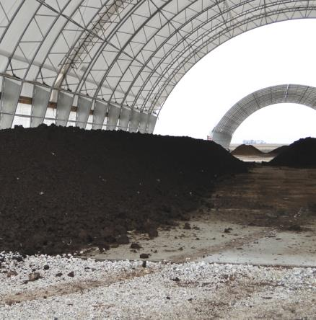
Indoor Composting
Common in poultry industry
Less affected by:
  Weather, temperature, seasonality
Challenges
  Space limitations
  Excess water/moisture
  Type of water used in
  foam depop of poultry
  prior to composting
Notes:
Composting may take place indoors or outside. The poultry industry has widely implemented indoor composting for mortalities. Indoor composting processes are less affected than outdoor composting by weather events, ambient temperatures, drying conditions, and seasonality. Indoor composting presents some challenges for space limitations (i.e., restricted space for the use of heavy equipment to turn piles). Copious amounts of water are used for foam depopulation of poultry and, although some water can expedite composting, excessive water volume can prolong decomposition times in the composting process. When choosing indoor composting as a disposal method following foam depopulation, it is important to use a neutral pH water source that is “soft” or minimally hard and has low sediment concentrations. [This is an image illustrating the protection afforded by an indoor composting facility. Photo source: Danelle Bickett-Weddle, Iowa State University]

Slide 7
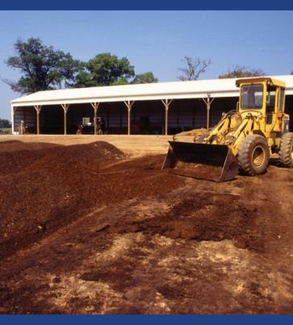
Outdoor Composting
Common for large animal species
  Long, narrow windrows formed
Site selection
  Well drained
  300 feet away from bodies
  of water
  Downwind of public
  areas/communities
Protect from adverse weather events
Notes:
Composting for large animal species such as beef and dairy cattle typically occurs outdoors. In an animal health emergency, piles would likely be formed into long, narrow windrows. Optimal composting sites should be well drained, must be located at least 300 feet away from bodies of water, and downwind of public areas or communities. Site accessibility should not be hindered by typical seasonal weather changes and a reasonable plan to control runoff must be in place. Adverse weather events such as high wind weather advisories and extreme precipitation can affect compost pile quality. To offset added moisture, base and cover layers of the compost pile may be made more absorbent by constructing them with additional thickness. [This photo depicts a tractor applying the layers to the outdoor composting pile. Photo source: USDA Agricultural Research Service]

Slide 8
Rendering
Notes:
This section will describe the process of rendering, as well as different configurations that may be used.

Slide 9
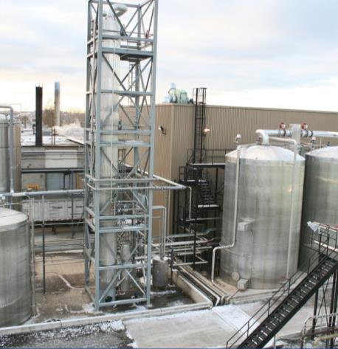
Rendering Overview
Off-site process
Uses heat to convert carcasses into
  Protein-based based
  solids (bone meal)
  Water
  Melted fat/tallow
Inedible for humans
Notes:
Rendering is an off-site process that uses heat to convert carcasses into protein-based solids (meat, feather, bone, and blood meal), water, and melted fat/tallow. Although some rendering plants associated with a packing plant or poultry processing facility may produce edible fats and proteins that might be used in the manufacture of gelatins or cosmetics if they conform to Food and Drug Administration (FDA) processing standards, only inedible rendering will be discussed in this presentation. Products that are deemed inedible for humans may be used in some livestock feeds, soap, and other production processes. [This is a photo of a rendering plant. Photo source: David Meeker, National Renderers Association]

Slide 10
Planning for Rendering
Limited number of rendering plants
  Limited surge capacity
Temporary storage of waste material
Transportation to the facility
Biosecurity issues through whole process
Disposal of end products
Notes:
Careful planning and coordination of disposal activities must occur so that rendering facilities are not overwhelmed. There may be few rendering plants in the proximity and surge capacity for emergency carcasses and associated waste material may be limited. While temporary storage and transportation of the waste material needs to be considered, biosecurity issues must be addressed. Biosecurity protocols within the facility during the processing may need to be modified to prevent pathogen transmission. Most pathogens (except prions, for example) are killed during the rendering process. All parties need to be aware of the fact that some rendered product may not be marketable. A plan for the final disposal of that product must be developed, such as landfilling or burial of the final products.

Slide 11
Dry Rendering
Only type available in the U.S.
Process
  Ground carcasses cooked in own fat
  Contained in horizontal, steam-jacketed cylindrical vessel with agitator
  High temperatures destroy pathogens
  End products – protein solids (meat, feather, bone, blood meal), fat, steam
Notes:
There are two types of inedible rendering: dry rendering and wet rendering. Dry rendering is the only type of rendering process currently utilized in the U.S. In general, the dry rendering process occurs off-farm, necessitating transport that poses some risk of pathogen spread. Dry rendering cooks ground carcasses in their own fat while contained in a horizontal, steam-jacketed cylindrical vessel equipped with an agitator. The final temperature of the cooker (250-275°F) destroys harmful pathogens and produces end products such as protein solids (meat, feather, bone, and blood meal), fat and steam. Although routine rendering produces usable end products that may be used in animal feeds, the end products from infected carcasses may not be marketable.

Slide 12
Batch Configuration
Raw material crushed to small pieces
Heat drives off moisture
Cooker heated to 250-275ºF
  Breaks cell structures
  Releases fat as tallow, drains away
Cooked material discharged
Process takes 2-3 hours
Notes:
There are two types of dry rendering systems – batch configuration and continuous rendering. In a batch configuration, the raw material from a receiving bin is conveyed to a crusher or similar device to reduce its size to pieces of 1-2 inches for efficient cooking. Cookers are heated at normal atmospheric pressure to around 212°F until the moisture is driven off through vents in the form of steam. The temperature rises to 250-275°F depending on the type of raw materials. This high temperature breaks the cell structure of the residue and releases the fat as tallow. The cooked material is discharged into a separate container, which allows the free-run fat to drain away from the protein solids known as tankage or cracklings. The tallow is decanted off and the solids are emptied from the cooker. The heating process during batch rendering normally takes 2-3 hours.

Slide 13
Continuous Configuration
All rendering processes done simultaneously
Little to no manual input required
  Automatic time and temperature controls
  Products generated at constant rate
Offer greater flexibility than batch systems
Notes:
In continuous rendering all the same rendering processes (heating and separation of fat and solids) are done simultaneously and consecutively. Most continuous rendering systems require little to no manual operation. Finished products will be generated at a constant rate if there is a adequate supply of carcasses. Continuous rendering systems are generally equipped with automatic controls for both time and temperature. Compared to batch rendering configuration, continuous systems also generally offer greater flexibility, allowing a wider range of time and temperature combinations for cooking raw materials.

Slide 14
Permitted Landfill/Burial
Notes:
Some types of commercial or industrial permitted landfills may provide a reasonable option for carcass disposal in some cases. This section will describe the permitted landfill/burial, and in addition, will include a description of unlined trench burial.

Slide 15
Landfill Regulation
Modern landfills required to meet standards
  Subtitle D of the Resource Conservation and Recovery Act (RCRA)
  Title 40 Code of Federal Regulations (CFR) Parts 239-299
  Permitted - liners, leachate containment systems, and gas collection systems
Notes:
Modern landfills are required to meet design and operating standards outlined in Subtitle D of the Resource Conservation and Recovery Act (RCRA). These RCRA regulations are contained in Title 40 Code of Federal Regulations (CFR) Parts 239-299. Key features of the permitted landfill design include liners, leachate containment systems, and gas collection systems.

Slide 16
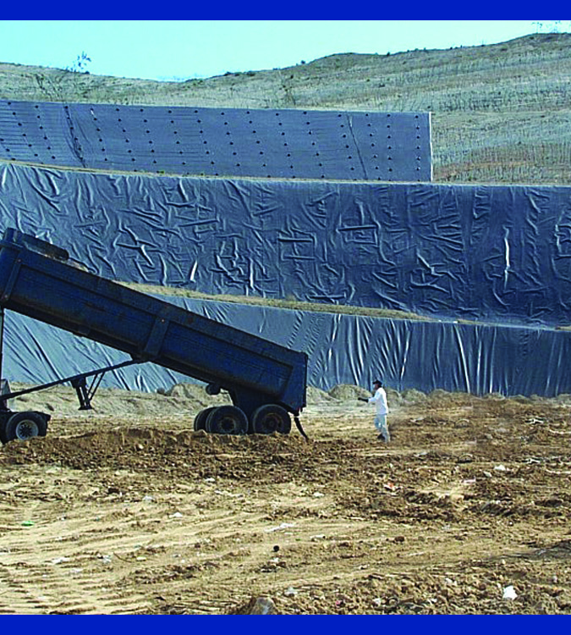
Permitted Landfill Overview
Three types of permitted landfills
  Construction and demolition
  Hazardous waste
  Municipal solid waste
    Used for catastrophic carcass disposal
    May lack environmental
    protection features
Notes:
Three types of permitted landfills exist in the United States: construction and demolition, hazardous waste, and municipal solid waste. Municipal solid waste landfills are often the most appropriate for catastrophic carcass disposal. Approximately 1,600 solid waste landfills currently operate in the U.S. as privately owned or operated by municipalities. For landfills to be considered a viable disposal option, officials should obtain a pre-catastrophe agreement with the landfill management/ownership for use of a landfill during an animal health emergency. In many states, disposal of animal carcasses and materials in landfills is permitted but the options may vary by state and circumstance. Many smaller or older landfills are unlikely to have extensive environmental protection features. [This photo shows the disposal of waste material at a landfill. Photo source: David Meeker, National Renderers Association]

Slide 17
Landfill Suitability Criteria
Location
Liner
Leachate management
Gas management
Monitoring
Odor and vermin control
Documentation
Notes:
During the 2001 outbreak of FMD, the United Kingdom identified minimum criteria for determining the suitability of a landfill for disposal of infected animal carcasses. The criteria include the following:
Location (proximity to various protected zones, aquifers, water tables, floodplains, etc.)
Liner (base and sides must be comprised of at least 1 meter of well-engineered clay)
Leachate management (effective and robust leachate management system to ensure collection of leachate for the next 20 years)
Gas management (required gas management infrastructures to collect gas from the whole of the site)
Monitoring (groundwater, surface water, and leachate)
Odor and vermin control
Documentation (location, number, and extent of animal carcasses deposited within the site)

Slide 18
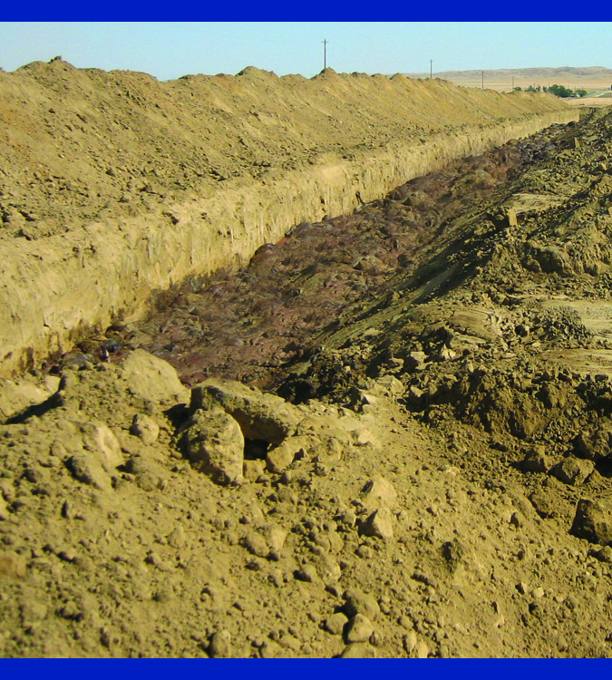
Unlined Burial Overview
Carcasses or waste materials placed in trench, earthen hole, or pit
Buried materials degrade over time
Leachate produced
  Potential groundwater contamination
Environmental liability
Notes:
Burial techniques discussed in this section on unlined burial options are differentiated from the previously discussed landfill disposal options because they are designed and engineered solely for the disposal of carcasses. In general, unlined burial of carcasses and related materials such as ash from other disposal procedures involves placing them in a trench or large, earthen hole or pit. Eventually, buried materials are degraded and broken down into minerals and organic material. Carcass degradation may generate significant quantities of leachate and groundwater contamination may result. The property owner is typically liable for all environmental remediation costs associated with the disposal method. [This is an image of an unlined burial site, constructed as a trench. Photo source: Jeff G. Taber, County of Kings Department of Public Health, Hanford, California]

Slide 19
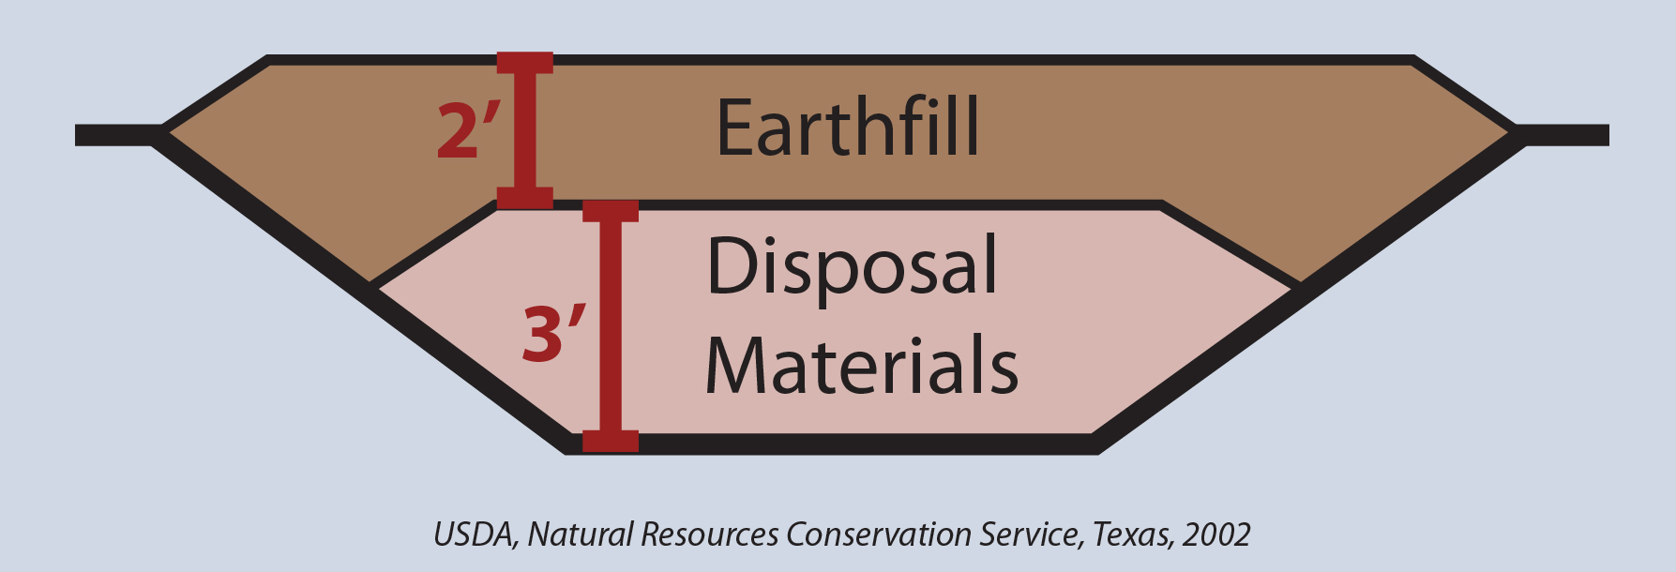
Unlined Trench Burial
On-farm or near depop location
Trapezoidal or vertical trenches
  4-8 feet deep and 6 feet wide
Notes:
Unlined trench burial typically takes place on or adjacent to premises where euthanasia occurs. It involves the excavation and creation of trapezoidal or vertical trenches for placement of carcasses. Trenches may vary from an estimated 4 feet to 8 feet in depth and are typically about six feet wide so that two large animal carcasses may be placed side by side. Waste materials are then covered with the excavated material (backfill). An extensive inventory of heavy equipment will likely be necessary to facilitate burial when used as a disposal method. [This is a schematic diagram of trench burial. Graphic illustration by: Andrew Kingsbury, Iowa State University]

Slide 20
Unlined Trench Burial
Length of time for disposal
  Time required for site identification
  Time required for site approval
  Species and number of carcasses
  Total excavation area and volume
  Type, quantity, and availability of excavation equipment
Environmental remediation
Notes:
The length of time required to dispose of carcasses via trench burial will depend on:
The time required to identify an appropriate site.
The time required to gain approval of the site by regulatory bodies such as environmental regulatory agencies.
The species and total number of carcasses to be buried.
The total excavation area and volume required.
The type, quantity, and availability of excavation equipment, as this determines the time required to excavate the necessary area. Response time can likely be minimized if as many of these issues as possible are addressed prior to the time of need.
The principal by-products resulting from burial are leachate and gases such as methane, carbon dioxide, hydrogen sulfide. The property owner is typically liable for all environmental remediation costs associated with the unlined trench burial. Depending on the volume of carcass material buried, some additional repair steps to backfill settlement, and contain gas or leachate may be needed.

Slide 21
Site Suitability
  Soil type and soil properties
  Slope, topography and hydrologic properties
  Wells, public areas, roadways, homes
  Underground utility or water lines
  Accessibility and subsequent use
  Resources and tools are available
State regulations may vary
Notes:
Soil type is critical in the decision to utilize trench burial, and in determining the suitability of a site. A less permeable soil type such as loam soil is preferred. In addition to soil type, other important characteristics include:
Soil properties (texture, permeability, surface fragments, depth to water table, depth to bedrock)
Slope or topography
Hydrologic properties
Proximity to water bodies, wells, public areas, roadways, dwellings, residences, municipalities, or property lines
Underground utility or water lines
Accessibility and subsequent intended use of the site
Resources such as the National Resource Conservation Service (NRCS), tools such as NRCS Geographic Information Systems (GIS) and state and university sources should assist the decision process. State regulations vary considerably in terms of specific criteria required for a suitable burial site.

Slide 22
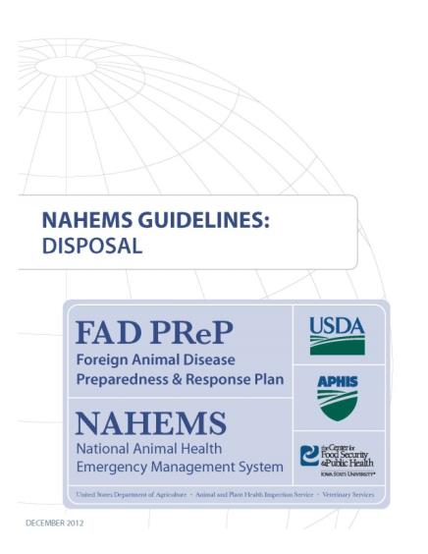
For More Information
FAD PReP/NAHEMS Guidelines & SOP: Disposal (2012)
  http://www.aphis.usda.gov/animal_health/emergency_management/
Disposal web-based training module
  http://naherc.sws.iastate.edu/
Notes:
More details can be obtained from the sources listed on the slide, available on the USDA website (http://www.aphis.usda.gov/animal_health/emergency_management/) and the NAHERC Training Site (http://naherc.sws.iastate.edu/).

Slide 23

Guidelines Content
Authors
Reneé Dewell, DVM, MS (CFSPH)
Tom Glanville, PhD (Iowa State University)
Significant contributions to the content were provided by
USDA APHIS VS:
Lori P. Miller, PE
Darrel K. Styles, DVM, PhD
Notes:
This slide acknowledges the authors and those who made a significant contribution to the content of the FAD PReP/NAHEMS Guidelines: Disposal document. Please see the Guidelines document for others who also provided additional assistance with content development.

Slide 24
Acknowledgments
Development of this presentation was by the Center for Food Security and Public Health at Iowa State University through funding from the USDA APHIS Veterinary Services
PPT Author: Kerry Leedom Larson, DVM, MPH, PhD, DACVPM
Reviewers: Janice Mogan, DVM; Reneé Dewell DVM, MS
Notes:
Information provided in this presentation was developed by the Center for Food Security and Public Health at Iowa State University College of Veterinary Medicine, through funding from the US Department of Agriculture, Animal and Plant Health Inspection Service, Veterinary Services. Reneé Dewell DVM,MS

