Slide 1
Continuity of Business
Overview
Adapted from the FAD PReP/NAHEMS Guidelines: Continuity of Business (2016)
Notes:
COB planning strives to mitigate the economic consequences of quarantine and movement control (QMC) during an FAD outbreak. COB employs science- and risk-based approaches to manage the movement of non-infected animals and non-contaminated animal products in order to stabilize animal agriculture, the food supply, and the economy. These approaches ease the effect of QMC while taking measures to control and contain the FAD.

Slide 2
Continuity of Business
Also known as managed movement
Allows movement of non-infected animals and non-contaminated animal products from non-infected premises during an FAD outbreak.
Helps agriculture and food industries to maintain normal business operations but mitigates the risks of animal and product movements.
The Secure Food Supply Plans

Slide 3
Preparedness and Response Goals of COB in an FAD Outbreak
Notes:
USDA APHIS has set several goals for COB in FAD preparedness and response.

Slide 4
Goals of COB
Preparedness
Prioritize animal or commodity movements that may be affected by disease or the disease response.
Establish a system for risk assessments, surveillance requirements, biosecurity procedures, and permitting to promote stakeholder compliance with regulatory interventions.
Notes:
APHIS will work with industry stakeholders and experts to prioritize movements that have the potential to be affected by disease or the disease response. Together, COB planners will establish a transparent and effective process for risk developing assessments, surveillance requirements, biosecurity procedures, and permitting processes to promote stakeholder acceptance and compliance with regulatory interventions by State, Federal, and Tribal authorities.

Slide 5
Goals of COB
Response
Implement the appropriate COB plan for the industries or industry segments affected by the outbreak.
Facilitate and permit the movement of non-infected animals and non-contaminated animal products from non-infected premises.
Notes:
APHIS will work with industry and Incident Command to implement the COB plan, allowing the permitted movement of
non-infected animals and non-contaminated animal products from non-infected premises.

Slide 6
Regulatory Intervention in an FAD Outbreak
Notes:
In an FAD outbreak, regulatory intervention at the Federal, State, Tribal, local, or industry level may occur.

Slide 7
Scope of Regulation
Determined by
Consequences of the outbreak
Disruption to interstate and international trade
Threat to national security, food security, animal health, the environment, and the economy
Acceptance of response policy
Scale of the outbreak
Rate of outbreak spread
Veterinary countermeasures available
Resources available for response
Notes:
The scope of regulatory intervention will be influenced by the following:
1) Consequences of the outbreak. The impact of the outbreak and the response effort, in terms of disruption to interstate commerce and international trade; threat to national security, food security, animal health, the environment, and the economy; and regulatory impact.
2) Acceptance. Acceptance of response policy (social and political) by different stakeholders, from local to international.
3) Scale of the outbreak. The number of animals infected, species infected, number of premises affected, and susceptible animal population density for infected areas or areas at high-risk of becoming infected with the disease.
4) Rate of outbreak spread. The rate of spread of infection in terms of number of premises, types of premises, number of animals, and types of animals; rate at which each Infected Premises (IP) leads to infection of one or more additional IP.
5) Veterinary countermeasures available. The availability and efficacy of veterinary countermeasures, including vaccines.
6) Resources available to implement response strategies. The capabilities and resources available to eradicate the disease in domestic animals and to control and eradicate the disease in potential wildlife reservoirs.

Slide 8
Quarantine & Movement Control (QMC)
Quarantine
Stringent restrictions on entering or leaving an area where disease is known to exist or is suspected
In an FAD outbreak, quarantine broadly prohibits movements of animals, animal products, and fomites from a specified premises, area, or region
Movement control
Criteria for the movement of animals within a regulatory Control Area
From non-infected premises
Requires permits
Based on specific criteria
Notes:
[Definitions for the purpose of this discussion.]
Quarantines and movement controls are an important regulatory intervention to control and contain an FAD.
A quarantine protects unaffected animal populations by containing the FAD and reducing disease transmission.
Federal quarantines and movement restrictions are typically instituted to control interstate and international movement of infected animals and contaminated animal products.
States may also use State authority to restrict the movement of animals, animal products, equipment, and other items. Depending on the disease and scope of the outbreak, the United States and/or individual States may use regionalization.
Disease-free regions or areas can be created to facilitate interstate and intrastate trade and potentially reopen U.S. international markets.

Slide 9
Authorities
Notes:
In an FAD incident response, the U.S. Code and Code of Federal Regulations provide policy, via statutes and regulations, for the United States Department Agriculture (USDA); interim regulations can be implemented—in the event of an outbreak—to prevent the spread of disease.

Slide 10
USDA APHIS Authorities
The Code of Laws of the United States of America (U.S.C.) are statues that have been passed by Congress and signed by the President. The Code of Federal Regulations (CFR) provides detailed interpretations of the U.S.C. as developed by the Executive branch agencies with comment allowed from the public.
APHIS receives its permanent and general regulatory authority from the Animal Health Protection Act (AHPA).
7 U.S.C. 8301 et seq.
Title 9 of the CFR provides APHIS detailed regulations on the control and eradication of animal diseases.
Notes:
The AHPA enables the Secretary of Agriculture to prevent, detect, control, and eradicate diseases and pests of animals, including foreign animal and emerging diseases, in order to protect animal health, the health and welfare of people, economic interests of livestock and related industries, the environment, and interstate and foreign commerce in animals and other articles. The term “animal” means any member of the animal kingdom (except a human), 7 U.S.C. 8301-8302. The Secretary is specifically authorized to carry out operations and measures to detect, control, or eradicate any pest or disease of livestock, which includes poultry, 7 U.S.C. 8308, and to promulgate regulations and issue orders to carry out the AHPA (7 U.S.C. 8315). The Secretary may also prohibit or restrict the importation, entry, or interstate movement of any animal, article, or means of conveyance to prevent the introduction into or dissemination within the United States of any pest or disease of livestock (7 U.S.C. 8303-8305).
Title 9 of the CFR provides detailed USDA APHIS administrative regulations for the control and eradication of animal diseases, including FADs and emerging animal diseases.
9 CFR 71.2 − Secretary (of Agriculture) to Issue Rule Governing Quarantine and Interstate Movement of Diseased Animals, Including Poultry
9 CFR 71.3 − Interstate Movement of Diseased Animals and Poultry Generally Prohibited
9 CFR 53 − Foot-and-Mouth Disease, Pleuropneumonia, Rinderpest, and Certain Other Communicable Diseases of Livestock or Poultry
9 CFR 161− Requirements and Standards for Accredited Veterinarians and Suspension or Revocation of Such Accreditation

Slide 11
State Authorities
Early stages of a response, including QMC, will involve State, Tribal, and local authorities and resources.
Typically, State quarantine orders are issued when an FAD is detected or suspected.
Relevant authorities vary by State and situation.
Authority of the State Animal Health Official is also variable by State.
Notes:
Legal authority is granted via statute by a legislating body, and regulations are promulgated by an executive agency under this statutory authority. Quarantine on a premises or movement restrictions within a Control Area may be issued based on an FAD detection. Since statutory authorities and regulations vary by State, it is important to become familiar with and follow the laws and regulations of your State, Tribal Nation, and/or locality. Generally, State quarantines and hold orders are issued by the relevant State authority when an FAD is detected or suspected. These may include quarantines of individual herds, flocks, premises, counties, or regions.

Slide 12
COB as Part of an FAD Response

Slide 13
Critical Activities
Public awareness campaign
Swift imposition of effective QMC
Rapid diagnosis and reporting
Epidemiological investigation and tracing
Increased surveillance
COB measures for non-infected animals and non-contaminated animal products
Biosecurity measures
Cleaning and disinfection measures
Effective and appropriate disposal procedures
Mass depopulation and euthanasia
Emergency vaccination
Notes:
During an FAD response, many activities must be conducted simultaneously. These are some of the critical activities which occur in an FAD outbreak, including COB. Other activities, such as surveillance, diagnostic testing, QMC, disposal, and vaccination will also help to rapidly and effectively control, contain, and eradicate the disease.

Slide 14
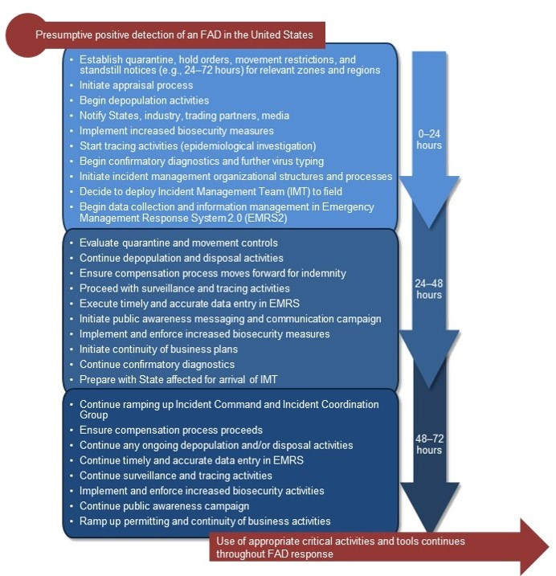
Critical Activities
Critical Activities in the First 72 Hours of an FAD Outbreak
Notes:
Competing Priorities and Interests
COB is not a standalone activity in an FAD outbreak. To be successful, COB must be integrated with other elements of an incident response. There are many activities that compete for limited resources in an event; a major challenge in preparing for and responding to FAD outbreaks is successfully managing these interests during the response. A priority of preparedness planning should be to discuss, mitigate, or resolve competing priorities prior to an incident. This can be accomplished by identifying required resources, establishing mutually accepted response goals and objectives, and increasing the awareness of these competing priorities.

Slide 15
COB & QMC
COB
Managed movement for non-infected premises in a Control Area
At-Risk and Monitored Premises
Industries maintain essential business functions (or return to business) during an outbreak
Risk of disease spread is managed
Limits impact of outbreak on indirectly affected parties
QMC
Keeps an FAD out of non-infected livestock and poultry populations to stop the spread of disease
Stops or significantly limits the movement of animals, products, fomites, vehicles, and equipment
Quarantines apply to Infected, Contact, and Suspect Premises

Slide 16
COB & QMC
COB and QMC have the same goal of preventing the transmission of an FAD to non-infected premises, particularly those outside the control area.

Slide 17
COB Plans for Managed Movement: Creating the Plans and Processes

Slide 18
Key Elements
Risk assessments
Surveillance requirements
Biosecurity guidance
Cleaning and disinfection
Epidemiological and premises information
Permitting guidance
Information management
Notes:
To effectively manage movement of non-infected animals and non-contaminated animal products from a regulatory Control Area, there are several common elements which are needed in a COB plan or procedure. Please note that every COB plan will be unique, depending on the disease agent, industry, and/or commodity in question.
To move non-infected animals and non-contaminated animal products in a disease outbreak from a regulatory Control Area, specific biosecurity guidelines, repeated diagnostic tests, and other measures may be required. These measures provide a high degree of confidence that movement will not increase the risk of disease transmission, to protect animal health, public health, and the food supply. These biosecurity, cleaning and disinfection, surveillance, and diagnostic requirements will be based on the best available science and proactive risk assessments. This will help to assure consumers, producers, responders, and other stakeholders that virus is not being transmitted between premises.

Slide 19
How COB Works
Notes:
COB plans were effectively implemented and used in the 2014—2015 highly pathogenic avian influenza outbreak in the United States.

Slide 20
Collaboration
COB planning requires the interaction of public officials, private sector, and academia/extension experts.
Prior to an outbreak, these groups develop processes to move animals and products from non-infected premises.
Proactive risk assessments are used to establish requirements for movement.

Slide 21
Challenges
Sector diversity
Acquiring consensus
Addressing competing needs and priorities
Keeping momentum going during planning
Delegating tasks
Clear responsibilities
Lack of resources
Effective use of resources
Buy-in from stakeholder groups
Notes:
There are a number of challenges that may be faced in developing and executing COB plans.

Slide 22
Continuity of Business: The Bigger Picture
Notes:
COB planning helps to reduce losses, facilitate food security, and allow agriculture and food industries to continue business operations by minimizing the impacts of quarantines on non-infected premises within regulatory Control Areas.

Slide 23
The Bigger Picture
COB benefits:
Planning helps protect animal health, food security, and public health
Continued supply of animals and animal products
Reduced production disruption and lessened economic impacts on rural communities
Improved understanding of the needs of industry, regulators, and consumers when dealing with an FAD response

Slide 24
Emergency Management
COB fits into the emergency management framework

Slide 25
Current COB Planning Efforts (Secure Food Supply Projects)
Notes:
Currently, there are a number of successful efforts underway where the government, private sector, and academia are collaborating to improve COB planning.

Slide 26
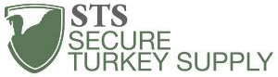
Secure Food Supply
Current public-private-academic collaborations and Secure Food Supply projects include:
Secure Poultry Supply Plan
Secure Egg Supply Plan
Secure Broiler Supply Plan
Secure Turkey Supply Plan
Secure Milk Supply Plan
National
Regional
Secure Pork Supply
Notes:
Secure Food Supply projects are developing commodity specific COB plans. Support for these plans is critical for their successful continuation. The goals of the Secure Food Supply projects are to do the following in an FAD outbreak:
• Avoid interruptions in animals and animal product movement to commercial processing from premises with no evidence of FAD infection;
• Provide a continuous supply of wholesome food to consumers; and
• Maintain business continuity for producers, transporters, and food processors through response planning.
The plans involve proactive risk assessments, permitting and movement guidance, surveillance guidelines, biosecurity guidelines, and other information specific to the commodity.
Key academic contributors to COB projects include the
• Center for Food Security and Public Health (CFSPH), Iowa State University;
• Center for Animal Health and Food Safety (CAHFS), University of Minnesota;
• University of California, Davis, Department of Veterinary Medicine and Epidemiology; and
• Veterinary Emergency Team, Texas A&M University.

Slide 27
For More Information
FAD PReP/NAHEMS Guidelines: Continuity of Business (2016) and related documents
http://www.aphis.usda.gov/fadprep/
Federal Emergency Management Agency (FEMA)
www.ready.gov
FEMA Business Recovery
www.ready.gov/business
Secure Food Supply Plans
www.securepoultrysupply.com
www.securemilksupply.org
www.securepork.org

