Slide 1
Cleaning and Disinfection
C&D Disinfectants
Adapted from the FAD PReP/NAHEMS
Guidelines: Cleaning and Disinfection (2014)
Notes:
This presentation is a general discussion of classes of chemical disinfectants – one method in the multi-step process of cleaning and disinfection, as performed in an animal health emergency. Always refer to the Site Specific Cleaning and Disinfection Standard Operating Procedures (SOP) developed for C&D protocols for a particular animal health response. This information was derived from the Foreign Animal Disease Preparedness and Response (FAD PReP)/National Animal Health Emergency Management System (NAHEMS) Guidelines: Cleaning and Disinfection (2014) and also the web-based training module.

Slide 2
Classes of Chemical Disinfectants for C&D Operations
Notes:
Cleaning and disinfection involves the use of physical or chemical processes to reduce, remove, inactivate, or destroy pathogenic microorganisms. After a thorough cleaning, the selection of the appropriate method of disinfection is crucial in decontamination of equipment, vehicles, premises, or personnel. If disinfection is to be performed using a chemical product, follow label instructions for application, contact time, and safety considerations. An ideal disinfectant is one that is broad spectrum, has low toxicity to humans and animals, is non-corrosive, and is relatively inexpensive. Few products meet all of these criteria. With the following slides we will discuss more detail on the selection and use of chemical disinfectants, as classified by their chemical nature.

Slide 3
Chemical Disinfection
Chemical
  USDA APHIS will determine which disinfectants are to be used
  Inactivates a wide variety of microorganisms – not all
  Chemical disinfectant classes
  Selection on characteristics, efficacy, and hazards
Notes:
In the event of a highly contagious foreign animal disease outbreak, USDA APHIS management will provide specific guidance to field personnel about which disinfectants should be used. Chemical disinfectants inactivate a wide variety of microorganisms, but not all. The products may be classified by their chemical nature. Each class has unique characteristics, efficacy, and hazards. Therefore, disinfection selection involves consideration of the product’s efficacy on a spectrum of microorganisms, material compatibility characteristics, and human hazards - all of which can usually be found on the product’s label. Most chemical disinfectants work by causing damage to a microorganism’s outermost structural integrity (i.e., disruption of the membrane proteins and lipids) which results in altered function, lysis, or interference with active transport and energy metabolism.

Slide 4
Chemical Disinfectants
Classes
Acids
Alcohols
Aldehydes
Alkali agents
Biguanides
Halogen-based compounds
Oxidizing/peroxide-based compounds
Phenols
Quaternary ammonium compounds
Notes:
This is a listing of classes of chemical disinfectants – acids, alcohols, aldehydes, alkali agents, biguanides, halogen-based compounds, oxidizing agents, phenols, and quaternary ammonium compounds. As said previously, chemical disinfectants inactivate a wide variety of microorganisms, such as most vegetative bacteria and enveloped viruses. However, fungal spores and non-enveloped viruses are generally less susceptible. Mycobacteria, bacterial endospores, and protozoal oocysts are highly resistant to most disinfectants. Prions, the etiologic agents of bovine spongiform encephalopathy and scrapie, are exceptionally resistant to chemical inactivation.

Slide 5
Chemical Disinfectants
Acids
  Inorganic and organic
  Alters pH – bactericidal below 3
  Hazardous and corrosive
Alcohols
  Ethanol and Isopropanol
  Hand sanitizers, small items
  Evaporate quickly and highly flammable
Notes:
Acids include inorganic (e.g., hydrochloric acid, sulfuric acid) and organic (e.g., acetic acid, citric acid) compounds. They exert antimicrobial action through the dissociation of free hydrogen ions, which alters the pH of the microorganism’s environment. Acids are generally effective against vegetative bacteria and can be bactericidal when the pH drops below 3. Acids are not considered effective against Mycobacteria or non-enveloped viruses; however, foot-and-mouth disease virus is an exception and is particularly sensitive to acids (citric acid). Acidic disinfectants can be caustic and cause chemical burns, therefore safety precautions need to be followed. Acids are highly corrosive to metal surfaces and concrete.
Alcohols are rapidly acting broad-spectrum disinfectants; they cause dissociation of free hydrogen ions which alters the pH of the microorganism’s environment. The most commonly used alcohol-based disinfectants are ethyl alcohol (ethanol) and isopropyl alcohol (isopropanol), used for hand sanitizers and antiseptics, and to disinfect small areas or items (e.g., pagers, cell phones, stethoscopes). They evaporate rapidly making extended exposure time difficult, and are highly flammable.

Slide 6
Chemical Disinfectants
Aldehydes
  Formaldehyde and glutaraldehyde
  Toxic at high concentrations
Alkali agents
  Sodium/calcium hydroxide, sodium carbonate, and calcium oxide
Biguanides
  Antiseptic (chlorhexidine)
  Toxic to fish
Notes:
Aldehyde [R-CHO] disinfectants include formaldehyde and glutaraldehyde. These alkylating agents denature proteins and disrupt nucleic acids causing irreversible inhibition of enzyme activity. High concentrations of formaldehyde can destroy all microorganisms, including spores, and has been used to inactivate viruses. Aldehydes are generally non-corrosive to metals, rubber, plastic and cement, but are highly irritating and toxic to animals and humans via contact or inhalation. Appropriate personal protective equipment must be worn when using all aldehyde products. Formaldehyde has been identified as a potential carcinogen. Occupational Safety and Health Administration (OSHA) standards limit the exposure time for personnel.
Alkali agents include products such as sodium or calcium hydroxide, sodium carbonate, and calcium oxide. Their antimicrobial action involves the dissociation of hydroxyl ions (–OH), which alters the environmental pH. The activity of alkalis is slow, but can be increased by raising the temperature and optimized at pH greater than 9. Alkalis are very caustic, and are corrosive to metals.
Biguanides are cationic compounds often used as a skin antiseptic and for preoperative skin preparation. Chlorhexidine is one of the most widely used biguanides and has very effective bactericidal action, but some bacteria (e.g., Pseudomonas) may be resistant. These disinfectants are inactivated by anionic compounds (e.g., soaps and detergents), hard water and organic matter and are pH sensitive, only functioning in the range of pH 5-7. Biguanides are toxic to fish and should not be discharged into the environment.

Slide 7
Chemical Disinfectants
Halogen-based compounds
  Chlorine or iodine (bleach)
  Broad spectrum
  Avoid forming toxic gasses
Oxidizing/peroxide-based compounds
  Hydrogen peroxide and others
  Virkon®S (footbaths)
Notes:
Halogen-based compounds include chlorine- or iodine-containing agents, such as household bleach. They function through their electronegative nature to denature proteins. Halogens are extremely sensitive to organic material, so thorough cleaning must be done prior to application. When used on clean surfaces, halogen-based compounds are broad-spectrum, with efficacy against bacteria, most viruses, Mycobacteria, and fungi. Halogens, especially chlorine, should never be mixed with strong acids or ammonia as toxic gases can be formed. USDA APHIS has a quarantine exemption for use of sodium hypochlorite for inactivating FAD agents.
Oxidizing/peroxide-based disinfectants are broad-spectrum and function by denaturing the proteins and lipids of microorganisms leading to membrane disorganization. They include hydrogen peroxide, peracetic acid, and peroxymonosulfate-based products (such as Virkon®S). Virkon®S, often used in footbaths, is considered to have low human toxicity; however, preparation of the powdered form can cause mucous membrane irritation. Face and eye protection should be worn.

Slide 8
Chemical Disinfectants
Phenols
  Among oldest disinfectants
  Broad spectrum (i.e., Mycobacteria)
Quaternary ammonium compounds
  Several “generations” of products
  Vary in composition and performance
  Corrosive and irritating at higher concentrations
Notes:
Phenols [C6H5OH] are among the oldest established disinfectants and include compounds derived from coal-tar or synthetic formulations or various homologues (e.g., cresols, xylenols and ethylphenols). They are generally broad-spectrum and function by denaturing cellular proteins. Phenolics are generally effective against many bacteria, Mycobacteria, fungi, and enveloped viruses. One of the phenols, 2-phenylphenol, is particularly effective against Mycobacterium species which are normally quite refractory to disinfectants. It was extensively used during the campaign against Mycobacterium bovis in the United States.
Quaternary ammonium compounds (QAC) are a diverse group of cationic surfactants normally used for routine cleaning of noncritical surfaces. QAC function by irreversibly binding to the negatively charged phospholipids in bacterial cell membranes and denaturing membrane proteins impairing permeability. There are several “generations” of products that vary in composition and performance. When used at recommended dilutions, QAC are generally non-toxic, but higher concentrations can be corrosive to metals and can cause irritation of the skin, eyes, and respiratory tract

Slide 9
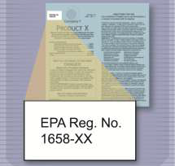
Disinfectant Regulation
Chemical disinfectants regulated by the U.S. EPA
  Federal Insecticide, Fungicide, and Rodenticide Act (FIFRA)
    Chemical disinfectants considered “antimicrobial pesticides”
    Pesticides must be registered
  Novel pathogens
    FIFRA exemption possible
Notes:
Important to note - Chemical disinfectants in the United States are regulated by the U.S. Environmental Protection Agency (EPA) under the Federal Insecticide, Fungicide, and Rodenticide Act (FIFRA) [Title 40 of the Code of Federal Regulations (CFR), Parts 150 to 189]. Under FIFRA, chemical disinfectants are considered to be “antimicrobial pesticides” that are intended for the control, prevention, and destruction of pathogenic microorganisms on inanimate objects and surfaces. FIFRA requires that any pesticide be registered or exempted before it may be sold or distributed in the United States. FIFRA further requires that all label use directions and safety precautions must be followed. In some situations (e.g., highly contagious foreign animal diseases), a particular pathogen may not be listed on the product label of an EPA-registered disinfectant. In these cases, Section 18 of FIFRA authorizes EPA to grant several different kinds of exemptions to Federal Agencies or States to use unregistered pesticides for a limited time, if EPA determines that emergency conditions exist. If granted, such exemptions would allow the use of non-registered pesticides or the “off-label” uses of a registered pesticide for a specified time period. USDA APHIS VS Staff will collaborate with the APHIS Policy and Program Development (PPD) Environmental and Risk Analysis Services (ERAS) Staff (phone: 301-734-8963) to obtain exemptions from EPA, either in advance of or immediately after an animal health emergency, as needed. [This illustration shows a registration number on a disinfectant label. Illustration by: Oriana Hashemi-Toroghi, Iowa State University]

Slide 10
Factors to Consider
Characteristics of the microorganism
  Susceptibility and persistence
Disinfection methods
  Efficacy under specific conditions
Environmental factors
Material composition/area
  Organic load, temps, water hardness
Notes:
When selecting a disinfection method or chemical product, there are a number of factors to be considered. These factors can impact efficacy, possibly cause failure of the disinfection procedures, or result in hazards or injury to personnel or animal if not considered or addressed. These include characteristics of the microorganism, disinfection methods and environmental factors. This will include understanding the general properties of the disease agent, its ability to persist in the environment, its transmission, and its susceptibility to disinfection. Understanding the effectiveness of a particular cleaning or disinfection product is determined by its composition and to a great extent by the conditions under which it is applied. In addition, environmental conditions such as organic load, surface topography, temperature, pH, water hardness, relative humidity, and the presence of other chemicals can also impact the efficacy of disinfection procedures. Lastly, the material composition of any surface, or area, to be decontaminated may present specific challenges to consider when planning C&D operations.

Slide 11
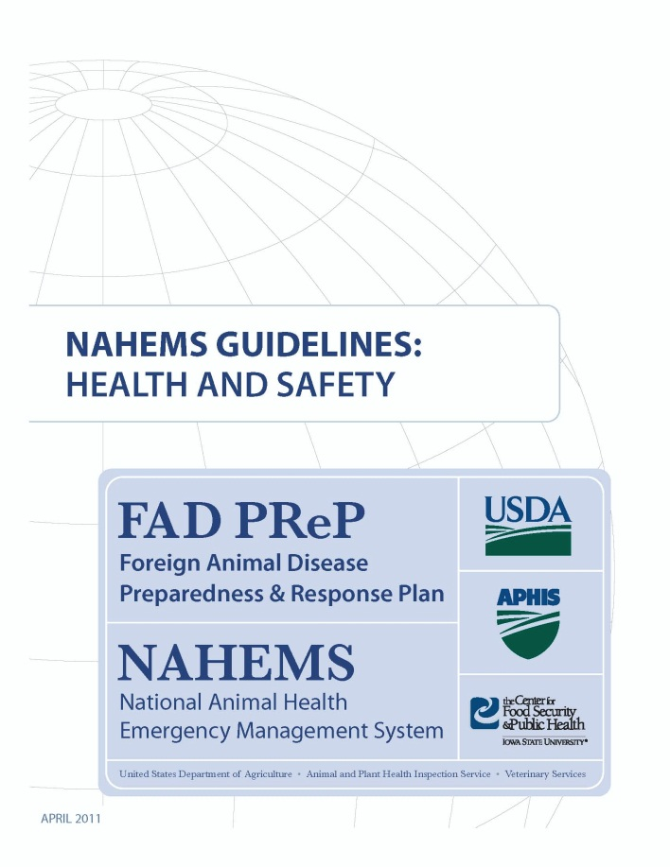
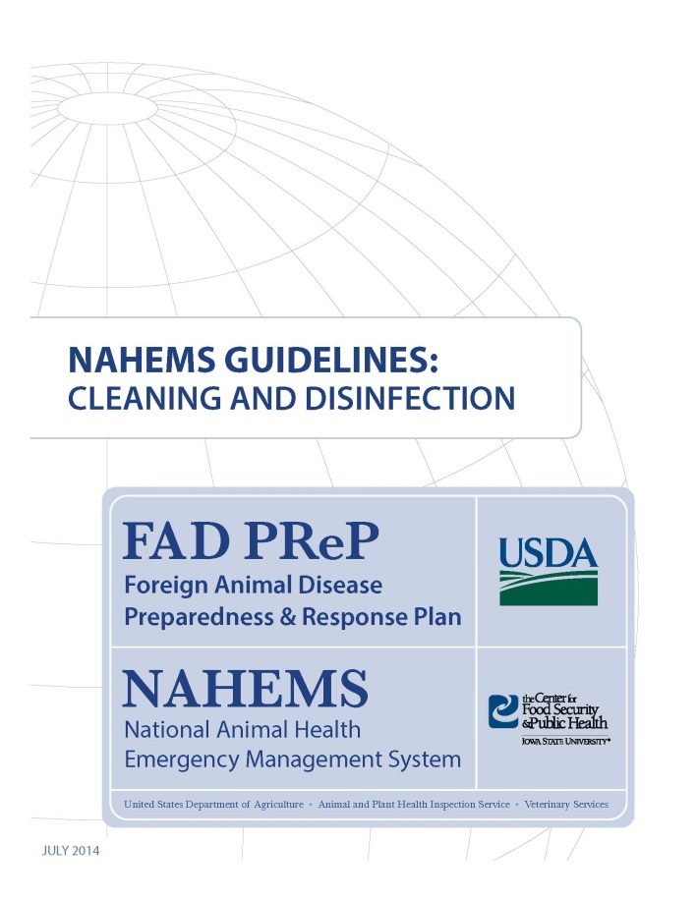
For More Information
FAD PReP/NAHEMS Guidelines & SOP: Cleaning and Disinfection
  http://www.aphis.usda.gov/fadprep
Cleaning and Disinfection web-based training module
  http://naherc.sws.iastate.edu/
Notes:
More details can be obtained from the sources listed on the slide, available on the USDA website (http://www.aphis.usda.gov/fadprep) and the National Animal Health Emergency Response Corps (NAHERC) Training Site (http://naherc.sws.iastate.edu/).

Slide 12
Guidelines Content
Author (CFSPH)
Glenda Dvorak, DVM, MS, MPH, DACVPM
Nichollette Rider, Junior Veterinary Student
Reviewers (USDA)
Nathan G. Birnbaum, DVM
Samantha B. Floyd, Biologist
Notes:
This slide acknowledges the authors and reviewers of the Guidelines document.

Slide 13
Acknowledgments
Development of this presentation was by the Center for Food Security and Public Health at Iowa State University through funding from the USDA APHIS Veterinary Services
PPT Author: Janice Mogan, DVM
Reviewers: Glenda Dvorak, DVM, MPH, DACVPM; Patricia Futoma, Veterinary Student
Notes:
Information provided in this presentation was developed by the Center for Food Security and Public Health at Iowa State University College of Veterinary Medicine, through funding from the US Department of Agriculture, Animal and Plant Health Inspection Service, Veterinary Services.

