Slide 1
Biosecurity
Premises Biosecurity for Bioexclusion
Adapted from the FAD PReP/NAHEMS Guidelines: Biosecurity (2016)
Notes:
Biosecurity is a cornerstone of livestock production systems (including poultry production) to maintain food safety and security, protect the environment, and facilitate continuity of business by protecting animals and animal products. In addition to the daily protocols to protect the health of livestock populations, biosecurity is crucial in containing disease in a foreign animal disease (FAD) outbreak. Should the FAD also be zoonotic, biosecurity is necessary to protect public health. Understanding the risks of disease transmission and the necessary preventive procedures will be essential during the response. [This information was derived from the Foreign Animal Disease Preparedness and Response (FAD PReP)/National Animal Health Emergency Management System (NAHEMS) Guidelines: Biosecurity (2016)].

Slide 2
This Presentation
Operational recommendations
Minimum measures for a production facility
Focus on bioexclusion
Normal day-to-day management
Adapted from: Checklist for Self-Assessment of Enhanced Poultry Biosecurity, US Poultry and Egg Association, Poultry Biosecurity
http://poultrybiosecurity.org/
Notes:
This presentation focuses on recommended operational biosecurity concepts and measures that can be implemented to protect the health of livestock from disease introduction and exposure. The concepts presented focus on bioexclusion to protect a healthy herd/flock; however, many can also be applied to the containment of disease. The recommendations for premises biosecurity in this presentation may be considered the minimum for a production facility, to be incorporated into day-to-day management practices. They are based on recommendations adapted from the Checklist for Self-Assessment of Enhanced Poultry Biosecurity, accessible on the US Poultry and Egg Association, Poultry Biosecurity website at: http://poultrybiosecurity.org/. Additional PowerPoint presentations discussing these and other biosecurity topics are also available in this series.

Slide 3
Premises Biosecurity
Operational procedures
Effective and more expedient than structural enhancements
Minimum for day-to-day
Mitigate common risks
Enhanced/additional biosecurity, if foreign animal disease detected
Notes:
The scope and spread of recent livestock disease outbreaks in the United States has demonstrated that routine biosecurity practices for some livestock premises may have been inadequate to prevent the introduction of disease. Quickly implementing major enhancements to structural biosecurity in existing facilities may not be possible. The recommendations in this presentation emphasize the elements for improving biosecurity that are believed to be the most effective and that can be implemented in a timely manner. These recommendations are intended as minimum operational biosecurity measures for day-to-day management. They address mitigation of some common risks, which can be implemented in a variety of livestock production facilities. However, producers need to consider enhancing both structural and operational biosecurity to reduce their overall vulnerability to disease. If an FAD is detected in the United States, or in the region, additional biosecurity procedures may be necessary.

Slide 4
Assign Responsibility Grant Authority
Notes:
Each production site (or integrated system) should have an individual assigned to designing and developing a site-specific biosecurity plan and implementing effective biosecurity procedures. This same individual is granted the authority to implement the plan, monitor and enforce compliance, and make modifications when necessary. The title of this individual may vary; the titles of Biosecurity Officer and/or Biosecurity Manager have been suggested.

Slide 5
Biosecurity Officer/Manager
Assigned individual, title may vary
Develop site-specific biosecurity plan
Implement effective procedures
Institutionalize the plan
Clearly written
Trains all personnel with appropriate materials
Address changing needs
Monitor compliance by everyone
Notes:
A Biosecurity Officer or Biosecurity Manager (the title may vary) assigned to this task most likely is associated with the facility and may need to consult with a veterinarian to develop the most effective plan. The biosecurity plan should be institutionalized as clearly written procedures. Details may be articulated in standard operating procedures documents. This Biosecurity Officer/Manager is responsible for implementing the plan, and training all personnel who enter the premises with the use of appropriate training materials. This individual adapts the plan to changing needs, and continuously monitors the procedures for compliance with the plan. Everyone, emphasize everyone, needs to comply.

Slide 6
Biosecurity Officer/Manager cont’d
Authority to:
Stop violations
Take corrective actions
Certify the biosecurity plan has consistently been followed by all
Notes:
The Biosecurity Officer/Manager should have the authority to stop violations, take corrective actions as needed, and have the authority to certify that the biosecurity plan has consistently been followed by all.

Slide 7
Training of Personnel
Ensure compliance
Biosecurity plan communicated and distributed
To everyone who accesses the facility
Training on site-specific biosecurity procedures
Training materials
Documented, with ongoing audits and refreshers
Notes:
To ensure compliance, the Biosecurity Officer/Manager is responsible for training. The site-specific biosecurity plan should be communicated and distributed to everyone who accesses the facility. In the case of normal operations, farm employees, contract crews, truck drivers, service personnel, and all visitors are trained on site-specific biosecurity procedures. Training materials should be provided in languages understood by those being trained. The training should be reviewed and documented. Everyone needs to understand the concepts and procedures that apply to their area of responsibility and understand the importance of all the steps. Audits and periodic refresher training should be ongoing.

Slide 8
Separation of Clean and Dirty
Notes:
A major concept in biosecurity is the separation of clean and dirty areas. For clarification, “clean” refers to non-infected, protected areas and areas where healthy animals are located. “Dirty” refers to areas or things that may be contaminated and a potential source of infection. This separation protects healthy animals from sources of infection and contains a disease in an outbreak. All biosecurity measures are intended to prevent the movement of pathogens from the dirty to the clean side that may expose susceptible animal populations.

Slide 9
Line of Separation
Line or barrier
Imagined (i.e., painted line on the ground)
Physical obstruction
Separating clean from dirty
Clean = non-infected
Dirty = potential source of infection
Clean/Dirty Line, C&D Line
Site-specific
Farm level, barn level, or between
Notes:
An essential component of biosecurity is the line or barrier–imagined or physical–separating clean (non-infected) from dirty (potential sources of infection). This barrier may be termed the Line of Separation, or the Clean/Dirty Line, and may serve as a Cleaning and Disinfection Line (C&D Line). In some cases, the Line will be a barrier/physical obstruction, such as a bench to cross, that separates areas. This barrier or Line of Separation will be site-specific, and may be implemented at the farm level (e.g., the circumference of the farm), or at the barn level (e.g., the walls of each individual housing unit); some plans may establish this Line somewhere in between.

Slide 10
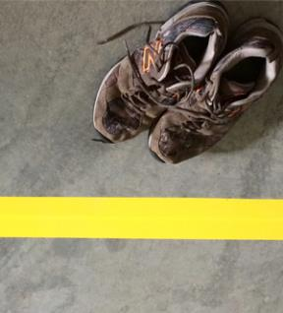
Line of Separation cont’d
Biosecurity plan addresses
How Line is defined and defended
For each type of movement across
Point of crossing
Critical control point to stop transfer of disease
Limited access across Line
Notes:
The biosecurity plan must address how this Line will be defined and defended for each type of movement that needs to cross this Line from the dirty to the clean side. A location where movement crosses this Line becomes a critical control point to stop the transfer of disease. The plan will identify essential versus nonessential movements across this Line, and define the biosecure procedures to enable essential movement across this Line, avoiding the transfer of disease agents. Biosecurity protocols for people crossing the Line will be different than those for vehicles crossing the Line. For biosecurity purposes, limiting the number of controlled access points across this Line will simplify mitigation. Ideally, limiting access to only one location will greatly enhance compliance of strategic actions implemented there.
[This photo, taken in an entry to an animal building, shows a highly visible, painted Line of Separation, and street shoes which have been left on the dirty side. Photo source: Pam Zaabel, Iowa State University]

Slide 11
Perimeter Buffer Area
Incorporated into plans for animals raised indoors
Sanitation standard reduces pathogen load in the environment
Additional separation between contaminated and non-contaminated
Further protects susceptible animals
Clearly delineated
Notes:
Biosecurity plans, particularly plans for livestock raised indoors, may incorporate a Perimeter Buffer Area as a transition area. Imposing a certain sanitation standard on everything entering the Perimeter Buffer Area reduces environmental contamination and pathogen load. This peripheral buffer needs to be well defined and marked, since it serves to place additional separation between the contaminated and non-contaminated space, and further protect the susceptible animals.

Slide 12
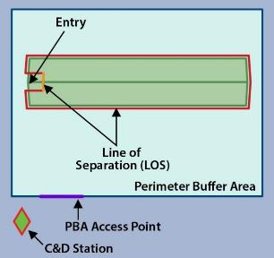
Perimeter Buffer Area
No visible contamination
Keep premises traffic patterns within it
Account for traffic patterns, topography, weather, and pathogen
Reentry through a controlled access point
C&D
Notes:
In this example, the (green) building is an illustration of a barn for animals raised indoors. The producer has designated the walls of the building to serve as the Line of Separation (red) isolating the animals from contamination. Immediately outside the building, the producer has designated a Perimeter Buffer Area as a transitional area to reduce environmental contamination. Sanitation efforts include preventing visible contamination from entering the Perimeter Buffer Area and keeping premises traffic patterns within it. When determining the Perimeter Buffer Area for each facility, account for traffic patterns on the premises, the topography around the animal housing, weather extremes, and what is known about the pathogen and its infectivity. If personnel need to leave the Perimeter Buffer Area, they reenter through a controlled access point, following appropriate biosecurity measures. An operational C&D Station is recommended to remove visible contamination from vehicles, equipment, and items needing to enter this area. To repeat, the Perimeter Buffer Area should be clearly delineated and located so that personnel comply with biosecurity procedures related to that area. [This is an example of implementation of a Perimeter Buffer Area and a Line of Separation protecting animals in one housing unit. Illustration by: Sydney Heppner, Iowa State University]

Slide 13
Biosecurity Protocols
Notes:
The following slides address some recommendations to mitigate common risks. Operational protocols and procedures to lessen the risks associated with the movement of personnel, vectors, equipment, vehicles, carcasses, manure/litter, bedding, and animals themselves are discussed. Recommendations on avoiding the introduction of pathogens in the water supply is also covered.

Slide 14
Personnel
Personnel and clothing/footwear
Site-specific procedures
Actions required before arrival
Actions at critical control points
Limits/controls access of pathogen to “clean” area via personnel
Shower/don clean outerwear
Mandatory to cross Line of Separation and/or enter Perimeter Buffer Area
Notes:
Personnel and their clothing/footwear may become contaminated by disease agents through direct and/or indirect exposure when they are off-site. Site-specific biosecurity procedures are intended to minimize the risk of transferring disease across the critical control points. Showering and changing into clean clothes immediately prior to arriving at the premises, or upon arrival, will greatly reduce the risk of disease introduction. Many facilities are shower-in/shower-out, and maintain the facility-specific outwear on-site, including boots, that personnel and visitors don when crossing the Line of Separation. The same concept applies to anyone who enters the clean area, such as the Perimeter Buffer Area or crosses the Line of Separation. It is mandatory that all personnel comply with the level of biosecurity implemented at that site.

Slide 15
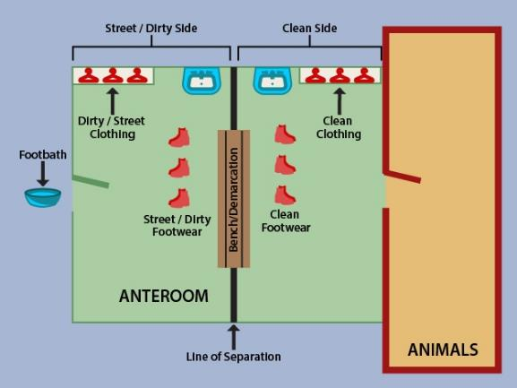
Danish Entry System
An example of Line of Separation
Notes:
This illustration shows an example of a Danish Entry System, utilizing a bench dividing the anteroom and providing a visual and physical Line of Separation between clean and dirty areas. With this type of anteroom, personnel who are potentially contaminated enter the room from the left and are prompted to perform the appropriate biosecurity protocols prior to crossing the Line of Separation (centered brown bench) to enter the animal building on the right. The same protocols are followed in reverse as personnel leave the animal housing on the right, crossing back across the Line of Separation to leave. (More examples of operational biosecurity are discussed in the “Operational Biosecurity Measures” PowerPoint presentations as part of this series.)
[This example of a Danish Entry System is adapted from http://www.inspection.gc.ca/animals/terrestrial-animals/biosecurity/standards-and-principles/general-producer-guide/eng/1398640321596/1398640379048?chap=9. Illustration by Sydney Heppner, Iowa State University]

Slide 16
Vectors – Pets, Wildlife, and Insects
Prevent transfer of disease by vectors (biological and mechanical)
Address the exclusion or elimination of vectors
Avoid environmental contamination
Prevent the movement of contaminated material
Mitigate situations and habitat that attract wildlife and scavengers
Notes:
Control measures should be implemented to prevent the transfer of disease by wildlife (i.e., wild birds, rodents), feral animals, and insects. Some of these living organisms can act as biological vectors. Pets residing on production facilities, as well as wildlife, can contribute to disease risk as mechanical vectors. Control measures should address the exclusion or elimination of these vectors. Measures also include avoiding environmental contamination though wildlife feces or infectious secretions, and preventing the movement of contaminated material. Protocols should mitigate situations and habitat that are attractive to wildlife and scavengers, such as spilled feed, disposal areas, or wildlife nesting areas.

Slide 17
Equipment
Clean and sanitize before crossing the Line of Separation
Have sufficient equipment available
Avoid sharing
Notes:
Biosecurity measures should diminish the opportunity for equipment to serve as fomites. Equipment should be effectively cleaned and sanitized before crossing the Line of Separation. Disease agents are easily transferred by the sharing of equipment by different animal populations. An important biosecurity measure is to have, provide, and use sufficient equipment to avoid sharing.

Slide 18
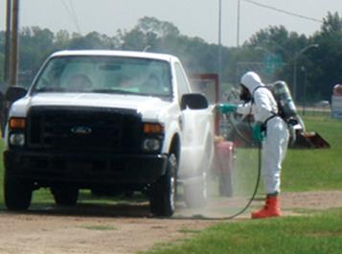
Vehicles
Exclude (unnecessary) vehicles from crossing the Line of Separation
Thorough cleaning and disinfection prior to crossing
Attention to wheels, wheel wells, and animal cargo areas
Limit pathways of internal vehicles
Notes:
Vehicles are a source of contamination with pathogens from other farms or from other animals. If at all possible through structural measures or operational processes, exclude vehicles such as feed deliveries, milk haulers, load-out carriers, and employee and visitor cars from crossing the Line of Separation. Vehicles crossing into the protected area of the premises should be thoroughly cleaned and disinfected. Particular attention needs to be paid to wheels and wheel wells. Frequently clean and disinfect those vehicles utilized internally to service the facility, and keep their pathways limited to within the Perimeter Buffer Area. Thoroughly clean and disinfect the cargo area of animal transport vehicles between loads.
[This photo shows the cleaning and disinfecting of a vehicle paying particular attention to the wheels and wheel wells. Photo source: Danelle Bickett-Weddle, Iowa State University]

Slide 19
Carcass/Manure Disposal
Protect susceptible animals from exposure
Avoid cross-contamination of pathways
Keep disposal service vehicles outside the Line of Separation
Prevent attracting wild animals or scavengers
Notes:
Disposal procedures should be designed and implemented to prevent exposure of susceptible animals to disease. Carcasses, manure, and spent litter may be a biosecurity risk, and should be disposed of in a manner that prevents cross-contamination of other production pathways and traffic patterns. Avoid animal areas in the removal process as much as possible. Avoid cross-contamination by separating the disposal pathway from the feed distribution pathway. Service vehicles for disposal pickup have likely visited other facilities and may have been contaminated off-site. Design processes that keep service vehicles outside the Line of Separation, and outside the Perimeter Buffer Area, if possible. In addition, the storage and disposal process should also prevent the attraction of wild animals or scavengers.

Slide 20
Animals
Closed herd or additions with documented health status
Isolate new animals for 30 days
All-in/all-out management
Housing cleaned between groups
Animals transported in cleaned and disinfected vehicles
Notes:
Prevent disease introduction through animal management and replacement decisions. Additions to the herd/flock may be made from offspring born and raised on the operation, which is described as a closed herd. Replacement livestock/poultry from outside the operation, including semen and embryos, should come from herds/flocks with documented biosecurity practices and a history of freedom from infection, preferably based on diagnostic testing. New additions should be isolated/quarantined for as long as 30 days before being allowed to co-mingle with the existing population. Ideally animals should be managed as all-in/all-out, meaning groups of the same age stay together from the time of arrival, through growth, until they leave for processing. Between one group leaving and the arrival of the next group, the housing is cleaned, disinfected, and left empty for a period of downtime to minimize carry over of pathogens from one group to the next. Transport animals in vehicles cleaned and disinfected (exterior and cargo areas) to minimize the risk of disease transmission from previously transported loads.

Slide 21
Feed, Bedding/Litter, Water Supply
Can be contaminated if exposed to pathogens
Store and handle properly
Immediately clean grain spills
Deliveries at remote locations
Use water from deep wells or treated sources
Notes:
Feed, feed ingredients, bedding/litter, and water can be contaminated if they have been exposed to a disease pathogen through vectors or containers acting as fomites. Grain, feed, and fresh bedding/litter should be stored and handled so that it cannot be contaminated, such as in closed containers. Clean any grain spills immediately so as not to attract scavengers. Accept outside deliveries at a location remote from animal areas, and shuttle products by on-site equipment to internal locations. Water should come from deep wells or sources that have been treated to eliminate any potential contamination with live pathogens.

Slide 22
Continuity of Business
Secure Food Supply Plans
Guidelines to minimize disease spread and ensure safe wholesome supply
Specific biosecurity standards
Available plans:
Secure Poultry Supply
Secure Milk Supply
Secure Pork Supply
Notes:
Premises biosecurity is an important component of the continuity of business plans, also known as the Secure Food Supply Plans. The goal of the Secure Food Supply Plans is to provide guidelines for producers, transporters, and processors to minimize disease spread during an FMD outbreak while ensuring a continuous, safe, and wholesome supply of animals and animal products for consumers. Biosecurity standards are described in, and are specific to, each plan. Some standards are still in development. Web links to the Secure Food Supply Plans for Eggs, Broilers, Turkeys (these three being integrated in the one Secure Poultry Supply Plan), Milk, and Pork are found in the FAD PReP/NAHEMS Guidelines: Biosecurity and Continuity of Business documents. In addition, the Secure Beef Supply Plan is in development.
.

Slide 23
Conclusion
Biosecurity
Maintains food safety and security
Protects the environment
Facilitates continuity of business
Excludes/contains disease
Site- and circumstance-specific
Consistent compliance
Notes:
In conclusion, biosecurity helps to maintain food safety and security, protect the environment, and facilitate continuity of business by protecting animals and animal products. The importance cannot be over-emphasized in daily protocols intended to exclude disease, as well as in plans to contain disease. Plans and protocols are developed based on the assessment and evaluation of each individual site, and circumstances. Established biosecurity measures are effective only when they are consistently followed by everyone

Slide 24
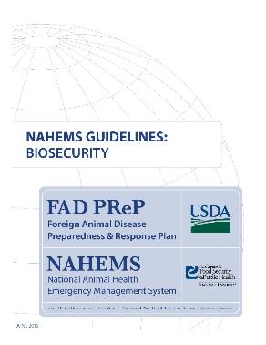
For More Information
FAD PReP/NAHEMS Guidelines & SOP: Biosecurity (2016)
http://www.aphis.usda.gov/fadprep
Biosecurity web-based training module:
http://naherc.sws.iastate.edu/
Notes:
More details can be obtained from the sources listed on the slide, available on the USDA website (http://www.aphis.usda.gov/fadprep) and the National Animal Health Emergency Response Corps (NAHERC) Training Site (http://naherc.sws.iastate.edu/).

Slide 25
Guidelines Content
Authors (CFSPH)
Janice P. Mogan, DVM
Heather Allen, PhD, MPA
Kristen Bretz, MS
Reviewers (USDA)
Jonathan T. Zack, DVM
James A. Roth, DVM, PhD, DACVM
Notes:
The print version of the Guidelines document is an excellent source for more detailed information. This slide acknowledges the authors and reviewers of the Guidelines document. It can be accessed at http://www.aphis.usda.gov/fadprep.

Slide 26
Acknowledgments
Development of this presentation was by the Center for Food Security and Public Health at Iowa State University through funding from the USDA APHIS Veterinary Services
PPT Authors: Janice P. Mogan, DVM; Logan Kilburn Reviewer: Kristen Bretz, MS
Notes:
Information provided in this presentation was developed by the Center for Food Security and Public Health at Iowa State University College of Veterinary Medicine, through funding from the US Department of Agriculture, Animal and Plant Health Inspection Service, Veterinary Services.

