Slide 1
Biosecurity
Overview
Adapted from the FAD PReP/NAHEMS
Guidelines: Biosecurity (2016)
Notes:
Biosecurity is a cornerstone of livestock production systems (including poultry production) to maintain food safety and security, protect the environment, and facilitate continuity of business by protecting animals and animal products. In addition to the daily protocols to protect the health of livestock populations, biosecurity is crucial in containing disease in a foreign animal disease (FAD) outbreak. Should the FAD also be zoonotic, biosecurity is necessary to protect public health. Understanding the risks of disease transmission and the necessary preventive procedures will be essential during the response. [This information was derived from the Foreign Animal Disease Preparedness and Response (FAD PReP)/National Animal Health Emergency Management System (NAHEMS) Guidelines: Biosecurity (2016)].

Slide 2
This Presentation
Basic biosecurity concepts
Routes of exposure
Steps to develop a biosecurity plan
Three levels of biosecurity
Practical application of operational measures in bioexclusion and biocontainment
Notes:
This presentation reviews basic biosecurity concepts. The routes of exposure to disease are described and presented as an important consideration in the 3-step development of a biosecurity plan. Three levels of biosecurity are introduced, and the practical applications of some operational measures are presented for bioexclusion and biocontainment.

Slide 3
Biosecurity Concepts
Measures or management practices
Prevent spread of disease
  Protect in routine, daily management
  Contain disease in an emergency
Individual assessment/analysis
  Health status and species
  Management and site arrangement
  Sources of contamination
  Areas needing protection
Notes:
Biosecurity can be defined as a collection of measures or management practices intended to protect animals or humans against the introduction and spread of disease or harmful biological agents. Biosecurity is incorporated into daily, routine management protocols to protect healthy livestock populations, and also implemented to contain disease in an animal health emergency, such as an FAD. Before developing and implementing biosecurity measures, an individual site risk assessment or hazard analysis should be performed. Consider the health status and species of the livestock, the management and site arrangements of the animals, and importantly, identify sources/areas of potential contamination and areas that need to be protected from contamination.

Slide 4
Separate Clean and Dirty
Line of Separation
  Imagined or physical
Pathways for disease movements
  Onto, off of, and within the facility
Critical control points
  Measures to prevent transfer
  People, supplies, equipment, vehicles, feed, mortalities, animals
Bioexclusion and/or biocontainment
Notes:
Part of the initial assessment includes creating a functional separation between dirty (potential sources of infection) and clean areas (non-infected). A Line of Separation is established, which may be imagined or physical. Specific pathways which enable a disease to move onto, off of, or within a facility are ascertained, considering routes of disease exposure. Critical control points are identified in movement and work pathways. A critical control point is a point, step, or procedure where control can be applied to prevent the transfer of a disease agent (or in a more broad interpretation, to prevent harm). Critical control points involve people, supplies and equipment, vehicles, feed, mortalities, and animals/animal products. The goal is to prevent the transfer of a disease agent across a specific control point from dirty to clean areas, whether the intention is to keep disease out (bioexclusion), or keep disease in (biocontainment).

Slide 5
Routes of Exposure to Disease
Notes:
In order to develop a comprehensive, effective biosecurity plan, it is necessary to understand how each disease of concern is spread and how susceptible animals are exposed. Each disease has transmission pathways based on the nature of the pathogenic agent. A mitigating action which prevents the spread of one disease may not be effective against another. While direct contact may be the most obvious route of exposure and the easiest to prevent, exposure by indirect means may provide the highest risk. Indirect exposure may occur through the environment or surfaces contaminated with secretions or infective materials. It should be emphasized that disease agents can be carried by animals without signs of infection. Some of the common routes of exposure are described.

Slide 6



Routes of Exposure
Direct Contact
  Direct transfer to skin,
  mucous membranes,
  wounds
Aerosol
  Inhalation of infectious
  droplets
Oral
  Ingested, consumed,
  environmental sources
Notes:
Direct exposure occurs when a susceptible animal physically contacts an infected animal. The disease agent is transferred to the skin, mucous membranes, or open wound of a susceptible animal through rubbing, biting, licking, or by contact with the blood, urine, milk, saliva, nasal secretions, or body lesions of an infected animal. Exposure may result from nose-to-nose contact, during breeding, or from dam to offspring during gestation, birth, and/or nursing.
Aerosol exposure occurs when infectious droplets containing pathogenic agents from an infected animal are inhaled by a susceptible animal, or make contact with the mucous membranes. Infectious droplets spread through the air may come from a sneeze or cough, urine, birthing fluids, or from feces.
Oral exposure may occur when the disease agent is ingested by a susceptible animal licking or biting an infected animal. Feces, urine, saliva, and other secretions containing disease agents can contaminate feed, water, or objects in the environment that animals lick or chew, like feed bunks or fencing.
[These three illustrations depict disease exposure through direct contact, aerosol, and oral routes. Illustrations by: Dani Ausen, Iowa State University]

Slide 7



Routes of Exposure cont’d
Fomites
  Inanimate objects
  Lateral spread
Vectors
  Living organisms
Zoonotic Disease
  Any of the routes
  Disease-specific
Notes:
Fomites are inanimate objects capable of transferring disease agents from an infected animal to a susceptible one. Exposure occurs through the movement of shovels, buckets, medical needles, trailers, and animal cargo areas contaminated with infectious pathogens. Historically in disease outbreaks, lateral spread through the movements of people with contaminated outerwear, equipment, and vehicles has been high risk.
Vectors can be described as any living organism, including, but not limited to, arthropods, insects, rodents, feral animals, and scavengers that can carry disease causing agents from an infected animal to a susceptible animal. Two types of vectors are recognized, biological (disease agent undergoes some part of its life cycle within the vector) and mechanical (transfer of the agent via external body parts).
Zoonotic diseases are transmissible between animals and humans. Exposure may occur through any of the five methods described above, depending on the disease. The biosecurity assessment should consider the risk of zoonotic disease to personnel and the public if the disease agent is not contained.
[These three illustrations depict disease exposure through fomites and vectors, plus zoonotic disease exposure. Illustrations by: Dani Ausen, Iowa State University]

Slide 8
Developing a Biosecurity Plan
Notes:
The process of developing a biosecurity plan focused on bioexclusion and/or biocontainment involves similar concepts and considerations. An assessment of the existing situation needs to be conducted, evaluating the disease agent(s) and the routes of transmission, the physical facility, and options for mitigation. The site-specific biosecurity plan should be clearly written and clearly outline the procedures to be followed at critical control points. To develop a biosecurity plan, consider a three step process.

Slide 9
Developing a Biosecurity Plan
Step 1: Prioritize the disease agents
  Consider species/susceptibility, housing, management, wildlife exposure
Step 2: Conduct a facility assessment
  Identify pathways/movements
Step 3: Implement processes to minimize impact of disease
  Prevent movements that carry disease
Notes:
Step 1: Identify and prioritize the disease agents of greatest concern. For example, disease agents will be based on species, susceptibility, age, and production stage of the animals. The risk of exposure may depend on management, type of housing, and potential contact with wild or feral animals.
Step 2: Conduct an assessment of the facility. Identify how disease agents may be transferred from one location to another - allowing introduction or escape. In this step, the critical control points are recognized, so that mitigation measures can be implemented
Step 3: Implement processes and procedures that eliminate, prevent, or minimize the potential impact of animal disease by preventing movement of entities that may carry disease, or that inadvertently transport the disease agent. Implement steps at critical control points to mitigate the risk of movement of personnel, equipment, manure, and animal carcasses, in addition to deliveries that may transport pathogens, either in the product being delivered (feed, bedding) or on the delivery vehicle that may be contaminated from contact with other animals or premises.

Slide 10
Developing a Plan cont’d
Movements of animals
  Closed herd is more protected
    Additions from offspring within the herd
  Managed in small, isolated groups
  All-in/all-out management, less co-mingling
  Animals that leave and return create a risk for the herd/flock
  Quarantines restrict movements
Notes:
Importantly, consider the movements of the animals themselves. A closed herd with additions coming from offspring within the herd, managed in small groups and isolated from others, will be more protected than a large group allowed to co-mingle. All-in/all-out management with less co-mingling between groups minimizes exposure to disease. Animals that leave the premises and are allowed to return pose a risk to the animals at home. A quarantine imposed on a herd/flock due to a disease outbreak prevents movements of those quarantined animals.

Slide 11
Levels of Biosecurity
Notes:
Owners and producers are responsible for protecting their animals from disease. Ideally, day to day procedures should be stringent enough that in the face of a disease outbreak, no enhancements would be necessary. Practically, this may not be feasible. If biosecurity is considered an investment in the protection of livestock health, the cost of this investment is weighed by each producer against the cost of the consequences. Consequences may not only be economic but, in some cases, may include significant loss of genetics. The types of biosecurity measures can be divided into three levels – conceptual, structural and operational.

Slide 12
Three Levels of Biosecurity
Conceptual
  Location, geospatial siting,
  orientation of the facility
Structural
  Capital investment, construction to prevent disease spread
Operational
  Processes, management practices, standard operating procedures to exclude or contain disease
Notes:
In general, there are three levels of biosecurity:
Conceptual biosecurity relates to the location, geospatial siting, and orientation of the facility. It also includes the scope and size of animal production units and complexes.
Structural biosecurity refers to the capital investment that enhances the ability to prevent disease spread. It includes the physical design, construction, and maintenance of a facility which help prevent the transfer or aid in the containment of disease.
Operational biosecurity refers to those processes and protocols, management practices, or standard operating procedures implemented to exclude or contain disease. Operational biosecurity pertains to procedures conducted on the premises, as well as the management of people, animals, supplies, equipment, vehicles, and other items related to disease control. The operational measures may be more quickly implemented, and receive more emphasis in this series of presentations.
Additional details on the three levels of biosecurity are presented in the FAD PReP/NAHEMS Guidelines: Biosecurity, and other PowerPoint presentations in this series.

Slide 13
Premises Biosecurity
Notes:
Livestock production facilities of all types face some common risks. These risks need to be addressed by the practical application of biosecurity measures as part of a site-specific biosecurity plan for bioexclusion. Some common elements need to be covered in the normal operating procedures, and may be considered the minimum for a production facility. In addition, producers need to consider enhancing both structural and operational biosecurity to reduce their overall vulnerability to disease. If an FAD is detected, additional biosecurity procedures may be necessary, beyond the normal.

Slide 14
Officer, Manager, Coordinator
Responsibility and authority
Assesses, designs, implements
Monitors and enforces
Ensures ongoing effectiveness
Certifies compliance
Communicates and trains everyone on concepts and procedures
Notes:
Each production site or system should assign an individual the responsibility to assess the facility, design a clearly written, site-specific biosecurity plan, and implement effective procedures. This Biosecurity Officer, Manager, or Coordinator (the title may vary) is granted the authority to monitor and enforce compliance and make modifications when necessary to ensure ongoing effectiveness. This individual has the authority to stop violations, take corrective actions as needed, and certify that the biosecurity plan has consistently been followed by all. To ensure compliance, this Manager communicates and distributes the plan to everyone who accesses the facility and is responsible for training farm employees, contract crews, truck drivers, service personnel, and all visitors. Everyone needs to understand the concepts and procedures that apply to their area of access and responsibility, and understand the importance of all the steps. Documented training, as well as audits and periodic refreshers, should be ongoing.

Slide 15
Establish Separation
Line of Separation
Prevent pathogens from crossing
Point of access = critical control point
Biosecurity measure defined for each movement
Perimeter Buffer Area
  Transition with sanitation standard
  Area of reduced contamination
  Wider separation between clean and dirty
Notes:
The biosecurity plan separates clean and dirty areas, establishes a site-specific Line of Separation, and defines measures to prevent the movement of pathogens from dirty to clean areas that may expose susceptible animals. This Line of Separation is site-specific, clearly marked, and may be a physical barrier. It may be established at the farm level (e.g., the circumference of the farm), or at the barn level (e.g., the walls of each individual housing unit); some site-specific plans may establish this Line somewhere in between. Each point of access across this Line is a critical control point. An effective biosecurity measure is needed for each movement that crosses this Line. Biosecurity plans, particularly plans for livestock raised indoors, may incorporate a Perimeter Buffer Area as a transition area where a sanitation standard is imposed on everything entering the Perimeter Buffer Area, reducing environmental contamination and pathogen load. This peripheral buffer places additional separation between the contaminated and non-contaminated space, and further protects the susceptible animals.

Slide 16
Operational Measures
Fomites
  Decontamination
People
  Biosecurity attire and sanitation
Vectors
  Barriers or control programs
Production traffic patterns
  Avoid cross contamination
Notes:
The strategic operational measures need to address risks posed by personnel, vectors, equipment, vehicles, carcass disposal, manure/litter management, replacement animals, and feed and water supplies, as examples. These entities may pose a risk as fomites, transferring disease agents from infected animals to susceptible ones. Decontamination is crucial prior to entering a protected area, such as the Perimeter Buffer Area or across the Line of Separation. Procedures for site-dedicated personnel and non-farm workers include biosecurity attire and sanitation standards. Vectors create exposure risks mechanically or through a bite, so contact needs to be prevented via barriers or control programs. Traffic patterns related to production, such as the movement of carcasses, manure, and feed must avoid pathways that could cause cross contamination. The biosecurity plan may go beyond on-site protocols to include employment related restrictions and the choice of animal replacements. For more details, see the PowerPoint presentation in this series Premises Biosecurity for Bioexclusion.

Slide 17
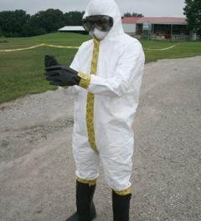
C&D and Biosecurity Attire/PPE
Cleaning and disinfection
  Reduces, inactivates, or destroys biological pathogens
  Physical, chemical, or combination
Biosecurity attire/PPE
  Prevents transfer by outerwear
  Protects responder health
  if zoonotic
Notes:
Biosecurity practices are site-specific; however, two operational components are part of most every biosecurity plan and serve as biosecurity tools - 1) cleaning and disinfection (C&D) and 2) biosecurity attire, most often called personal protective equipment (PPE). C&D procedures are used to reduce, inactivate, or destroy biological pathogens, thereby inhibiting or eliminating their further spread. C&D methods may involve the use of physical (e.g., heat or ultraviolet light), chemical (e.g., detergents, sanitizers, disinfectants, sterilants), or a combination of processes and are conducted on most items that cross the Line of Separation when moving from dirty to clean areas.
Biosecurity attire/PPE, in the form of cleaned coveralls, boots, or disposable PPE outerwear is utilized to prevent contaminated clothing and footwear from serving as fomites. In a zoonotic disease event, PPE also serves as a barrier to protect personnel from the disease agent. Although these two components are highly significant, they are only a part of a complete biosecurity plan. [This photo shows a responder in Level C PPE, which includes a respirator. Photo source: Andrew Kingsbury, Iowa State University]

Slide 18
Biosecurity in an
FAD Response
Notes:
During an FAD emergency response, authorities within the Incident Command System will delegate specific biosecurity responsibilities and tasks. Applying practical biosecurity measures is crucial, beginning with the first report of a potential FAD. Response activities involve contact with infected animal populations and with contaminated premises. Response activities also involve those premises with animals considered non-infected. During an FAD event, implemented biosecurity protocols will vary with the type of livestock facilities – small backyard, open outdoor facilities, confinement facilities including large and complex production units – as well as with the disease/health status of the livestock in the facility, the disease pathogen, and type of response activities ongoing. Employing the most practical and effective measures is based on site-specific risks.

Slide 19
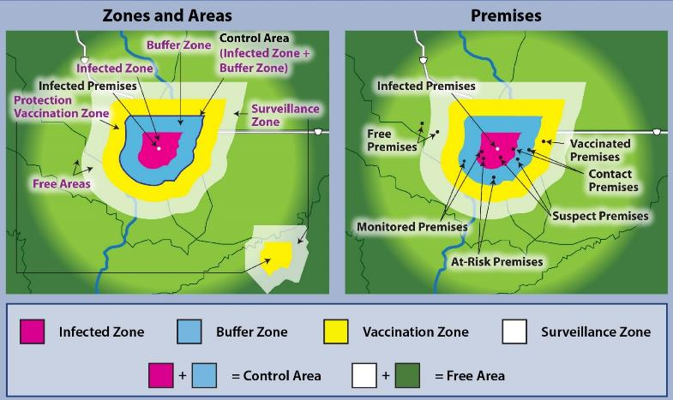
Zones, Areas, and Premises
Notes:
Immediately after an FAD detection, zone, area, and premises designations will be applied geographically reflecting the disease or disease-free status of the animal population related to the FAD. If animals are no longer present, the designation reflects the infective risk of the location, as known at that time. The premises with the infected animals will be designated as an Infected Premises, and quarantined. A regulatory Control Area, comprised of an Infected Zone and Buffer Zone, will be defined to surround the Infected Premises. These figures are examples of zones and areas on the left, and on the right, examples of the locations that have been designated with specific premises classifications based on disease/health status of the animals. Chosen biosecurity measures related to the FAD response activities will be designed to exclude and/or contain disease, based on the premises designation. [Example Zones, Areas, and Premises. Diagrams provided by: USDA; Illustration by: Dani Ausen, Iowa State University]

Slide 20
Containment and/or Exclusion
Premises designations
  Source of infection
  Enhanced risk of disease exposure
  Type of response activities
Biocontainment and/or bioexclusion
Guidance on response activities provided by Incident Command
Notes:
The premises designations identify those premises that may be a source of infection, and those that may be at enhanced risk of exposure to disease. The designations may also indicate the type of activities, and the type of biosecurity measures needed at these locations. On contaminated premises, such as Infected Premises, depopulation, disposal, and cleaning and disinfection, termed dirty operations, may be performed; biocontainment is the focus. At-Risk, Monitored, and Free Premises are considered locations with no evidence of disease. Response activities, such as surveillance, audits, or vaccination if implemented, are termed clean operations; bioexclusion is the focus. The results of the epidemiological investigation are needed to confirm the disease status of animals on Contact and Suspect Premises as infected or non-infected. It is imperative to use biosecure methods of entry onto those premises, as well as biosecure methods of exit. Specific biosecurity guidance for response activities will be provided by Incident Command focused on biocontainment, bioexclusion, or both.

Slide 21
Biocontainment Work Zones
Separation between dirty and clean
  Hot Zone or Exclusion Zone (EZ)
  Warm Zone or Contamination Reduction Zone (CRZ)
  Cold Zone or Support Zone (SZ)
Access is controlled
  Decontamination Corridor
  Critical control point
Notes:
On an Infected Premises, containment areas have been described using Work Zones, with terms related to hazardous materials (HAZMAT) incidents. Work Zones are one method of creating a separation between the dirty area (potential source of infection) and clean area (non-infected). Areas are designated as the Hot Zone or Exclusion Zone (EZ), Warm Zone or Contamination Reduction Zone (CRZ), and Cold Zone or Support Zone (SZ). By implementing these Work Zones, access to contaminated areas is controlled to prevent the transfer of the disease agent to other livestock or areas. These Work Zones also have a defined Decontamination Corridor, which serves as the point of access on or off the premises, and a critical control point where biosecurity measures are conducted.

Slide 22
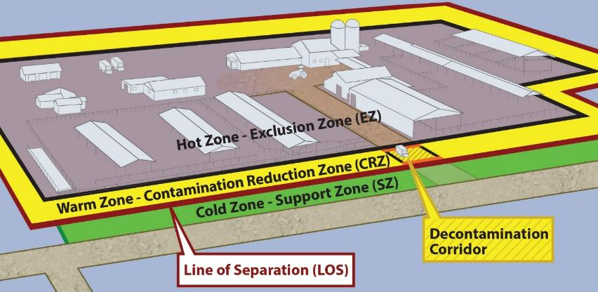
Biocontainment Work Zones
Notes:
This illustrates an example of Work Zones on a contaminated premises. In this case, the Hot Zone-Exclusion Zone (shaded in brown) designates the dirty or contaminated area associated with the infected herd or flock. Full personal protective equipment (PPE) must be worn. The Cold Zone-Support Zone (seen in green) is the non-contaminated area outside and extending beyond the premises. This is the “cleanest” work zone with the lowest relative risk of exposure to pathogens and other hazards, such as decontamination chemicals. The Warm Zone-Contamination Reduction Zone is a transition zone, regarded as having a reduced pathogen load in the environment. It acts as a buffer further separating contaminated from non-contaminated. It is still a high-risk area due to the potential of exposure to pathogens and chemical disinfectants. In an FAD response, all personnel are required to wear full PPE in the Warm Zone. The Decontamination Corridor is within the Warm Zone-Contamination Reduction Zone. All movements pass through the Decontamination Corridor before crossing the Line of Separation into the Cold Zone-Support Zone. [This illustration depicts Work Zones imposed on an Infected Premises. Illustration by: Andrew Kingsbury, Iowa State University]

Slide 23
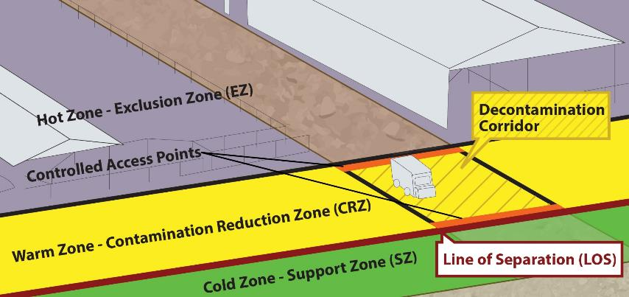
Decontamination Corridor
Notes:
This Decontamination Corridor serves as the controlled access between the Hot and Cold Zones. All movements, personnel, equipment and vehicles, transition through the Decontamination Corridor before crossing the Line of Separation into the Cold Zone – Support Zone (SZ). This is where biosecurity actions are taken to prevent the disease from “crossing the line” during necessary movements of people, equipment, and possibly vehicles. Site-specific protocols for PPE, decontamination of personnel and equipment, including vehicles, occurs along the corridor with stations for depositing tools, equipment, and other items. Final decontamination and disinfection of PPE as well as final doffing of PPE occur in this corridor. [This illustration is a close up of the Decontamination Corridor and controlled access points. Illustration by: Andrew Kingsbury, Iowa State University]

Slide 24
Protocols for Biocontainment
Dirty operations at quarantined sites
Understand all biosecurity protocols
Identify Hot, Warm, Cold Zones
Define and defend the Line of Separation
Park vehicles in Cold Zone
Don PPE – disposable is preferred
Notes:
In an FAD outbreak, some responders will be conducting activities on the dirty side of operations, on-site at quarantined, contaminated premises, or at sites considered contaminated within the disease Control Area. The activities conducted may include depopulation, disposal, and cleaning and disinfection. Biocontainment of the pathogen will be the focus when conducting response operations. Before crossing the Line of Separation, understand all biosecurity protocols for the assigned task. If not already established, identify the Hot, Warm and Cold Zones. Vehicles are parked on the clean side, in the Cold Zone. Define and defend the Line of Separation against the transfer and escape of pathogens. Don PPE, which is used as a biosecurity measure, as well as personal protection for the assigned task. Disposable PPE is optimal, and includes coveralls (e.g., Tyvek®), boot covers and/or reusable boots that can be cleaned and disinfected, head cover, and gloves for biosecurity purposes, in addition to respiratory, head, and hearing protection, as needed.

Slide 25
Protocols for Biocontainment cont’d
Protect electronics, to be immersed
Contain and secure disposables
Carry in only essentials
All movements through the Decontamination Corridor
Minimize unnecessary exposure
C&D and doffing in Decon Corridor
  Tools, equipment, vehicles
Notes:
Protect cell phones and essential electronics in water proof containers to be immersed in disinfectant upon exit. Prepare to contain used disposable items in a biosecure manner at exit to avoid the transfer of pathogens. This may involve securing the disposables on-site for later handling, or double bagging the materials in plastic bags, disinfecting the outer bag, and securing it to follow disposal procedures at another location. Only essential equipment and supplies cross the Line of Separation into the Hot Zone. All movements between contaminated and non-contaminated areas across the Line of Separation must occur through the Decontamination (Decon) Corridor. Enter the Hot Zone through the proper access point. While in the Hot Zone, perform required tasks while minimizing unnecessary exposure to the pathogen. Exit only through the Decontamination Corridor, where cleaning, disinfection and final doffing of PPE occurs. Tools, equipment, outer plastic bags containing contaminated disposables need to be pathogen-free when exiting across the Line of Separation. Clean and disinfect vehicles and large equipment. In addition to the easily visible surfaces, take extra care cleaning the wheel wells and under carriage.

Slide 26
Protocols for Bioexclusion
Clean operations at non-infected sites
Follow premises’ biosecurity plan
Identify Line of Separation
  Animal area is clean, protected side
  Remove all contamination prior to entry at controlled access point
  Don biosecurity attire/PPE
Notes:
When conducting clean operations during an FAD response, especially within the Control Area, recognize that non-infected premises are at higher risk of disease exposure due to the proximity of Infected Premises. A biosecure entry is critical to protect susceptible animals. At a minimum, follow the premises’ biosecurity plan for bioexclusion. An escort from the facility may aid in compliance. If not already established, identify a Line of Separation – with the animal side being the clean, protected side. Set up a controlled access point to remove all contamination from the items necessary to cross the Line into the facility. Don site-specific biosecurity attire/PPE including cleaned, disinfected boots. A boot bath may be utilized at entry and at exit.

Slide 27
Protocols for Bioexclusion cont’d
Minimize movements and spread
Begin activities with most susceptible animal group
When exiting across Line of Separation, doff PPE
C&D boots and all equipment
Secure disposables according to the biosecurity plan
Notes:
Minimize movements and potential spread of pathogens while conducting on-site response activities. If it is necessary to have contact with multiple groups of animals on a premises, start with the most susceptible and finish with those showing clinical signs, or decontaminate and change outwear between groups. When exiting back over the Line of Separation, doff PPE, and, as a precaution, clean and disinfect boots and all equipment. Any equipment that is not cleaned and disinfected on site, as well as any disposable materials, should be secured in a separated dirty compartment of the vehicle until disposed or sanitized, according to the biosecurity plan.

Slide 28
Conclusion
Biosecurity concepts multifaceted
Protect healthy animals from introduction of disease
Contain disease from spreading in an outbreak
FAD response efforts require both biocontainment and bioexclusion practiced correctly and consistently
Notes:
Biosecurity concepts involve strategic decisions, adequate investment, and management practices affecting movements of livestock, equipment and personnel. Training, supervision, and accountability of personnel are necessary. Biosecurity measures are prioritized based on risk, probability of occurrence, ease/cost of implementation, and consequences (economic and non-economic). Protocols are essential to protecting healthy animals, as well as to contain disease in an outbreak. During an FAD response, biocontainment efforts are necessary on quarantined premises. Bioexclusion efforts are necessary for activities on non-infected premises. Both biocontainment and bioexclusion protocols are enforced during surveillance and epidemiologic investigations, when the animal’s true health status is yet to be determined. A biosecurity measure is only effective if it is practiced correctly and consistently. To emphasize, correctly and consistently are key concepts.

Slide 29
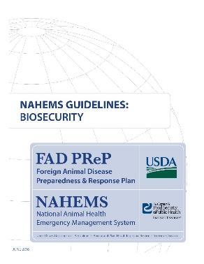
For More Information
FAD PReP/NAHEMS Guidelines
& SOP: Biosecurity (2016)
  http://www.aphis.usda.gov/fadprep
Biosecurity web-based training module:
  http://naherc.sws.iastate.edu/
Notes:
More details can be obtained from the sources listed on the slide, available on the USDA website (http://www.aphis.usda.gov/fadprep) and the National Animal Health Emergency Response Corps (NAHERC) Training Site (http://naherc.sws.iastate.edu/).

Slide 30
Guidelines Content
Authors (CFSPH)
Janice P. Mogan, DVM
Heather Allen, PhD, MPA
Kristen Bretz, MS
Reviewers (USDA)
Jonathan T. Zack, DVM
James A. Roth, DVM, PhD, DACVM
Notes:
The print version of the Guidelines document is an excellent source for more detailed information. This slide acknowledges the authors and reviewers of the Guidelines document. It can be accessed at http://www.aphis.usda.gov/fadprep.

Slide 31
Acknowledgments
Development of this presentation was by the Center for Food Security and Public Health at Iowa State University through funding from the USDA APHIS Veterinary Services
PPT Authors: Janice P. Mogan, DVM; Logan Kilburn
Reviewer: Kristen Bretz, MS
Notes:
Information provided in this presentation was developed by the Center for Food Security and Public Health at Iowa State University College of Veterinary Medicine, through funding from the US Department of Agriculture, Animal and Plant Health Inspection Service, Veterinary Services.

