Slide 1
Biosecurity
Biosecure Areas
Uninfected and Infected
Adapted from the FAD PReP/NAHEMS
Guidelines: Biosecurity (2016)
Notes:
Biosecurity is a cornerstone of livestock production systems (including poultry production) to maintain food safety and security, protect the environment, and facilitate continuity of business by protecting animals and animal products. In addition to the daily protocols to protect the health of livestock populations, biosecurity is crucial in containing disease in a foreign animal disease (FAD) outbreak. Should the FAD also be zoonotic, biosecurity is necessary to protect public health. Understanding the risks of disease transmission and the necessary preventive procedures will be essential during the response. [This information was derived from the Foreign Animal Disease Preparedness and Response (FAD PReP)/National Animal Health Emergency Management System (NAHEMS) Guidelines: Biosecurity (2016)].

Slide 2
This Presentation
Illustrated examples of biosecure areas
  Uninfected premises
  Infected premises
  Line of Separation
  No transfer of disease
  Separates clean and dirty areas
  Location based on specific situation, facility arrangement, and animal health status
Notes:
This presentation illustrates examples of biosecure areas using two types of production facilities. In the maps that follow, the biosecure areas of each facility are illustrated as an uninfected premises where biosecurity measures would focus on bioexclusion. Then the biosecure areas of the facility are illustrated as an infected premises, showing Work Zones as implemented in biocontainment. The Line of Separation–the physical or imaginary line separating clean, non-contaminated areas from dirty, contaminated areas that may serve as a source of infection - is shown in the examples as the health status of the animals change from uninfected to infected. These examples show fictional poultry production facilities, but the concepts can be applied to other types of livestock facilities as well. The important message is to defend the Line of Separation, wherever that is located, against the transfer of disease.

Slide 3
Two Examples
Provide broad guidance
Separation based on housing, work paths, and animal health status
Protocols implemented at the most strategic points
Indoor and outdoor production, uninfected and infected
Notes:
These two examples of facility layouts (site maps) are intended to provide broad guidance for creating a separation between the clean and the dirty areas of a premises based on the type and arrangement of housing, the production work paths, and the health status of the resident animals. These examples are illustrated as uninfected premises and then as infected premises, showing how the biosecure areas and the location of the Line of Separation change. Biosecurity protocols need to be implemented at the most strategic points. Implementation of these concepts can be adapted to a variety of livestock production facilities. The first example illustrates poultry raised indoors in closed, solid-wall buildings (e.g., egg production). These concepts may also be useful for indoor production of other species, such as for some swine facilities. The second example is for poultry raised free range in a fenced area (e.g., meat or egg production). This second example has challenges similar to other livestock production, such as a beef feedlot where cattle are confined, but raised outdoors. Biosecure areas can be determined and implemented a number of different ways - these are examples.

Slide 4
Poultry (Livestock) Raised Indoors
Notes:
These next slides explore biosecure areas of an uninfected poultry production facility raising animals indoors in multiple buildings with solid sides. This illustration includes a connecting conveyer/walkway, as might be found in layer facilities. The walls of the poultry buildings serve as the Line of Separation (LOS), represented as the continuous red line. All connected buildings are treated as one biosecure unit.

Slide 5
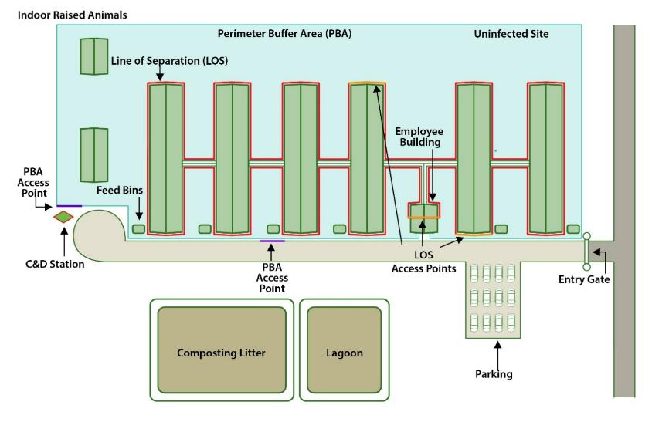
Uninfected – Raised Indoors
Notes:
As an uninfected premises, the producer defines and defends the Line of Separation (LOS identified in red) to isolate the poultry from possible exposure to disease (bioexclusion). Stringent biosecurity measures are conducted at the controlled access points, represented as three LOS Access Points in orange, prior to entering the animal housing unit. The producer may implement a Danish Entry System at each LOS Access Point to prevent HPAI and other pathogens from crossing the LOS and exposing animals to disease. To enhance compliance with biosecurity protocols, access across the LOS into the animal buildings is limited to only three points.
[All illustrations in this presentation by Sydney Heppner, Iowa State University]

Slide 6
Uninfected – Raised Indoors
Notes:
Depending on the facility layout, the site-specific work paths, and the type and arrangement of buildings, it may be possible for the producer to institute a Perimeter Buffer Area (PBA) as a transition area or outer control boundary, shown as the shaded blue area, prior to crossing the LOS and accessing the animal housing. Producers are encouraged to institute a cleanliness standard for entering a Perimeter Buffer Area to reduce potential environmental contamination, furthering protection of the healthy birds. A C&D station is located at the left end of the driveway, to clean vehicles of visible organic material prior to passing through the PBA Access Points (represented as a purple line). The parking area for employees and any visitors is located outside the PBA. An area of manure/waste management is shown outside the Perimeter Buffer Area as a reminder to locate these areas away from animals to avoid environmental contamination from service trucks. Composting litter and/or lagoons will not necessarily be found on every poultry/livestock premises.

Slide 7
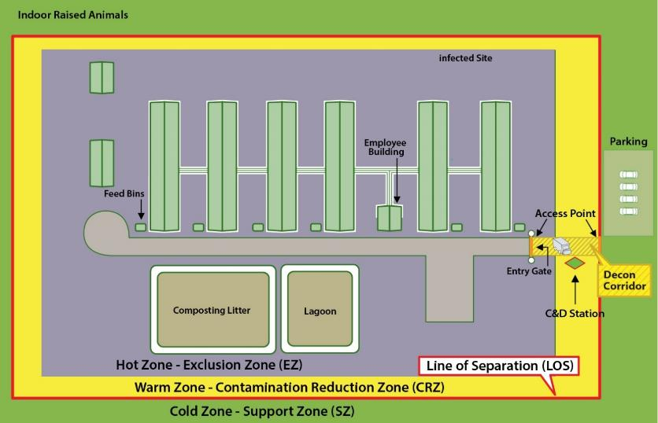
Infected – Raised Indoors
Notes:
This example illustrates the same facility of poultry raised indoors, but now it has been designated as an HPAI Infected Premises. Once the poultry on a premises are infected with HPAI, the premises is quarantined. Usually, an Infected Premises is considered contaminated and the infective risk applies throughout the whole farm or operation. Work Zones are established to restrict access, isolate the infected poultry and any areas of contamination, and prevent escape of the virus from the premises (biocontainment). Containment areas are designated as the Hot Zone-Exclusion Zone (EZ) shown as that central area in gray, Warm Zone-Contamination Reduction Zone (CRZ) in yellow, and Cold Zone-Support Zone (SZ) in green around and extending beyond the perimeter. The Decontamination (Decon) Corridor with a C&D Station, represented by the hatched area at the right, serves as the point of access on or off the premises. All movements out of the Hot Zone-Exclusion Zone require decontamination.

Slide 8
Infected – Raised Indoors
Notes:
It is important to note that the Line of Separation (LOS), also known as the Clean/Dirty Line and represented as the red line, now encircles the premises and separates the contaminated areas from the clean Cold Zone-Support Zone. This LOS has been repositioned from its location on the uninfected premises in order to accommodate the Work Zones on the contaminated premises. The Hot Zone-Exclusion Zone encompasses the housing of the infected poultry and the highly contaminated areas, including any areas of manure management. The parking area has been relocated to the right to the Cold Zone-Support Zone to minimize movements across the LOS. Biosecurity measures to mitigate the escape of the virus are conducted according to Work Zone and response activities. Note: the width of the zones is not necessarily to scale.

Slide 9
Poultry (Livestock) Raised Outdoors
Notes:
These next slides explore biosecure areas of an uninfected poultry production facility raising animals outdoors but confined in a fenced area. In this case, these free-range birds have access to covered sheds and outdoor space. There is no room on this premises to create a Perimeter Buffer Area as a transitional area around the facility. This situation may be compared to the biosecurity challenges of a cattle feedlot.

Slide 10
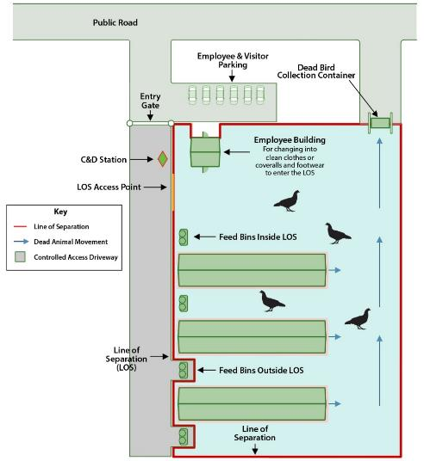
Uninfected – Raised Outdoors
Notes:
For this farm, the producer has defined the Line of Separation (LOS), represented as the red line, to encircle the area around the entire animal enclosure, along a fence. This is the Line that must be defended against the introduction of disease. The employees caring for the poultry access the area and cross the LOS at the Employee Building at the top of the illustrated animal enclosure. Here, as much as possible, biosecurity measures prevent the transfer of pathogens by personnel into the area where poultry may be exposed.

Slide 11
Uninfected – Raised Outdoors
Notes:
A C&D Station is positioned on the limited access driveway on the left near the wide LOS Access Point shown in orange. Vehicles are washed before crossing the LOS to enter the animal area. Employee parking is located outside the LOS. The pathway for mortalities, as identified by arrows at the right, move them to a storage location accessed by service vehicles outside the LOS. The LOS is positioned so that some feed bins are also located outside the LOS to keep feed delivery vehicles from crossing the LOS. There are efforts to minimize movements across the LOS, but a significant biosecurity challenge in this poultry facility is lack of control of exposure to wild birds and their fecal matter.

Slide 12
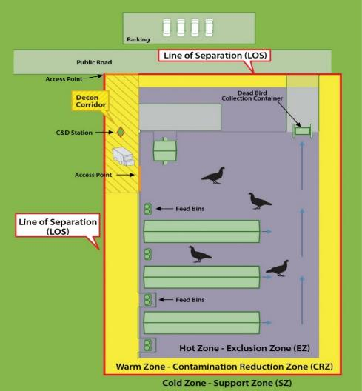
Infected – Raised Outdoors
Notes:
This illustrates the same premises of free-range birds, but now it has been designated as an HPAI Infected Premises. Containment areas are described as Work Zones. The Hot Zone-Exclusion Zone (EZ) is shown as the shaded central gray area within the fence line. It also includes the mortality storage and the former parking area. The Warm Zone-Contamination Reduction Zone (CRZ) is in yellow, and Cold Zone-Support Zone (SZ) encircles and extends beyond the contaminated areas. The Decontamination (Decon) Corridor with its C&D Station, represented by the hatched area at the upper left corner of the premises, serves as the point of access on or off the premises. All movements, including containers of contaminated carcasses, must move through the Decon Corridor to be cleaned and disinfected before being moved across the LOS and removed from the premises.

Slide 13
Infected – Raised Outdoors
Notes:
It is important to note that the Line of Separation (LOS), also known as the Clean/Dirty Line and represented as the red line, separates the clean Cold Zone-Support Zone from the contaminated areas. This Line has been repositioned from its location on the uninfected premises in order to accommodate the Work Zones on the contaminated premises. The Hot Zone-Exclusion Zone encompasses the area to which the poultry had access and the highly contaminated areas. The parking area has been relocated to the Cold Zone-Support Zone, at the top of the illustration, to minimize movements across the LOS. Biosecurity measures to mitigate the escape of the virus are conducted according to Work Zone and response activities. Again, the LOS is defended to prevent the transfer of disease. Note: the widths of the zones are not necessarily to scale.

Slide 14
Conclusion
Biosecurity is challenging for both bioexclusion and biocontainment
Biosecure areas are designated on uninfected and infected premises
Line of Separation is defended
Protocols are similar to prevent the transfer of disease
Evaluate according to the specific situation
Notes:
In conclusion, biosecurity is a challenge for both bioexclusion and biocontainment. Biosecure areas are designated whether the challenge involves an uninfected or an infected premises. The Line of Separation is defended to prevent the disease pathogen from reaching healthy animals. The protocols for bioexclusion and for biocontainment are similar--to prevent the transfer of disease. Each premises needs to be evaluated individually, and the Line of Separation should be determined according to the specific situation.

Slide 15
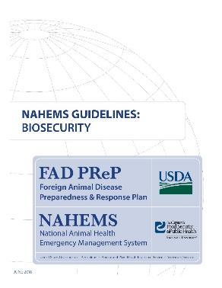
For More Information
FAD PReP/NAHEMS Guidelines
& SOP: Biosecurity (2016)
  http://www.aphis.usda.gov/fadprep
Biosecurity web-based training module:
  http://naherc.sws.iastate.edu/
Notes:
More details can be obtained from the sources listed on the slide, available on the USDA website (http://www.aphis.usda.gov/fadprep) and the National Animal Health Emergency Response Corps (NAHERC) Training Site (http://naherc.sws.iastate.edu/).

Slide 16
Guidelines Content
Authors (CFSPH)
Janice P. Mogan, DVM
Heather Allen, PhD, MPA
Kristen Bretz, MS
Reviewers (USDA)
Jonathan T. Zack, DVM
James A. Roth, DVM, PhD, DACVM
Notes:
The print version of the Guidelines document is an excellent source for more detailed information. This slide acknowledges the authors and reviewers of the Guidelines document. It can be accessed at http://www.aphis.usda.gov/fadprep.

Slide 17
Acknowledgments
Development of this presentation was by the Center for Food Security and Public Health at Iowa State University through funding from the USDA APHIS Veterinary Services
PPT Authors: Janice P. Mogan, DVM; Logan Kilburn
Reviewer: Kristen Bretz, MS
Notes:
Information provided in this presentation was developed by the Center for Food Security and Public Health at Iowa State University College of Veterinary Medicine, through funding from the US Department of Agriculture, Animal and Plant Health Inspection Service, Veterinary Services.

