Slide 1
The Survey Interview
NAHMS Goat 2019
Coordinator workshop
July 24, 2019

Slide 2
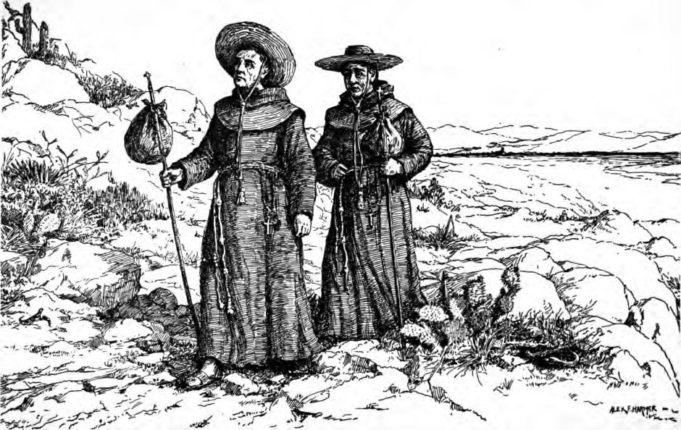
Notes:
Two priests, a Dominican and Jesuit, are discussing whether it is a sin to smoke and pray at the same time. After failing to reach a conclusion, each goes off to consult his respective superior.
The next week they meet again. The Dominican says, “Well, what did your superior say?”
The Jesuit responds, “He said it was alright.”
“That’s funny,” the Dominican replies. “My superior said it was a sin.”
The Jesuit says: “What did you ask him?”
The Dominican replies: “I asked him if it was all right to smoke while praying.”
“Oh,” says the Jesuit. “I asked my superior if it was all right to pray while smoking.”

Slide 3
Survey Methodology
Small changes in wording make big differences (so says Survey Methodology research)
NAHMS studies are based on “Survey Methodology” discipline
Survey = a systematic method for gathering information from a “study” population for the purposes of constructing quantitative descriptors of the attributes of a larger “target” population
Notes:
Study population - made up of a sample of units
Quantitative descriptors = “statistics”

Slide 4
Generalization
Study design – selection criteria
Statistical weights
Sampling design – random selection
Notes:
E.g. from Swine 2000 study
External population = 65K farms with 66 million pigs with domestic swine with ag cash receipts > $1000
Target population = 40K farms with 64 million pigs in top 17 states with 100 + total inventory
Study population = 4500 farms with 18 million pigs selected from target population
Use selection criteria and study design to go from external pop → target pop
Use sampling to go from target pop → study pop
Use estimation to go from study → target pop (if probability based sampling)
Use generalization to go from target → external pop
➔ After sampling, in statistical analysis procedures for extrapolation we want to generate valid point estimates for the target population. E.g percent; mean

Slide 5
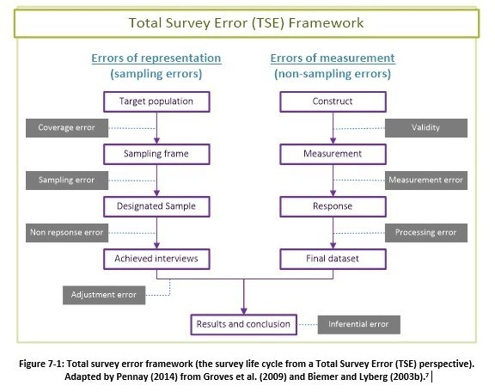

Slide 7
Notes:
Measurement: the critical task for measurement is to design questions that produce answers reflecting perfectly the constructs we are trying to measure.

Slide 8
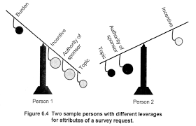
Leverage to reduce survey non-response

Slide 9
Introductory script
“Hello, my name is Mary Smith, and I work for the USDA’s Veterinary Services. Let me show you my identification. The USDA is conducting a nationwide survey, and we are interested in talking to people about their goat operation on a variety of topics, including … You should have received a letter from USDA’s National Agricultural Statistics Service telling you about this survey.”

Slide 10
Notes:
Measurement: the critical task for measurement is to design questions that produce answers reflecting perfectly the constructs we are trying to measure.

Slide 11
Interviewer behavior to reduce measurement error
Rapport with Respondent
Read questions exactly as worded
Explain process and procedures
Probe nondirectively
Record answers accurately
Notes:
We reduce measurement error by standardizing the data collection process

Slide 12
1. Rapport with Respondent
Interact with respondent in a way that is
Professional
Task oriented
Minimizes potential of respondents to infer preferences for kinds of answers that are obtained
Goal: Important for Interviewer to establish the right kind of relationship with respondents that would allow them to feel free to answer the questions accurately and completely.
Personal or formal? Effect on interview.

Slide 13
1. Rapport with Respondent
Go for balance of warm and professional.
Refrain from expressing any views or opinions on topics covered in the questionnaire
Refrain from presenting any personal information that might provide a basis for inferring what your preferences or values might be relevant to content of interview.
Some informal chatting on neutral topics is good; but for most part interviewers should focus on the task.

Slide 14
Read questions exactly as worded
Read questions exactly as worded
Notes:
2. This is the most fundamental and universally supported principle of standardized interviewing.

Slide 15
3. Explain Q&A process to respondent
Q. “Overall, how would you rate the school your child attends – excellent, very good, good, fair or poor?”
A. “I’d say ‘not so good’.”

Slide 16
3. Explain Q&A process to respondent
“I’m going to ask you to pick one of the answers I read – excellent, very good, good, fair, poor. I know this may seem artificial, and it is possible that none of those answers exactly captures the way you feel. However, the way a survey works is that we ask people exactly the same questions and have them choose from exactly the same answers. Then we can meaningfully compare the answers that different people give. If we change the questions, or we have people choose their own words, then it gets harder to actually compare what different people say.”

Slide 17
4. Probing
A “probe” is an attempt to obtain an adequate or complete answer by the Respondent when they fail to provide one.
Interviewer should probe in a way that does not effect which response category is chosen, i.e. be nondirective.
For close ended questions – repeat the question and all response categories.
For open ended, numeric questions – try to get right format or more exact number.
Notes:
Failure on our part in writing good questions

Slide 18
Probing examples
“Yes, I had a few goats with lumps.”
“About every seven months.”

Slide 19
5. Record answers exactly as given
Try to write narrative response verbatim and not paraphrase or summarize

Slide 20
Model of response process for survey questions
Question Comprehension
Information Retrieval
Judgment / Estimation
Reporting of response

Slide 21
Problems in answering survey questions
Failure to encode the information sought
E.g. witnesses of same crime; dietary survey vs diary
Notes:
e.g. eye witnesses to crime report different details; what is reported on dietary survey differs greatly from food diary. What gets “encoded” in one’s mind varies. People can not provide info they do not have.
E.g. survey question “Do you think that children suffer any ill effects from watching programs with violence in them?” Children can be young people, regardless of relationship to R; or offspring, regardless of age. Age cutoff for “children” varies with situation. What of grandchildren? When a R is confused, they will likely be too embarrassed to ask for clarification.
Taking more time, i.e. longer introduction to question, slower pace to interview, will help with memory recall.
Three estimation processes used by R’s for behavioral questions: recall-n-count; rate-based estimation; impression-based guess
Once R has generated an estimate / initial judgement, next step is translating that judgment into an acceptable format. Three most common item formats are open ended with numerical answer; closed q with ordered response scales, closed with categorical response options. In visual based – primacy bias (tend to answer first options); in auditory based – recency bias (tend to answer last option)
E.g. embarrassed or intrusive questions, e.g. drug use. Also confusing questions and frustration. Over report positive behaviors, e.g. voting
Navigational errors, i.e. in SAQ

Slide 22
Problems in answering survey questions
Failure to encode the information sought
E.g. witnesses of same crime; dietary survey vs diary
Misinterpretation of the questions
E.g. terms such as “weekday” or “children”
Forgetting and other memory problems
Flawed judgment or estimation strategies
Multiple strategies, e.g. records, count, rate, guess
Problems in formatting an answer
Primacy effect; recency effect
More or less deliberate misreporting
Failure to follow instructions, e.g. navigational errors
Notes:
e.g. eye witnesses to crime report different details; what is reported on dietary survey differs greatly from food diary. What gets “encoded” in one’s mind varies. People can not provide info they do not have.
E.g. survey question “Do you think that children suffer any ill effects from watching programs with violence in them?” Children can be young people, regardless of relationship to R; or offspring, regardless of age. Age cutoff for “children” varies with situation. What of grandchildren? When a R is confused, they will likely be too embarrassed to ask for clarification.
Taking more time, i.e. longer introduction to question, slower pace to interview, will help with memory recall.
Three estimation processes used by R’s for behavioral questions: recall-n-count; rate-based estimation; impression-based guess
Once R has generated an estimate / initial judgement, next step is translating that judgment into an acceptable format. Three most common item formats are open ended with numerical answer; closed q with ordered response scales, closed with categorical response options. In visual based – primacy bias (tend to answer first options); in auditory based – recency bias (tend to answer last option)
E.g. embarrassed or intrusive questions, e.g. drug use. Also confusing questions and frustration. Over report positive behaviors, e.g. voting
Navigational errors, i.e. in SAQ

Slide 23
Problems in answering survey questions
Failure to encode the information sought
Misinterpretation of the questions
E.g. terms such as “weekday” or “children”
Notes:
e.g. eye witnesses to crime report different details; what is reported on dietary survey differs greatly from food diary. What gets “encoded” in one’s mind varies. People can not provide info they do not have.
E.g. survey question “Do you think that children suffer any ill effects from watching programs with violence in them?” Children can be young people, regardless of relationship to R; or offspring, regardless of age. Age cutoff for “children” varies with situation. What of grandchildren? When a R is confused, they will likely be too embarrassed to ask for clarification.
Taking more time, i.e. longer introduction to question, slower pace to interview, will help with memory recall.
Three estimation processes used by R’s for behavioral questions: recall-n-count; rate-based estimation; impression-based guess
Once R has generated an estimate / initial judgement, next step is translating that judgment into an acceptable format. Three most common item formats are open ended with numerical answer; closed q with ordered response scales, closed with categorical response options. In visual based – primacy bias (tend to answer first options); in auditory based – recency bias (tend to answer last option)
E.g. embarrassed or intrusive questions, e.g. drug use. Also confusing questions and frustration. Over report positive behaviors, e.g. voting
Navigational errors, i.e. in SAQ

Slide 24
Problems in answering survey questions
Failure to encode the information sought
Misinterpretation of the questions
Forgetting and other memory problems
Notes:
e.g. eye witnesses to crime report different details; what is reported on dietary survey differs greatly from food diary. What gets “encoded” in one’s mind varies. People can not provide info they do not have.
E.g. survey question “Do you think that children suffer any ill effects from watching programs with violence in them?” Children can be young people, regardless of relationship to R; or offspring, regardless of age. Age cutoff for “children” varies with situation. What of grandchildren? When a R is confused, they will likely be too embarrassed to ask for clarification.
Taking more time, i.e. longer introduction to question, slower pace to interview, will help with memory recall.
Three estimation processes used by R’s for behavioral questions: recall-n-count; rate-based estimation; impression-based guess
Once R has generated an estimate / initial judgement, next step is translating that judgment into an acceptable format. Three most common item formats are open ended with numerical answer; closed q with ordered response scales, closed with categorical response options. In visual based – primacy bias (tend to answer first options); in auditory based – recency bias (tend to answer last option)
E.g. embarrassed or intrusive questions, e.g. drug use. Also confusing questions and frustration. Over report positive behaviors, e.g. voting
Navigational errors, i.e. in SAQ

Slide 25
Problems in answering survey questions
Failure to encode the information sought
Misinterpretation of the questions
Forgetting and other memory problems
Flawed judgment or estimation strategies
Multiple strategies, e.g. records, count, rate, guess
Notes:
e.g. eye witnesses to crime report different details; what is reported on dietary survey differs greatly from food diary. What gets “encoded” in one’s mind varies. People can not provide info they do not have.
E.g. survey question “Do you think that children suffer any ill effects from watching programs with violence in them?” Children can be young people, regardless of relationship to R; or offspring, regardless of age. Age cutoff for “children” varies with situation. What of grandchildren? When a R is confused, they will likely be too embarrassed to ask for clarification.
Taking more time, i.e. longer introduction to question, slower pace to interview, will help with memory recall.
Three estimation processes used by R’s for behavioral questions: recall-n-count; rate-based estimation; impression-based guess
Once R has generated an estimate / initial judgement, next step is translating that judgment into an acceptable format. Three most common item formats are open ended with numerical answer; closed q with ordered response scales, closed with categorical response options. In visual based – primacy bias (tend to answer first options); in auditory based – recency bias (tend to answer last option)
E.g. embarrassed or intrusive questions, e.g. drug use. Also confusing questions and frustration. Over report positive behaviors, e.g. voting
Navigational errors, i.e. in SAQ

Slide 26
Problems in answering survey questions
Failure to encode the information sought
Misinterpretation of the questions
Forgetting and other memory problems
Flawed judgment or estimation strategies
Problems in formatting an answer
Primacy effect; recency effect
Notes:
e.g. eye witnesses to crime report different details; what is reported on dietary survey differs greatly from food diary. What gets “encoded” in one’s mind varies. People can not provide info they do not have.
E.g. survey question “Do you think that children suffer any ill effects from watching programs with violence in them?” Children can be young people, regardless of relationship to R; or offspring, regardless of age. Age cutoff for “children” varies with situation. What of grandchildren? When a R is confused, they will likely be too embarrassed to ask for clarification.
Taking more time, i.e. longer introduction to question, slower pace to interview, will help with memory recall.
Three estimation processes used by R’s for behavioral questions: recall-n-count; rate-based estimation; impression-based guess
Once R has generated an estimate / initial judgement, next step is translating that judgment into an acceptable format. Three most common item formats are open ended with numerical answer; closed q with ordered response scales, closed with categorical response options. In visual based – primacy bias (tend to answer first options); in auditory based – recency bias (tend to answer last option)
E.g. embarrassed or intrusive questions, e.g. drug use. Also confusing questions and frustration. Over report positive behaviors, e.g. voting
Navigational errors, i.e. in SAQ

Slide 27
Problems in answering survey questions
Failure to encode the information sought
Misinterpretation of the questions
Forgetting and other memory problems
Flawed judgment or estimation strategies
Problems in formatting an answer
More or less deliberate misreporting
Failure to follow instructions, e.g. navigational errors
Notes:
e.g. eye witnesses to crime report different details; what is reported on dietary survey differs greatly from food diary. What gets “encoded” in one’s mind varies. People can not provide info they do not have.
E.g. survey question “Do you think that children suffer any ill effects from watching programs with violence in them?” Children can be young people, regardless of relationship to R; or offspring, regardless of age. Age cutoff for “children” varies with situation. What of grandchildren? When a R is confused, they will likely be too embarrassed to ask for clarification.
Taking more time, i.e. longer introduction to question, slower pace to interview, will help with memory recall.
Three estimation processes used by R’s for behavioral questions: recall-n-count; rate-based estimation; impression-based guess
Once R has generated an estimate / initial judgement, next step is translating that judgment into an acceptable format. Three most common item formats are open ended with numerical answer; closed q with ordered response scales, closed with categorical response options. In visual based – primacy bias (tend to answer first options); in auditory based – recency bias (tend to answer last option)
E.g. embarrassed or intrusive questions, e.g. drug use. Also confusing questions and frustration. Over report positive behaviors, e.g. voting
Navigational errors, i.e. in SAQ

Slide 28
Problems in answering survey questions
Failure to encode the information sought
E.g. witnesses of same crime; dietary survey vs diary
Misinterpretation of the questions
E.g. terms such as “weekday” or “children”
Forgetting and other memory problems
Flawed judgment or estimation strategies
Multiple strategies, e.g. records, count, rate, guess
Problems in formatting an answer
Primacy effect; recency effect
More or less deliberate misreporting
Failure to follow instructions, e.g. navigational errors
Notes:
e.g. eye witnesses to crime report different details; what is reported on dietary survey differs greatly from food diary. What gets “encoded” in one’s mind varies. People can not provide info they do not have.
E.g. survey question “Do you think that children suffer any ill effects from watching programs with violence in them?” Children can be young people, regardless of relationship to R; or offspring, regardless of age. Age cutoff for “children” varies with situation. What of grandchildren? When a R is confused, they will likely be too embarrassed to ask for clarification.
Taking more time, i.e. longer introduction to question, slower pace to interview, will help with memory recall.
Three estimation processes used by R’s for behavioral questions: recall-n-count; rate-based estimation; impression-based guess
Once R has generated an estimate / initial judgement, next step is translating that judgment into an acceptable format. Three most common item formats are open ended with numerical answer; closed q with ordered response scales, closed with categorical response options. In visual based – primacy bias (tend to answer first options); in auditory based – recency bias (tend to answer last option)
E.g. embarrassed or intrusive questions, e.g. drug use. Also confusing questions and frustration. Over report positive behaviors, e.g. voting
Navigational errors, i.e. in SAQ

Slide 29
Questions?

