Slide 1
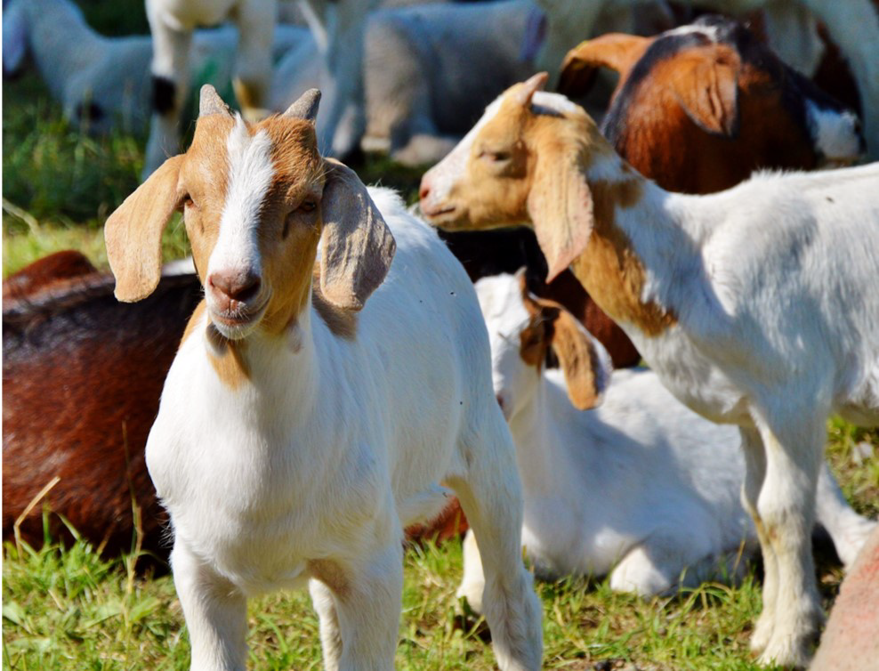
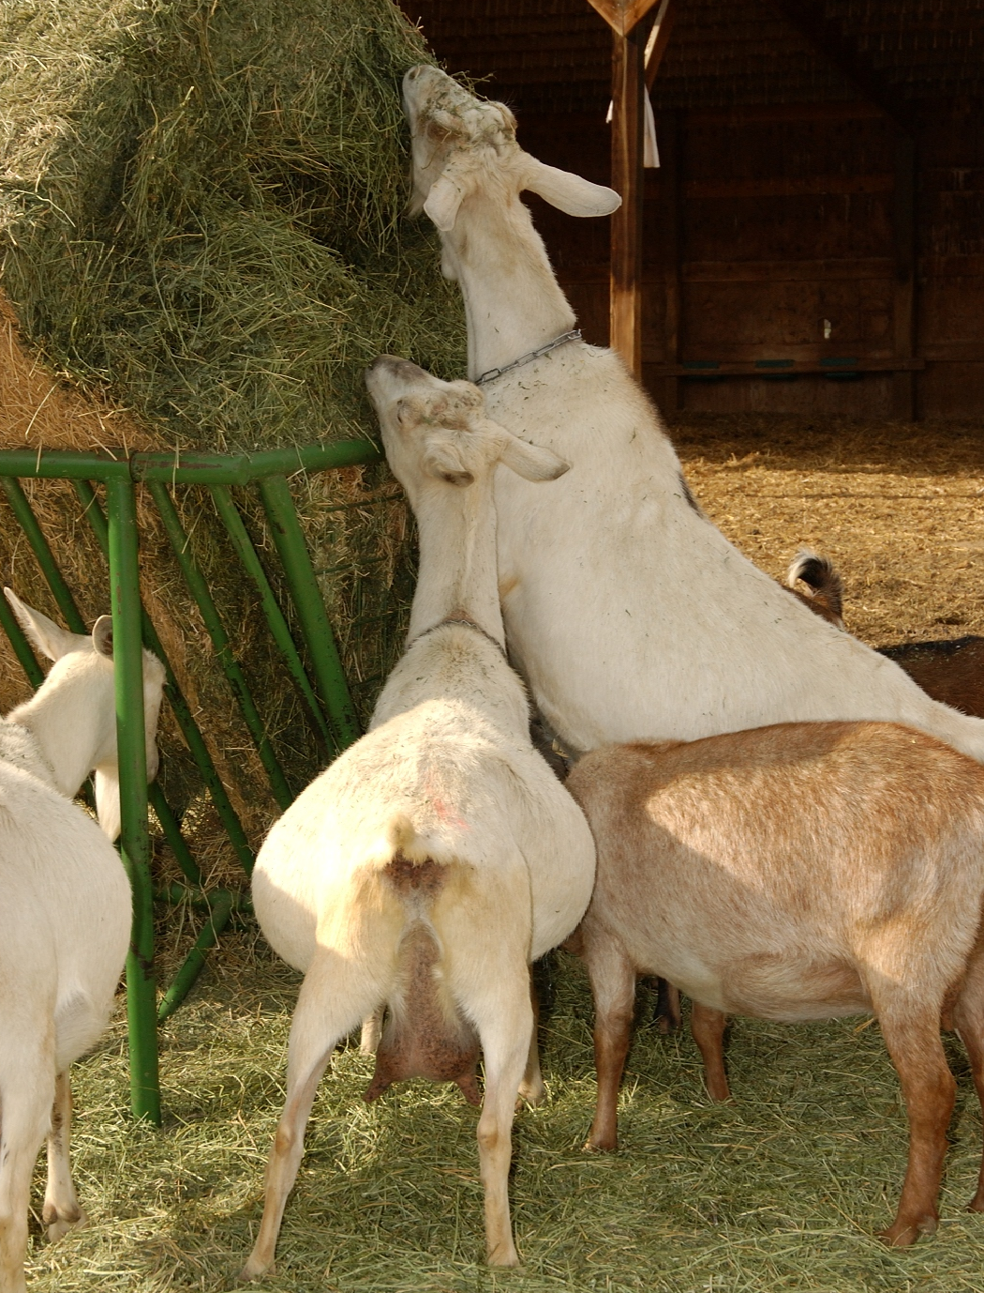
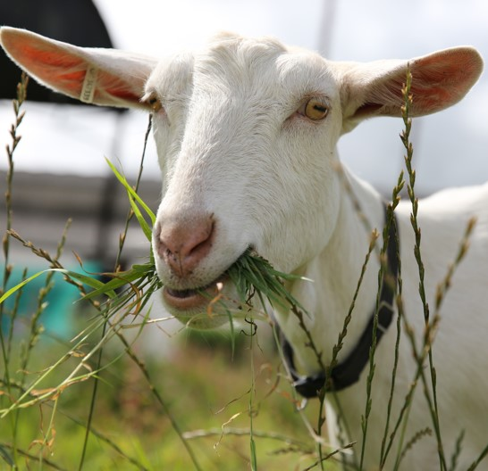
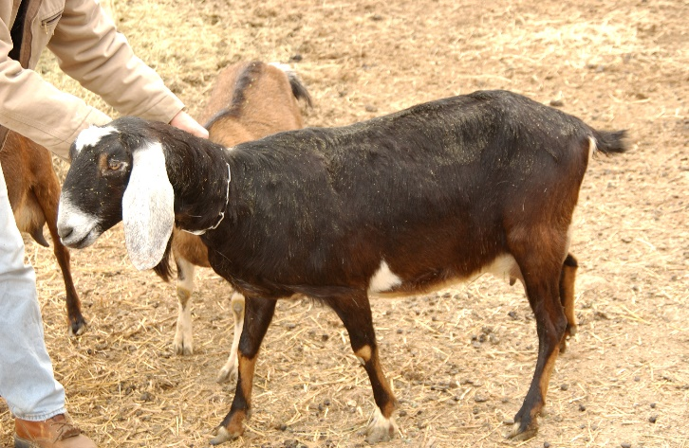
NAHMS Coordinator Training – Introduction to NASS National Animal Health Monitoring System (NAHMS) Goat 2019 Study
U.S. Department of Agriculture
Animal and Plant Health Inspection Service
Veterinary Services

Slide 2
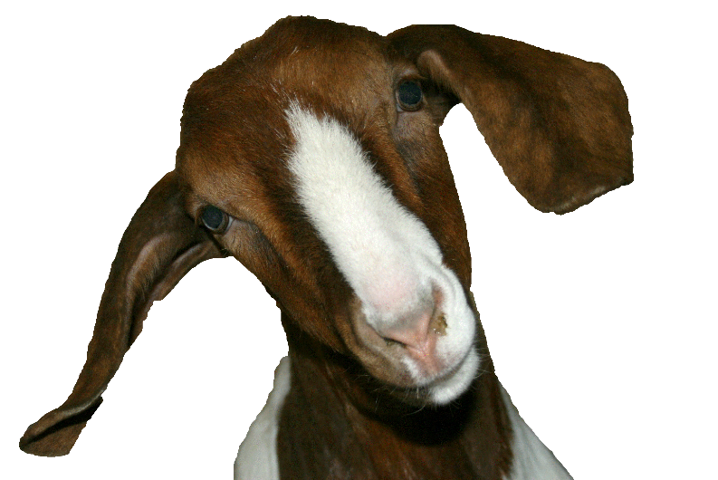
Introduction to NASS

Slide 3
Who is NASS?
Purpose
USDA agency charged with the collection and dissemination of agricultural statistics
Origin
NASS stems from the new USDA’s Division of Statistics, est. 1863
Organization
NASS Headquarters
(Agricultural Statistics Board and Methodology, Census and Survey, Statistics, Research and Development, Ops Divisions)
12 NASS Regional Field Offices (RFOs)
Non-regulatory, statistical agency
3

Slide 4
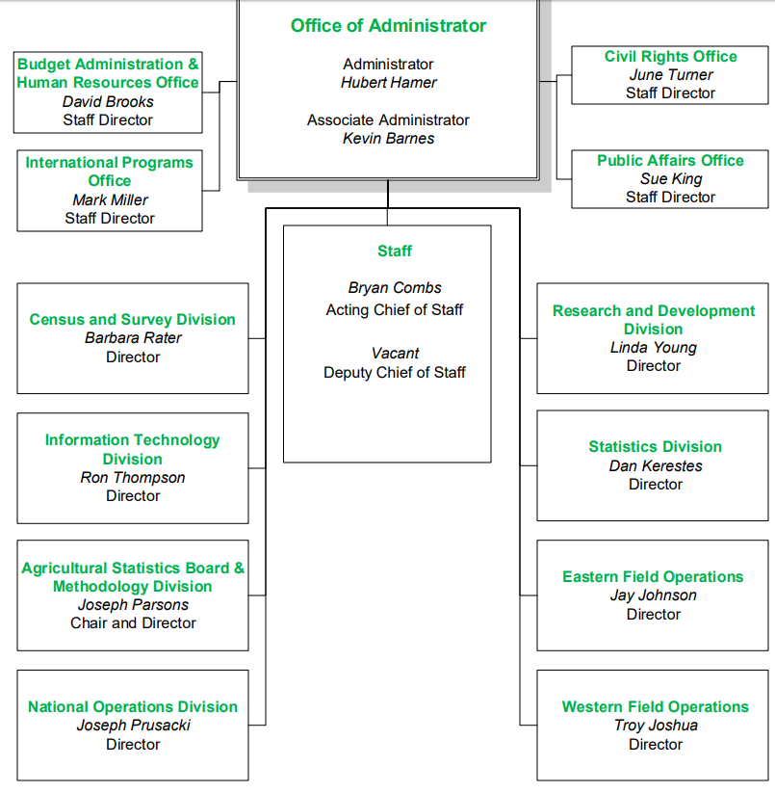
Organization Chart
4

Slide 5
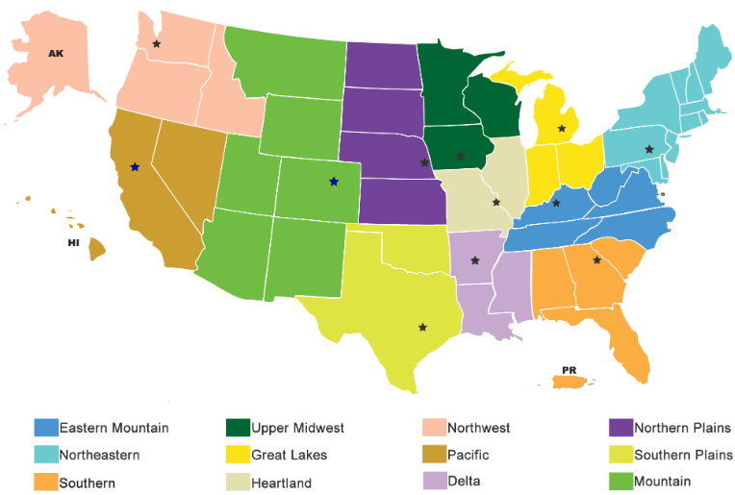
Regional Field Offices (RFOs)
5

Slide 6
NASS Mission
The National Agricultural Statistics Service provides timely, accurate, and useful statistics in service to U.S. agriculture.
6

Slide 7
What does NASS do?
Census
Surveys
Partnerships
Enumeration
Conducts the Census of Agriculture every 5 years (latest in 2017) in accordance with U.S. Code
Also conducts over 400 surveys per year across all major agricultural, livestock, and aquaculture commodities
Partners with the National Association of the State Departments of Agriculture (NASDA) for face-to-face enumeration (also, mail-, phone-, and web-based surveys)
Partners with other USDA Agencies to conduct a variety of agricultural-based surveys
7

Slide 8
NASS Survey Areas
Crops
Livestock
Other
Grains
Hay
Oilseeds
Cotton
Tobacco
Potatoes
Sugar
Other field crops
Citrus fruit
Non-citrus fruit
Nuts
Vegetables
Floriculture
Crop measures
Crop progress
Acreage
Plantings
Processing
Prices received by farmers
Agricultural chemical use
Livestock measures
Cattle
Hogs
Sheep
Goats
Equine
Poultry
Milk and dairy
Aquaculture
Bees and honey
Mink
Inventory
Yield and Production
Stocks disposition
Marketings
Slaughter
Production/disposition
Prices received by farmers
Inventory/production values
Numbers of farms
Land in farms
Land values
Cash rents
Agricultural labor
Cold storage
Cash receipts
Production expenditures
8

Slide 9
NASS-NAHMS partnership
NASS has partnered with NAHMS to conduct over 30 national studies of animal management and health in a variety of commodities
Both contribute to the planning, design, and sampling for the national studies
NASS turns over contact information for producers who consent to participating in Phase II (VS Phase)
NASS makes first contact with producers and typically implements the Phase I (NASS Phase) questionnaire (management-focused)
9

Slide 10
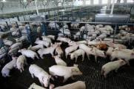
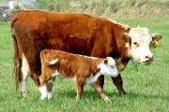
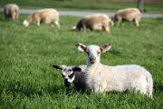
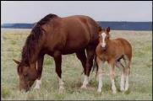
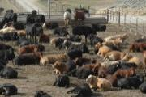
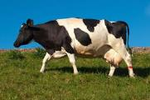
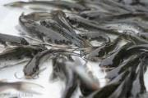
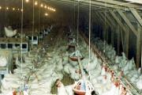
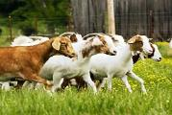
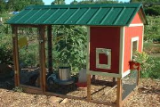
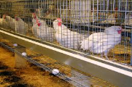
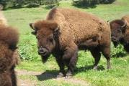
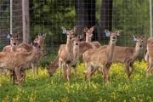
Pilot studies conducted in 7 states
1987
1988
1989
1990
1991
1992
1993
1994
1995
1996
1997
A Timeline of NAHMS Studies
(1987 – 2019)
National Swine Survey
National Dairy Heifer Evaluation Project
Beef Cow/Calf Health & Productivity Audit (CHAPA)
Swine
Sheep
Equine
1998
1999
2000
2001
2002
2003
2004
2005
2006
2007
Beef Feedlot
Layers
Swine
Sheep
Dairy
Catfish
Poultry
Equine
Swine
Poultry
(small scale)
Dairy
Swine (Small Enterprise)
Beef Cow-Calf
Goats
Catfish
Cattle Death Loss
Sheep Death Loss
Poultry
2008
2009
2010
2011
2012
2013
2014
2015
2016
2017
2018
2019
Beef Feedlot
Sheep
Small-Scale
Operations
Dairy Heifer Raisers
Swine
Layers
Ranched
Bison
Dairy
Farmed Cervids
Equine
Sheep Death Loss
Goat Death Loss
Cattle Death Loss
Beef Cow-Calf
Antimicrobial Use Swine
Antimicrobial Use Feedlot
Goats

Slide 11
NASS Data Protections and Confidentiality
Value
Law
What is protected?
NASS is committed to protecting the confidentiality of information providers
There are laws protecting data confidentiality and violations can result in prison time or fines
- USC, Title 7, Section 2276, “Confidentiality of Information”
- USC, Title 18, Paragraph 1905, “Disclosure of Confidential Information Generally”
- Confidential Information and Statistical Efficiency Act (CIPSEA) of 2002, Sections 512-513 “Limitations on Use and Disclosure of Data and Information” and “Fines and Penalties”
Only NASS employees or sworn agents have access to record-level NASS data, all other data released is aggregated
11

Slide 12
NAHMS Data Protections and Confidentiality
Mirrored values
Statistical unit
NAHMS is committed to protecting the confidentiality of information providers
As a designated statistical unit, NAHMS and NAHMS agents have the same commitments under the law to protect confidential information and use it only for statistical purposes
12

Slide 13
Protecting Data and Confidentiality
Protect PII
All Personally Identifiable Information (PII) (names, addresses, phone numbers, or any other information that, when used in combination with other available information, can be used to identify an individual person) should be protected at all times
Consent form turnover process
Proper treatment of consent forms and of nondisclosure forms during the turnover process help to adhere to data protections requirements
Protect against the improper disclosure, access, modification, or destruction of confidential data at all times
Maintain a secure work area with special emphasis when performing duties in a non-office environment
13

Slide 14
Protecting Data and Confidentiality
Protections via blinding
Producer contact information is only kept on the consent forms to make contact with producers
From VS contact forward, only an ID number is associated with a producer’s data
Turnover to NAHMS Coordinator
Study information
NAHMS Headquarters
VS Contact
Contact Information
NASS Contact
Contact information
ID
ID
ID
14

Slide 15
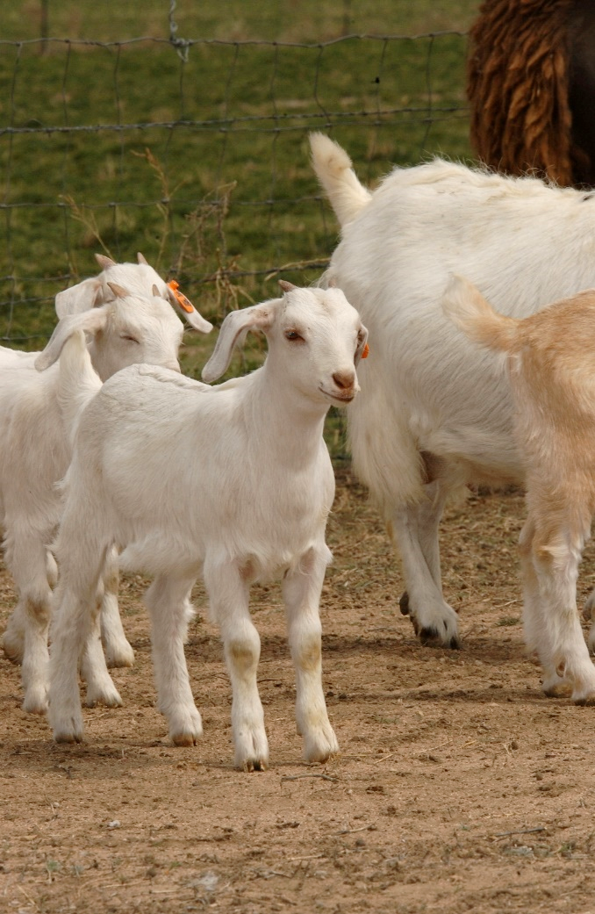
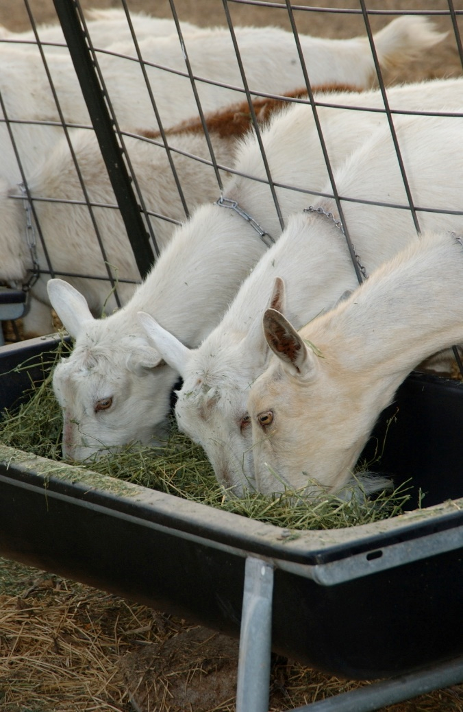
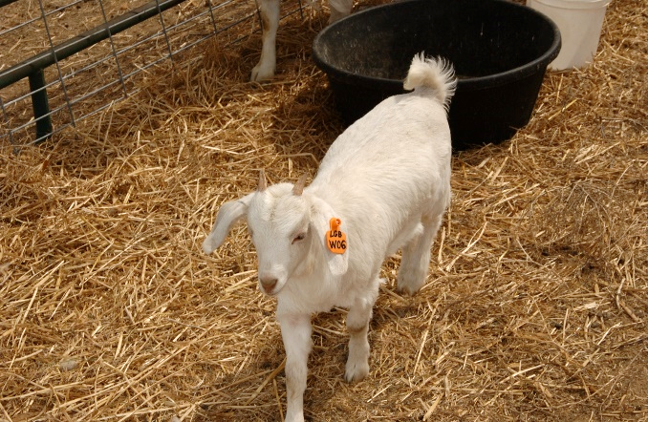
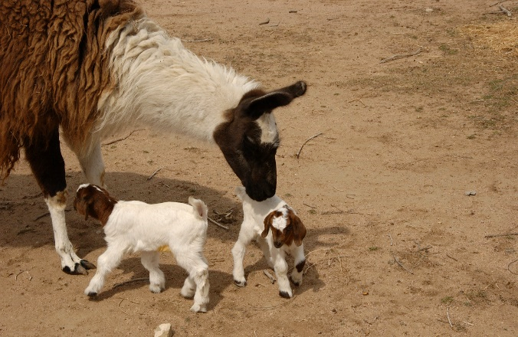
Timeline and Materials

Slide 16
Timeline
Phase I
(NASS)
6/3/2019: NASS will mail pre-survey materials
7/1/2019 – 8/9/2019: NASDA enumerators will set up and complete face-to-face interviews using the General Goat Management Questionnaire and Consent Form
Turnover
(NASS to VS)
Meet with NAHMS State Coordinators to sign a NASS Representative Agreement, ADM-043, and turn over Consent Forms
Send all hard-copy General Goat Management Questionnaires to NASS Central Processing
Scan Consent Forms into the SMS database
8/23/2019: The RFO’s
8/16/2019: NASDA enumerators send the last of the hard-copy General Goat Management Questionnaires and Consent Forms to the appropriate Regional Field Office (RFO)

Slide 17
Timeline
Phase I
(NASS)
6/3/2019: NASS will mail pre-survey materials
Turnover
(NASS to VS)
8/16/2019: NASDA enumerators send the last of the hard-copy General Goat Management Questionnaires and Consent Forms to the appropriate Regional Field Office (RFO)
7/1/2019 – 8/9/2019: NASDA enumerators will set up and complete face-to-face interviews using the General Goat Management Questionnaire and Consent Form
8/23/2019:
NAHMS State Coordinators meet with NASS RFOs to sign a NASS Representative Agreement, ADM-043, and turn over Consent Forms
NASS RFOs scan Consent Forms into the SMS database and send all hard-copy General Goat Management Questionnaires to NASS Central Processing for data entry

Slide 18
Timeline (cont.)
Phase II
(VS)
9/9/2019 – 12/15/2019: VS enumerators will set up and complete face-to-face interviews using the Goat 2019 – VS Initial Questionnaire and biological testing forms

Slide 19
Phase I (NASS) Materials
Pre-survey materials
General Goat Management Questionnaire
Consent Form for continuation into Phase II

Slide 20
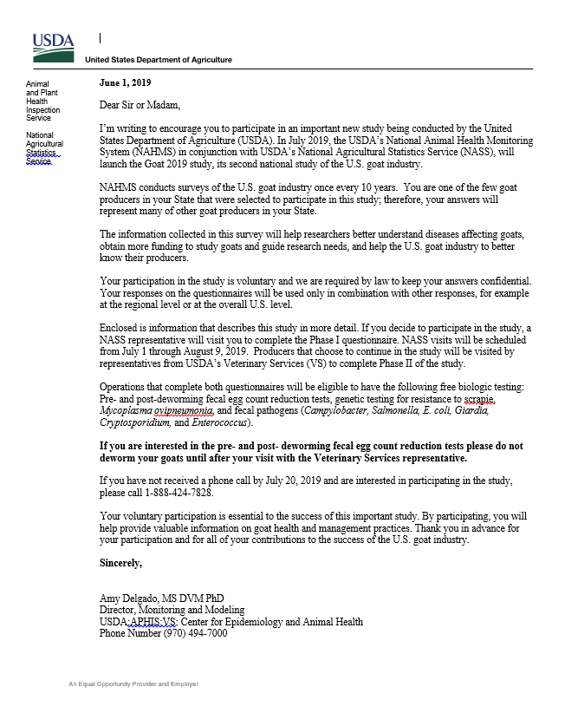
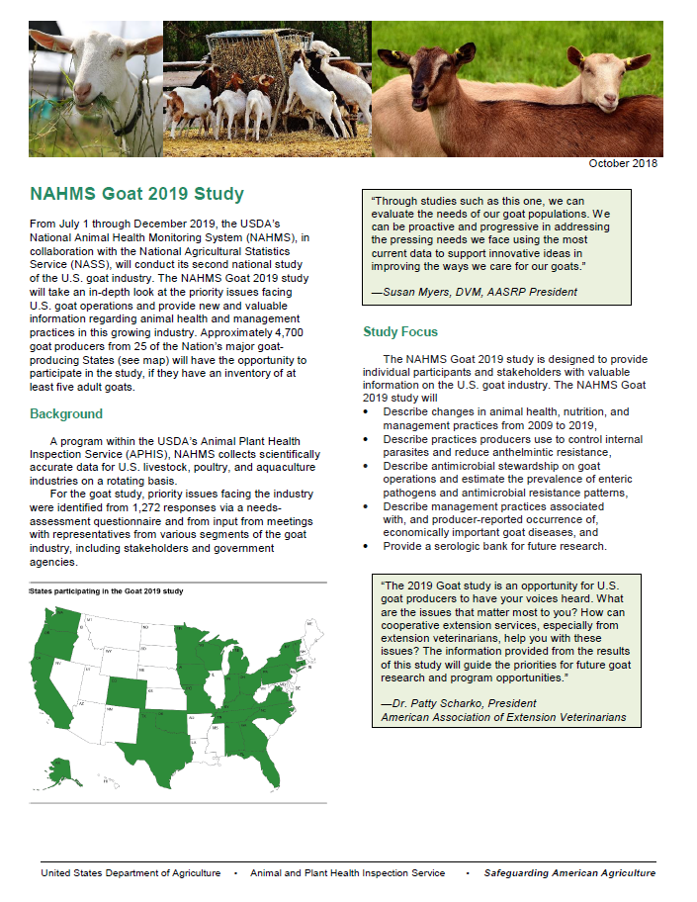
Pre-survey Letter
Launch Sheet

Slide 21
Study Timeline / Biologics Benefits Sheet
Study Promotion: How you can Help!

Slide 22
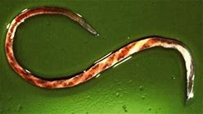
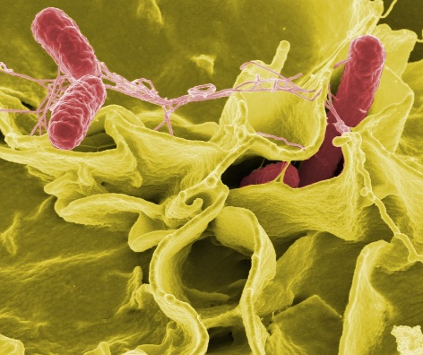
Incentives for Producers who Complete both Questionnaires
Internal parasite tests
Do not deworm 60 days prior to VS visit. Ensure producers know that if they want this testing, they should not deworm 60 days prior to the VS visit.
Scrapie genetic tests
Genetic testing results will be returned in 3 months
Enteric microbe tests
Total savings: Up to $2,467
Free biological testing
(during VS Visit)
Salmonella, E. Coli, etc.

Slide 23
General Goat Management Questionnaire
Administered by NASDA enumerators from 7/1/2019 – 8/9/2019
Operations eligible if they have 5 or more adult goats
Operations identified using EPAID (two-digit State code, four zeroes, four digit operation ID)

Slide 24
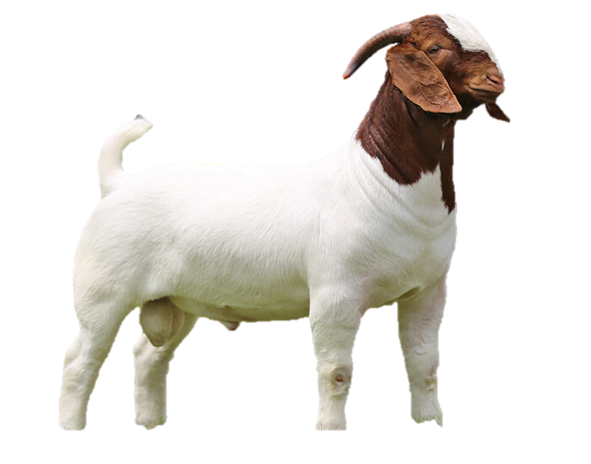

Slide 25
Turnover Materials
Consent Form for continuation into Phase II
Nondisclosure forms:
NASS Representative Agreement
ADM-043

Slide 26
VS Consent Form
The producer agrees to share their contact information with NAHMS:
Allows producer to participate in Phase II
Doesn’t obligate the producer to participate in Phase II, and they do not need to make a decision about participating in Phase II until the time of the visit by the VMO

Slide 27
VS Consent Form
For consenting operations, the following information will be included at the bottom of the form
Number of goats on the operation on 7/1/2019
Operation address, phone number, and email address
Use of goats on the operation (meat, dairy, fiber, agritourism, other) – can check more than one category
Any notes (e.g., alternative contact method, contact issues)

Slide 28
VS Consent Form Flow
NASDA enumerators will send consent forms to the appropriate RFO by 8/16/2019
The RFO will scan the consent forms into the SMS database
Then, NAHMS Coordinators will meet with the appropriate RFO by 8/23/2019

Slide 29
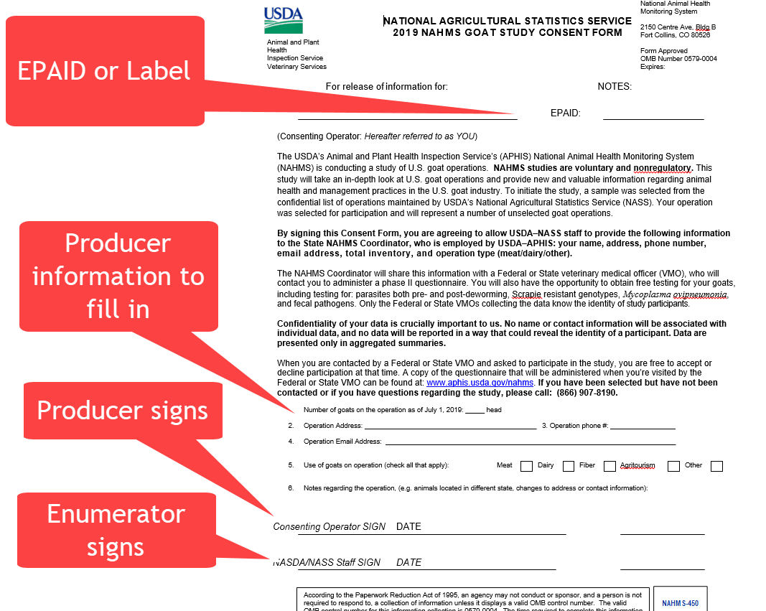
Consent Form
NAHMS Coordinators do not sign
Turned over consent forms will have already been signed

Slide 30
Nondisclosure Forms
Personal meeting between the NASS RFO and NAHMS State Coordinator by 8/23/2019
NAHMS Coordinator will sign both forms below
ADM-043
Allows RFO to turn over the consent forms to the NAHMS Coordinator
Must be witnessed by someone from the NASS RFO
NASS Representative Agreement
Allows the NAHMS Coordinator to observe the signing of ADM-043 forms by VS Field Staff (so they can handle consent form information)

Slide 31
Nondisclosure Forms Flow
NASS RFO will send the signed forms to NAHMS headquarters for signature
NAHMS headquarters will copy the signed forms and
Send the originals back to NASS
Keep the copies for NAHMS records

Slide 32
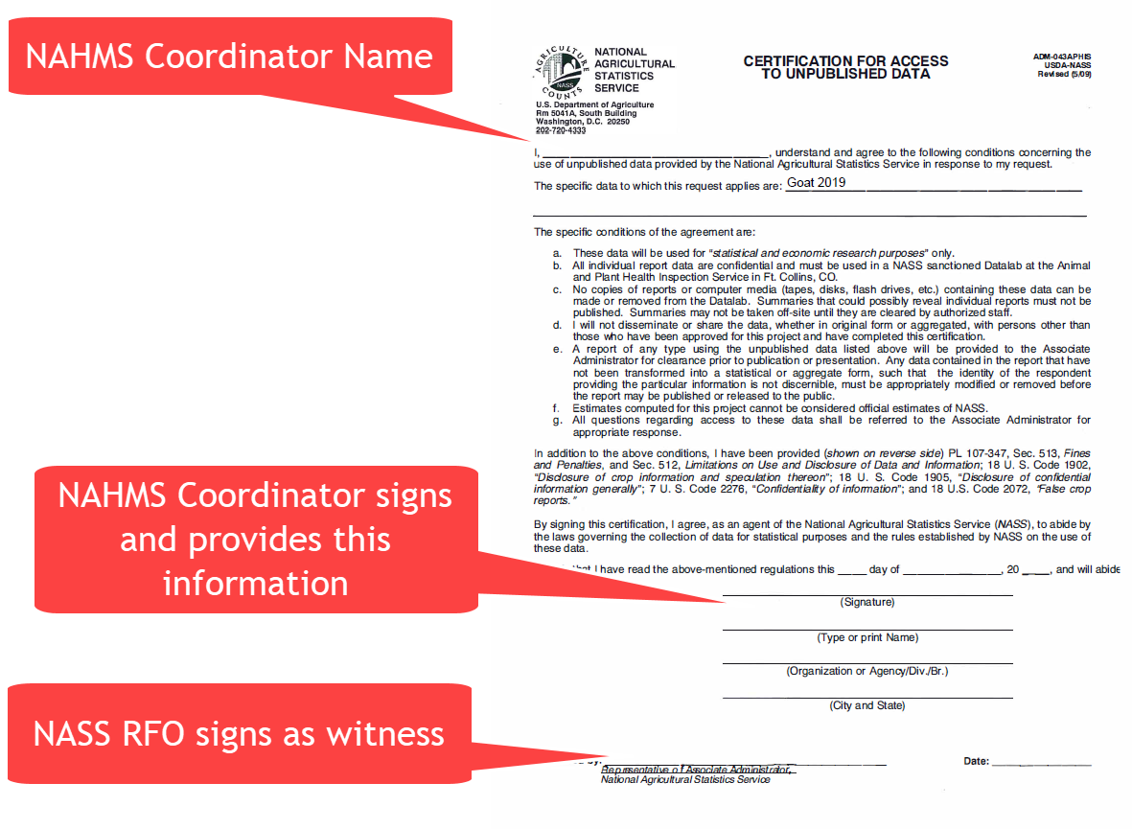
ADM-043

Slide 33
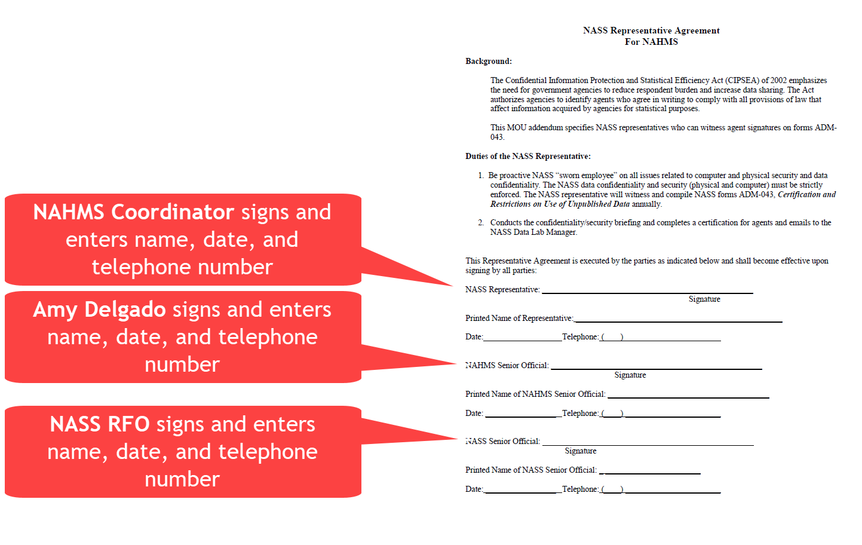
NASS Representative Agreement

Slide 34
What to do with consent forms?
Hard-copy consent forms can be used to assign producers to Field Staff
An electronic dataset will be available to help assign producers to Field Staff by zip code or county quickly and verify hard-copy consents
Field Staff: Preferably Federal VMOs, but can be AHTs
NOTE: for swab and fecal collections, a veterinarian must be present on the operation
Assign yourself a some operations as well
This file will be sent securely and will be encrypted and password protected

Slide 35
Protecting consent form data
Use passwords and encryption on all electronic data related to the study
Consent forms have PII on them and so must be protected
While using the producer contact information for contact activities, use folders to hide consent form information and keep them in a safe place
Don’t send the hard-copy consent forms to NAHMS headquarters
After contacting producers, these should be locked up until NAHMS headquarters notifies you that they can be destroyed
While not in use, consent forms should be locked in a secure area
Consent form information should not be stored or sent electronically

Slide 36
Phase II (VS) Materials
VS Initial Questionnaire
Biological Sampling Collection Records
Pre-deworming
Post-deworming
Enteric Microbe
Blood and Swab Sample
General Producer Agreement
Agritourism Questionnaire

Slide 37
Working with NASS Contacts

Slide 38
NASS Contacts
Get to know your NASS contact!
They are a valuable resource and a smooth turnover process is critical to the success of the study
They are experienced in survey administration and management
They can help if you have questions regarding Phase I or turnover

Slide 39
Contact List

Slide 40
NASS Trainings
NASS RFO Training (late April-early May (date TBD))
NASS Schools (early May (dates TBD))
Training of NASS RFOs will take place via webinar
NASS RFO staff will train NASS field enumerators in more localized trainings
NAHMS Coordinators are encouraged to attend this webinar training
This is an opportunity to connect with NASS contacts, get a better understanding of Phase I, and lets you answer any questions the NASS enumerators may have
NAHMS Coordinators and/or their staff are encouraged to attend these trainings
40

Slide 41
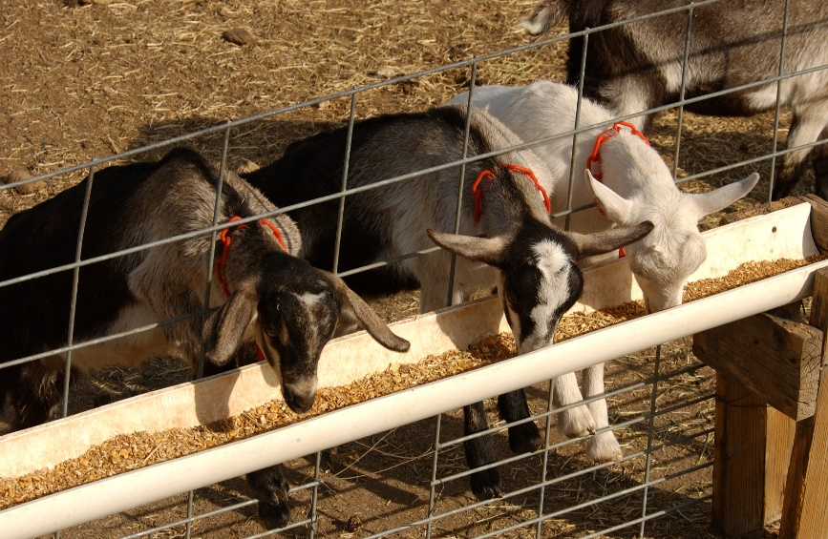
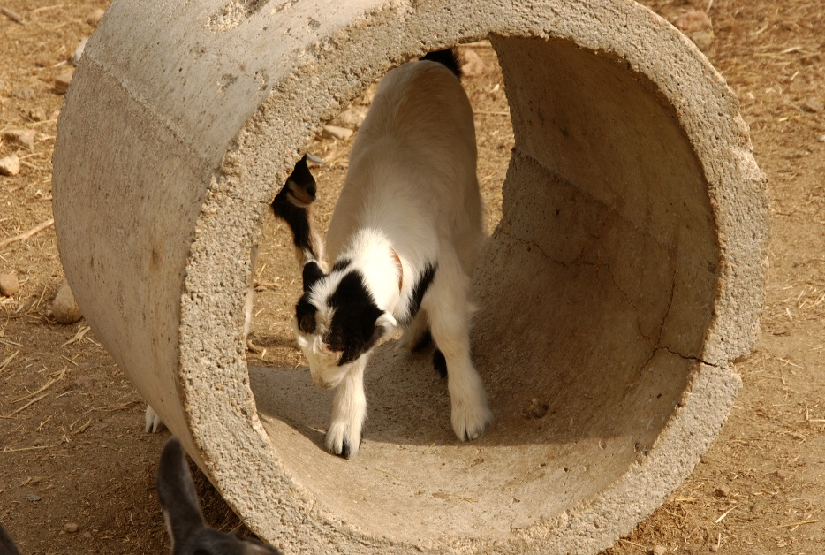
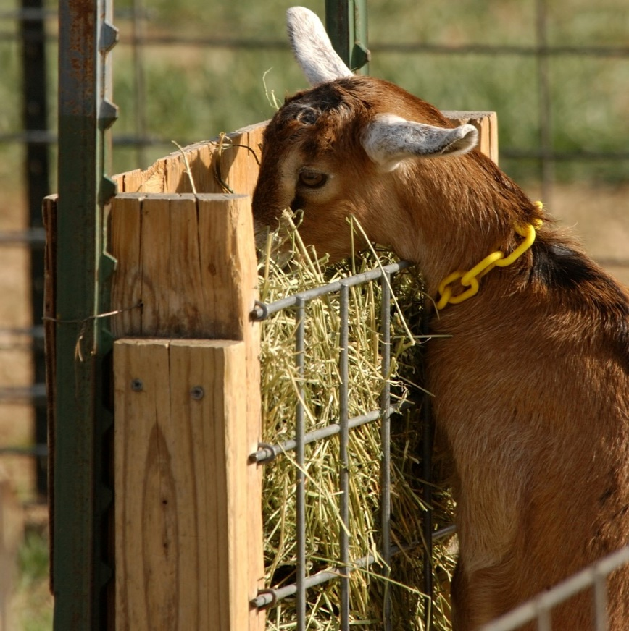
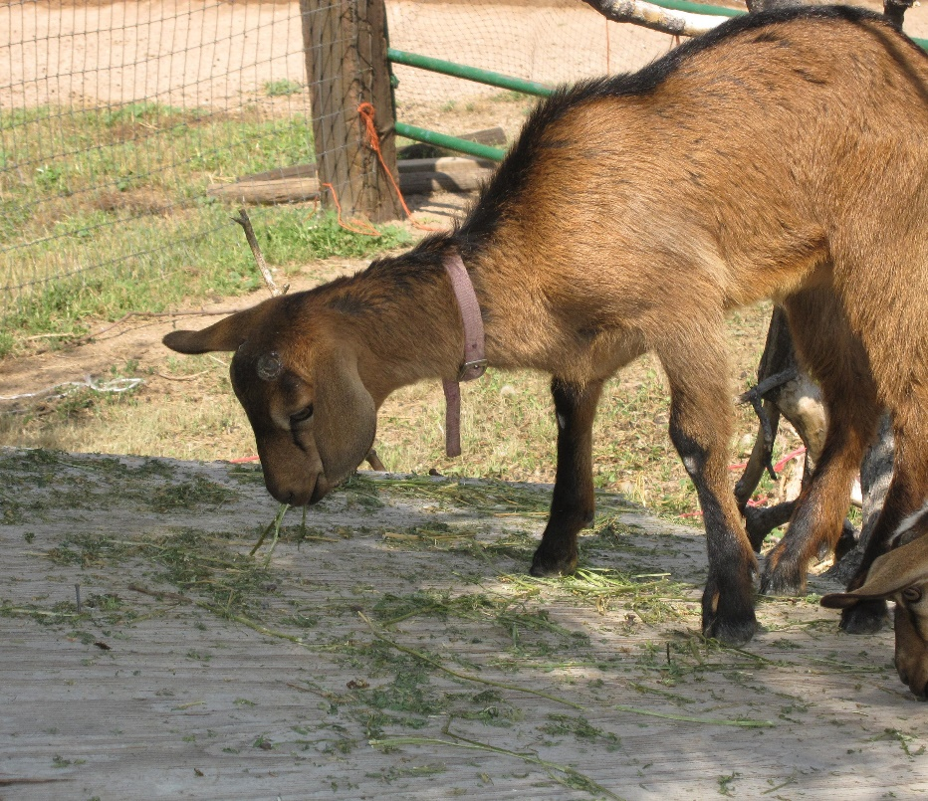
Common Questions

Slide 42
Common Questions
Where do the forms I need come from?
Consent Forms will be turned over to you from the NASS RFO via an in-person meeting before 8/23/2019
RFO: Where do my forms go?
Questionnaires are mailed to NASS Central Processing
Consent forms are scanned and turned over to the NAHMS Coordinator
Nondisclosure forms are copied and
The original forms stay with the RFO
The copied forms are given to the NAHMS Coordinator
Non-disclosure forms (ADM-043 and the NASS Representative Agreement) will be signed during this meeting as well

Slide 43
Common Questions
Where do the forms I need come from?
Consent Forms will be turned over to you from the NASS RFO via an in-person meeting before 8/23/2019
Where do the forms go?
Consent Forms are taken back to the State office and distributed to Field Staff so they can make contact with producers
Non-disclosure forms (ADM-043 and the NASS Representative Agreement) will be signed during this meeting as well
Non-disclosure forms will be sent to NAHMS Headquarters to receive a final signature

Slide 44
Common Questions
Who do I contact if I have trouble during turnover?
The NASS RFO
RFO: Where do my forms go?
Questionnaires are mailed to NASS Central Processing
Consent forms are scanned and turned over to the NAHMS Coordinator
Nondisclosure forms are copied and
The original forms stay with the RFO
The copied forms are given to the NAHMS Coordinator
NAHMS Headquarters
Abby Zehr
(see the contact list for the appropriate RFO for you)
Abigail.C.Zehr@usda.gov
970-494-7252
Matthew Branan (NASS liaison)
Matthew.A.Branan@usda.gov
970-494-7349

Slide 45
Useful Links
Default RFO Contact List
Guide for Communicating about NASS
https://www.nass.usda.gov/About_NASS/pdf/Talking-About-NASS-Guide.pdf
https://www.nass.usda.gov/Statistics_by_State/RFO/index.php
Data Protections and Confidentiality
NAHMS Goat 2019 Site
(Not Required, but can get some good refresher information if needed) https://aglearn.usda.gov/course/view.php?id=37567
https://www.aphis.usda.gov/aphis/ourfocus/animalhealth/monitoring-and-surveillance/nahms/goat_questionnaires

Slide 46
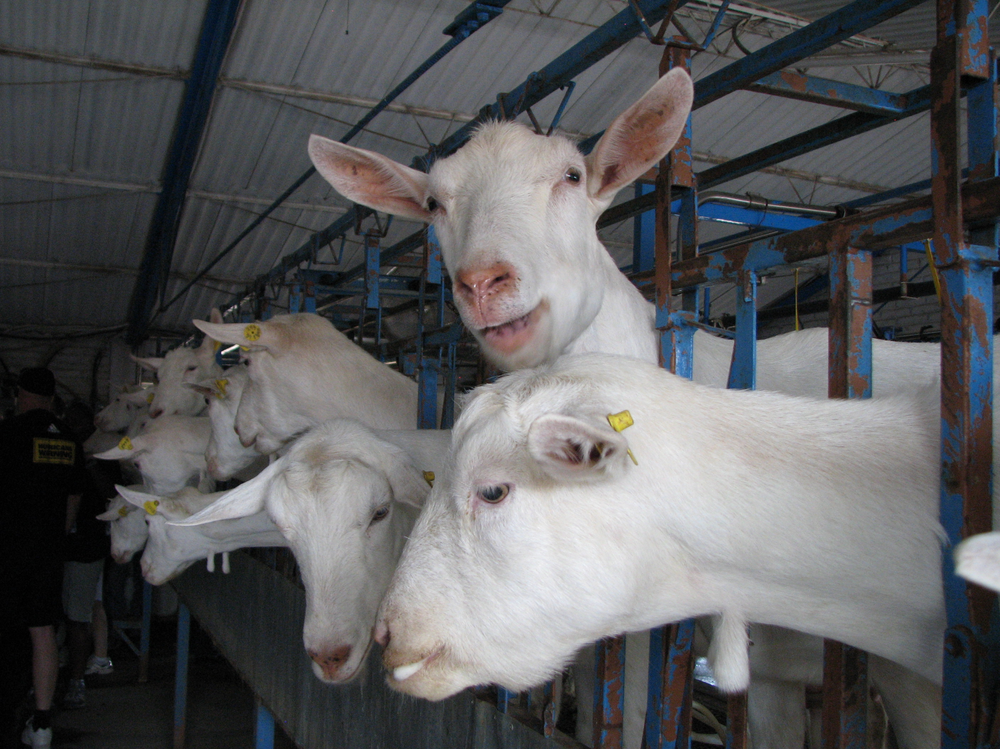
Thank you to all the NAHMS Coordinators, who make these studies successful!

Slide 47
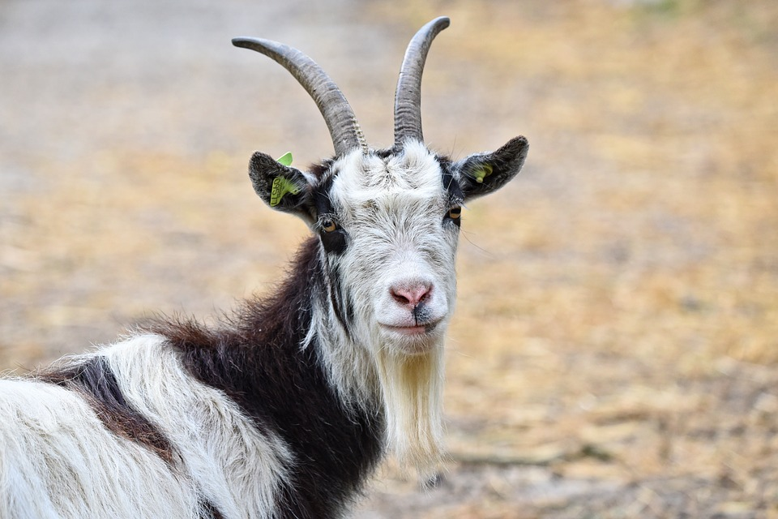
Questions?

