Slide 1
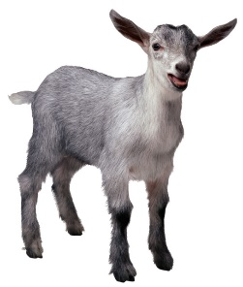
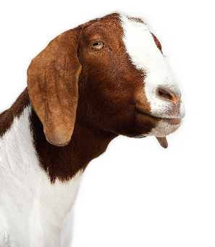
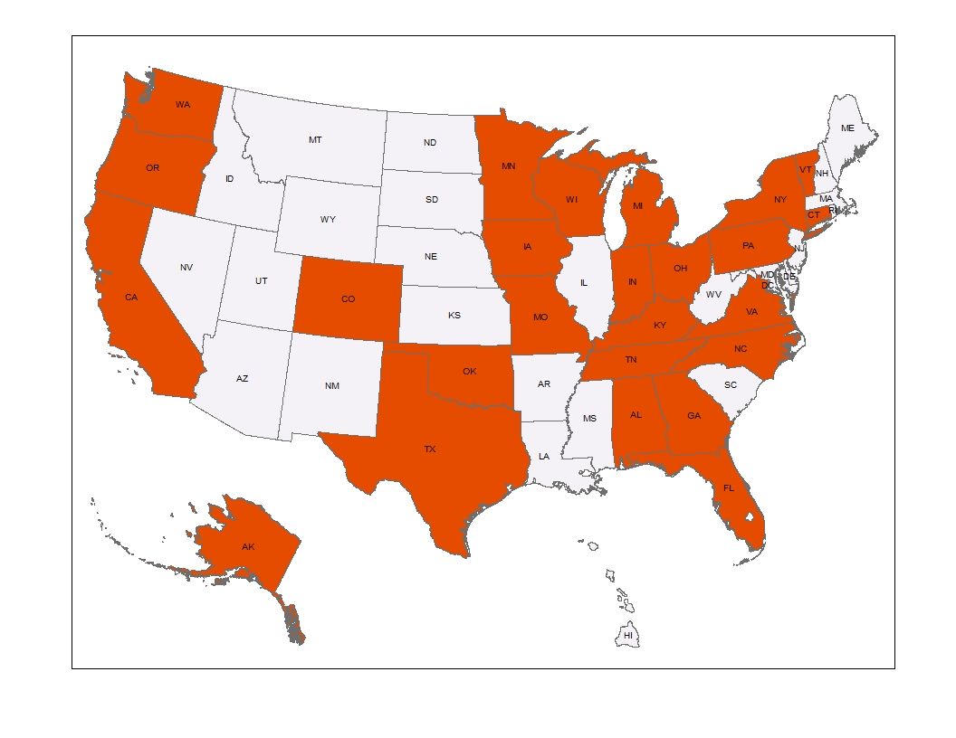
Designing the National Animal Health Monitoring System (NAHMS) 2019 Goat Study
Katherine Marshall,¹ Natalie Urie,¹ Alyson M Wiedenheft,^{1,2} Matthew A Branan¹
¹United States Department of Agriculture [USDA], Animal and Plant Health Inspection Service, Veterinary Services, Fort Collins, CO, USA ²Colorado State University, Fort Collins, CO, USA
Introduction
NAHMS Study Process
Objectives
NAHMS studies characterize the health and management of the U.S. animal industries. NAHMS is a nonregulatory program within the USDA’s Animal Plant Health Inspection Services’ Veterinary Services designed to periodically collect scientifically accurate data for U.S. livestock, poultry and aquaculture industries on a rotating basis. This will be NAHMS’ second national goat study; the first was conducted in 2009.
Producer participation in NAHMS studies is voluntary and, to protect producer identities, individual operation data is confidential.
Each NAHMS study evolves through five primary activities: needs assessment, study design, data collection, analysis, and information dissemination.
Identify changes in animal health, nutrition, and manage­ment practices in the U.S. goat industry from 2009 to 2019.
Report practices producers use to control internal parasites and reduce anthelmintic resistance.
Describe antimicrobial stewardship on goat operations and estimate the prevalence of enteric pathogens and antimicrobial resistance patterns.
Describe management practices associated with, and producer-reported occurrence of, economically important goat diseases.
Provide a serologic bank for future research.
2017 Assessed critical information gaps:
Needs Assessment
Study Design
Data Collection
Reporting
Data Analysis
Fall 2020 and beyond
- Web-based surveys
- Interviewed industry leaders
- Solicited direct input from stakeholders
Disseminate reports
2020
NAHMS
Study
Process
Validate and
analyze data
Now
- Setting study objectives
- Developing data collection instruments
- Developing biologic sampling plans
- Training data collectors
Sampling and Data Collection
Sample: Approximately 4,700 randomly selected operations with 5+ goats in 25 States.
Assessing Critical Information Needs
Figure 6. NAHMS Goat 2019 Study States
Critical information needs were determined by input from a diverse group of stakeholders via focus groups and online surveys.
To help determine study priorities, an online needs assessment survey was conducted.
1,272 respondents from 50 States and 3 countries (New Zealand, Virgin Islands and Philippines)
Survey period = August 1- October 3, 2017
July – December 2019
Selected states represent:
- 77.9% of U.S. operations
with 5+ goats
- 82.7% of U.S. goats on
operations with 5+ goats
Implement study
Needs Assessment: Top Disease Priorities
The highest number of responses indicated that internal parasites were the top priority. (Fig. 3) Caseous lymphadenitis was ranked second and was the number one priority for 10.0 percent of all respondents. The top disease priority was the same across all industry roles (Fig. 4), but Q Fever was the number 2 priority for respondents representing government/university employee industry roles.
Figure 3. Top disease, disorder, or pathogen priorities according Figure 4. Top ranked disease, disorder, or pathogen,
to respondent ranking by primary industry role
Figure 1. Percentage of respondents by primary industry role
Figure 2. Percentage of respondents by goat type owned
Participating States
Data Collection
Phase 1: July - August 2019, on-farm interviews administered by NASS representatives.
Phase 2: September – December 2019, goat producers who agreed to participate in Phase 2 of the study will be contacted by APHIS or State veterinary health professionals to schedule in-person interview and collect biologic samples.
Goat Types Owned | Percent of Goat Owners
Meat goats | 63.3%
Dairy goats | 47.9%
Show goats | 44.5%
Vegetation control goats | 12.9%
Fiber Goats | 4.4%
Pack goats | 2.5%
Other goats | 1.3%
Disease, disorder, or pathogen priorities | Primary Industry Role
 | Goat owners (n=994) | Veterinarians/ nutritionists (n=131) | Government and university employees (n=96) | Other (n=10)
Internal parasites | 1 | 1 | 1 | 1
Caseous lymphadenitis | 2 | 2 | 3
Caprine arthritis encephalitis | 3 | 4 | 4 | 3
Mastitis | 4 |  |  | 2
External parasites | 5
Lameness |  | 3
Nutritional disorders |  | 5 |  | 4
Q fever |  |  | 2
Abortions |  |  | 5
Scours |  |  |  | 5
Goat owners
Study Benefits
Veterinarians/
Nutritionists
Producer Benefits
Producers can benchmark their practices relative to others
Producers who complete Phase 2 are eligible for free testing to include
- Gastrointestinal parasite fecal egg reduction counts
- Scrapie resistant genotype testing
- Fecal pathogen culture and antimicrobial resistance testing
for Salmonella, E coli, Campylobacter, Giardia, and
Crypstopsoridium
Industry Benefits
Animal health companies can target research and product development
Academicians, industry groups, and university extension can focus educational efforts
Trade negotiators and policymakers are provided science-based information
Federal, State,
Tribal Gov’ts / University
Other (researchers, 4H leaders, etc.)
Respondents were asked to rank top management priorities, disease issues, and incentives for participation.
Number of Respondents
Needs Assessment: Incentives to Participate
Needs Assessment: Management Priorities
Figure 5. Highest ranked incentives for study participation
Parasite and anthelminthic
resistance testing was the top
incentive for study participation .
1st priority
2nd priority
3rd priority
Number of Respondents
Acknowledgements: We sincerely thank the American Dairy Goat Association, American Goat Federation, USAHA and other organizations for their support.
For more information visit www.aphis.usda.gov or email Katherine.l.marshall@aphis.usda.gov

