Slide 1
Surveillance, Epidemiology, and Tracing
Surveillance Part 2:
Implementing Surveillance
Adapted from the FAD PReP/NAHEMS Guidelines: Surveillance, Epidemiology, and Tracing (2014).
Notes:
An animal health emergency could have a detrimental effect on the nation's agriculture, food supply, and economy. Veterinary responders, animal health technicians, and other trained personnel may assist with surveillance, epidemiology, and tracing activities. In order to perform these job duties, a broad understanding of surveillance and epidemiological concepts is required. This presentation is Part 2 in describing the process of implementing surveillance. [This information was derived from the Foreign Animal Disease Preparedness and Response (FAD PReP)/National Animal Health Emergency Management System (NAHEMS) Guidelines: Surveillance, Epidemiology, and Tracing (2014).]

Slide 2
This Presentation
Describes sampling methods
Outlines diagnostic tests
Diagnostic sample collection
Overview of surveillance planning resources
Notes:
This presentation provides more information about the development of a surveillance plan implemented in a foreign animal disease (FAD) outbreak. It describes the different sampling methods, how those samples are collected, and the different diagnostic tests that are run. It also identifies different resources that may be helpful in surveillance planning.

Slide 3
Sampling Methods
Notes:
This presentation will focus on some considerations for implementing some of the operational aspects of surveillance activities. It will discuss sampling methods, diagnostic tests, and sample collection, as examples that need to be considered. Sampling methods for a surveillance system must be described in detail for a foreign animal disease (FAD) outbreak. Data collection methods must be determined and statistical concerns must also be addressed. This section describes considerations for developing accurate and practical sampling methods.

Slide 4
Sampling Methods
Considerations for accurate and practical sampling methods:
Sample type
Sample size
Random sampling vs. targeted sampling
Sampling duration and frequency
Sample areas/locations
Availability of diagnostic tests
Pooled testing
Notes:
Considerations for developing accurate and practical sampling methods include sample type; sample size; random sampling vs. targeted sampling; sampling duration and frequency; sample areas/locations; availability of diagnostic tests; and pooled testing.

Slide 5
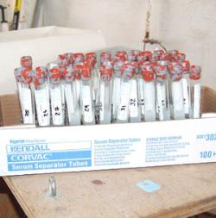
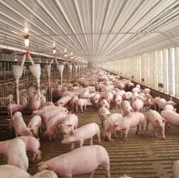
Sample Type and Size
Sample type
Disease agent
Available tests
Laboratory capabilities
Sample size
Population size
Disease prevalence
Diagnostic test sensitivity
Confidence level
Notes:
The type of sample collected depends on the FAD agent, available tests, laboratory capabilities/preferences, and resources. Information can be collected via
surveys, questionnaires, visual inspections, and collection of diagnostic specimens (ante or post mortem). It is rarely feasible to test all susceptible animals in an outbreak. In most cases, a subset of the herd or group is selected.
The size of the group sampled is affected by:
Population size;
Disease prevalence;
Diagnostic test sensitivity (the likelihood that a test will accurately identify infected animals); and
Confidence level (the degree of certainty that test results reflect true disease status in the animal population). Generally speaking, the larger the sample selected, the greater the confidence that can be placed in the results.
[The top photo is a photo of properly labeled sample tubes ready for use in collecting samples. The bottom photo illustrates a population of susceptible animals from which a subset will be sampled. Top photo source: Alex Ramirez, Iowa State University. Bottom photo source: Iowa State University, VDPAM]

Slide 6
Random vs. Targeted
Random sampling
Every animal in the targeted population has an equal chance of getting selected for testing
Targeted sampling
May choose animals for convenience or because a certain group has a specific risk factor or higher prevalence of disease
Notes:
Random sampling assures every animal in the targeted population has an equal chance of getting selected for testing. Targeted sampling may choose animals for convenience or because a certain group has a specific risk factor or higher prevalence of disease. On the following slides we will further look into these two methods of sampling and examples to better help explain these concepts.

Slide 7
Comparison
Random sampling
Targeted sampling
Every animal has an equal chance of being selected for testing
Preferred over non-random sampling for determining prevalence or incidence of disease
Results are better extrapolated
Animals not chosen randomly
Usually preferred during a disease outbreak
Primary objective is to identify cases of disease
Cost effective and increases likelihood of finding new cases
Notes:
Random Sampling assures that every animal in the target population has an equal chance of being selected for testing. Random sampling is generally preferred over non-random sampling for determining the prevalence or incidence of disease because results can be better extrapolated to the population at risk. Example: Assume that 50 dairy cows per day are examined (sampled) to determine the incidence of lameness in a herd. Examining every nth cow in the milk string would provide a sample that represents the whole group.
Targeted (non-random) Sampling may choose animals for convenience or because a certain group has a specific risk factor or higher prevalence of disease. Non-random samples are often preferred during a disease outbreak because the primary objective of surveillance is to identify cases of the disease. This method is cost effective and increases the likelihood of finding new cases. Example: Using the previous example, targeted or non-random sampling of the herd may test the last 50 cows in the milk string because cows with lameness are more likely to be at the end of the string.

Slide 8
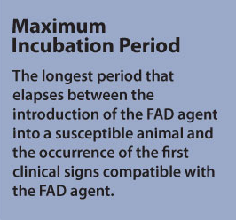
Sampling Frequency
Surveillance
Begins as soon as possible in an FAD outbreak
Susceptible animals
Sampled a minimum of three times during the maximum incubation period
Notes:
Surveillance should begin as soon as possible in an FAD response. In general, it is necessary to inspect/sample susceptible animals a minimum of three times during the maximum incubation period for the disease under investigation. The maximum incubation period is defined as the longest period that elapses between the introduction of the FAD agent into a susceptible animal and the occurrence of the first clinical signs compatible with the FAD agent. [The text in this illustration provides the definition of Maximum Incubation Period. Illustration by: Bridget Wedemeier, Iowa State University]

Slide 9
Determining Frequency
Latent period
Period of time between host infection and ability to infect others
Incubation Period
Period of time between infection and development of clinical signs
Infectious period
Period of time that an infected animal can transmit the pathogen to another susceptible animal
Rapidity of disease transmission
Likelihood of disease spread
Notes:
In most cases, susceptible animals will be placed under surveillance for at least two maximum incubation periods. Sampling frequency for animals, herds or premises is based on a number of factors including:
Latent period: period of time between host infection and the ability to infect others
Incubation period: period of time between infection and the development of clinical signs
Infectious period: period of time that an infected animal can transmit the pathogen to another susceptible animal
Rapidity of disease transmission between animals and premises
Likelihood of disease spread
NOTE: Repeated tests are often necessary. When repeated tests are conducted, a previous negative test result can strengthen a subsequent negative test result when the interval between tests is short. Two negative test results occurring within days of each other are more reliable than two negative test results occurring within weeks of each other.

Slide 10
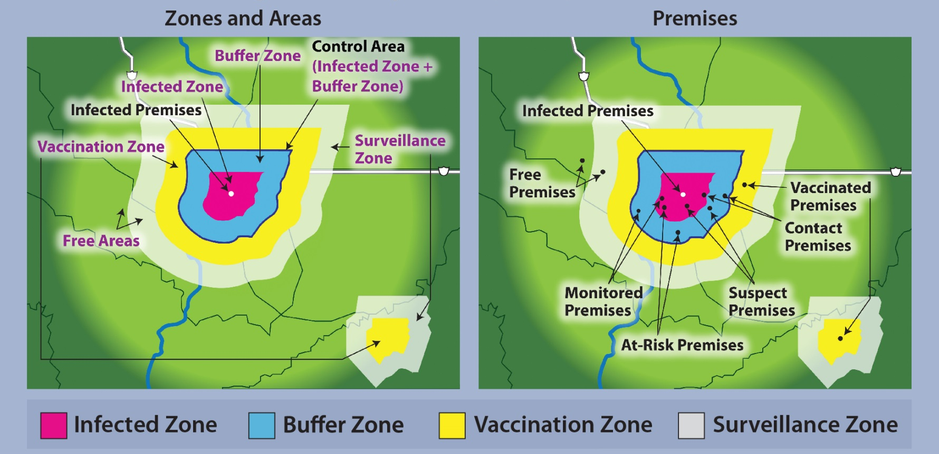
Sampling Areas/Locations
Target population may be selected based on area or location
Notes:
A target population may be selected based on area or location. The nature of the FAD agent and its ability to spread long distances through aerosol transmission may place livestock miles away from the infected premises under surveillance. The process of premises/zone classification is very important for determining surveillance needs by location. Specific surveillance activities to locate new cases may be important throughout all zones, but may be focused on the Control Area (Infected Zone and Buffer Zone). Gathering information to demonstrate freedom from infection, using a different set of protocols, may focus on the Free Area. [These maps visually illustrate disease Zone, Area, and Premises designations. Content provided by: USDA. Illustration by: Dani Ausen, Iowa State University]

Slide 11
Other Considerations
Diagnostic test availability
Validated and approved
Affected by manufacturer capacity, reagent availability, etc.
Pooled testing
Samples from multiple animals are combined into a single test
Cost effective and useful when resources are limited
May not be appropriate for all samples
Notes:
Other factors to consider when choosing sampling methods include the following. The chosen sampling methods for an FAD outbreak will consider the laboratory tests that are validated, approved, and available for the disease agent (diagnostic test availability). Test availability may be affected by manufacturer capacity, reagent availability, etc. Pooled testing is a testing method where samples from multiple animals are combined into a single test. This testing method is cost effective and useful when time and resources are limited. Pooled testing may not be appropriate for all sample types or pathogens and, in some cases, may increase the likelihood of false negative results. The availability of a validated and approved diagnostic test for the FAD agent may also affect sample choice. Additional information on diagnostic tests is found later in this presentation.

Slide 12
Diagnostic Tests
Notes:
Surveillance planning includes consideration of appropriate diagnostic tests. The next section discusses choosing a diagnostic test, as well as sensitivity and specificity, and laboratory capacity.

Slide 13
Choosing a Diagnostic Test
National Veterinary Services Laboratory (NVSL) determines which diagnostic tests will be used
Factors considered include:
Speed
Reliability and reproducibility
Precision and accuracy
Ease of use
Cost
Notes:
The National Veterinary Services Laboratories (NVSL) will determine which diagnostic tests will be used in an FAD outbreak. When choosing a diagnostic test, NVSL will consider factors such as: speed, reliability, reproducibility, precision, accuracy, ease of use, and cost for each available diagnostic test.

Slide 14
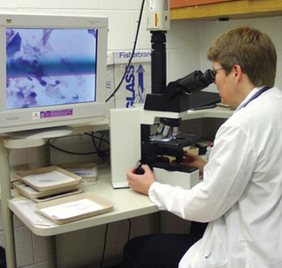
Sensitivity and Specificity
Sensitivity
Ability of a test to correctly classify diseased animals as positive
Specificity
Ability of test to correctly classify non-diseased animals as disease negative
Notes:
Sensitivity and specificity are important criteria to consider when choosing a diagnostic test. A variety of diagnostic tests may be available for a given disease. Each diagnostic test has a different ability to correctly identify diseased and non-diseased animals. Sensitivity is the ability of a test to correctly classify a percentage of diseased animals as positive. For example, if the test sensitivity is 95 percent, 95 out of 100 sick animals will be detected. Specificity is the ability of a test to correctly classify non-diseased animals as disease negative. [This photo shows a sample being examined microscopically. Photo source: Danelle Bickett-Weddle, Iowa State University]

Slide 15
Laboratory Capacity
Foreign Animal Disease Diagnostic Laboratory (FADDL)
Plum Island, NY
National Veterinary Services Laboratories (NVSL)
Ames, IA
National Animal Health Laboratory Network (NAHLN)
Various approved laboratories
Notes:
As previously mentioned, multiple factors will affect diagnostic test availability. Laboratory capacity, or the ability of a laboratory to complete necessary FAD testing, may also be a limiting factor. In an FAD response, samples will be sent to the Foreign Animal Disease Diagnostic Laboratory (FADDL) in Plum Island, NY or the NVSL in Ames, IA depending on the disease and test to be performed. Alternatively, the National Animal Health Laboratory Network (NAHLN), a network of State, university, and other approved laboratories, maintains the capacity and capability to provide laboratory services in support of FAD outbreaks. For FAD investigations, if only one sample is collected, the sample will be sent to NVSL (either FADDL or NVSL Ames). If there are two samples collected, the first sample will be sent to NVSL (either FADDL or NVSL Ames), and the second sample can be sent to a NAHLN laboratory. In all cases, confirmation of FADs is performed by NVSL. For FAD surveillance, NAHLN laboratories will be involved based on their capacity and available assays. For more information on sample collection and testing, please see the FAD Investigation Manual (FAD PReP Manual 4-0).

Slide 16
Diagnostic Sample Collection
Notes:
The type of specimen collected is determined by the disease of concern, available diagnostic tests, and the ability to obtain samples from target species. The number and type of specimens to collect will be communicated by Incident Command (IC).

Slide 17
Types of Specimens
Blood or serum
Skin or vesicular lesions
Epithelial tissue or vesicular fluid
Feces, rectal swabs, cloacal swabs, or genital tract swabs
Semen samples
Nasal, oral, or oropharyngeal swabs
Nasal discharge, saliva, tears
Tissues
Tonsil, spleen, kidney, liver, lymph node, lung, brain, etc.
Milk
Other environmental samples
Notes:
Diagnostic specimens that may be collected include those listed on the slide. Specimens may include animal tissues or fluids, animal products like milk, or environmental samples. For in-depth information on collecting diagnostic specimens, please see the FAD Investigation Manual (FAD PReP Manual 4-0).

Slide 18
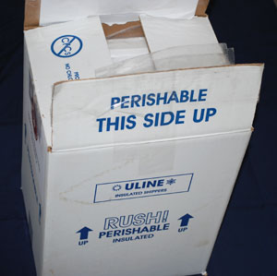
Specimen Collection
Follow protocols to prevent cross- contamination and sample degradation
Collecting specimens
Packaging specimens
Biosecurity protocols
Notes:
Collecting Specimens: Collect specimens according to the protocol and in a manner that prevents cross-contamination and sample degradation. Clearly and legibly label individual specimen tubes/containers with permanent, waterproof ink in a manner that allows identification of the specimen (animal, location, date, type, etc.)
Packaging specimens for shipment: Another factor that can impact sample quality is transportation and shipping of specimens. The diagnostic lab, shipping company and the U.S. Department of Transportation establish packaging and shipping requirements which must be followed. For further information see:
(http://www.aphis.usda.gov/wps/portal/aphis/ourfocus/animalhealth?1dmy&urile=wcm%3apath%3a%2Faphis_content_library%2Fsa_our_focus%2Fsa_animal_health%2Fsa_lab_information_services%2Fsa_diagnostic_tests%2Fct_packaging_labeling)
Biosecurity protocols: Lastly, adhere to the biosecurity protocols established for sample collection, packaging and shipment in order to prevent cross contamination of samples and the further spread of disease agents. [This photo illustrates packaging and shipping materials. Photo source: Pam Zaabel, Iowa State University]

Slide 19
Freedom from Infection
Demonstrating freedom from infection is part of a surveillance plan
Freedom from infection
Implies the absence of the pathogen in a country, zone or compartment
Must be demonstrated to the World Organization for Animal Health (OIE)
Standards outlined in Chapter 1.4 of the OIE Terrestrial Animal Health Code
Notes:
The surveillance plan must include a plan for demonstrating freedom from infection. Freedom from infection implies the absence of the pathogenic agent in a specified animal population, or population in a country, zone, or compartment. As a member of the World Organization for Animal Health (OIE), the United States makes every effort to demonstrate freedom from infection to a level of confidence acceptable under OIE standards. These standards are outlined in Chapter 1.4 of the OIE Terrestrial Animal Health Code (2011). An example proof of disease freedom surveillance scheme for HPAI is provided in the HPAI Surveillance SOP.

Slide 20
Surveillance Planning Resources
Notes:
There are a variety of resources that may be helpful during surveillance planning.

Slide 21
Planning Resources
Outbreak Surveillance Toolbox
Assists in surveillance plan development
Provides:
Case definitions and case classifications
Premises classifications
Disease control zones
Sampling plans
Notes:
The Outbreak Surveillance Toolbox, available on the APHIS Intranet or on CD, is designed to assist in developing a surveillance plan. The Toolbox provides information and resources to establish:
Case definitions
Case classifications
Premises classifications (Same as found in APHIS Foreign Animal Disease Framework: Response Strategies (FAD PReP Manual 2-0))
Disease control zones (Same as found in APHIS Foreign Animal Disease Framework: Response Strategies (FAD PReP Manual 2-0))
Sampling plans within each Control Area (or Free Area) to detect disease within individual herds and “prove” disease freedom

Slide 22
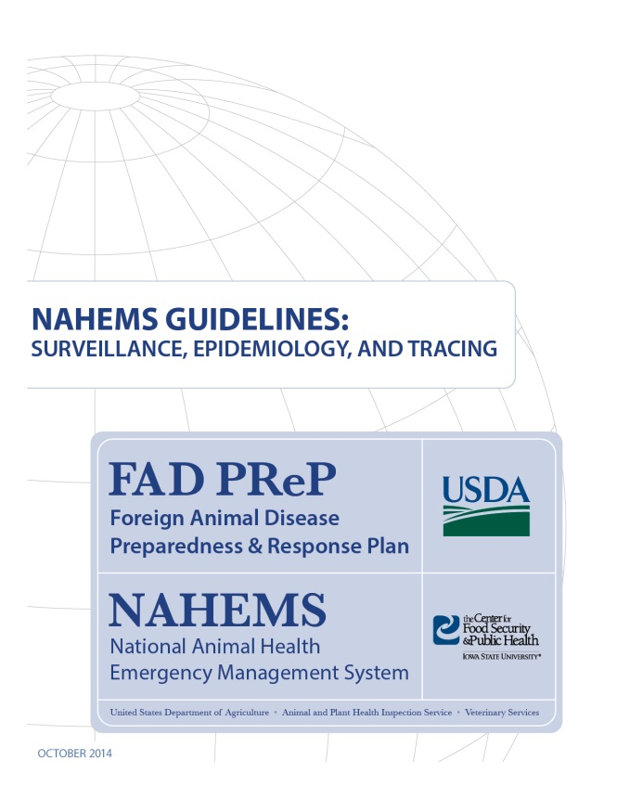
For More Information
FAD PReP/NAHEMS Guidelines: Surveillance, Epidemiology, and Tracing, and SOP: Surveillance
http://www.aphis.usda.gov/fadprep
Surveillance, Epidemiology, and Tracing web-based training module
http://naherc.sws.iastate.edu/
Notes:
More details can be obtained from the sources listed on the slide, available on the USDA website (http://www.aphis.usda.gov/fadprep) and the NAHERC Training Site (http://naherc.sws.iastate.edu/).

Slide 23
Guidelines Content
Authors (CFSPH)
Kerry Leedom Larson, DVM, MPH, PhD, DACVPM
Glenda Dvorak, DVM, MPH, DACVPM
Janice Mogan, DVM
Courtney Blake, BA
Reviewers (USDA APHIS VS)
Dr. R. Alex Thompson
Dr. Lowell Anderson
Dr. Steve Goff
Dr. Fred Bourgeois
Notes:
The print version of the Guidelines document is an excellent source for more detailed information. In particular, the Guidelines document has listings of additional resources. This slide acknowledges the authors and reviewers of the Guidelines document. It can be accessed at http://www.aphis.usda.gov/fadprep.

Slide 24
Acknowledgments
Development of this presentation was by the Center for Food Security and Public Health at Iowa State University through funding from the USDA APHIS Veterinary Services
PPT Authors: Patricia Futoma, Veterinary Student; Kerry Leedom Larson, DVM, MPH, PhD, DACVPM
Reviewers: Janice Mogan, DVM; Melissa Lang, BS
Notes:
Information provided in this presentation was developed by the Center for Food Security and Public Health at Iowa State University College of Veterinary Medicine, through funding from the US Department of Agriculture, Animal and Plant Health Inspection Service, Veterinary Services.

