Slide 1
Quarantine and Movement Control
Overview
Adapted from the FAD PReP/NAHEMS Guidelines: Quarantine and Movement Control (2016)
Notes:
In a foreign animal disease (FAD) incident, control and containment of the disease agent is essential to eradication and recovery. Quarantine and movement control (QMC) are critical activities to protect animal health, by helping to prevent the disease agent from being transmitted to non-infected livestock and poultry populations. QMC stops and controls movements in a regulatory Control Area. This presentation focuses on diseases spread by direct and indirect contact rather than vector-borne diseases, as QMC is not particularly effective at preventing the movement of mobile insect vectors. However, QMC activities can still prevent the movement of infected hosts, which may be important in vector-borne FAD incidents. In an incident, quarantines and movement controls are handled through the Unified Incident Command, following local, State, and Federal laws/regulations. [This information was derived from the Foreign Animal Disease Preparedness and Response (FAD PReP)/National Animal Health Emergency Management System (NAHEMS) Guidelines: Quarantine and Movement Control (2016)].

Slide 2
This Presentation
Definition of relevant terms
Authority of responsible agencies
FAD response activities
General quarantine and movement control (QMC) considerations
Concepts of permitting
Personnel responsibilities
Notes:
This presentation is intended to provide all responders with a common general understanding of how quarantine and movement control (QMC) would be implemented in an FAD incident in domestic livestock or poultry. This presentation addresses the following topics: the definition of relevant terms, authority of agencies responsible for QMC activities, FAD response activities, and general considerations of quarantines and movement control. Additionally, it addresses the concepts of permitting and permitted movement, and describes responsibilities of personnel who must ensure smooth operations during an outbreak. Additional presentations discussing these issues in greater detail are available.

Slide 3
Definitions
Quarantine
  Stringent restrictions
  Prohibits movement from specified premises, area, or region
Hold order
  Temporary, during investigation
  Usually under State authority
Standstill notice
  Temporary, prohibits new movement
  Federal authority/official notice
Notes:
For the purpose of this document, the following terms and definitions will be used:
Quarantine refers to imposing stringent restrictions on entering or leaving a premises, area, or region where disease is known to exist or is suspected. During an FAD outbreak, a quarantine broadly prohibits the movement of animals, animal products, and fomites (e.g. equipment, vehicles, clothing, footwear) from a specified premises, area, or region. Consideration is given to critical movements like feed trucks.
Hold order is a temporary order, similar in effect to a quarantine, typically implemented while additional diagnostics or investigation is conducted. Hold orders are usually, but not always, under State authority: definition, scope, and terminology may vary by State.
Standstill notice is the temporary prohibition of the initiation of any new movement of the susceptible species in a defined area. A standstill notice is typically implemented at a Federal level, put into effect through an official notice and subsequent publication in the Federal Register.

Slide 4
Definitions cont’d
Movement control
  Controls movement in Control Area
  Movement from premises with no evidence of infection
  Permits based on meeting criteria
Continuity of business (COB)
  Managed movement for specific commodity
Notes:
A continuation of these definitions include:
Movement control refers to controlling the movement of animals, animal products, and fomites in a regulatory Control Area. These movements are from non-infected premises, require permits, and are based on meeting specific criteria to ensure that such movement poses a negligible risk of pathogen transmission.
Continuity of business (COB) is a term used for a specific type of movement control known as managed movement. COB typically focuses on a specific commodity and is intended to mitigate the economic effects of a regulatory Control Area.

Slide 5
FAD Response Goals
Detect, control, and contain the disease in animals as quickly as possible;
Eradicate the disease using strategies that seek to stabilize animal agriculture, the food supply, and the economy and that protect public health and the environment; and
Provide science- and risk-based approaches and systems to facilitate continuity of business for non-infected animals and non-contaminated animal products.
Notes:
QMC activities are a critical component of a response effort. Three response goals for an FAD outbreak in the United States as outlined in the APHIS Foreign Animal Disease Framework: Response Strategies (FAD PReP Manual 2-0) are:
Detect, control, and contain the disease in animals as quickly as possible;
Eradicate the disease using strategies that seek to stabilize animal agriculture, the food supply, and the economy and that protect public health and the environment; and
Provide science- and risk-based approaches and systems to facilitate continuity of business for non-infected animals and non-contaminated animal products.

Slide 6
FAD Response Goals cont’d
Achieving these three goals will allow individual livestock facilities, States, Tribes, regions, and industries to resume normal production as quickly as possible.
They will also allow the United States to regain disease-free status without the response effort causing more disruption and damage than the disease outbreak itself.
Notes:
Achieving these three goals will allow individual livestock facilities, States, Tribes, regions, and industries to resume normal production as quickly as possible. The objective is to allow the United States to regain disease-free status without the response effort causing more disruption and damage than the disease outbreak itself.

Slide 7
Goals of QMC
Preparedness goals
  Develop effective QMC plans for
  affected locations
  Develop effective managed movement plans for non-infected locations
Response goals
  Establish a Control Area within 6 hours
  Implement QMC in the Control Area quickly
  Consider competing priorities -
  disease transmission vs. critical movements
Notes:
The QMC-specific goals support overall FAD response goals.
The preparedness goals are as follows:
To work with stakeholders to develop effective plans and processes for affected premises, areas, and regions.
To work with stakeholders to develop effective managed movement plans for non-infected premises, areas, and regions.
The response goals are as follows:
Through a Unified Incident Command, coordinate the establishment of an Infected Zone and a Buffer Zone (a Control Area) within 6 hours of identifying the index case.
Once a Control Area has been established, implement QMC in the Control Area as rapidly as possible.
Ensure QMC considers competing priorities, weighing the risk of disease transmission against the need for critical movements (e.g., feed trucks) and business continuity.

Slide 8
Authorities
Notes:
Both Federal and State agencies have authority to protect against and respond to animal disease. The Code of Laws of the United States of America (U.S.C.) and the Code of Federal Regulations (CFR) are codified authorities representing different stages of the Federal legislative process. The U.S.C. provides the general and permanent statutes of the United States, which are passed by Congress and signed by the President. Executive branch agencies then interpret the U.S.C., developing detailed regulations in the CFR. The CFR is developed through a public rulemaking process, where the public is allowed to comment. In an FAD incident response, the U.S.C. and CFR provide policy, via statutes and regulations, for USDA; interim regulations can be implemented—in the event of an outbreak—to prevent the spread of disease.

Slide 9
Federal Authority
APHIS authority through AHPA Act
Secretary of Agriculture is authorized to:
  Prevent, detect, control, and eradicate diseases and pests of animals
  Protect animal health, human health
  and welfare, and economic interests
  Prohibit importation, entry or interstate movement throughout US
  Prevent the introduction or dissemination of disease
Notes:
APHIS receives its regulatory authority from the Animal Health Protection Act (AHPA), 7 U.S.C. 8301 et seq. The AHPA authorizes the Secretary of Agriculture to carry out operations and measures to prevent, detect, control, and eradicate diseases and pests of animals, including foreign animal and emerging diseases, in order to protect animal health, the health and welfare of people, economic interests of livestock and related industries, the environment, and interstate and foreign commerce in animals and other articles. The Secretary may also prohibit or restrict the importation, entry, or interstate movement of any animal, article, or means of conveyance to prevent the introduction into or dissemination within the United States of any pest or disease of livestock (7 U.S.C. 8303‑8305). Title 9 of the CFR provides detailed USDA APHIS administrative regulations for the control and eradication of animal diseases, including FADs and emerging animal diseases.

Slide 10
State Authority
Initially, State, Tribal, local authorities and resources
Authority granted to SAHO varies
Quarantine
  May be issued on FAD detection or suspicion
  Scope based on specific authority
  Intended to control disease intrastate
Notes:
Initial FAD response and enforcement of QMC will involve State, Tribal, and local authorities and resources. Authority granted to the State Animal Health Official (SAHO) varies from State to State. Legal authority is usually granted by a legislating body, and by an executive agency. Quarantine of a premises—or movement restrictions—within a Control Area may be issued, based on an FAD detection or a suspected FAD. These may include quarantines of an individual pen, herd, flock, premises, county, section, or area, depending on the specific State authority. State quarantines are used to stop and control the spread of an infectious or contagious disease within a State.

Slide 11
Extraordinary Emergency
Declared by US Secretary of Agriculture
Federal government authorized to control intrastate movement
  In addition to interstate and international movement
Regulatory intervention
  By Unified Incident Command:
  State, Tribal Nations, and Federal
Notes:
While typically States control intrastate movements, it is important to recognize that if the United States Secretary of Agriculture declares an Extraordinary Emergency, the Federal government is then authorized to control intrastate movement, in addition to interstate movement and international movement. Additionally, an FAD outbreak in the United States may result in emergency regulatory intervention by State, Tribal Nations, and Federal authorities via a Unified Incident Command.

Slide 12
Response to a Foreign Animal Disease Outbreak
Notes:
During an FAD response, many activities must be conducted simultaneously to achieve the goals of an FAD response. These activities must be conducted in a coordinated manner. Three epidemiologic principles form the foundation of any FAD response strategy to contain, control, and ultimately eradicate the disease in the U.S. domestic livestock or poultry population. These epidemiologic principles are, to:
Prevent contact between the disease and susceptible animals.
Stop the production of the disease agent.
Increase the disease resistance of susceptible animals or reduce the shedding of the disease agent in infected or exposed animals.
The response activities based on these three principles are listed on the next slide.

Slide 13
Critical Activities
Critical Activities and Tools for Containment, Control, and Eradication
Public awareness campaign
Swift imposition of effective QMC
Rapid diagnosis and reporting
Epidemiological investigation and tracing
Increased surveillance
COB measures for non-infected animals and non-contaminated animal products
Biosecurity measures
Cleaning and disinfection measures
Effective and appropriate disposal procedures
Mass depopulation and euthanasia (as response strategy indicates)
Emergency vaccination (as the response strategy indicates)
Notes:
This chart lists some of the critical activities which occur in an FAD outbreak, including QMC. Other activities, such as surveillance, diagnostic testing, COB, disposal, and vaccination will also help to rapidly and effectively control, contain, and eradicate the disease. For example, the quarantine of infected animals, movement controls in the Control Area, and biosecurity measures aid in preventing contact between the disease and susceptible animals. Depopulation, as necessary, stops the production of the disease agent. Emergency vaccination, if a suitable vaccine is available and can be administered in a timely manner, can increase the disease resistance of susceptible animals. [Critical Activities and Tools for Containment, Control, and Eradication. Content provided by: USDA]

Slide 14
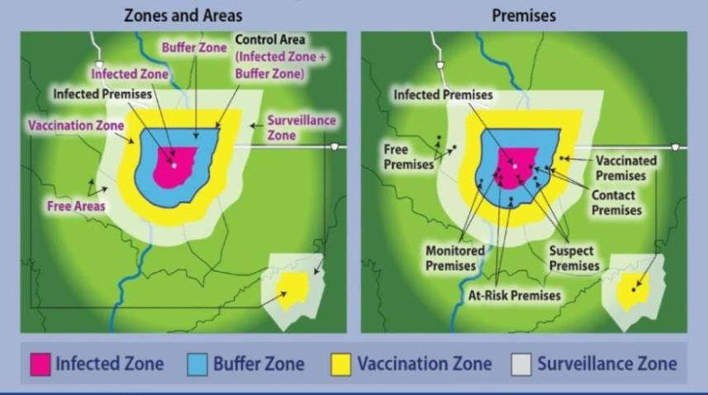
Zones, Areas, Premises
Notes:
During an FAD outbreak, geographic locations are classified or designated according to specific criteria related to disease or disease-free status. These designations help to associate specific response activities with specific locations. These figures show examples of zones and areas on the left, and examples of the locations of premises that have been designated with specific classifications on the right. QMC activities focus on the Control Area - comprised of the (dark pink) Infected Zone plus the (blue) encircling Buffer Zone. Quarantines are implemented for Infected, Contact, and Suspect Premises in the Control Area. It is important to note that these figures are examples, and are not to scale. More detail on designations of zones, areas, and premises, and the factors considered in determining their size is explained in the FAD PReP/NAHEMS Guidelines: Quarantine and Movement Control document, APHIS FAD Framework: Response Strategies (Manual 2-0) and in the Zones, Areas and Premises PowerPoint presentation associated with this series. [Example Zones, Areas, and Premises. Diagrams provided by: USDA; Graphic illustration by: Dani Ausen, Iowa State University]

Slide 15
General Considerations for Quarantine and Movement Control
Notes:
It is reasonable to assume that movement activities that pose a high risk of transmitting disease will fall under a stop movement order (or a similar term used by States, such as embargo), and that movement controls or continuity of business (managed movement plans) will be applied to critical movements, and/or to those movements involving lower risk, depending upon the situation. Close coordination of authority, resources, and expertise will be necessary between Federal, State, local, and Tribal governments. Planning for an emergency is critical in order to develop a consistent, coordinated approach to response and resource allocation in a regional or multi-State disease outbreak. A priority of preparedness planning should be to discuss, mitigate, or resolve competing priorities prior to an incident.

Slide 16
Coordination and Planning
Coordination conducted through ICS
Planning enhances efficiency
  Determine authorities
  Identify resources
  Identify agricultural routes
  Develop communications plans
  Ensure appropriate supplies
  Understand roles and responsibilities
Notes:
Coordination of priorities and resources will be conducted through the Incident Command System (ICS). Federal and State animal health officials will need to work closely with emergency management agencies in identifying available State and local resources from sources such as public works departments, departments of transportation, departments of wildlife and natural resources, law enforcement, public health, universities, veterinary reserve groups, and local contractors. Planning at every level, including industry, will reduce the time it takes to control, contain, and eradicate the outbreak. Planning is necessary to:
Determine the legal authority and procedures for issuing, enforcing, and lifting a quarantine, for biosecurity, permitting, traffic control, and road maintenance.
Identify resources that are trained and ready, those that need to be developed, and those that may be shared through agreements.
Identify major agricultural routes (livestock and pick-up/delivery of products such as milk and feed) and suitable checkpoint sites on those routes.
Develop communications plans to share information internally and externally.
Ensure appropriate supplies and equipment such as personal protective equipment (PPE) and disinfectants.
Understand the different roles and responsibilities of those involved in the response.

Slide 17
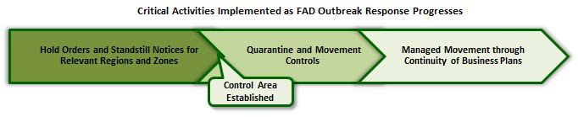
Progression of Activities
Notes:
QMC-imposed limits on movement can affect the ability of a producer or processor to continue key operations during an outbreak. Business processes, including production and distribution, may be disrupted. COB, on the other hand, manages the movement of non-infected animals and non-contaminated animal products in a regulatory Control Area. Managed movement helps agricultural industries maintain essential business functions, or return to business during an FAD response, while the risk of disease spread and threat to animal health and public health is effectively managed. The ultimate goal of COB is to minimize unintended negative effects of the disease and disease response on the affected industries and consumers while still achieving the goals of a disease response. Transitioning between standstill notices, quarantine and movement control, to management movement through continuity of business plans requires effective preparedness planning ahead of an event between all relevant partners. [Critical Activities Implemented as FAD Outbreak Response Progresses. Content provided by: USDA]

Slide 18
Individual Premises Quarantine
(Typically State)
Notes:
An FAD response effort will begin locally, involving local, State, and Tribal authority and resources. If needed, Federal authority and resources will then be employed. In an FAD outbreak, there may be both State quarantines and Federal quarantines, but typically, an individual premises quarantine will be issued under State authority. Regardless of the authority to issue a quarantine, Unified Incident Command should make a strong effort to have clear communication and appropriate educational materials on disease transmission to gain voluntary compliance from producers, families, and others involved in the quarantine.

Slide 19
Implementing Premises Quarantine
State authority varies by State
Criteria for issuance varies by State
Animals may or may not be present
  Notify owner/agent and secure premises
  Establish biosecurity and restrict movement
  Develop contingency plans
    Prepare for essential movement and
    medical emergencies
Notes:
The authority of the SAHO to issue a quarantine or a “hold order” on a premises varies by State. A quarantine may be issued based on a presumptive positive diagnosis, pending laboratory confirmation, or only on the basis of a confirmed positive. An individual premises quarantine or hold order is typically requested by a foreign animal disease diagnostician (FADD) who has investigated and determined the findings are consistent with an FAD. Infected, Contact, and Suspect Premises are subject to individual premises quarantine. Quarantines may be imposed on facilities with live animal inhabitants (farms or feedlots), as well as those without (auction markets). Implementing a quarantine involves notifying the owner/agent, securing the premises to prevent unauthorized movement, establishing biosecurity procedures, as well as restricting movement of animals, animal products, and fomites. It also involves contingency planning to allow for essential movements and to quickly obtain medical care for any sick or injured personnel, while minimizing the risk of pathogen transmission.

Slide 20
Area or Region Quarantine
(Control Area)
Notes:
The State and/or Unified Incident Command establish a regulatory Control Area around Infected and Contact Premises, and depending on the epidemiological situation, possibly around Suspect Premises. A Federal quarantine (or a Federal area quarantine) may be issued when requested by a SAHO, or as directed by the U.S. Secretary of Agriculture. As defined in 9 CFR 71, a quarantined area is as follows: “The States, Territories, or the District of Columbia or portions thereof quarantined by the Secretary of Agriculture for the specific contagious, infections, or communicable animal disease mentioned in each part.”

Slide 21
    Implementing Federal Area Quarantine
Federal authority to quarantine a Control Area
  Disease agent, trading considerations,
  State-specific issues, epidemiology
Appear as Federal Register Notice
Can be effected prior to publication
In addition to premises quarantines
Unified Command, State and Federal
States’ efforts reimbursed
Notes:
If established, Federal area quarantines are typically applied to a regulatory Control Area. Factors used to determine this area are based on characteristics of the disease agent, trading partner considerations, State-specific issues, and the epidemiology of the outbreak. Federal area quarantines must appear as a Federal Register Notice. However, Federal area quarantines can go into effect before the Federal Register Notice is published. A Federal quarantine may exist in addition to individual premises quarantines under State authorities. Under a Unified Command, both State and Federal personnel are likely to be involved in establishing, securing, and maintaining a Federal quarantine. USDA may request that the affected States contribute resources to maintain and enforce the quarantine; USDA will reimburse States for this effort via cooperative agreement. The State and Unified Incident Command effectively implementing a regulatory Control Area without a Federal area quarantine may be a preferred solution for all stakeholders, depending upon the animal disease, interstate commerce reactions, international trading partner reactions, and overall ability to manage the incident or outbreak.

Slide 22
Quarantine Release
Premises quarantine released if confident with disease status
Federal area quarantine release indicated by Federal Register notice
  Does not need to be all at once, reducing the size of the Control Area gradually
  Trade considerations or epidemiologic information
Notes:
Individual premises may remain under quarantine even after the Control Area has been lifted; this is at the discretion of the State. The State and Unified Incident Command need to have a high level of confidence that the premises, and surrounding premises in close proximity, are free from the disease agent. Federal area quarantines, if implemented, are typically in place until the end of an incident. A Federal Register notice indicates the release of Federal quarantine. The entire area of a Federal quarantine does not need to be released simultaneously. There may be reasons—including, but not limited to trade considerations or epidemiologic information—to release portions of the Federal quarantine, in other words, reducing the size of the Control Area gradually before the complete release of the entire Federal area quarantine.

Slide 23
Recent FAD Control Areas
HPAI Control Areas were established
  Around Infected and Contact Premises
Federal area quarantines were not established
May/may not be established during an FAD outbreak
Notes:
It is important to note that Control Areas were established around Infected and Contact Premises during recent FAD outbreaks (HPAI) in the United States; Federal area quarantines were not established in HPAI, and may/may not be established during an FAD outbreak.

Slide 24
Movement Control and Permitting
Notes:
Movement controls are the critical activity which accompanies quarantines. The term “movement control” refers to controlling the movement of animals, animal products, and fomites into, within, and out of a regulatory Control Area while minimizing the risk of pathogen transmission. For individual premises, quarantines are imposed on Infected, Contact, and Suspect Premises, while movement controls focus on At-Risk and Monitored Premises. Continuity of business, or management movement, establishes specific criteria for the movement of animals or commodities from premises.

Slide 25
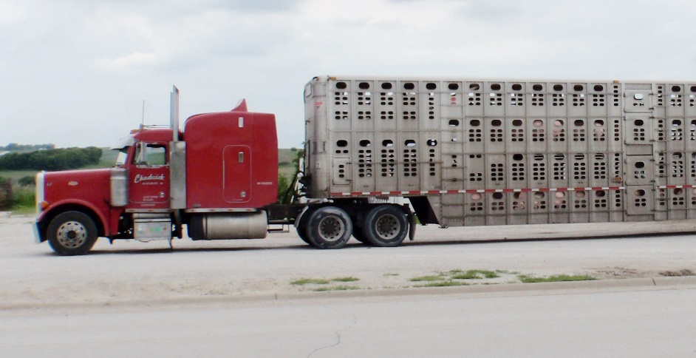
Control Area Movements
Moving animals, animal products, fomites
Broad guidance
  APHIS Foreign Animal Disease Framework:
  Response Strategies (FAD PReP Manual 2-0)
  Specific criteria
  Science
  Risk of disease
  transmission
  Circumstances of
  the outbreak
Notes:
In APHIS Foreign Animal Disease Framework: Response Strategies (FAD PReP Manual 2-0), broad guidance is provided for moving animals, animal products, and fomites into, out of, and within a regulatory Control Area. The decision to authorize movements is determined by specific criteria based on science, the risk of disease transmission, and the circumstances of the outbreak. For example, susceptible livestock from outside the Control Area are generally prohibited from moving onto Infected, Suspect or Contact Premises within the Control Area. However, the same livestock may be authorized to move onto At-Risk or Monitored Premises, if specific criteria are met and a permit to move is granted. Movement from inside a Control Area to a location outside of the Control Area is highly controlled. At-Risk Premises must become Monitored Premises to move susceptible livestock or poultry out of a Control Area by permit. Depending on the circumstance, permits are issued by Incident Command for a critical (for animal welfare) or essential movement (directly related to the completion of response activities). Movements are allowed by COB permits (either as an operational permit or Secure Food Supply permit), based on specific criteria. Biosecurity measures are essential to all authorized movements to reduce the risk of further transmitting disease and infecting new populations of animals. [This photo depicts a truck transporting livestock, one type of movement that will be evaluated and addressed by QMC activities. Photo source: Alex Ramirez, Iowa State University]

Slide 26
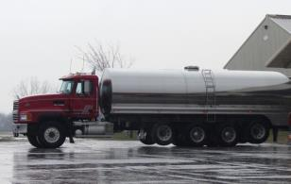
Continuity of Business
COB, managed movement
  Specific criteria for movement
Voluntary participation
Specific criteria
  Surveillance
  Cleaning, disinfection
  Biosecurity measures
  Epidemiological
  information
Notes:
Continuity of business (COB) or managed movement is a specific type of movement control, which establishes specific criteria for the permitted movement of certain livestock species and commodities from a premises. Producer participation in managed movement plans is voluntary. If producers choose to participate, specific criteria are required to receive a permit for permitted movement. Criteria may be specific for the commodity, the origin and destination, as well as the disease pathogen. Managed movement mitigates the impact of the Federal area quarantine on unaffected producers, and is risk- and science-based, weighing the risk of disease transmission. Developed by public-private-academic partnerships, the criteria for these permitted movements typically require surveillance, cleaning and disinfection, biosecurity measures, and epidemiological information. [The milk in this milk truck is one of the commodities that may be permitted to move. Photo source: Danelle Bickett-Weddle, Iowa State University]

Slide 27
Permitting
Specific or COB movements
  Considers risk assessments, surveillance, biosecurity, national
  and OIE standards
  Significant information management
  EMRS2 is the system of record for an animal health emergency response
Notes:
Permitting in an incident will primarily be either specific, covering critical and essential movements on and off quarantined Infected, Suspect, and Contact Premises, or COB permits to facilitate business and operational continuity for non-infected (At-Risk and Monitored) premises inside the regulatory Control Area. Permitting lessens the risk of transmitting the disease agent by considering risk assessments, surveillance information, biosecurity procedures, as well as national and World Organization for Animal Health standards. It is essential that personnel responsible for permitting have access to the most recent information about the outbreak. Permitting is likely to require significant resources and information management capabilities during an outbreak. New situational information may change permitting requirements. Data collection, management, and analysis capabilities are required. The APHIS VS’ Emergency Management Response System (EMRS2) is the primary information management system involved in permitting. EMRS2 is the “system of record” for an animal health emergency response in the United States.

Slide 28
Checkpoints
Enforce requirements
  May need accompanying permit
    Verifies vehicle is in compliance
    with all movement criteria
Avoid threatening animal welfare
Standard operating procedures provided through Incident Command
Violations reported to officials
Notes:
Checkpoints can help enforce movement control requirements. Conveyances moving out of the Control Area may need to be accompanied by a permit for permitted movement. This permit provides verification that any criteria for movement has been met, such as that a vehicle is properly cleaned and disinfected and is transporting animals, fomites, or products in accordance with State and Federal laws and regulations. Every effort should be made to avoid holding animals at a checkpoint or situations that may threaten animal welfare. Depending on the level of compliance, the conveyance should be returned to the premises of origin (if it cannot be permitted), or sent to its destination (if permitted), or Unified Incident Command will provide further instructions. Violations, including failure to have the necessary permit, should be reported to the appropriate officials.

Slide 29
Personnel
Notes:
Typically, personnel in the Animal Movement and Permits Group will perform QMC activities, though other personnel are likely to be involved. Responsibilities may include providing recommendations for quarantines and guidance on permitted movements, responding to movement requests, issuing and tracking permits, communicating with owners/agents of animals subject to QMC, establishing premises quarantine, collaborating with other authorities and response personnel to enforce QMC protocols and implement biosecurity procedures, and staffing check points to ensure compliance with the permit system. Carrying out QMC activities falls to both policy and operational personnel. All personnel need to be properly trained so they can work efficiently and collaboratively. In addition, personnel need to be aware of the hazards, and take the proper precautions to protect themselves.

Slide 30
Responsibility and Coordination
National Incident Coordination Group
  Gathers resources, evaluates policy options, implements strategies
Incident Management Team
  Handles operations in the field
  Communicates with owners, coordinates with other ICS personnel
  Permits allowable movements
Notes:
The APHIS National Incident Coordination Group (ICG) is responsible for gathering resources, evaluating policy options, and implementing response strategies. The ICG coordinates agencies, authorities, and resources. Among other activities, it provides advice and recommendations on quarantines, permit requirements, and size of Control Areas. The Incident Management Team (IMT) handles the operational side of QMC activities, to implement QMC activities in the field. IMT personnel serve as the first line of communication with owners and agents of animals subject to QMC. Additionally, they collaborate with other authorities, and coordinate with other ICS personnel responsible for biosecurity, depopulation, disposal, cleaning and disinfection, wildlife management and vector control, and surveillance. The IMT also permits allowable movements of animals, animal products, vehicles, equipment, and other materials.

Slide 31
Hazards
Responder safety
  Orientation covering precautions
  Required personal protective equipment
Biosecurity
  Prevent disease spread
  Knowingly or unknowingly contaminated
  Understand pathogen transmission
  Work zones control access
Notes:
The personal safety of each responder, particularly if a zoonotic disease is involved, is essential. All personnel should receive a complete orientation covering potential hazards, necessary safety precautions, and hygiene requirements. Required personal protective equipment (PPE) may include outerwear, safety goggles, high visibility vests, and respirators. The hazard of spreading disease to susceptible animal populations must be addressed through biosecurity. QMC personnel, particularly those assigned on-site to quarantined premises, may work in known contaminated areas. Personnel responsible for evaluating the biosecurity of movements or assigned to checkpoints may unknowingly become contaminated. It is imperative to fully understand pathogen transmission routes. For all authorized movements, proper cleaning and disinfection is necessary. The establishment of work zones control access to enter and leave quarantined premises and help prevent contamination of clean areas. In addition, a waiting period, defined by Unified Incident Command, must be enforced where personnel avoid contact with any susceptible unaffected animal species.

Slide 32
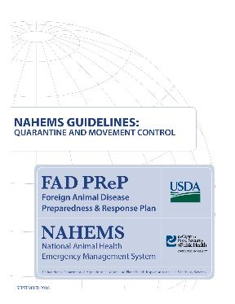
For More Information
FAD PReP/NAHEMS Guidelines: Quarantine and Movement Control
  http://www.aphis.usda.gov/fadprep
Quarantine and Movement Control web-based training module
  http://naherc.cfsph.iastate.edu/
Notes:
More details can be obtained from the sources listed on the slide, available on the USDA website (http://www.aphis.usda.gov/fadprep) and the National Animal Health Emergency Response Corps (NAHERC) Training Site (http://naherc.cfsph.iastate.edu/).

Slide 33
Guidelines Content
Authors (CFSPH)
Janice P. Mogan, DVM
Heather Allen, PhD, MPA
Kristen Bretz, MS
Reviewers (USDA)
Randall Crom, DVM (Retired)
Jonathan Zack, DVM
Notes:
The print version of the Guidelines document is an excellent source for more detailed information. This slide acknowledges the Guidelines’ authors and reviewers. It can be accessed at http://www.aphis.usda.gov/fadprep.

Slide 34
Acknowledgments
Development of this presentation was by the Center for Food Security and Public Health at Iowa State University through funding from the USDA APHIS Veterinary Services
PPT Authors: Janice Mogan, DVM; Logan Kilburn
Reviewers: Kristen Bretz, MS
Notes:
Information provided in this presentation was developed by the Center for Food Security and Public Health at Iowa State University College of Veterinary Medicine, through funding from the US Department of Agriculture, Animal and Plant Health Inspection Service, Veterinary Services.

