Slide 1
Mass Depopulation & Euthanasia
Responsibilities of Euthanasia Personnel
Adapted from the FAD PReP/NAHEMS
Guidelines: Mass Depopulation and Euthanasia (2015)
Notes:
This purpose of this presentation is provide an overview of responsibilities of euthanasia personnel and their role in emergency depopulation of livestock during an animal health emergency. [This information was derived from the Foreign Animal Disease Preparedness and Response (FAD PReP)/National Animal Health Emergency Management System (NAHEMS) Guidelines: Mass Depopulation and Euthanasia (2015).]

Slide 2
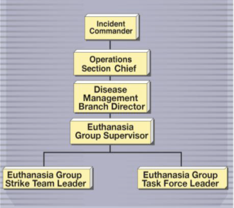
Euthanasia Group
Operations Section
Provides advice to Command level
Notifies owners, operators
Coordinates with:
  Logistics Section
  Disposal Group
  Appraisal Group
  Compensation/
  Claims Unit
Notes:
The Euthanasia Group is made up of skilled and trained individuals who depopulate or euthanize livestock and poultry on Infected and/or Contact Premises. The Euthanasia Group is located within the Operations Section and works closely with other groups and units to ensure a smoothly functioning operation. The Euthanasia Group provides advice and recommendations to the Command level on euthanasia procedures. The Euthanasia Group also notifies owners or operators of Infected or Contact Premises of mass depopulation or euthanasia procedures that will be used and secures acceptance for these procedures. The Euthanasia Group coordinates closely with the Logistics Section; the Disposal Group; and other response Groups such as the Appraisal Group and the Compensation/Claims Unit. [This illustration shows the Incident Chain of Command. Photo source: Andrew Kingsbury, Iowa State University]

Slide 3
Group Supervisor
Reports to Disease Management Branch Director/Operations Section Chief
In charge of all Euthanasia Teams and Euthanasia Team Members
Ensures measures are implemented effectively, personnel are familiar with proper techniques
Notes:
The Euthanasia Group Supervisor is in charge of all Euthanasia Teams and Euthanasia Team Members, and reports to the Disease Management Branch Director or Operations Section Chief. The Euthanasia Group Supervisor’s primary responsibility is to ensure that euthanasia measures are implemented effectively during an animal disease emergency and that all euthanasia personnel are familiar with the euthanasia techniques utilized for the animal health emergency.

Slide 4
Group Supervisor (cont’d)
Additional duties include:
  Determines number, type of personnel, equipment needed
  Identifies training requirements
  Coordinates Group activities with other groups
  Prepares briefings and reports and verifies all reports
Notes:
Additional duties of the Euthanasia Group Supervisor include determining the number and types of personnel, vehicles, and equipment needed to conduct euthanasia operations. The Euthanasia Group Supervisor is responsible for identifying personnel training requirements and orienting new employees to the specifics of their duties within the Euthanasia Group. The Euthanasia Group Supervisor is tasked with coordinating Euthanasia Group activities with other response Groups. The Euthanasia Group Supervisor must also verify the accuracy and completeness of all required reports and submit them promptly.

Slide 5
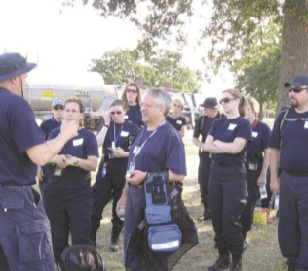
Team Leaders
Duties:
  Ensures safe, humane, effective procedures are performed
  Assists Group Supervisor
  Instructs and trains
  Team Members
  Assigns tasks to
  Team Members
Notes:
The Euthanasia Team Leader’s primary focus is ensuring that safe, humane, effective euthanasia procedures are performed on animals in all premises involved in an animal health emergency. Additionally this individual assists the Euthanasia Group Supervisor in determining the number and types of personnel, vehicles, and euthanasia-related equipment needed to conduct depopulation and/or euthanasia operations. The Team Leader also instructs and trains Euthanasia Team Members in euthanasia protocols, policies and procedures, humane animal handling methods, and general safety precautions. The Euthanasia Team Leader also assigns tasks to Euthanasia Team Members and supervises their work. [This photo shows Team Members consulting with a Team Leader on-site before beginning activities. Photo source: Kristi Rodas-Niesen, NVRT 3 member]

Slide 6
Team Leaders (cont’d)
Additional duties include:
  Serves as liaison to various premises
  Serves as technical resource for information on methods, procedures
  Prepares briefings and reports
  Works closely with:
    Appraisal Group
    Compensation/Claims Unit
    Disposal Group
Notes:
The Euthanasia Team Leader serves as a liaison to various premises, informing owners and managers and providing technical and other additional information related to euthanasia activities as needed. This individual serves as a technical resource for information on current euthanasia and depopulation methods and procedures. The Euthanasia Team Leader prepares briefings and reports for the Euthanasia Group Supervisor and notifies him or her immediately of any issues or problems; and works closely with other units and groups in the animal emergency response organization, particularly the Appraisal Group and the and Compensation/Claims Unit, whose activities precede euthanasia activities, and the Disposal Group whose activities follow euthanasia.

Slide 7
Team Members
Assigned to defined area or premises
Experienced and trained
Perform euthanasia activities
Work to contain and control
Notes:
Euthanasia Team Members are typically assigned to a clearly defined area or premises. A team is composed of members who are experienced or trained in euthanasia and can carry out animal euthanasia under supervision of or by order of a veterinarian. In the event of an animal disease emergency, the work of the Euthanasia Team Members on an infected or exposed premises is essential to the containment and control of a disease outbreak.

Slide 8
Hazard Communication
Review hazards associated with methods used
Explain specific safety precautions, hygiene requirements to witnesses, stakeholders
Use required PPE required
Special procedures may be needed for zoonotic disease
Notes:
The Team Leader should confirm that all personnel associated with the premises to be depopulated have been briefed on the depopulation procedure and any applicable euthanasia-related hazards. If requested, Euthanasia Group members can assist in communication of information to the owner, owner’s family, and premises employees. Specific safety precautions or hygiene requirements should be explained to witnesses and stakeholders before the Euthanasia Group enters the premises. Personal Protective Equipment (PPE) appropriate for the disease, situation, and individual will be supplied accordingly as determined by the Safety Officer. All PPE must be used according to guidelines established by the Safety Officer. Euthanasia Group Members should wear appropriate personal protective gear to ensure personal safety and compliance with Occupation Safety and Health Administration (OSHA) standards. This is particularly important if a zoonotic disease is involved and other special precautions may be necessary.

Slide 9
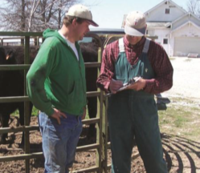
Animal Welfare Issues
Euthanasia group works to:
  Ensure animals are appropriately housed, maintained, euthanized
  Consult on animal welfare issues
  Make effort to comply with counsel of APHIS Animal Welfare personnel
Notes:
The Euthanasia Group should work closely with welfare experts within the USDA as well as industry welfare experts on all aspects of euthanasia related to animal welfare. Guidance documents such as the American Veterinary Medical Association (AVMA) Guidelines for the Euthanasia of Animals may also provide valuable information. Expertise within the USDA will likely include qualified Veterinary Medical Officers and field personnel with training in animal welfare and depopulation procedures. These individuals may serve in an advisory capacity to ensure that animals are appropriately housed, maintained, and depopulated or euthanized humanely. The Euthanasia Group should make a concerted effort to comply with the counsel of APHIS Animal Welfare personnel when it is reasonable and practical to do so. [This photo shows a veterinarian talking with a producer on-site. Photo source: Danelle Bickett-Weddle, Iowa State University]

Slide 10
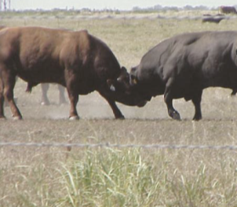
Euthanasia Group Safety
Multiple factors may affect safety
  Size, weight of animals
  Animal temperament
  Animal familiarity/comfort
  with humans
  Dangerous animals
  Restraint methods/equipment
  Euthanasia methods/equipment
Notes:
In addition to the general hazards mentioned previously, the safety of the Euthanasia Group may be affected by several factors, including the size and body weight of the animals to be euthanized and the temperament of the species being euthanized. The animals‘ familiarity and comfort with humans is also considered when determining safety risk, and special care and precautions must be taken if the animals are unaccustomed to being handled by humans. Animals generally regarded as being dangerous such as bulls, bison, and large boars are also given special consideration. Available equipment for animal restraint and methods must be sufficient to ensure the safety of team members. In addition, the means of restraint must facilitate the depopulation or euthanasia procedures and allow adequate time for its completion. Methods and/or equipment chosen for euthanasia is a primary concern since human safety is a primary consideration when choosing methods of depopulation or euthanasia. Hazards inherent to certain procedures such as free bullets, CO2, and electrocution should be weighed when choosing euthanasia equipment and methods. [This photo shows that large animals can be dangerous. Photo source: Reneé Dewell, Iowa State University]

Slide 11
NVS 3D Teams
Arranged through National Veterinary Stockpile (NVS)
3D Teams
  Depopulation/disposal/disinfection
  Provide personnel
    Equipped to handle many situations
    Provide own safety items and equipment
    Can be quickly mobilized
Notes:
The National Veterinary Stockpile (NVS) is the nation’s repository of veterinary countermeasures, including supplies, equipment, field tests, vaccines, and commercial support services. The NVS mission is to provide States the countermeasures they need to respond to catastrophic animal disease outbreaks that terrorists or nature may create. As part of this mission, the NVS can also arrange service contracts for mass depopulation, disposal, and decontamination teams, called 3D Teams, if additional assistance is required.
Commercial services provided through contracts with 3D Teams, can rapidly supply large numbers of personnel with equipment to support States that do not have sufficient personnel and resources. The 3D Teams are equipped to handle many types of emergencies and provide their own personnel, safety items, and equipment for most situations. They can be quickly mobilized and expanded to 600 personnel in three days, 1,000 in one week, and more if required. When evaluating a disaster response situation, including mass depopulation, states that require additional resources can request assistance from a contracted 3D Team source. Once APHIS approves the 3D support, the approved state must provide a short statement of work.

Slide 12
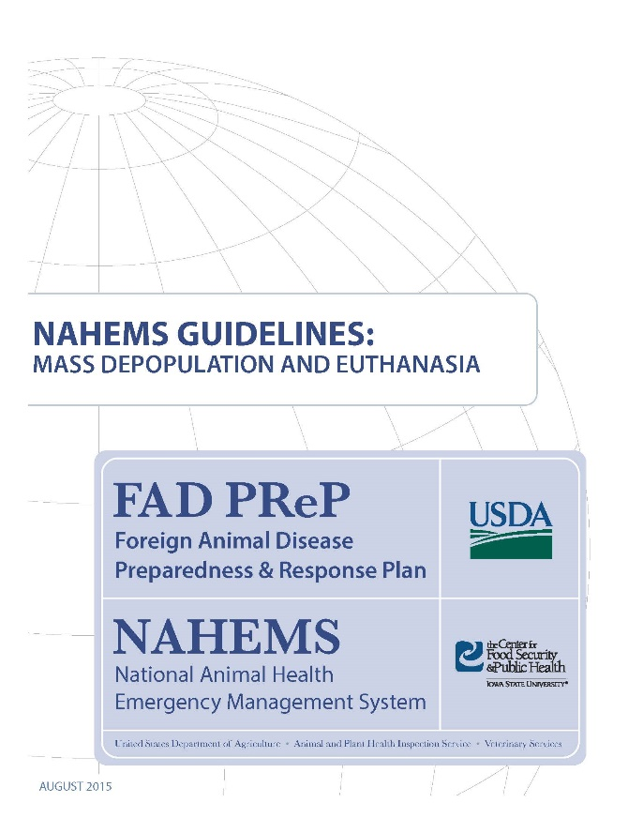
For More Information
FAD PReP/NAHEMS Guidelines: Mass Depopulation and Euthanasia (MDE) (2015)
  http://www.aphis.usda.gov/fadprep
MDE web-based training module
  http://naherc.sws.iastate.edu/
Notes:
More details can be obtained from the sources listed on the slide, available on the USDA website (http://www.aphis.usda.gov/fadprep)
and the NAHERC Training Site (http://naherc.sws.iastate.edu/).

Slide 13
Guidelines Content
Authors (CFSPH):
Reneé Dewell DVM,MS
Nichollette Rider, Veterinary Student
Significant contributions to the content were provided by
USDA APHIS VS:
Lori P. Miller, PE
Darrel K. Styles, DVM, PhD
Notes:
This slide acknowledges the authors and those who made a significant contribution to the content of the FAD PReP/NAHEMS Guidelines: Mass Depopulation and Euthanasia document. Please see the Guidelines document for others who also provided additional assistance with content development.

Slide 14
Acknowledgments
Development of this presentation was by the Center for Food Security and Public Health at Iowa State University through funding from the USDA APHIS Veterinary Services
PPT Authors: Dawn Bailey, BS; Kerry Leedom Larson, DVM, MPH, PhD, DACVPM
Reviewers: Glenda Dvorak, DVM, MPH, DACVPM: Cheryl L. Eia, JD, DVM, MPH, Patricia Futoma, BS, Veterinary Student, Reneé Dewell DVM,MS
Notes:
Information provided in this presentation was developed by the Center for Food Security and Public Health at Iowa State University College of Veterinary Medicine, through funding from the US Department of Agriculture, Animal and Plant Health Inspection Service, Veterinary Services.

