Slide 1
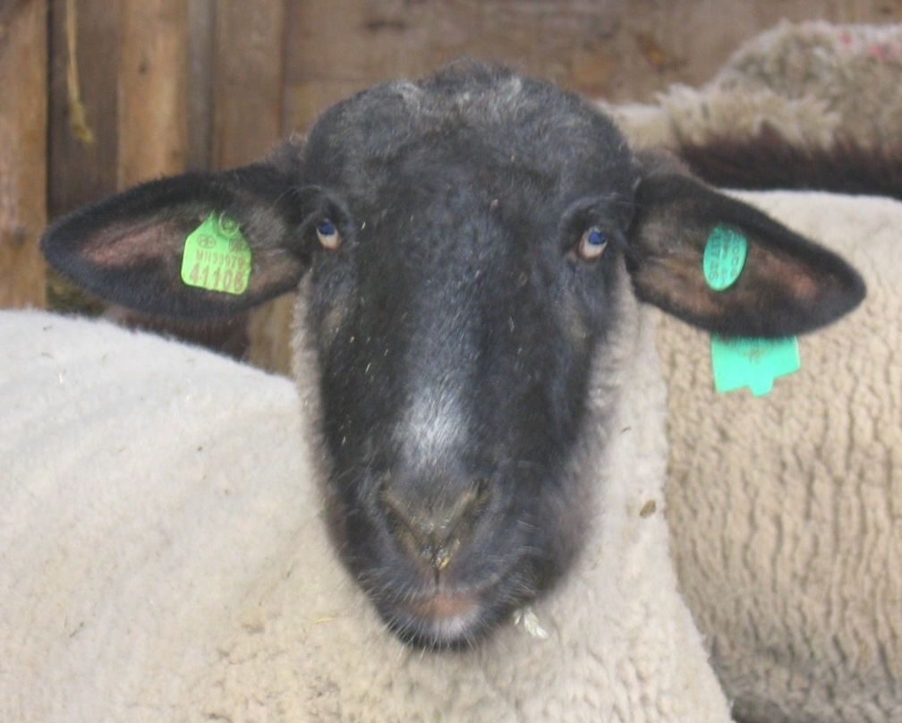
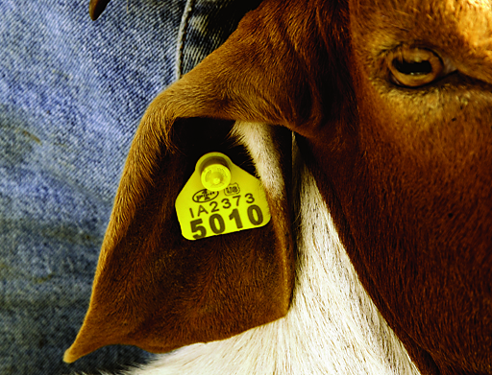
SHEEP and GOAT
Identification:
Visual and Electronic
Published April 2019

Slide 2




Don’t feel like reading the whole presentation?
Slides 3 through 6 give you the bare minimum. For more details and exceptions, keep reading.
Slide 7 is a list of topics with hyperlinks to slides in presentation.
Action buttons on each page:
Return to the last slide viewed
Return to Slide 7 with list of topics

Slide 3
Call 866-USDA-TAG:
To get a flock ID assigned if you don’t have one, and
If you haven’t received free tags from APHIS before, you can request up to 80 free plastic tags, or
If you have received tags before or need more tags or a different type of tag, you can purchase your own official tags from an approved tag manufacturer, once you have a flock ID
Tag it!

Slide 4
What is needed for sheep/goats crossing a state line and not in slaughter channels or going to a federally approved market?
Must have an ICVI
  Interstate Certificate of Veterinary Inspection issued by an Accredited Veterinarian
  Note: Some states also require an ICVI for instate shows.

Slide 5
Moving sheep/goats in slaughter channels?
Complete an owner/hauler statement to accompany the animals
  See slides 9-10 for details
Notes:
You can use the official form or provide the information using another document that contains the required information including legibly hand writing the information

Slide 6
When is a record required?
A record must be made when official ID is applied to a sheep/goat or a sheep/goat is acquired or disposed of
Record must be kept for five years after animal dies or is no longer owned by you.

Slide 7
Where to find information?
Topic | Slide Number (click hyperlink for each topic)
Definitions | 8 to 18
What’s changed? | 19 to 29
Sheep/goats requiring identification | 30 to 35
Exceptions | 36 to 38
Sheep/Goat ID tips and advice | 39 to 41
Official ID devices and methods | 42 to 59
Options for earless goats | 60
Group/lot ID | 61 to 62
Permanent brands or ear notches | 63
Tattoos | 64 to 75
Implants | 76 to 82
Records | 83 to 96
Animal Disease Traceability | 97 to 98

Slide 8
Definition of Terms Used

Slide 9
Owner/Hauler Statement
A signed written statement by the owner or hauler that includes:
  The name, address, and phone number of the owner and, if different, the hauler;
  The date the animals were moved;
  The flock identification number or PIN assigned to the flock or premises of the animals;
  If moving individually unidentified animals or other animals required to move with a group/lot identification number, the group/lot identification number and any information required to officially identify the animals;

Slide 10
Owner/Hauler Statement
List continued -
  The number of animals;
  The species, breed, and class of animals. If breed is unknown, for sheep the face color and for goats the type (milk, fiber, or meat) must be recorded instead; and
  The name and address of point of origin, if different from the owner’s address, and the destination name and address.
An existing document that includes the same information that is signed by the owner or the hauler meets this definition.

Slide 11
Group/Lot Identification Number (GIN)
Flock ID, Standardized PIN or LID followed by the date the group of animals was assembled in MMDDYY format.
If more than one group is created on the same date, a sequential number will be added to the end of the GIN.
A group lot comprised of animals from a single flock of origin may be subdivided after leaving the premises on which the group lot was formed by adding an S followed by a sequential number to the end of the GIN to create a GIN for each sub group.

Slide 12
Group/Lot Identification Number (GIN)
If a flock identification number is used, the flock identification number, date, and sequential number(s) will be separated by hyphens.
Examples:
  If using flock ID: MD123456-061216-12-S4
  If using PIN/LID: 004T56706121612S4

Slide 13
Flock ID
NSEP Flock ID number
  Varies in number of digits, starts with the state postal abbreviation (IA=Iowa)
  Assigned by the State or the APHIS/VS office in your State
  Held in State and Scrapie Program databases
Notes:
NSEP Flock ID number is the same as Scrapie Flock ID number.

Slide 14
Flock ID (cont.)
NSEP Flock ID number
  Flock ID represents a group of animals associated with one or more locations; multiple flock ID numbers may be assigned to the same location.
  Required to order any scrapie program ID eartag or device
  Is the number printed on Flock ID eartags and may be used to create an official tattoo when combined with a production number unique within the flock
Notes:
NSEP Flock ID number is the same as Scrapie Flock ID number.

Slide 15
Standardized National PIN
Standardized National Premises Identification Number (PIN)
  7 digit alphanumeric, example: 01AB2CD
  Allocated through interface with premises allocator and a State’s premises registration system
  PINs are location identifiers for operations
  Required to be recorded in the National Scrapie Database to order “840” eartags or implant (RFID or visual only)
  For more information on PINs refer to the traceability standards at https://www.aphis.usda.gov/traceability/downloads/ADT_standards.pdf

Slide 16
Standardized LID
Standardized Location Identification Number (LID)
  LIDs are administered through a State’s or Tribe’s internal system and may be used in place of a PIN.
  All LIDs start with the State or Tribe code which makes the LIDs nationally unique.
  Consist of six or eight alphanumeric characters. Additionally, seven alphanumeric characters may be used only when the last character is a check digit based on ISO 7064:1983, a standard published by the International Organization for Standardization (ISO).
Notes:
NSEP Flock ID number is the same as Scrapie Flock ID number.

Slide 17
Standardized LID
Standardized Location Identification Number (LID)
  Required to be recorded in the National Scrapie Database to order “840” eartags and implants (RFID and visual only) if a PIN has not been assigned
  For more information on LIDs refer to the traceability standards at https://www.aphis.usda.gov/traceability/downloads/ADT_standards.pdf
Notes:
NSEP Flock ID number is the same as Scrapie Flock ID number.

Slide 18
Legacy PIN
Legacy Premises Identification Number
Original premises number used in the Scrapie National Database and some State databases
Is being replaced by standardized PIN or LID
Once replaced, will be maintained for historical purposes
Varies in number of digits, starts with the state postal abbreviation (IA=Iowa) and may be the same as the flock ID in some states.
Assigned by State or APHIS/VS office in your State
Notes:
NSEP Flock ID number is the same as Scrapie Flock ID number.

Slide 19
What was Changed by the 2019 Federal Regulation Revision?

Slide 20
What has changed for goats?
The slaughter and low-risk commercial goat exemptions have been eliminated. This means individual official ID (eartags, tattoos* or implants*) is required for goats in interstate commerce with the EXCEPTIONS noted in the next 3 slides.
*Tattoos or implants may not be use as the only form of official ID for animals moving in slaughter channels at over 18 months of age or through a livestock market or buying station

Slide 21
What has changed for goats?
EXCEPTIONS:
Wethers under 18 months of age - no ID or owner hauler statement required
Goats in slaughter channels at under 18 months of age accompanied by an owner hauler statement and group/lot ID (may be mixed source)

Slide 22
What has changed for goats?
EXCEPTIONS:
Goats moving as a single source group/lot accompanied by an owner/hauler statement to:
  A federally approved livestock market,
  slaughter establishment,
  another premises of the flock listed in the nation scrapie database, or
  instate to a another site where they will be officially identified.

Slide 23
What has changed for goats?
EXCEPTIONS:
Earless goats may have the eartag applied to a neck collar such that the collar or eartag must be cut to remove the collar
Backtags applied near the poll may be used for earless goats and on the back for horned buck goats deemed too dangerous to eartag at a market that are moving direct to slaughter

Slide 24
What has changed for sheep and goats?
In addition to previously existing requirements, requires sexually intact sheep/goats regardless age and wethers over 18 months of age to be officially identified before leaving the premises on which they currently reside if the owner of the sheep/goats engages in interstate commerce of sheep/goats or the premises on which the sheep/goats reside receives sheep/goats that have been moved interstate or from which sheep/goats are moved interstate.
  Depending on type of animals and type of movement involved, individual ID (eartags, tattoos, or EID) or group/lot ID recorded on an owner/hauler statement may be used (see slides 6-11 for details).

Slide 25
What has changed for sheep and goats?
When individual ID is required, persons who engage in interstate commerce must apply or have an agent apply official individual ID.
The official ID used must be assigned to the flock of origin in the National Scrapie Database, be the animal’s registry tattoo or implant, or a flock ID tattoo.
Exceptions:
  Sheep/goats moved to a federally approved market where market assigned official ID is applied

Slide 26
What has changed for sheep and goats?
Requires ear tagging of sheep/goats over 18 months of age in slaughter channels, unless moving as a single source group/lot accompanied by an owner hauler statement to a federally approved livestock market or slaughter establishment, or instate to another site to be ear tagged.
Exceptions:
  For direct to slaughter movements, backtags may be used for earless goats and for horned buck goats deemed too dangerous to eartag at a market.
  For earless goats the eartag may be applied to a neck strap.

Slide 27
What has changed for sheep and goats?
Requires group/lot ID and owner hauler statement that identifies the sheep/goats as being in slaughter channels for sexually intact sheep/goats of any age and wethers over 18 months of age in slaughter channels.
Requires the use of a group/lot ID recorded on an owner/hauler statement for sheep/goats (other than wethers under 18 months of age) moving without official individual animal ID in interstate commerce.

Slide 28
What has changed for sheep and goats?
Limits the use of back tags as official individual ID to buck goats for immediate slaughter that can not be safely eartagged and earless animals for immediate slaughter.
Clarifies that, if not already officially identified, sheep/goats need to be identified on unloading at a premises that receives sheep/goats that have been in interstate commerce or from which sheep/goats are moved interstate

Slide 29
Disclaimer
The following slides are accurate for most States and most situations. However, federal exemptions may apply to some movements and States may have:
Specific exemptions, or
Higher Standards
Notes:
Some states have:
exempted some animals when moved within the State.
set higher standards than USDA.
To ensure you are in compliance, call your state’s Animal Health Regulatory Office or the Animal Health Regulatory Office of the state to where you are shipping your sheep. Many states have provided this information and it can be found on the NIAA Website.

Slide 30
Sheep and Goats Requiring Official Identification

Slide 31
Required to be individually officially identified see slide notes for exceptions
  Sheep/Goats on change of ownership that are:
    Over 18 months of age*, or
    Sexually intact (any age) and NOT in slaughter channels.
  Sheep/Goats moved for exhibition except wethers under 18 months of age
  * 18 months of age as evidenced by eruption of the second incisor.
  States may have more stringent ID regulations or may exempt certain animals in intrastate commerce.
Notes:
States may have more stringent ID regulations and some states exempt white face sheep from ID on change of ownership in intrastate commerce - check with the State Veterinarian’s office prior to shipping your sheep. Sheep that have remained in the same state since birth and that are owed by people that do not engage in the interstate commerce of sheep/goats and have not resided on premises where sheep and goats are moved or received in interstate commerce are only subject to state rules.
Federal exceptions – sheep moved for management purposes without change of ownership and without commingling with animals from other flocks (such as grazing) between premises owned or leased by the owner that are listed as additional premises of the flock in the National Scrapie Database or to an instate site where official ID is applied upon unloading the sheep that are moved with group/lot ID and an Owner/hauler statement, sheep moved as part of a same source lot to an approved market where they will be identified prior to sale or to a slaughter establishment were their identity is maintained may move with group/lot ID and an Owner/hauler statement rather than individual ID. Sheep that were exempted by a State from identification in intrastate commerce may be identified to the flock in which they last resided before entering interstate commerce.

Slide 32
Required to be individually officially identified see slide notes for exceptions
  Sheep/Goats over 18 months of age* or sexually intact (any age) and NOT in slaughter channels moved without change of ownership:
    interstate to a premise not listed in the National Scrapie Database as a premises of the flock unless moving to an approved market where market assigned ID will be applied or to a slaughter establishment as a single source group/lot.
  * 18 months of age as evidenced by eruption of the second incisor.
  States may have more stringent ID regulations.
Notes:
States may have more stringent ID regulations and some states exempt white face sheep or commercial goats from ID on change of ownership in intrastate commerce - check with the State Veterinarian’s office prior to shipping your. Sheep or goats. Sheep or goats that have remained in the same state since birth and that are owed by people that do not engage in the interstate commerce of sheep/goats and have not resided on premises where sheep and goats are moved or received in interstate commerce are only subject to state rules.
Federal exceptions – sheep or goats moved for management purposes without change of ownership and without commingling with animals from other flocks (such as grazing) between premises owned or leased by the owner that are listed as additional premises of the flock in the National Scrapie Database or to an instate site where official ID is applied upon unloading the sheep/goats that are moved with group/lot ID and an Owner/hauler statement, sheep/goats moved as part of a same source lot to an approved market where they will be identified prior to sale or to a slaughter establishment were their identity is maintained may move with group/lot ID and an Owner/hauler statement rather than individual ID. Sheep/goats that were exempted by a State from identification in intrastate commerce may be identified to the flock in which they last resided before entering interstate commerce.

Slide 33
Required to be individually officially identified see slide notes for exceptions
  Sheep/Goats over 18 months of age* or sexually intact (any age) and NOT in slaughter channels moved without change of ownership: (continued from previous slide)
    instate, if the owner of the animals engages in the interstate commerce of sheep and goats, and the animals are moved to a premise not listed in the National Scrapie Database as a premises of the flock unless it is a site were the animal will be officially identified with ID assigned to the flock of origin, to an approved market where market assigned ID will be applied, or to a slaughter establishment as a single source group/lot.
Notes:
States may have more stringent ID regulations and some states exempt white face sheep or commercial goats from ID on change of ownership in intrastate commerce - check with the State Veterinarian’s office prior to shipping your. Sheep or goats. Sheep or goats that have remained in the same state since birth and that are owed by people that do not engage in the interstate commerce of sheep/goats and have not resided on premises where sheep and goats are moved or received in interstate commerce are only subject to state rules.
Federal exceptions – sheep or goats moved for management purposes without change of ownership and without commingling with animals from other flocks (such as grazing) between premises owned or leased by the owner that are listed as additional premises of the flock in the National Scrapie Database or to an instate site where official ID is applied upon unloading the sheep/goats that are moved with group/lot ID and an Owner/hauler statement, sheep/goats moved as part of a same source lot to an approved market where they will be identified prior to sale or to a slaughter establishment were their identity is maintained may move with group/lot ID and an Owner/hauler statement rather than individual ID. Sheep/goats that were exempted by a State from identification in intrastate commerce may be identified to the flock in which they last resided before entering interstate commerce.

Slide 34
Required to be individually officially identified
  Sheep/goats when they are designated as:
    exposed,
    high-risk,
    suspect, or
    test-positive animals.
  Sheep/goats designated for test as part of a disease investigation
  Sheep from non-compliant flocks prior to movement
  States may have more stringent ID regulations.
Notes:
States may have more stringent ID regulations

Slide 35
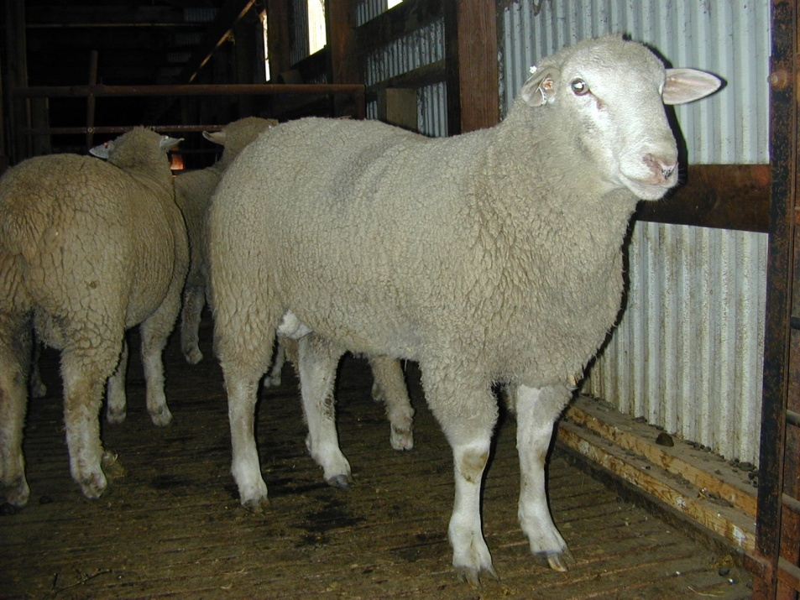
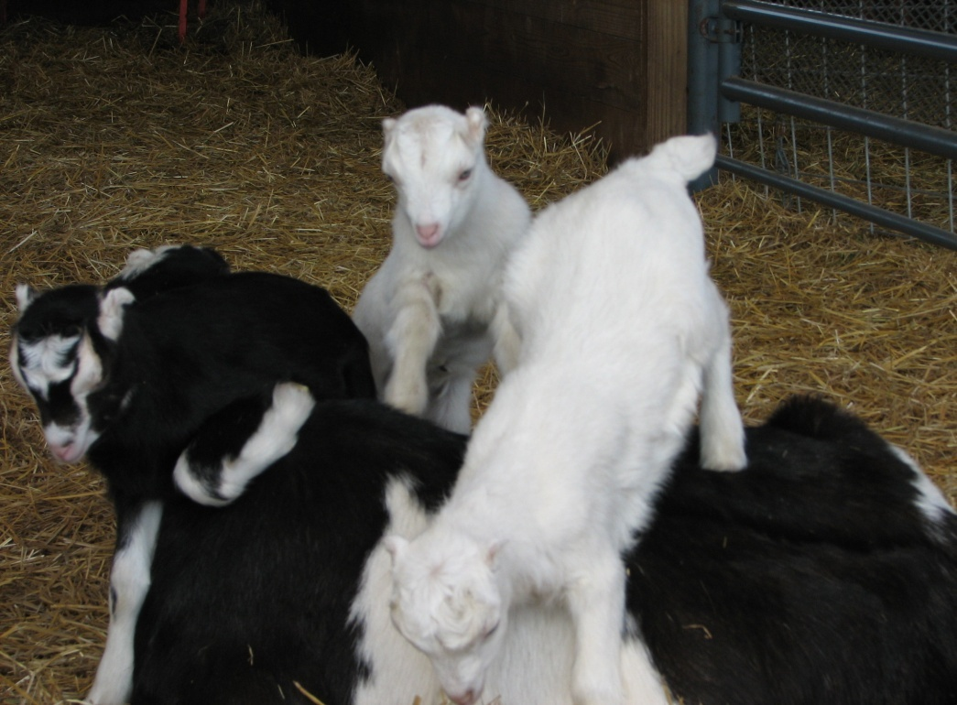
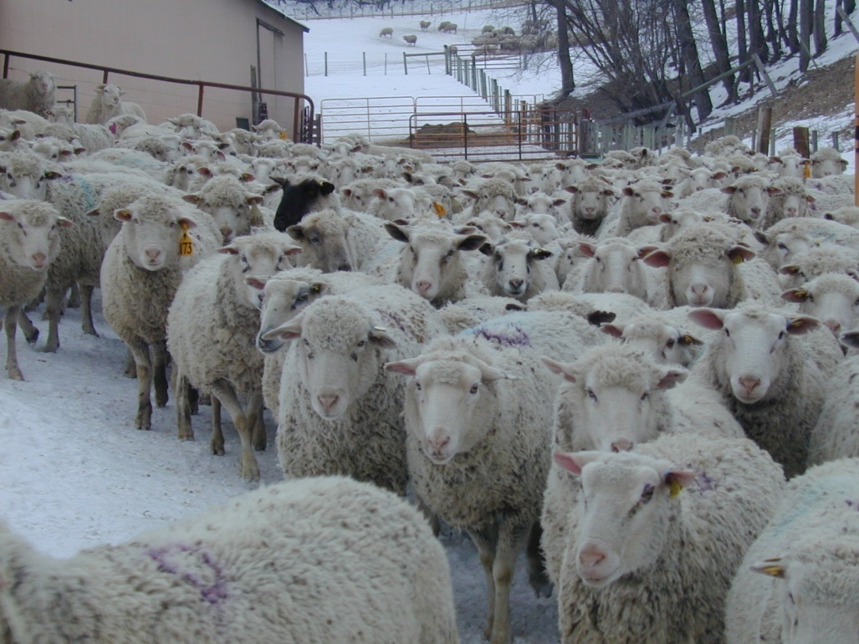
Potential breeding sheep/goats are required to be identified prior to leaving the farm/ranch on which they were born or where they currently reside with some exceptions*
Rams/Bucks and Ram Lambs/Buck kids
Ewe/Doe & Lamb/Kid
Ewes/Does and Ewe Lambs/Doe Kids
Notes:
*Exceptions –
Sheep/goats that have remained in the same state since birth and that are owed by people that do not engage in the interstate commerce of sheep/goats and when the sheep/goats have not resided on premises where sheep or goats are moved or received in interstate commerce are only subject to state rules. Some states exempt white face sheep or commercial goats from official ID on change of ownership in intrastate commerce and many states do not require official ID if there is no change of ownership. Check with the State Veterinarian’s office for State regulations. Sheep/goats that were exempted by a State from identification in intrastate commerce may be identified to the flock in which they last resided before entering interstate commerce.
Group/lot ID and an Owner/hauler statement may be used instead of individual ID for:
Sheep/goats moved for management purposes without change of ownership and without commingling with unidentified animals from other flocks (such as grazing) between premises owned or leased by the owner that are listed as additional premises of the flock in the National Scrapie Database or to an instate site where official ID is applied upon unloading the sheep/goats.
Sheep/goats moved as part of a same flock of origin group/lot to a federally approved market (instate or out-of-state) where they will be identified prior to sale or to a slaughter establishment were their identity is maintained through slaughter.

Slide 36
Federal Exceptions for Individual ID of Sheep of Any Age
Animals moved for management purposes without change of ownership and without commingling with animals from other flocks (such as grazing) between premises owned or leased by the animal’s owners. Group/Lot ID and an Owner/Hauler Statement is Required.
Notes:
Sheep or goats moved for grazing or similar management reasons whenever the animals are moved from a premises owned or leased by the owner of the animals to another premises owned or leased by the owner of the animals. The premises must be recorded in the National Scrapie Database as additional flock premises and commingling must not occur with unidentified animals born in another flock or any animal not part of the flock
Sheep and goats of any age shipped directly to an approved slaughter facility or an approved market that has agreed to act as an agent for the owner to apply official ID when all the animals in a section of a truck are from the same premises of origin and are accompanied by an owner/hauler statement (Note: the owner/hauler statement must contain the information needed for the plant or market to officially identify the animals.

Slide 37
Federal Exceptions for Individual ID of Sheep of Any Age
Animals moving within their State of birth if their owner and the owner of the premises on which they reside do not engage in interstate commerce of sheep/goats
Animals maintained and moved as a single source group/lot to an approved market or to a slaughter facility. Group/Lot ID and an Owner/Hauler Statement is Required.
Notes:
Sheep or goats moved for grazing or similar management reasons whenever the animals are moved from a premises owned or leased by the owner of the animals to another premises owned or leased by the owner of the animals. The premises must be recorded in the National Scrapie Database as additional flock premises and commingling must not occur with unidentified animals born in another flock or any animal not part of the flock
Sheep and goats of any age shipped directly to an approved slaughter facility or an approved market that has agreed to act as an agent for the owner to apply official ID when all the animals in a section of a truck are from the same premises of origin and are accompanied by an owner/hauler statement (Note: the owner/hauler statement must contain the information needed for the plant or market to officially identify the animals.

Slide 38
Federal Exceptions for Individual ID of Sheep Under 18 Months of Age in Slaughter Channels and Wethers Under 18 months of Age
Wethers under 18 months of age (some states require individual ID )
Sheep under 18 months of age may move as mixed source group/lots in slaughter channels with a group/lot ID and an owner hauler statement (some states require individual ID)
Slaughter channels include animals moved to:
  a federal or state inspected slaughter establishment or custom exempt establishment for immediate slaughter
  an individual for immediate slaughter for personal use
  a restricted (slaughter only) livestock facility or sale
  an approved terminal feedlot

Slide 39
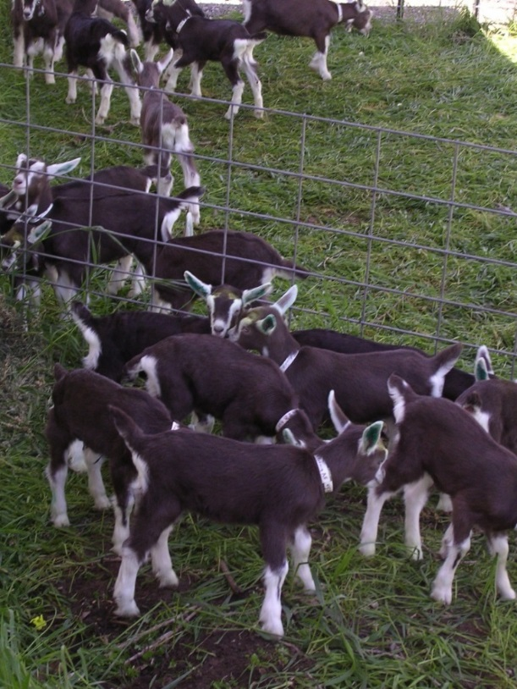
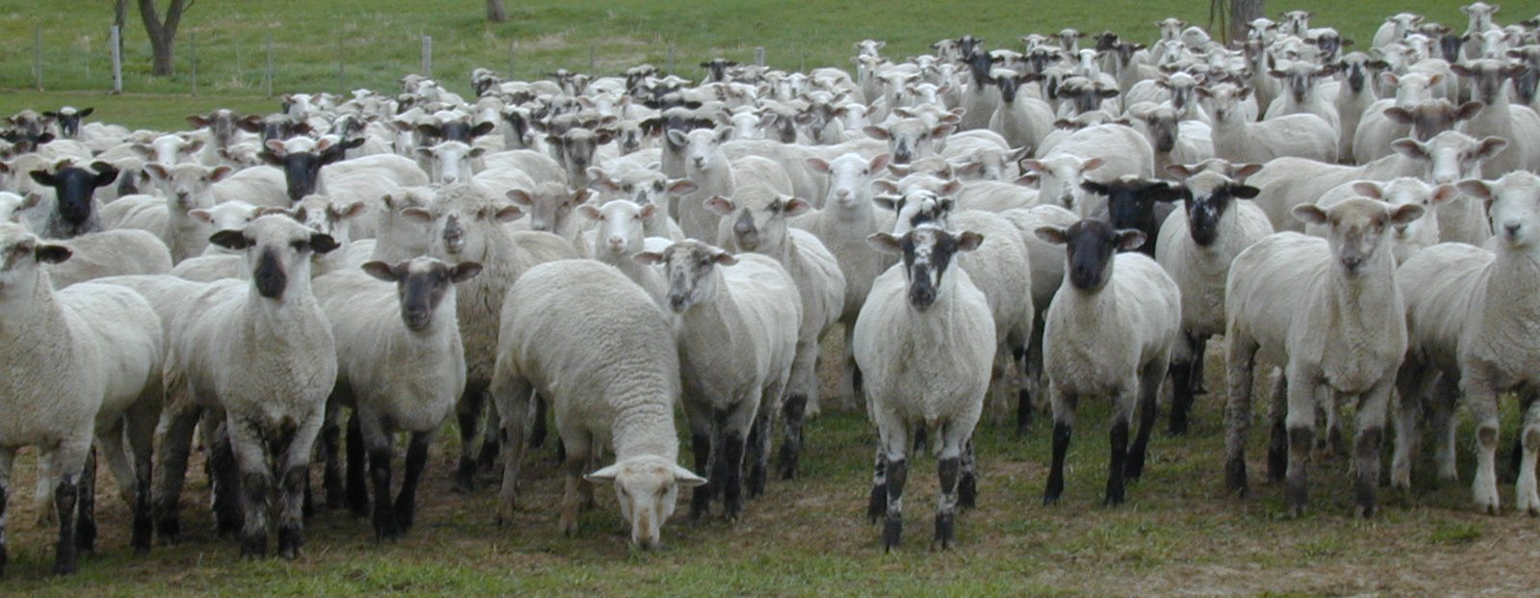
Sheep/Goat ID Tips/Advice
Notes:
The “federal program” is the National Scrapie Eradication Program (NSEP)

Slide 40
ID Tips/Advice
Do not buy or sell a sheep/goat over 18 months of age for any purpose unless they have official ID.
Do not buy or sell sexually intact sheep/goats under 18 months of age that is not officially identified unless they are moving directly to a slaughter establishment, a slaughter only market or sale, a terminal feedlot, or the buyer is going to slaughter them or have them slaughtered for personal use and in each case you have an owner/hauler statement completed by the buyer stating such.
List of exceptions on next slide
Notes:
This should be expressed as advice and not as an absolute requirement since some exceptions exist.
Exceptions:
– Animals that are exempted from identification in intrastate commerce by the State that are moving within their State of birth and are not sold/purchased by persons who engage in interstate commerce or reside on premises were animals are received in interstate commerce or from which animals move in interstate commerce.
– Animals sold and maintained as a single source group/lot in slaughter channels accompanied by owner/hauler statement(s) documenting the movement.

Slide 41
ID Tips/Advice
Exceptions:
Animals that are exempted from identification in intrastate commerce by the State that are moving within their State of birth and are not sold/purchased by persons who engage in interstate commerce or reside on premises were animals are received in interstate commerce or from which animals move in interstate commerce.
Animals sold and maintained as a single source group/lot in slaughter channels accompanied by owner/hauler statement(s) documenting the movement.
Notes:
This should be expressed as advice and not as an absolute requirement since some exceptions exist.
Exceptions:
– Animals that are exempted from identification in intrastate commerce by the State that are moving within their State of birth and are not sold/purchased by persons who engage in interstate commerce or reside on premises were animals are received in interstate commerce or from which animals move in interstate commerce.
– Animals sold and maintained as a single source group/lot in slaughter channels accompanied by owner/hauler statement(s) documenting the movement.

Slide 42
Official ID Devices and Methods

Slide 43
Official ID Devices and Methods
Note: each device or method has specific requirements and limits on use that are described on later slides. Only official eartags may be used for any type of movement.
Official Eartags including RFID eartags
Group/Lot Identification
Flock ID Tattoos
Registry Tattoos
Electronic Implantable Devices (EID)
Registered Brands and Ear Notches
Back tags
Official eartags on neck straps

Slide 44
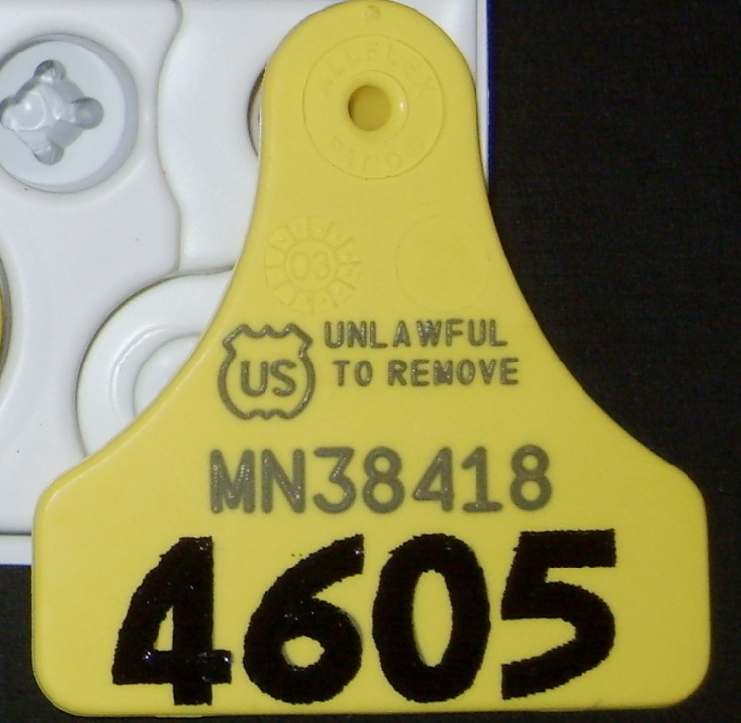
How do I know if a tag is an official tag?
The US Shield
is on all official
tags.

Slide 45

Tags for Sheep/Goats
Some official tags have designated colors and meanings:
  Yellow Metal: animal was exposed and is permanently restricted to a premises
  Red Metal: animal tested positive for scrapie on an official test
  Blue Metal or Plastic: animal is in slaughter channels, tag imprinted with “Slaughter Only” or “Meat”

Slide 46
Where do I get my NSEP tags?
Call 1-866-USDA-TAG (1-866-873-2824)
  Directs the caller to the office for their state which assigns flock IDs and places tag orders
  Tags provided at no charge to producers by USDA
    Plastic - Allflex Couple 74 tag (available through 9/2020 to producers ordering for the first time)
    Metal – National Band & Tag (available through 8/2019 for producers who have not gotten tags since 8/2017)
Notes:
This office can place a tag order or directly send serial tags. Other tags may be purchased by producers directly from approved manufacturers after getting a scrapie flock ID number by calling 1-866-USDA-TAG. Additional information on these tags is provided on the following slides.
Provide your herd’s registration prefix and
ask that it be used as your Scrapie Flock/Herd
ID number in conjunction with your state postal abbreviation.

Slide 47
Where do I get my NSEP tags?
After getting a flock ID, purchase tags as described on the following slides.

Slide 48
Approved Eartags and Manufacturers
For Purchase** from the manufacturer in various colors, sizes and styles:
  Plastic
    Allflex
    Premier
    Shearwell Data Animal Identification and Management Systems
  Metal
    National Band & Tag
** Contact the manufacturer to purchase after getting a Flock ID number by calling 1-866-USDA-TAG
*** Standardized PIN/LID is also required to purchase RFID tags
Notes:
Official tags provided at no charge are listed the previous slide. To order these or to get a flock ID and/or PIN/LID call 1 866 USDA TAG.
Official ‘For purchase tags’ are listed on this slide. To order these tags, call the manufacturer.
RFID requires a standardized premises or location identification number to purchase these tags.
For manufacturer contact information and updates go to https://www.aphis.usda.gov/aphis/ourfocus/animalhealth/animal-disease-information/sheep-and-goat-health/national-scrapie-eradication-program/ct_to_order_ear_tags

Slide 49
Approved Eartags and Manufacturers
For Purchase** from the manufacturer in various colors, sizes and styles:
  RFID***
    Allflex - eartags
    National Band & Tag - eartags
    Shearwell Data Animal Identification and Management Systems - eartags
    Alliance ID – implants
    EZid – implants
** Contact the manufacturer to purchase after getting a Flock ID number by calling 1-866-USDA-TAG
*** Standardized PIN/LID is also required to purchase RFID tags or implantable ID
Notes:
Official tags provided at no charge are listed the previous slide. To order these or to get a flock ID and/or PIN/LID call 1 866 USDA TAG.
Official ‘For purchase tags’ are listed on this slide. To order these tags, call the manufacturer.
RFID requires a standardized premises or location identification number to purchase these tags.
For manufacturer contact information and updates go to https://www.aphis.usda.gov/aphis/ourfocus/animalhealth/animal-disease-information/sheep-and-goat-health/national-scrapie-eradication-program/ct_to_order_ear_tags

Slide 50
Purchase an approved eartag complementary to your management
The program has evolved to address producers’ needs and management styles.
There are approved tags available for purchase by producers in different styles, colors, sizes, numbering options, and with flock name imprint.
Call 1-866-USDA-TAG to have your flock information entered into the ordering system, then contact the tag manufacturer to purchase your choice of official tags.

Slide 51
Current list of Approved Tag Manufactures and Contact Information Available at:
https://www.aphis.usda.gov/aphis/ourfocus/animalhealth/animal-disease-information/sheep-and-goat-health/national-scrapie-eradication-program/ct_to_order_ear_tags
Notes:
This slide and the following slide have the websites for Federally approved tag manufacturers.

Slide 52
Factors that Contribute to Optimal Eartag Retention and Minimal Infection/Tissue Reaction
Ideal Placement Location
Tag Lambs/Kids at < 6 Months Old
Tag Clean, Dry Ears
Pre-dip Tag Stem in Lubricant at Time of Tagging
Place Female Portion of Tag on Inside of Ear
Avoid Tagging in the Humid Summer Months when possible

Slide 53
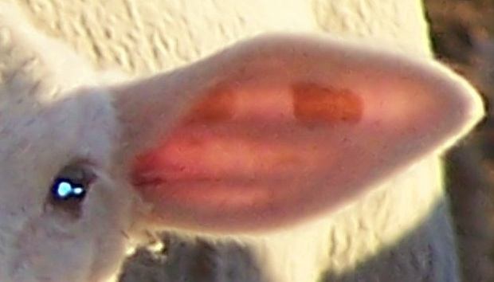
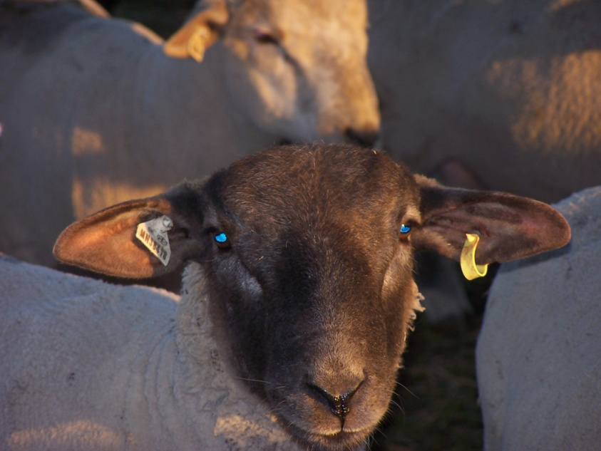
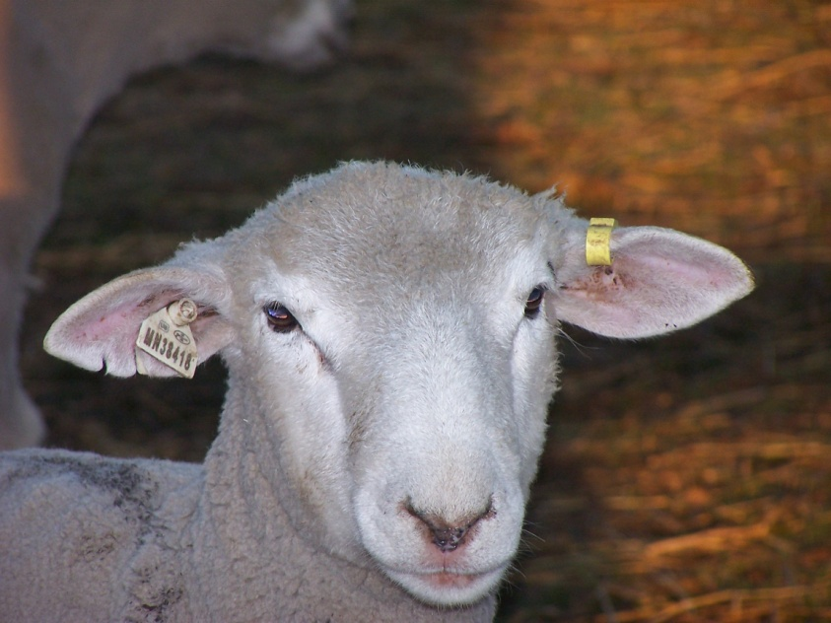
Tag Placement
Official Scrapie Tag (plastic two-piece tag)
  Place in left ear to aid in shearing
  Do not put in any tissue other than the ear
Notes:
Animals that cannot be ear tagged because of absent or injured ears, or because the application of an eartag would obscure an official tattoo, may have the official eartag attached to a durable neck strap that can only be removed by cutting the strap or the eartag and which must accommodate the expected growth of the animal. When a neck strap is used in this manner to identify sexually intact animals, not in slaughter channels, we recommend that these animals be identified with a second form of official identification, such as an official tattoo in the tail fold.

Slide 54
Tag Placement
Metal Tags
Apply about a third of the way from the ear base. Plastic tags are recommended for wool producing animals to reduce risk of injury to shearers, animals and shearing equipment. If applying a metal tag to a wool animal apply it to the bottom edge of the left ear a third to half way from the base to reduce the risk of hitting the tag with the clipper blades
Notes:
Applying to the bottom edge of the ear in wool/fiber animals is recommend to reduce risk of hitting the tag with the clipper blades. Hitting a metal tag may damage clippers and injure the shearer. This risk should be considered when deciding whether to use plastic or metal tags. In hair sheep or goats using the top (sky side) of the ear close to the base of the ear (where the ear meets the head) allows the producer to view that there is a metal tag applied and for “easy” reading of the this tag.

Slide 55
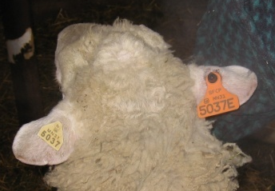
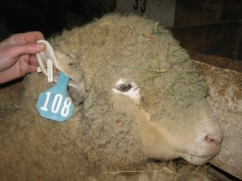
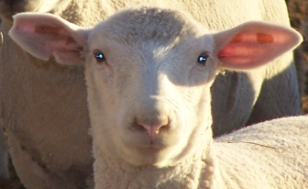
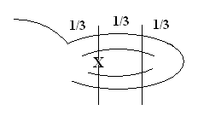

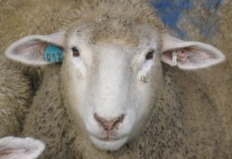
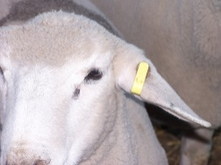
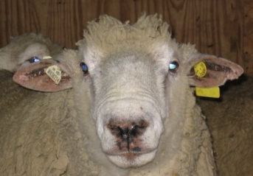
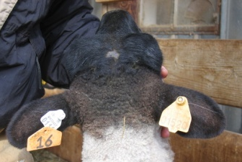
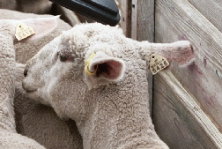
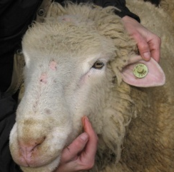
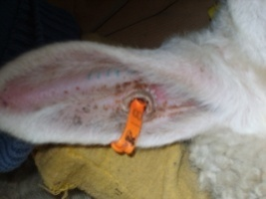
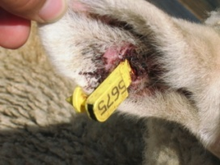
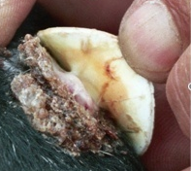
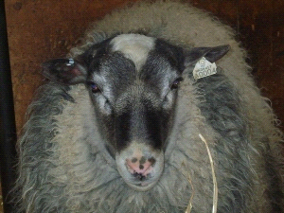
National Scrapie Eradication Program
Recommended Tagging Practices
Examples of Official USDA Tags:
Factors that Contribute to Optimal Eartag Retention and Minimal Infection/Tissue Reaction:
Ideal Placement Location Left Ear
Tag Lambs at < 6 Months Old
Avoid Tagging in the Humid Summer Months
Place Female Portion of Tag on Inside of Ear
Pre-dip Tag Stem in Lubricant at Time of Tagging
Tag Clean, Dry Ears
X
No Infection
Mild Infection
Severe Infection

Slide 56
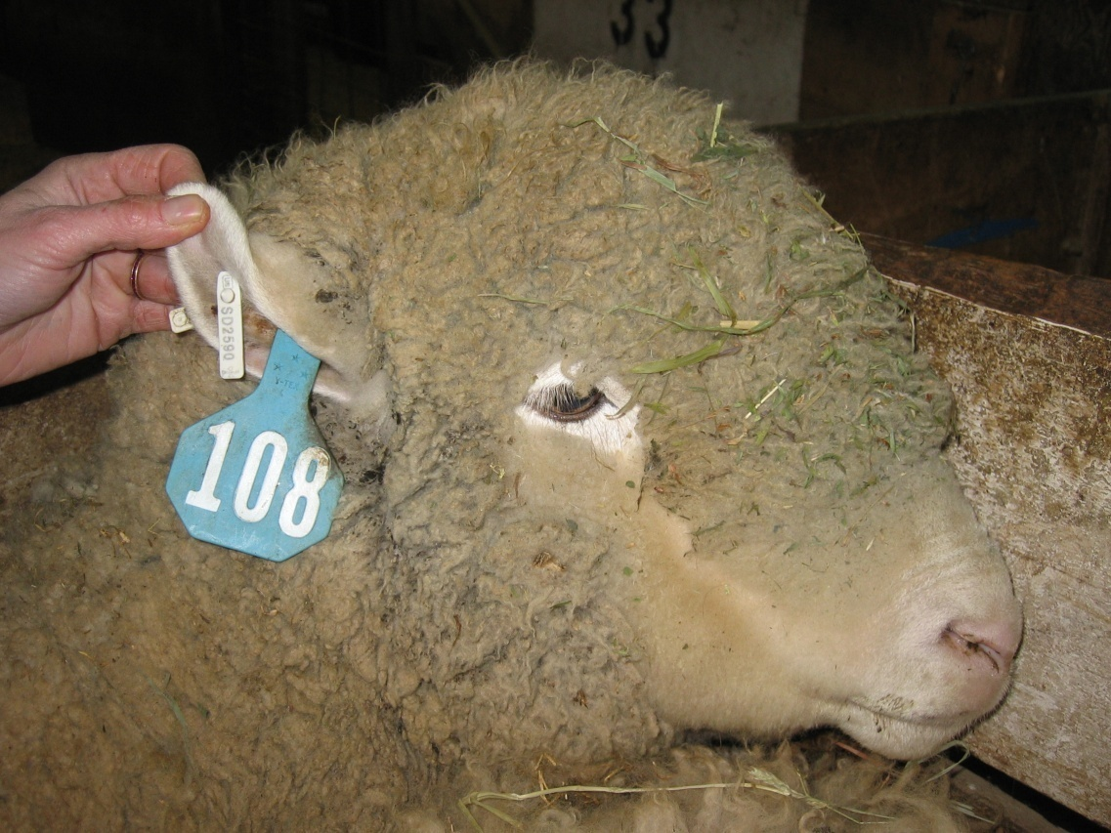

National Scrapie Eradication Program
Tags for Sheep/Goats
Examples of Official USDA Tags
The white, yellow, and
orange tags are official
Notes:
White, yellow and orange tags are official tags.
* The blue tag is not an official tag

Slide 57


National Scrapie Eradication Program
Tags for Sheep/Goats
Examples of Official USDA Tags

Slide 58
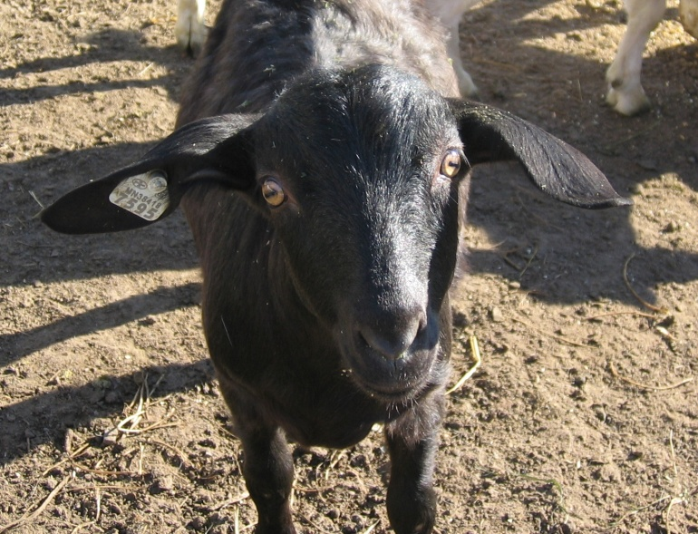
National Scrapie Eradication Program
Tags for Sheep/Goats
Examples of Official USDA Tags

Slide 59
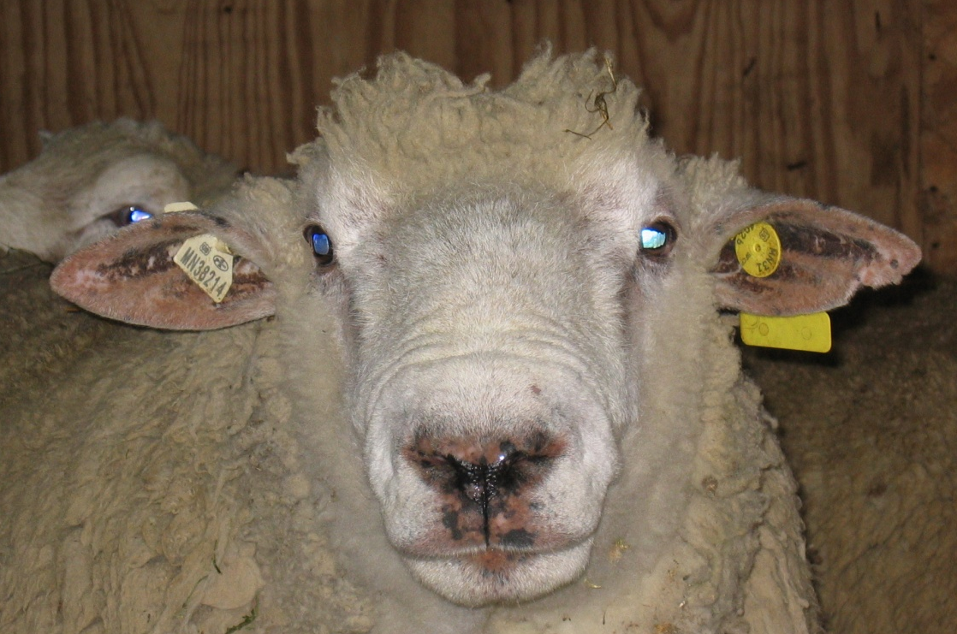

National Scrapie Eradication Program
Tags for Sheep/Goats
Examples of Official USDA Tags
Notes:
Tag 16 is not an official tag.

Slide 60
Options for Earless Sheep/Goats
Earless sheep/goats may have the eartag applied to a neck strap/collar such that the collar or eartag must be cut to remove the collar
Backtags applied near the poll may be used for earless sheep/goats moving direct to slaughter

Slide 61
Group/Lot Identification
Group/Lot ID is allowed in lieu of individual ID when accompanied by an owner/hauler statement for:
Animals in slaughter channels <18 months of age
Animals in slaughter channels ≥ 18 months of age kept in a group with animals from the same flock of birth through out the marketing process without commingling with unidentified animals from another flock.
Notes:
Owner/hauler statement that contains the information needed to officially identify the animals to their flock of origin and, when required, their flock of birth. Group or flock identification is only allowed for:
Animals in slaughter channels under 18 months of age;
Animals in slaughter channels at 18 months and older (as evidenced by the eruption of the second incisor) if the animals were kept as a group on the same premises on which they were born and have not been maintained in the same enclosure with unidentified animals from another flock at any time, including throughout the feeding, marketing, and slaughter process;
Animals in slaughter channels 18 months of age and older (as evidenced by the eruption of the second incisor) identified with official individual ID or, in the case of animals from flocks that are low-risk commercial flocks, identified using identification methods or devices approved for this purpose;
Animals moving for grazing or other management purposes between two premises both owned or leased by the flock owner and recorded in the National Scrapie Database as additional flock premises or to an instate facility where official ID will be applied and where commingling will not occur with unidentified animals born in another flock or any animal that is not part of the flock; and
Animals moving to a livestock facility approved in accordance with 9 CFR 71.20; if facility management has agreed to act as an agent for the owner to apply official identification and if the animals have been in the same flock in which they were born and have not been maintained in the same enclosure with unidentified animals born in another flock at any time. Animals may be identified with any other official identification method or device approved by the Administrator for particular circumstances.

Slide 62
Group/Lot Identification
Group/Lot ID is allowed in lieu of individual ID when accompanied by an owner/hauler statement for: (continued)
Animals moving for grazing between two premises owned or leased by flock owner and recorded in the National Scrapie Database as an additional premises of the flock
Animals moving to an approved livestock facility (market) from the flock of origin
Notes:
Owner/hauler statement that contains the information needed to officially identify the animals to their flock of origin and, when required, their flock of birth. Group or flock identification is only allowed for:
Animals in slaughter channels under 18 months of age;
Animals in slaughter channels at 18 months and older (as evidenced by the eruption of the second incisor) if the animals were kept as a group on the same premises on which they were born and have not been maintained in the same enclosure with unidentified animals from another flock at any time, including throughout the feeding, marketing, and slaughter process;
Animals in slaughter channels 18 months of age and older (as evidenced by the eruption of the second incisor) identified with official individual ID or, in the case of animals from flocks that are low-risk commercial flocks, identified using identification methods or devices approved for this purpose;
Animals moving for grazing or other management purposes between two premises both owned or leased by the flock owner and recorded in the National Scrapie Database as additional flock premises or to an instate facility where official ID will be applied and where commingling will not occur with unidentified animals born in another flock or any animal that is not part of the flock; and
Animals moving to a livestock facility approved in accordance with 9 CFR 71.20; if facility management has agreed to act as an agent for the owner to apply official identification and if the animals have been in the same flock in which they were born and have not been maintained in the same enclosure with unidentified animals born in another flock at any time. Animals may be identified with any other official identification method or device approved by the Administrator for particular circumstances.

Slide 63
Permanent Brand/Ear Notches
Allowed for low-risk commercial sheep/goats in slaughter channels when the brand or ear notch is registered with an official brand registry
Must be accompanied by:
  A brand inspection certificate and owner statement dated within 30 days, and
  A veterinarian’s statement issued within 12 months of movement
Notes:
Permanent brands and ear notches, registered with an official brand registry, are allowed for the official identification of sheep and goats allowed to move with group-lot identification by 9 CFR 79.3 as described in III.A.3.e when accompanied by:
A brand inspection certificate and an owner statement dated within 30 days, stating that the animals were born in and have resided throughout their lives in low-risk commercial flocks, and
A veterinarian’s statement issued within 12 months of the movement indicating that the flock of origin identified in the owner statement was inspected and met the requirements of a low-risk commercial flock on the date of issuance.

Slide 64
Registry Tattoos
Registration tattoos may be used to officially identify individual sheep/goats moving without a transfer of ownership or for sale if:
The association registry premises or flock tattoo prefix is linked in the National Scrapie Database to the APHIS-assigned premises identification number and flock ID number of the flock of birth or the registry’s tattoos have been approved by USDA (see list);
The tattoo is legible
AND - see next slide
Notes:
* A copy of the registration certificate, and, if not in the name of the current owner, a copy of the application for transfer of ownership in the name of the current owner where the sale occurred within 60 days, or
* A certificate of veterinary inspection that lists the flocks of origin and birth, the registry, and the registry tattoo. List of approved registries https://www.aphis.usda.gov/animal_health/animal_diseases/scrapie/downloads/approval-of-goat-registry-tattoos.pdf

Slide 65
Registry Tattoos (cont.)
The animal is accompanied by:
  A copy of the registration certificate or an unexpired temporary registration certificate, and, if not in the name of the current owner, a copy of the completed application for transfer of ownership in the name of the current owner where the sale occurred within 60 days, or
  For animals under 60 days of age a copy of a completed application for registration, or
  An interstate certificate of veterinary inspection that lists the flocks of origin and birth, the registry, and the registry tattoo.
Note: The tattoos and registration paper on the following slide are NOT from the same ewe.

Slide 66
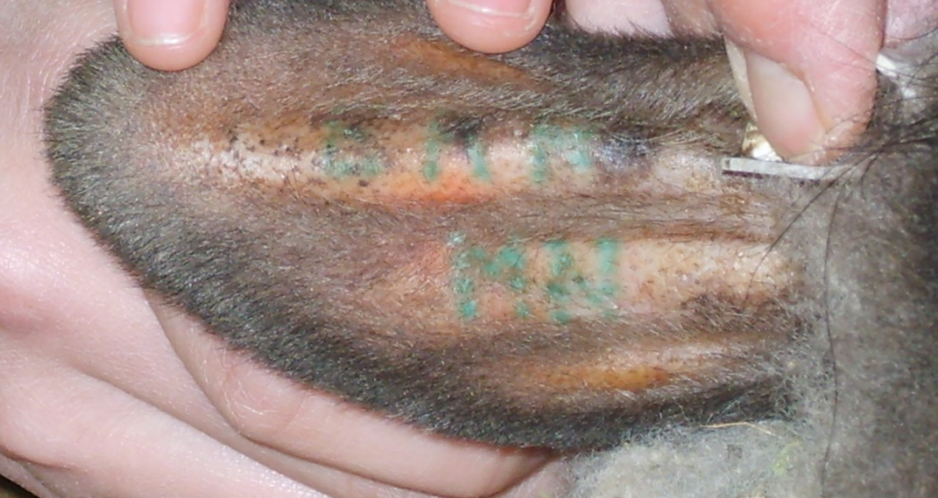
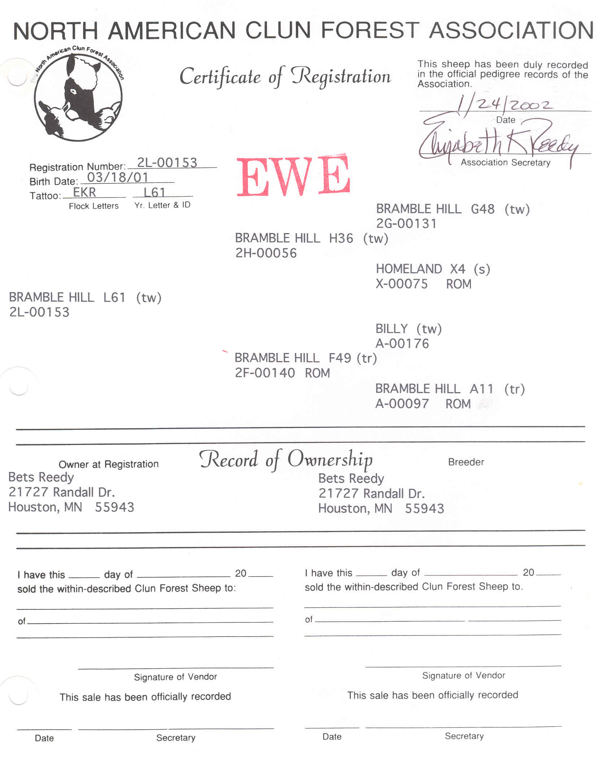
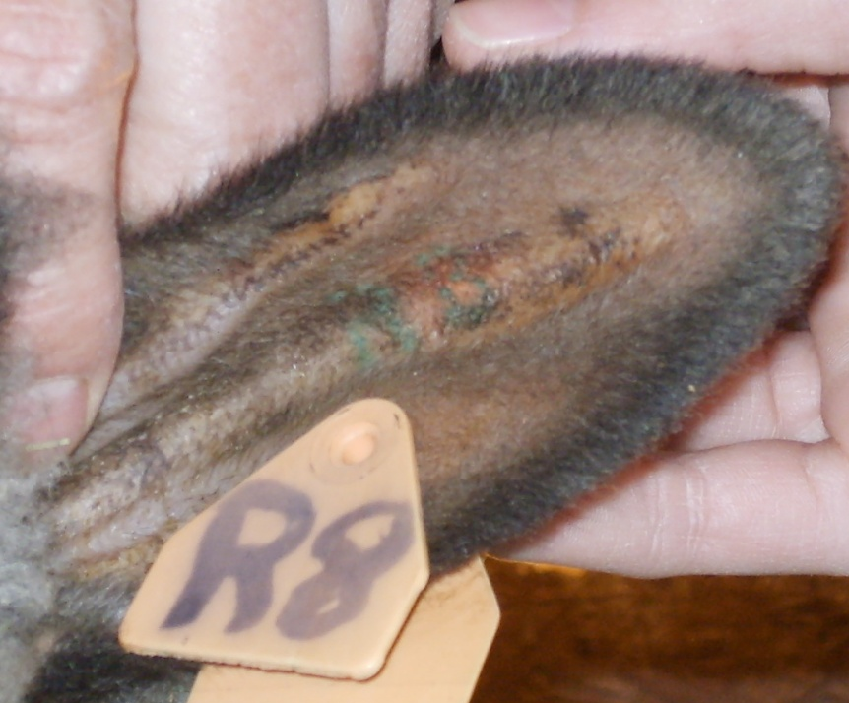
Sheep Tattoo and Registration Certificate
Notes:
This registration paper is NOT from the same animal whose tattoos/ears are shown.
It is from a ewe that is no longer alive.

Slide 67
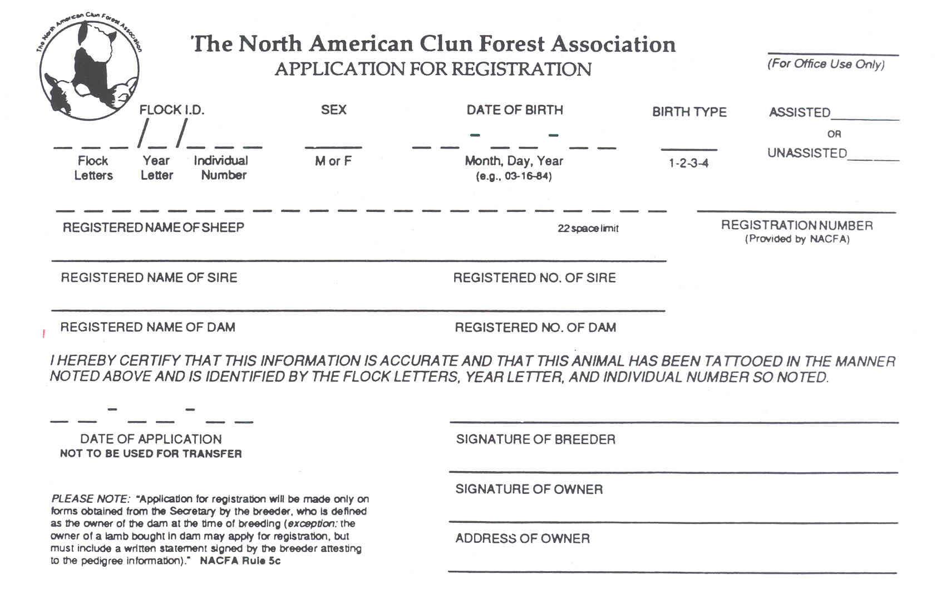
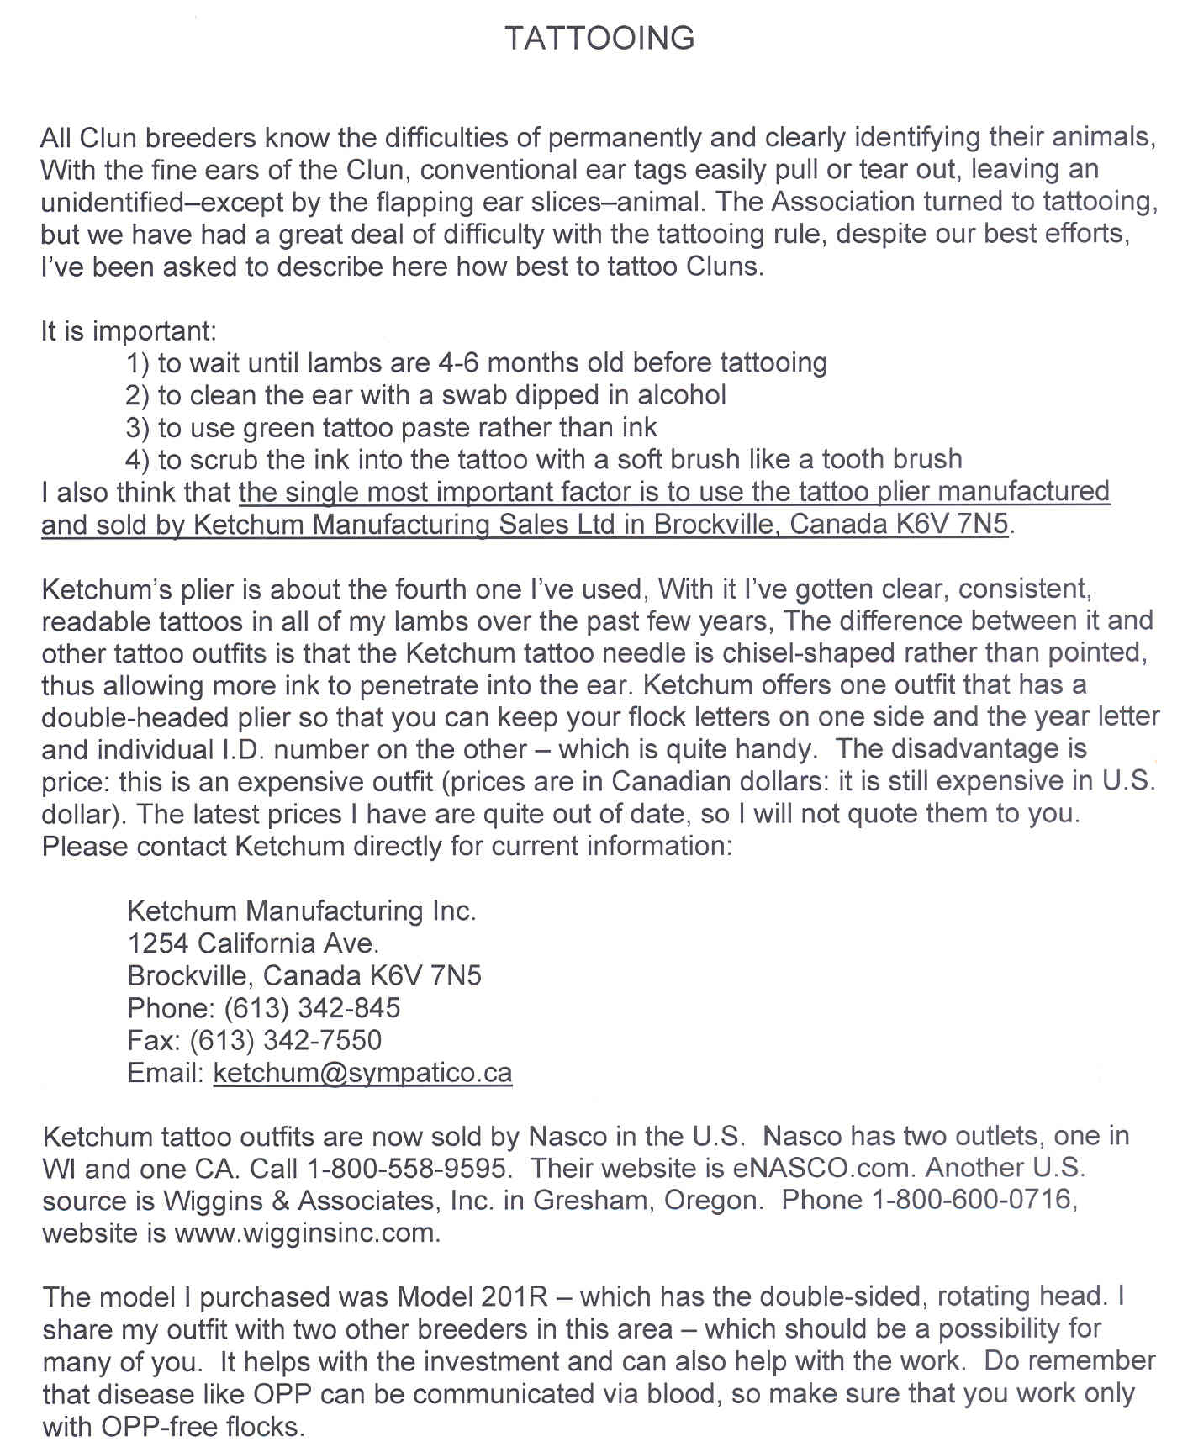
Example of Registry Information (application and tattooing instructions from
N.A. Clun Forest Association)

Slide 68
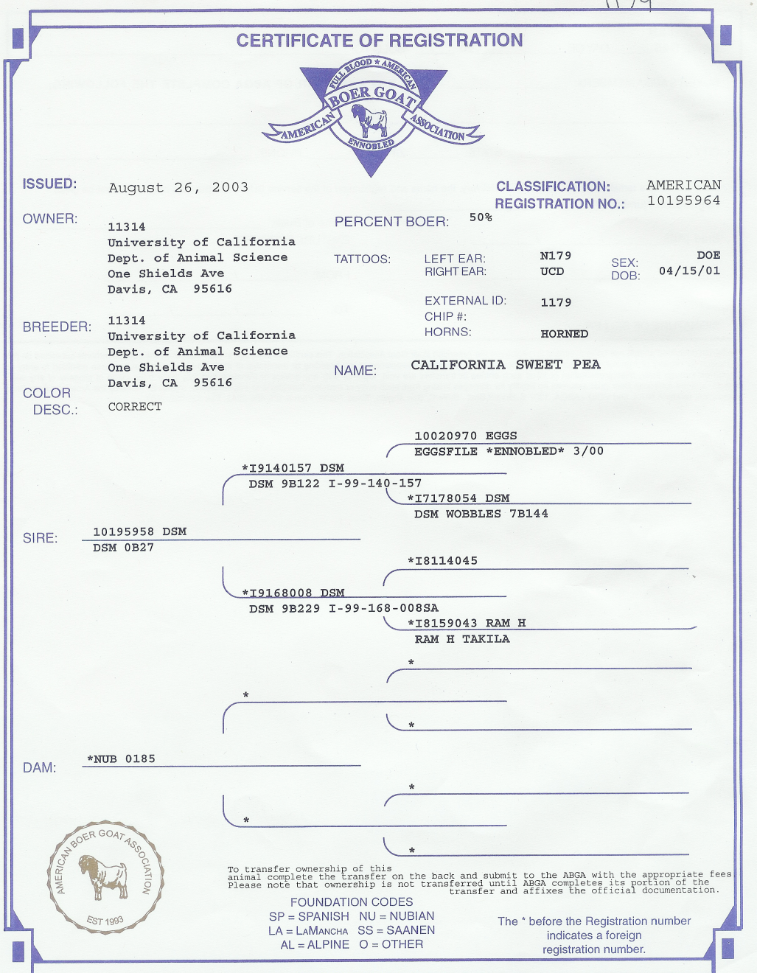
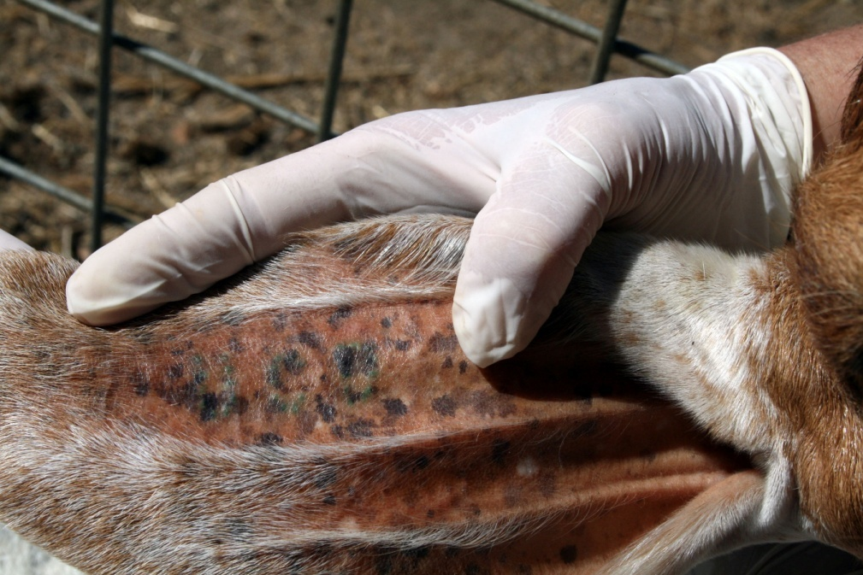
Goat Tattoo and
Registration Certificate
U C D
Notes:
This registration paper is NOT from the same animal whose ear tattoo is shown.
It is from a doe that is no longer alive.

Slide 69
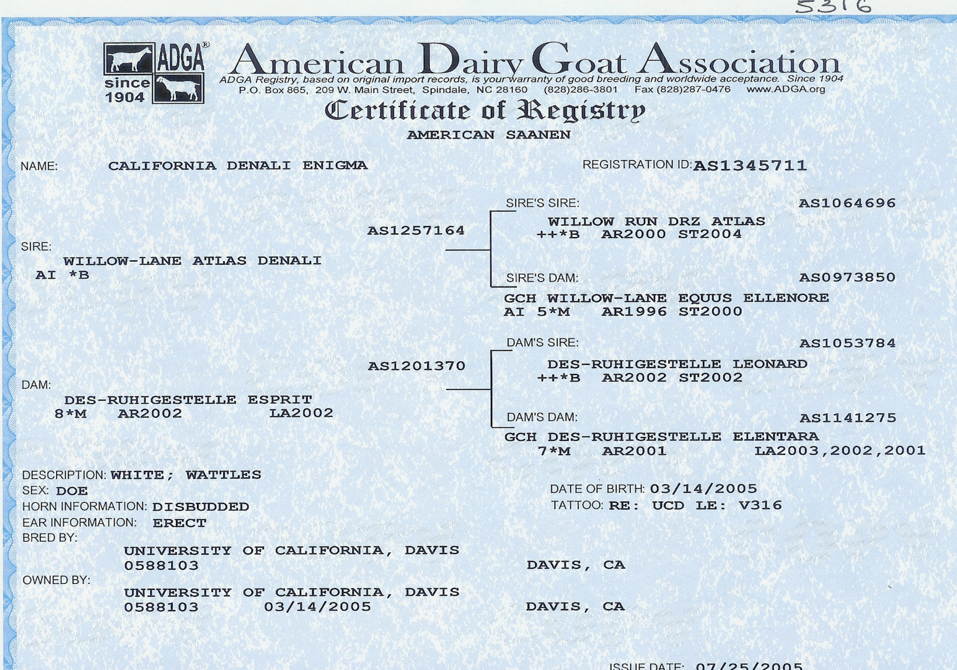
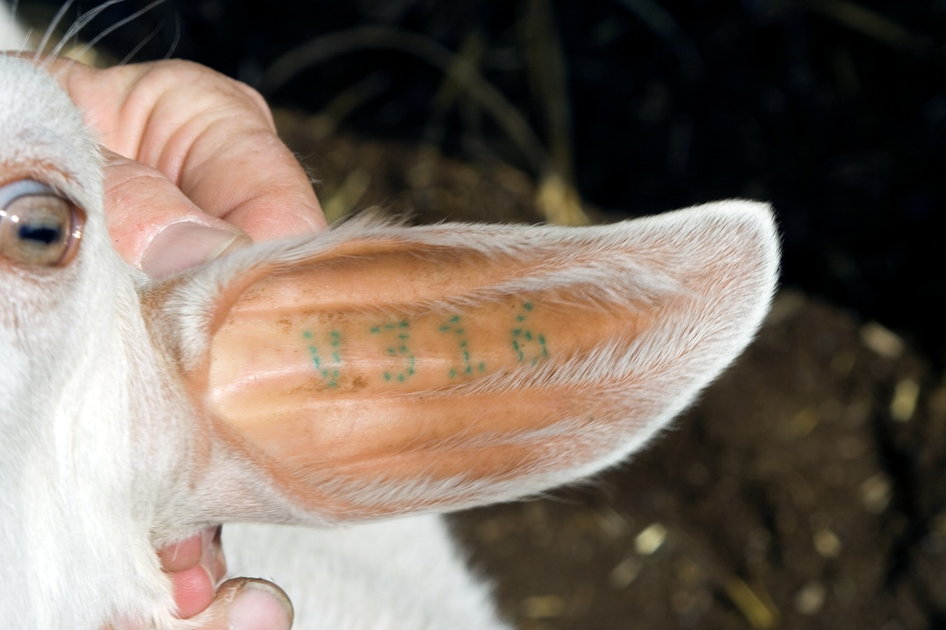
Example of Registry Information
Notes:
Example of Goat Registration

Slide 70
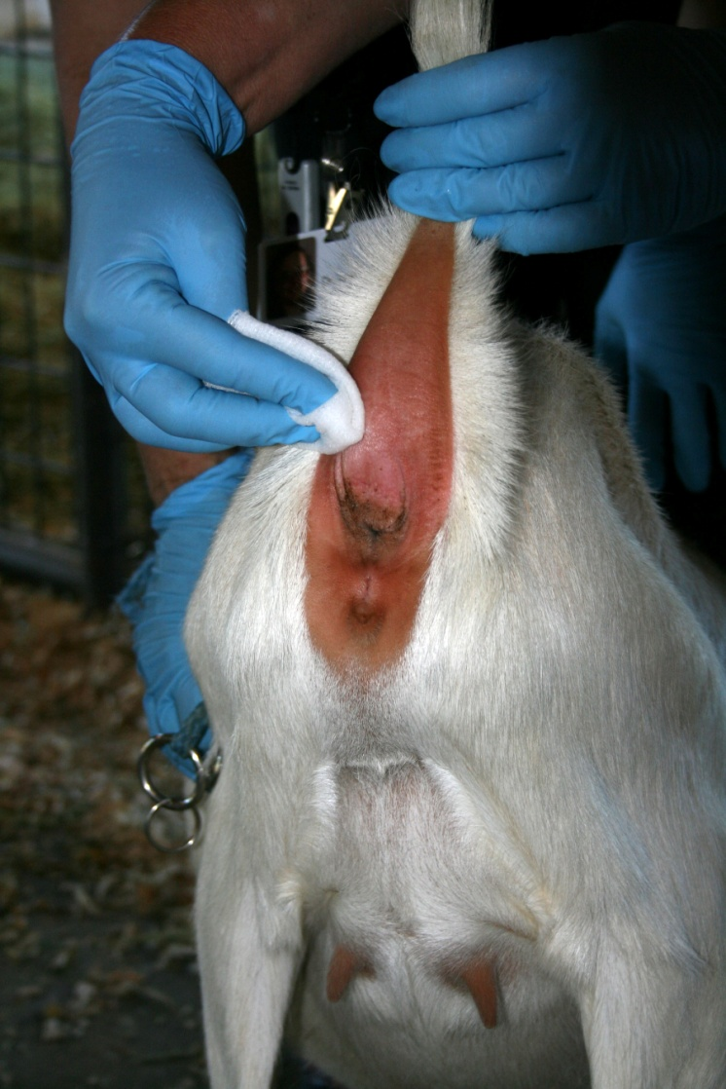
National Scrapie Eradication Program
How to Tattoo a LaMancha - Tail Web
Wait until kids are over 3 months old
Test tattoo on paper first to ensure legibility
Clean area where tattoo will be applied
Apply green* paste ink with toothbrush
Hold kid firmly
Press tattoo pliers firmly
Brush ink/use toothbrush to apply ink
Notes:
Green paste ink seems to work the best for tattooing - in dark or light areas.

Slide 71
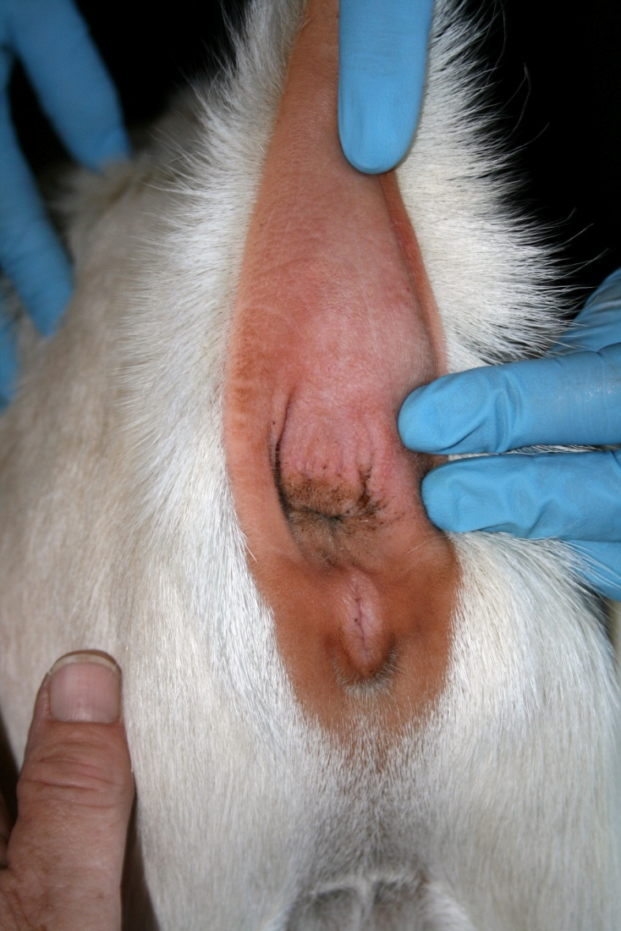
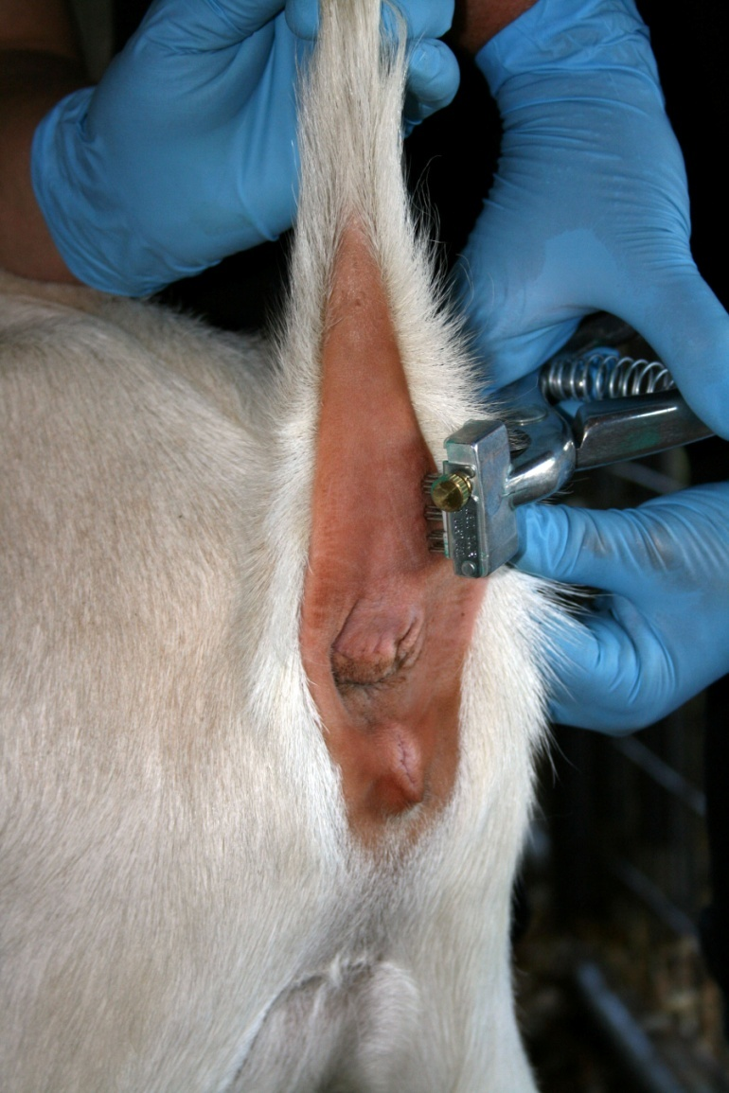
National Scrapie Eradication Program
LaMancha Tail Web Tattoo
Site where tattoo should be applied.
Applying the tattoo.

Slide 72
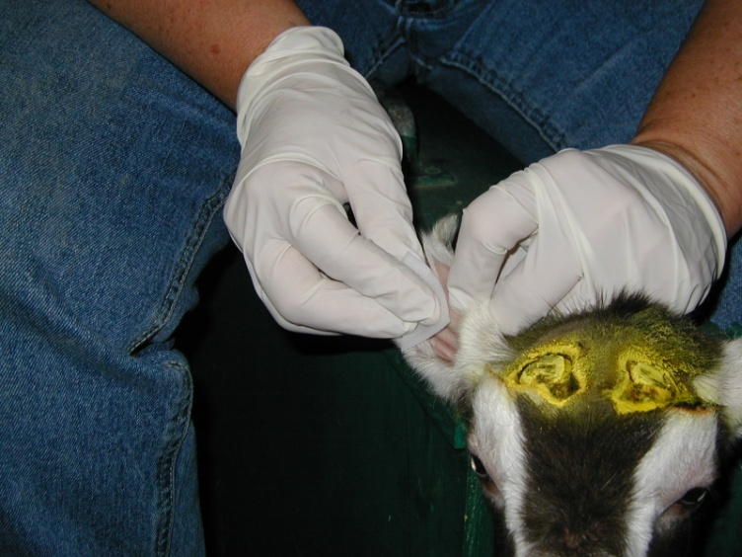
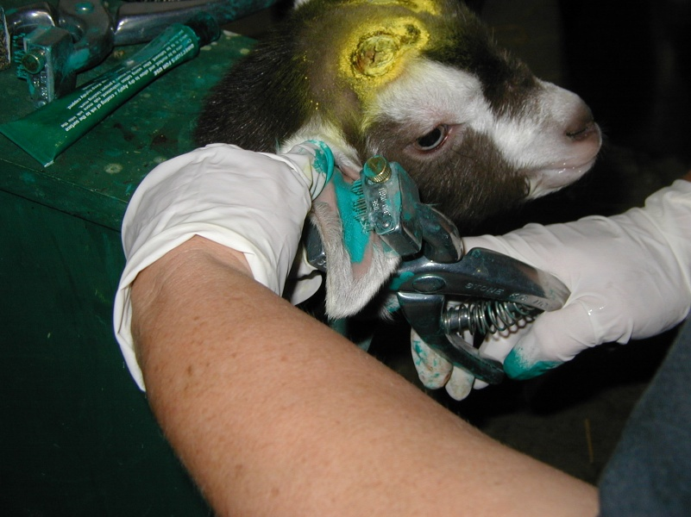
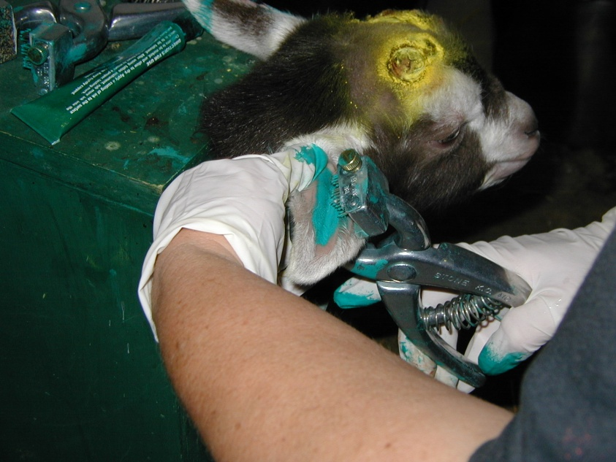
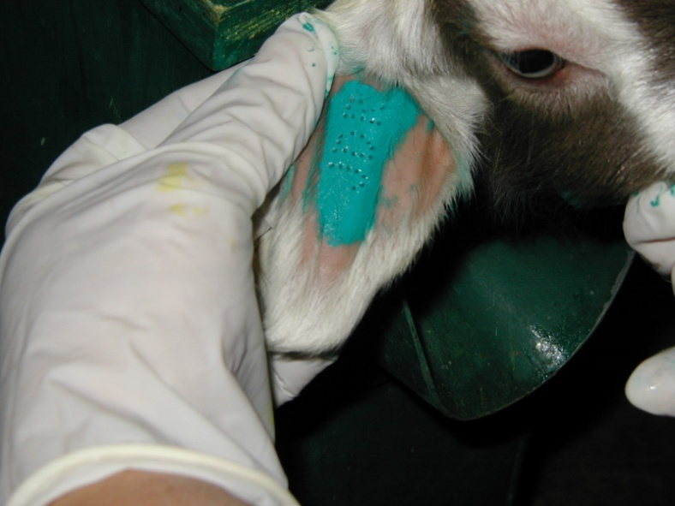
National Scrapie Eradication Program
Ear Tattooing in Goat Kids
Notes:
Kid is shown in a disbudding box. [NOTE: The use of all nitrofurazone (yellow spray on disbudded kid) has been banned by the FDA in food animals.]
Wait to do until kids are over 3 months old,
Test tattoo on paper first to ensure legibility,
Clean area where tattoo will be applied,
Apply green* paste ink with toothbrush,
Hold kid firmly,
Press tattoo pliers firmly,
Brush ink/use toothbrush to rub in ink.

Slide 73
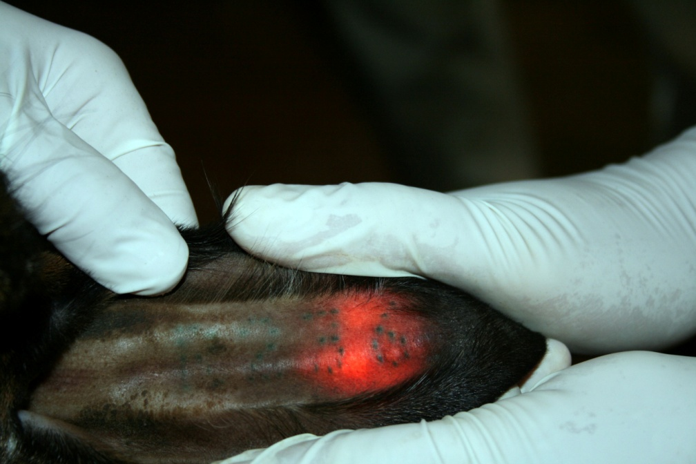
National Scrapie Eradication Program
Ear Tattoos for Goats
Reading a tattoo
with a flashlight providing backlight illumination
Notes:
Tattoos can best be read in dark colored ears when a flashlight is shined from the back of the ear.

Slide 74
Goat Identification Problems
Use of registration tattoos is a privilege.
Owners must assure legibility of tattoos.
Owners must assist with tattoo reading process.
  Provide light to assist with reading.
Owners must keep accurate acquisition and disposition records.
Breeding animals including culls must be traceable to herd of origin.

Slide 75
Flock ID Tattoos
      A combination of the flock ID number assigned to the flock of birth or origin in the Scrapie National Database and an individual number unique within the flock, may be used to officially identify sheep/goats if:
      The tattoo is legible
      The animals are not in slaughter channels or moving through livestock markets or buying stations
      The animals are accompanied by an owner/hauler statement or ICVI
      The numbers are placed in different ears or in the same ear with the flock ID number above the individual number
Notes:
In the case of animals with absent or injured ears, the tail fold.

Slide 76
Electronic Implantable Identification (EID) for Sheep/Goats
      General Requirements:
      The implant must be placed between the skin and the cartilage of the backside of the ear near where the ear joins the head or between the skin and the bone of the tail near the base of the tail;
      The animal must be tattooed with a legible “E” if the implant is at the base of the ear, or “ET” if the implant is in the tail fold;
      The tattoo must be at least 0.3 inches high in the ear or, in the case of earless animals, the tail fold;

Slide 77
Electronic Implantable Identification (EID) for Sheep/Goats
      General Requirements (cont.):
      The animal must not in slaughter channels or moving through a concentration point where a transfer of ownership will occur, such as a livestock market or buying station, excluding sales of registered animals where an application for transfer of registration is completed and accompanies the animal when it leaves the sale or premises of origin;
      The animal is accompanied by an implant reader that can read the implant in the animal and is made available for use by APHIS or State authorities to verify the implant number in the animal;

Slide 78
Electronic Implantable Identification (EID) for Sheep/Goats
      General Requirements (cont.):
      The implant is used in accordance with other applicable laws and regulations; and
      The implant complies with ISO 11784 and ISO 11785, or has been approved as a new device type as described above, and the device was approved under 9 CFR 79.2(k). The implant number must be an Animal Identification Number (840) issued to the flock of origin in the AIMS module of the National Scrapie Database or applied to the animal before March 11, 2015.

Slide 79
Electronic Implantable Identification (EID) for Registered Sheep/Goats
      Additional requirements for registered sheep/goats:
      The electronic implant number has been recorded in the book of record of a sheep or goat registry association and on the registration certificate; and
      The animal is accompanied by a copy of the registration certificate . and, if not in the name of the current owner, a copy of the completed application for transfer of ownership in the name of the current owner where the sale occurred within 60 days, or for animals under 60 days of age a copy of a completed application for registration;

Slide 80
Electronic Implantable Identification (EID) for Sheep/Goats that are NOT Registered
      Additional requirements for nonregistered sheep/goats:
      Sheep/goats must be from flocks listed in the National Scrapie Database;
      The movement is either for exhibition purposes or other movement without change in ownership, or for change in ownership that is directly to a flock listed in the National Scrapie Database where the new owner has a reader that can read the implant in the animal;

Slide 81
Electronic Implantable Identification (EID) for Sheep/Goats that are NOT Registered
      Additional requirements for nonregistered sheep/goats (cont.):
      The animal is legibly tattooed with the flock identification number in the ear, or, in the case of earless animals, the tail fold or in animals where the tail fold is too small the flank;
      The animal is accompanied by a certificate of veterinary inspection or, if a certificate of veterinary inspection is not otherwise required, an owner/hauler statement that lists the flock of origin, the flock ID number, the electronic implant number, and, if required by 9 CFR, the flock of birth.

Slide 82
Proper EID Placement
      Between the skin and the cartilage of the backside of the ear near where the ear joins the head or between the skin and the bone of the tail near the base of the tail
      Animal is tattooed with a legible “E” if the implant is at the base of the ear, or “ET” if the implant is in the tail fold
      Tattoo is at least 0.3 inches high in the ear or, in the case of earless animals, the tail fold

Slide 83
Record Keeping
Records are an important tool in eradicating scrapie. They should be:
  Kept for 5 years
  Easily retrieved
Notes:
If the animal leaves or arrives at the farm due to purchase, sale, or show; that Scrapie ID tagging record must be kept for 5 years from that point of time.
Needs to be easily retrieved so in the process of an investigation the process is efficient and the historical records benefit you.
The original tag number or all possible flocks of origin and the new official ID number must be listed in the record of official identification applied when an animal loses an eartag while in interstate commerce.

Slide 84
Records required of persons who purchase, acquire, sell, or dispose of animals
Number of animals purchased or sold (or transferred without sale);
Date of purchase, sale, or other transfer;
Name and address of the person from whom animals were purchased or otherwise acquired or to whom they were sold or otherwise transferred;

Slide 85
Records required of persons who purchase, acquire, sell, or dispose of animals (cont.)
The species, breed, and class of animal.
  If breed is unknown, for sheep the face color and for goats the type (milk, fiber, or meat) must be recorded instead;
A copy of the brand inspection certificate for animals officially identified with brands or ear notches;
A copy of any certificate or owner/hauler statement required for movement of the animals purchased, sold, or otherwise transferred; and

Slide 86
Records required of persons who purchase, acquire, sell, or dispose of animals (cont.)
If the flock of origin or the receiving flock is under a flock plan or post-exposure management and monitoring plan, any additional records required by the plan.
You are encouraged but not required to record the official ID numbers on the animals

Slide 87
Records required of persons who apply official identification to animals
Flock identification number of flock of origin, name and address of person who currently owns the animals, and name and address of owner of the flock of origin if different;
Name and address of owner of the flock of birth, if known, for animals born after January 1, 2002, in another flock and not already identified to flock of birth;

Slide 88
Records required of persons who apply official identification to animals (cont.)
Date the animals were officially identified;
Number of sheep and the number of goats identified;
Breed and class of the animals
  If breed is unknown, for sheep the face color and for goats the type (milk, fiber, or meat) must be recorded instead;

Slide 89
Records required of persons who apply official identification to animals (cont.)
Official identification numbers applied to animals by species or GIN applied in the case of a group lot (for sequential numbers they may be listed as “low number - high number”);
Whether animals were identified with “Slaughter Only” or “Meat” identification devices; and
Any group/lot number with which animal was previously identified.

Slide 90
Examples of acceptable records (slides 91 – 93, 95)
Records do not have to be exactly like these examples
Records just need to contain required information
You may find it more convenient combine these records into one record, particularly if you keep individual animal records

Slide 91
Example:
Purchased/Acquired Additions Record
Owner Name________________________________________
Address __________________________________________
Number of animals acquired | Date acquired | Species | Breed if know, (If not known Sheep face color or Goat type (fiber, meat or dairy)) | Name and address of person or market from whom the sheep/or goat was acquired | Class:
Notes:
Retain this record and copies of any certificate, brand certificate or owner/hauler statement required for movement of the animals purchased or otherwise transferred for 5 years. If you received an owner hauler statement or ICVI with the required information you can retain that rather than creating a new record. Recording individual ID numbers is desirable but not required.
Classes of animals: Feeder lambs/kids (FL or FK), Slaughter lambs/kids (SL or SK), Slaughter ewes/rams (SE or SR), Slaughter does/bucks (SD or SB), Replacement ram lambs or buck kids (RR or RB), Yearling replacement rams/bucks (YR or YB), Mature breeding rams or bucks (BE or BD), Replacement ewe lambs or doe kids (RL or RD), Yearling replacement ewes/does (YE or YD), Mature breeding ewes or does (BE or BD), Other – explain

Slide 92
Example:
Sales and Dispositions Record
Owner Name________________________________________
Address __________________________________________
Number of animals sold or disposed | Date sold or disposed | Species | Breed if know, (If not known Sheep face color or Goat type (fiber, meat or dairy)) | Name and address of person or market to whom the sheep/or goat was sold disposed | Class:
Notes:
Retain this record and copies of any certificate, brand certificate or owner/hauler statement required for movement of the animals sold or otherwise transferred for 5 years. Note: a properly completed owner hauler statement will include this information and may be retained in place of making an additional record.
Recording individual ID numbers is desirable but not required.
Classes of animals: Feeder lambs/kids (FL or FK), Slaughter lambs/kids (SL or SK), Slaughter ewes/rams (SE or SR), Slaughter does/bucks (SD or SB), Replacement ram lambs or buck kids (RR or RB), Yearling replacement rams/bucks (YR or YB), Mature breeding rams or bucks (BE or BD), Replacement ewe lambs or doe kids (RL or RD), Yearling replacement ewes/does (YE or YD), Mature breeding ewes or does (BE or BD), Other – explain

Slide 93
Example:
Record of Sheep or Goats Officially Identified
Owner and Facility Name________________________________________
Address and Phone Number ____________________________________
Number of animals identified | Date identified | Species | Breed if know, (If not known Sheep face color or Goat type (fiber, meat or dairy)) | All group lot identification numbers with which the animal was previously identified | Group lot identification number assigned, if applicable | Tag sequences applied and tag type (slaughter or non-slaughter), if applicable | Name, address and flock ID of the flock of origin and if known flock of birth | Name and address of current owner if different than the flock of origin | Class:
Notes:
Retain this record and copies of any certificate, brand certificate or owner/hauler statement required to identify the animals.
Classes of animals: Feeder lambs/kids (FL or FK), Slaughter lambs/kids (SL or SK), Slaughter ewes/rams (SE or SR), Slaughter does/bucks (SD or SB), Replacement ram lambs or buck kids (RR or RB), Yearling replacement rams/bucks (YR or YB), Mature breeding rams or bucks (BE or BD), Replacement ewe lambs or doe kids (RL or RD), Yearling replacement ewes/does (YE or YD), Mature breeding ewes or does (BE or BD), Other – explain

Slide 94
Record Keeping Quick Tip:
If an official tag is lost, replace it ASAP with another official tag and record that number, and if known:
  Previous tag number, or
  Tag(s) numbers it could have been, or
  Name and address of the flock of origin.
Notes:
If tag is lost replace it ASAP with another tag and record that number and the previous tag number if known.

Slide 95
Example:
Scrapie Tag Replacement Record
Owner or Manager Name ____________________________
Phone Number _____________________________________
Facility or Flock Address _____________________________
Date official identification removed or lost and replaced | Reason for replacement | Official ID number replaced (to the extent possible) | Type of Official ID replaced (e.g., metal, plastic, RFID eartag); | Official ID number applied | Type of Official ID applied (e.g., metal, plastic, RFID eartag);
Notes:
This record must be retained for 5 years. If the replaced official ID number isn’t recorded in full you must also record the tag application data required in 79.2 (g). Official tags may only be removed if medically necessary.

Slide 96
Required Record Keeping Summary
A record must be made when official ID is applied to the animal or an animal is acquired or disposed of.
The record must be kept for five years after the animal dies or is no longer owned by you.

Slide 97
Confused Regarding How Scrapie Program ID and the Traceability Rule Relate?

Slide 98
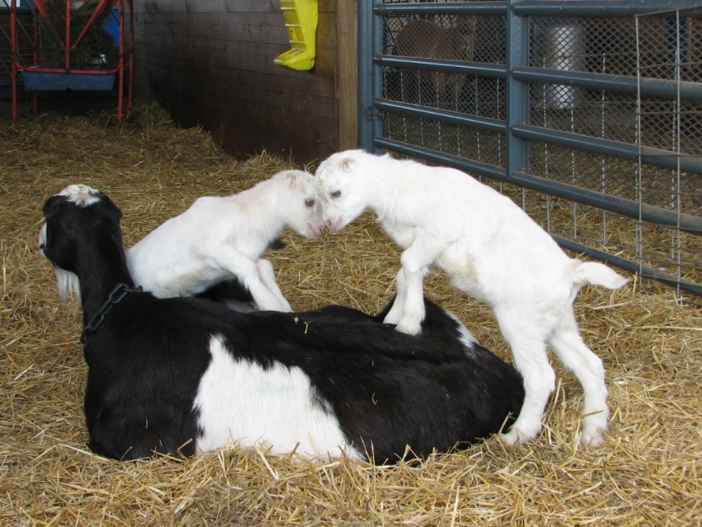
Scrapie Program ID and the Traceability Rule
The traceability rule incorporates the scrapie program ID regulations in 9 CFR part 79 by reference; it does not establish new requirements for sheep or goats.
Notes:
Complying with the identification requirements of the National Scrapie Eradication Program is required by a regulation that has been in place since September 2001.
The traceability proposed rule incorporates the scrapie program ID regulations by reference, it would not establish new requirements for sheep or goats

Slide 99
Questions?
If you have additional questions,
please call your local VS Field Office, their phone numbers can be found on the following website:
https://www.aphis.usda.gov/animal_health/downloads/sprs_contact/field_office_contact_info.pdf
or email the
National Scrapie Eradication Program
scrapie@aphis.usda.gov

Slide 100
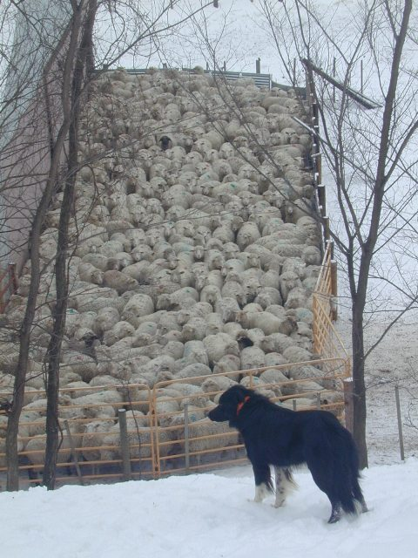

Slide 101
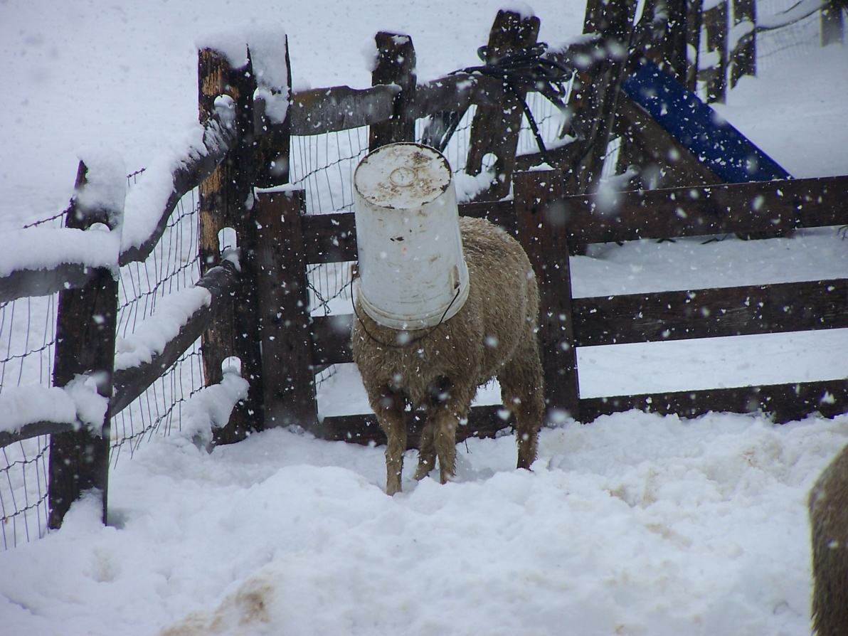
Information current as of 3/25/19
This presentation was created for the US Sheep and Goat Industries by staff at the University of Minnesota, College of Veterinary Medicine and NIAA Staff with support from the USDA NSEP.
Copies of this presentation are available from NIAA.
Notes:
This presentation was created for the US Sheep Industry by staff at the University of Minnesota, College of Veterinary Medicine and NIAA Staff with support from the USDA NSEP.

