Slide 1

VSPS
Veterinary Services Process Streamlining
Animal Import Module (AIM)
On-Line Process for
Land Border Port Importers/Brokers

Slide 2
Obtain a Level 1 e-Authentication Account
You will need an e-Auth user ID and password to login to VSPS.
  If you don’t have your e-Auth user ID and password yet refer to the Welcome to VSPS for Importers and Brokers document for detailed instructions and print screens.
1. Go to the eAuthentication website: http://www.eauth.usda.gov
Click on Create an Account.
Click on Register for a Level 1 Account.
Create your brief customer profile.
Respond to the confirmation e-mail within 7 days to activate your account.

Slide 3
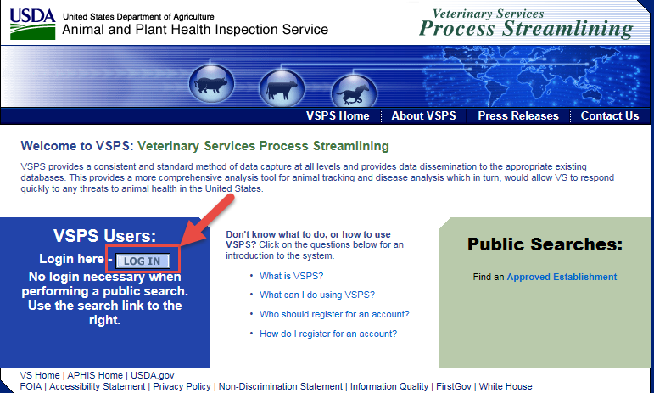
Log into VSPS with e-Authentication Account
Go to VSPS: https://vsapps.aphis.usda.gov/vsps/
Click Log In
  The first time you log into VSPS you will need to complete your profile and request the Importer role. Role approval can take up to 24 hours.

Slide 4
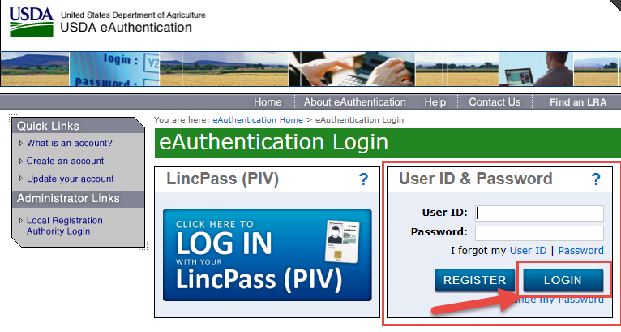
Log into VSPS with e-Authentication Account
Enter your e-Authentication user ID and password
Click Login

Slide 5
Create New Importation
How to create a new importation request

Slide 6
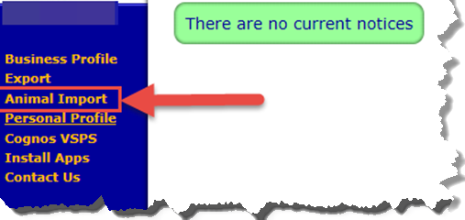
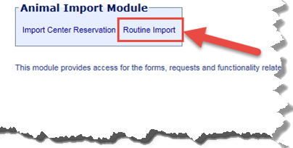
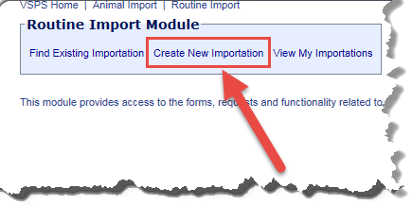
1. Click Animal Import
2. Click Routine Import
3. Click Create New Importation

Slide 7
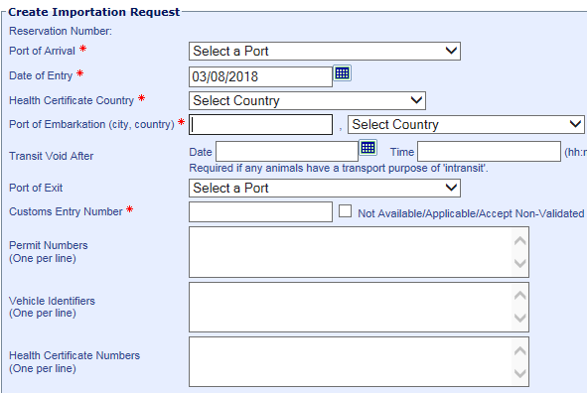
Port of Arrival* – The U.S. port at which the animal(s) is expected to enter the country.
Date of Entry* – Date the animal(s) enters the U.S.
Health Certificate Country* – Country that issued the Health Certificate for the animal(s).
Port of Embarkation* (City and State/Province, Country) – Type the City and State/Province, select the Country from the drop down list.
Transit Void After – Not needed for Feeder Cattle
Port of Exit – Not needed for Feeder Cattle
Customs Entry Number* – Enter the customs entry number. If not available check the ‘not available’ box.
Permit Numbers – Enter if known. One number per line.
Create Importation Request
Enter data into appropriate fields for the Importation Request.
Only items marked with a red asterisk (*) are required.
Vehicle Identifiers – Enter identification numbers for vehicles associated with an importation if known or applicable. One number per line.
Health Certificate Numbers – Health certificate numbers associated with the animals involved with an importation. One number per line.

Slide 8
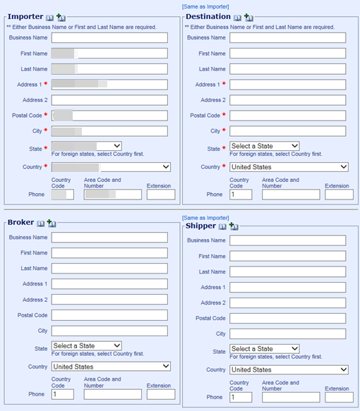
Address Book Feature
Search for a contact by clicking
Add contact
Enter information, click to save
Note: Required fields have a red asterisk (*)
Importer: Will pre-fill from your profile in VSPS. Update as needed.
**Click on the ‘Same as Importer’ link above the Destination and Shipper if they are the same as the Importer for quicker data entry.

Slide 9
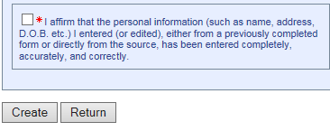
People or Businesses
Enter information for Importer, Destination, Broker, Shipper and Consignee
Note: Required fields have a red asterisk (*)
Business Name* and/or First Name/Last Name*
** Either Business Name or First Name/Last Name are required, not both.
Address 1* – Street address
Address 2 – Additional address information (Apt #, Bldg #, etc.)
Country * City/State*Note: select the country first.
Postal Code* – Postal/zip code for the address.
Note: When you enter a postal code and click the tab button on the keyboard the system will search for the City and State associated and automatically enter it if found.
Phone – Phone number for the contact.
Note: VSPS defaults to the U.S. country code of (1); the following number must contain 10 digits. If you are entering a non-U.S. number, manually enter the country code.
* Read and check the ‘I affirm’ box and click Create to create the Importation Request.

Slide 10
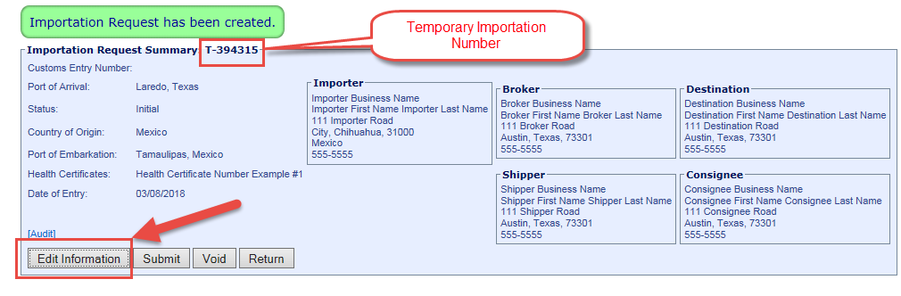
Create the Importation Request
Importation Request created (T).
Use buttons: Edit to make corrections, Void to delete.
Once the Port views the Importation Request it can no longer be edited.

Slide 11
Add Animal Information
Add the animals to the importation request

Slide 12
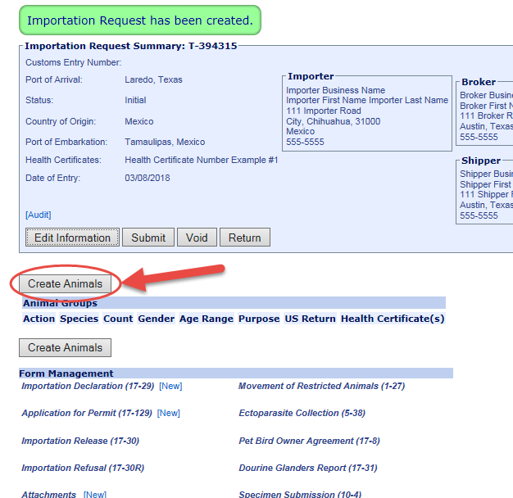
Add Animals to Importation Request
Click Create Animals button

Slide 13
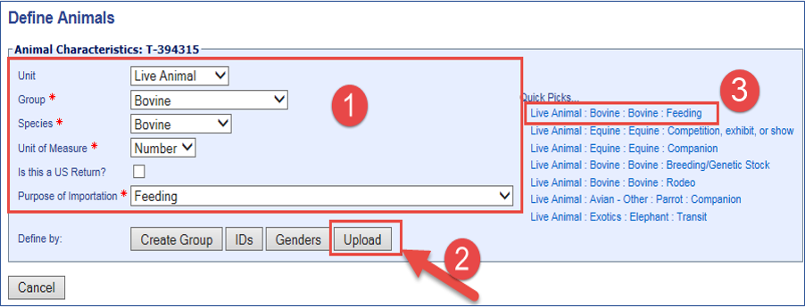
Define Animals
Select the Animal Characteristics (Bovine Feeder Cattle shown).
  Unit: Live Animal
  Group: Bovine
  Species: Bovine
  Unit of Measure: Number
  Purpose of Importation: Feeding
Click on Upload.
Quick Picks are created by the application based on previous entries. Selecting a Quick Pick will automatically fill the required fields for Animal Characteristics.

Slide 14
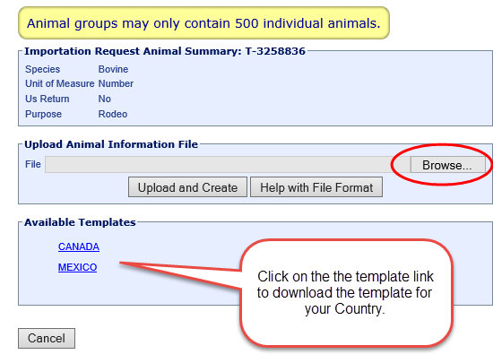
Upload Animal Information File
Click on Browse…

Slide 15
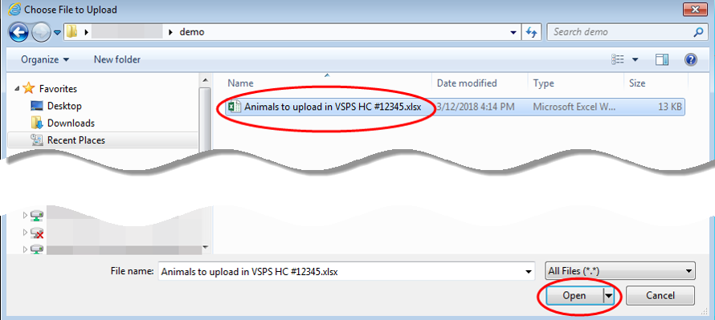
Upload Animal Information File
Navigate to the appropriate Excel file template that contains the animal details.
Double-click on the file, or click on the file name and click Open.
**Note: The excel file must be saved as the .xlsx format.

Slide 16
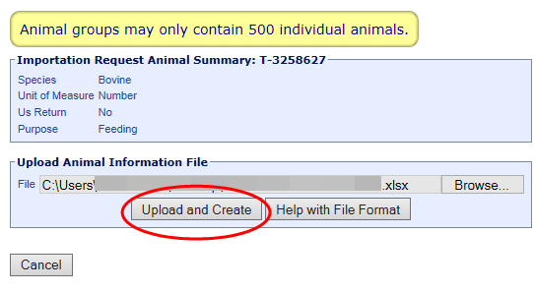
Upload Animal Information File
Click Upload and Create to upload the selected file.
Click Cancel to go back to the previous screen and not upload a file.

Slide 17
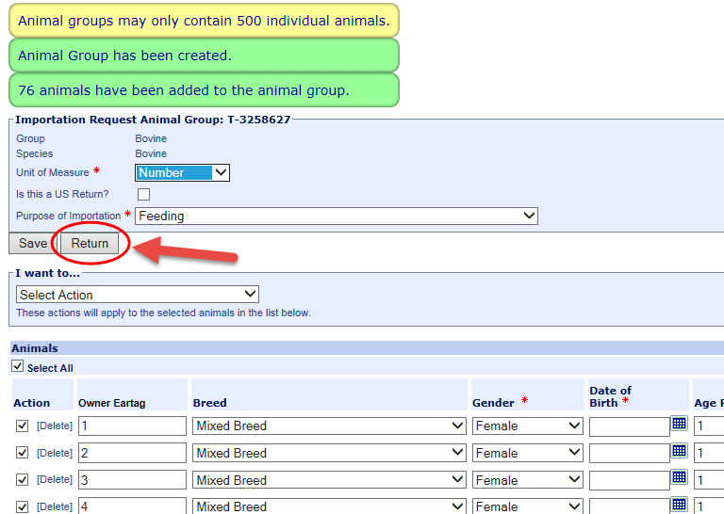
Animals Added to Importation Request
The animals in the spreadsheet have been added to the Importation Request
Verify the information is correct
Click Return

Slide 18
Attaching documents
Attach the spreadsheet template of animals, health certificate(s) and/or other documents.

Slide 19
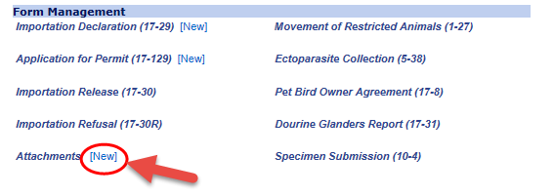
Adding Attachments
Go to the Form Management section of the Importation Request, click on [New] next to Attachments

Slide 20


Click the Browse… button to find and select the appropriate file to attach to the Importation Request.
The path & file name display in the field after you select a file.
Name to Use – Type the name of the file, as you want it to appear in VSPS.
If you leave the area blank, the name will be the name of the file.
Click Create to create the attachment.
Click Return to return to the previous screen, without creating the attachment.
In the Form Management section, you now see:
[View] Click, to view the attachment.
[Delete] Click, to delete the attachment.
You can attach multiple attachments.
You can edit the Importation Request summary, animal data, and forms while the IR is in Initial or Submitted to Port status. You can no longer edit it after the port views it.

Slide 21
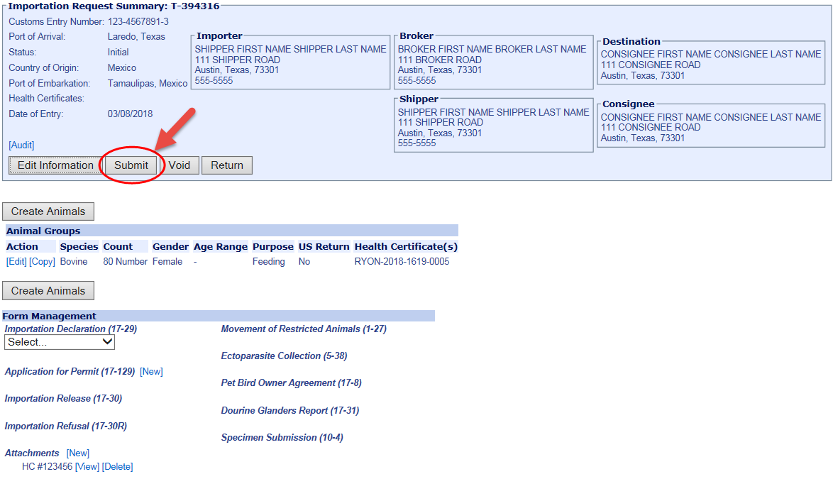
Review all information to make sure it’s accurate.
Click Submit to submit the Importation Request to the port.
Note: You will have the option to Edit the Importation Request up until the port views the importation request.
When the port views the Importation Request the status will be ‘Under Review’.

Slide 22
Find Existing Importations
Use to narrow search results for the importations you have created.
View, edit, copy or void created importation requests.
Changes can only be made if the status is ‘Initial’ or ‘Submitted to Port’.

Slide 23
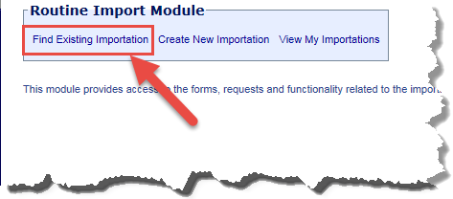
1. Click Animal Import
2. Click Routine Import
3. Click Find Existing Importation

Slide 24
Importation Request Search
Enter one or more of the following search values:
Port of Arrival - United States port that the animals (identified on the IR) will enter through.
Search by Name fields – (Importer, Broker, Destination, Shipper, Consignee) – Enter a first or last name separated by a single space.
You may also enter a partial name and insert an asterisk (*) in place of missing letters.
Date of Entry – Starting date of a date range in which the animals reached the port of arrival.
Through – Ending date of a date range in which the animals reached the port of arrival.
Document Number – Number auto-assigned by VSPS to the request. Starts with a “T” if not submitted to port.
Status – Current status of the Importation Request:
Still able to edit the IR
Initial – The importer/broker has created an Importation Request (IR), but has not submitted it to a port.
Submitted to Port – The importer/broker has submitted the IR to a port.
Can no longer edit the IR (view access only)
Under Review – The port is reviewing the IR.
Approved – The port has approved the IR and is processing it.
Received – The port has received the IR and is processing it.
Closed – The port has completed the IR.
Voided – The IR is nullified.
Species – Species of the animals being imported.
Unit Type – Type of animal import.
Animal ID – Enter an identification number for the animals being imported. In the Select ID Type field, select the type of ID.
Attached Document Type – Type of document that is attached to the IR you area searching for.
Purpose – Purpose of the importation
Destination State – State (in the United States) to which the animals are being delivered.
**If you click search without entering any search values the results will show all importation requests entered.

Slide 25
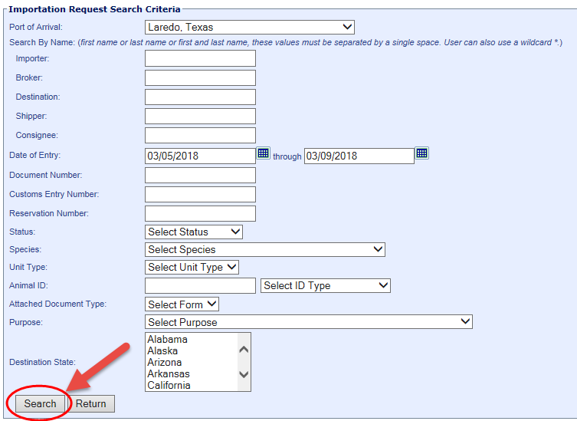
Enter search criteria and click Search:

Slide 26
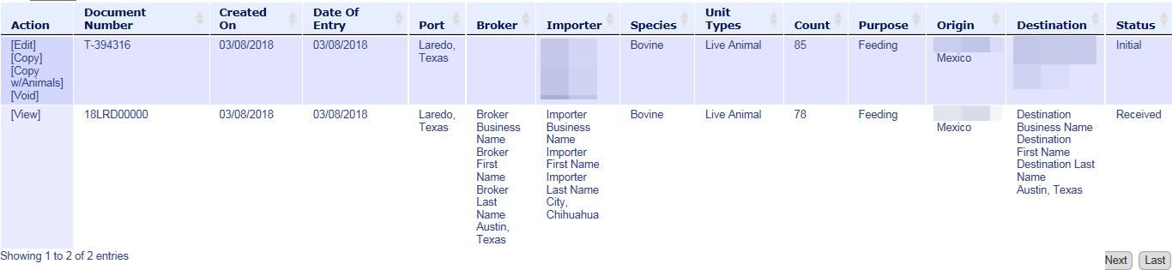

Example of search results:
The following functions, based on IR status, are available for the IRs in the search results list:
IR Status = Initial or Submitted to Port
Edit | Click to open and modify the Importation Request (IR).
Copy | Click to copy IR information (no animal data) to a new IR.
Copy w/Animals | Click to copy IR information (with animal data) to a new IR.
Void | Click to cancel (void) the IR.
IR Status = Under Review, Approved, Received, Closed
View | Click to open the IR in read-only mode

Slide 27
Declined Importation Request
These instructions show how to edit information on your Importation Request.
You can edit the Importation Request as long as the status is: Initial or Submitted to Port.
If after submitting an Importation Request to a port, the port finds something on the Importation Request that needs to be changed, they will Decline it and enter comments for what needs to be changed.
An email will be sent to the person that created the Importation Request notifying of the changes required.
Edit the Importation Request, make the changes, and Submit again.

Slide 28
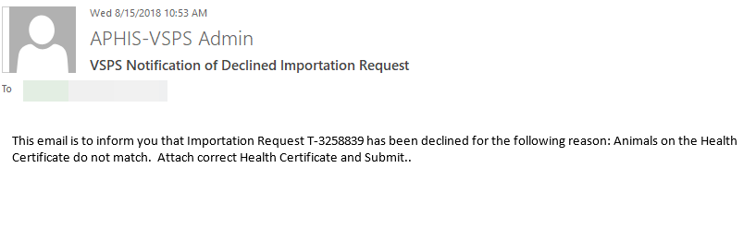
When an Importation Request is Declined by the port, the person that entered the Importation Request will receive an email.
The email will give the Importation Request Document Number and will give the reason for the decline.
The email will look something like the below example:

Slide 29
The status of the Importation Request will switch back to ‘Initial’ so the person that created the Importation Request can make the needed changes.
Find the Importation Request Document Number by doing the following:
1. Click Animal Import
2. Click Routine Import
3. Click Find Existing Importation

Slide 30
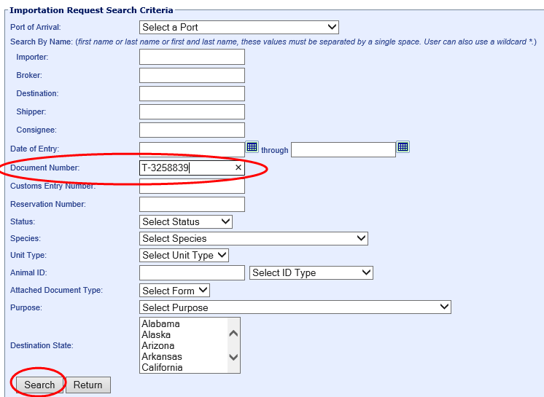
Enter the Document Number from the email into the Document Number search box and click Search.

Slide 31
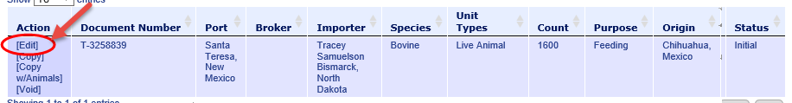
Click Edit under the Action area.

Slide 32
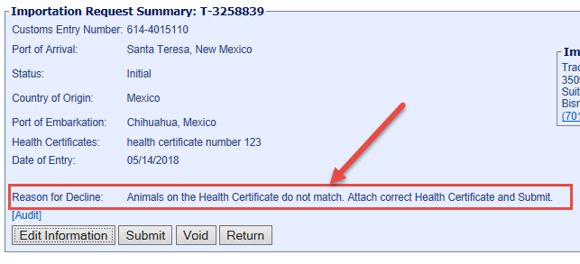
Look in the Reason for Decline area to see what changes need to be made.

Slide 33
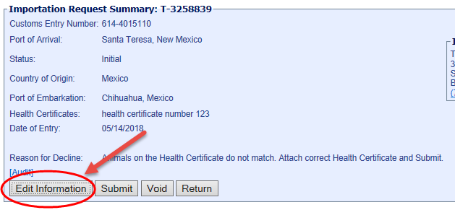
Click on Edit Information if any of the following information needs to be updated:
Date of Entry | Importer, Broker
Destination | Shipper
Consignee | Customs Entry Number
Vehicle Identifiers | Health Certificate Numbers

Slide 34
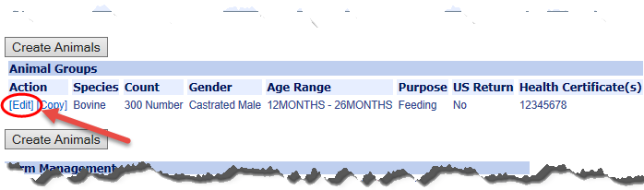
If you uploaded the wrong spreadsheet of animals or need to remove or update some animals from the Importation Request you would click Edit next to the animal group under the Animal Groups section.

Slide 35
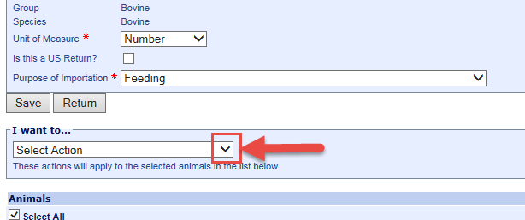
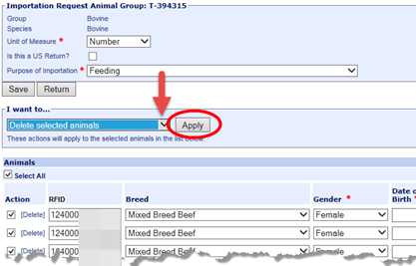
To delete the entire list of uploaded animals so you can upload a new spreadsheet:
Under the I want to… section, click the drop down arrow next to the select action box.
Select Delete Selected Animals and click Apply.
Since all animals are selected this deletes ALL animals.

Slide 36
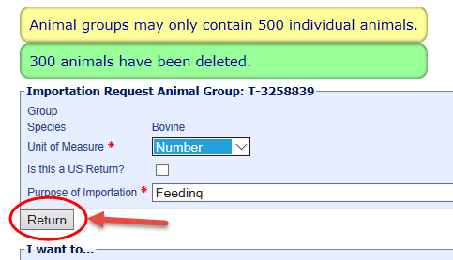
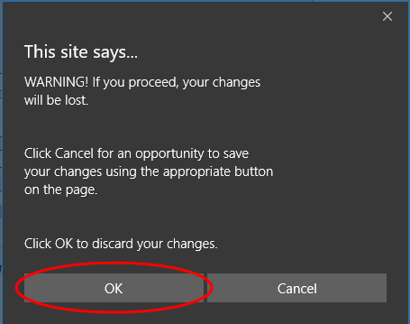
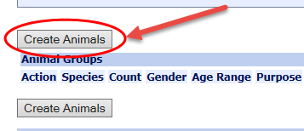
After animals have been deleted, click the Return button.
Click OK on the warning screen:
Click Create Animals to upload the new spreadsheet of animals:

Slide 37
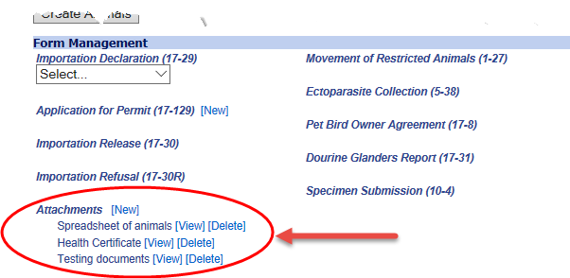
If you need to update the Attachments, under the Form Management section:
Click on View to view the attachment.
Click on Delete to delete the attachment.
Click on New to add a new attachment.

Slide 38
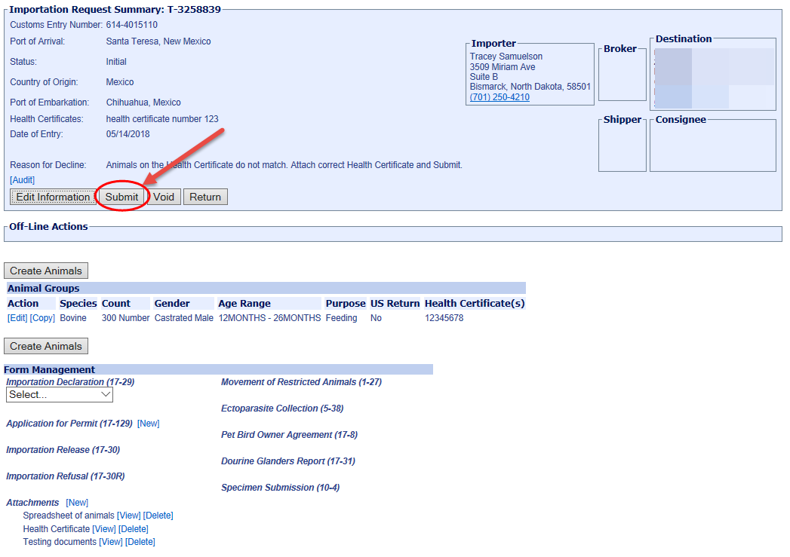
After the changes are made, click Submit to submit the Importation Request to the Port again.

Slide 39
Address Book
Add contacts to the address book for faster data entry later.
Update contact information that has been added to the address book.
Delete contacts from the address book.

Slide 40
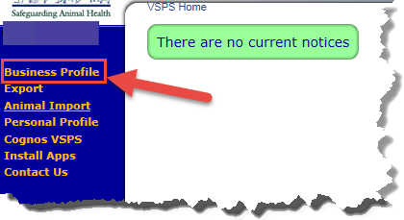
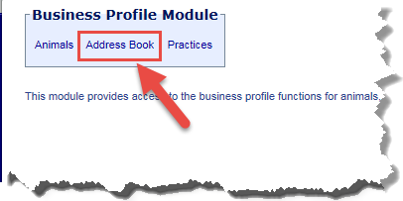
1. Click Business Profile
2. Click Address Book

Slide 41
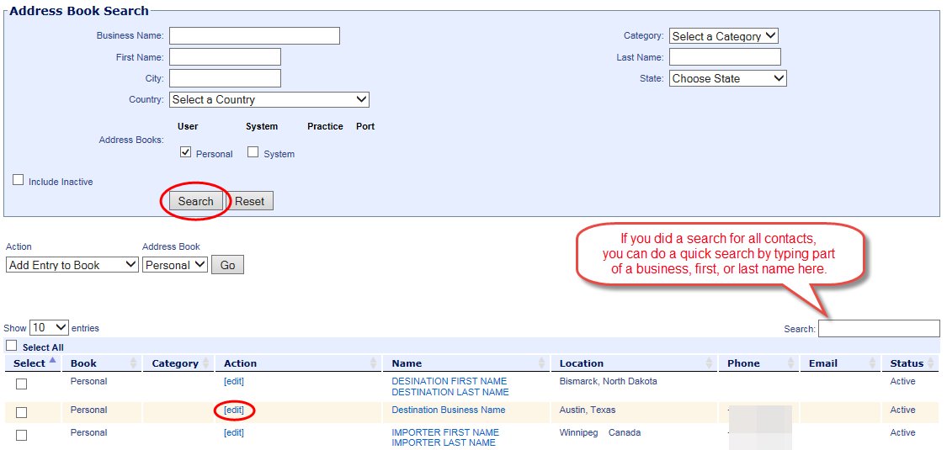
Address Book
Click Search to see all addresses in your address book.
Enter Name to filter search
Click edit next to contact to update

Slide 42
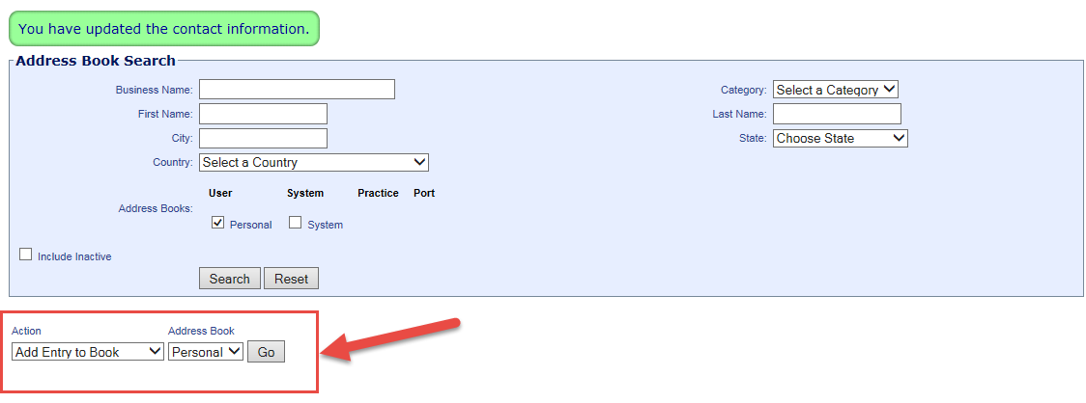
Add contact
Under Action select:
  Add Entry to Book
  Under Address Book select:
  Personal

Slide 43
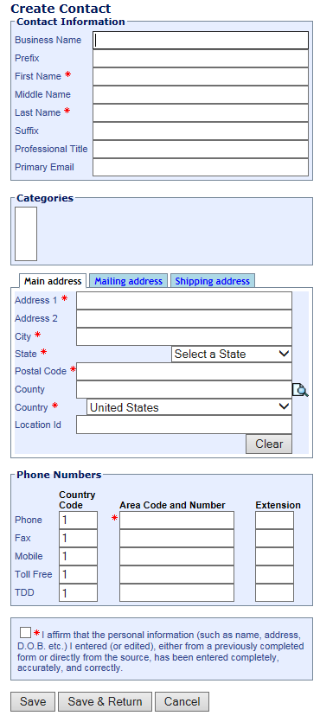
Creating A Contact
Enter name information
main address
phone number
Check the ‘I affirm…’ checkbox
Click Save & Return.
Required fields have a red asterisk (*)

Slide 44
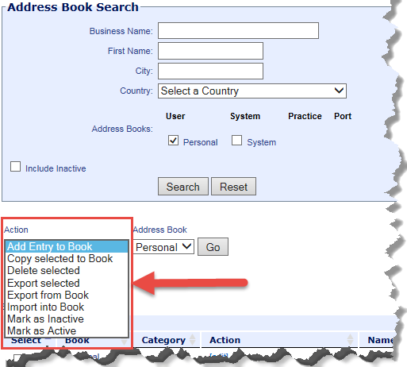
Address Book Options
Action options:
Add Entry to Book – Add a contact to the address book selected.
Copy selected to Book – used to copy addresses to a shared address book.
Delete Selected – Search for a contact, check the box next to the contact, select the ‘delete selected’ option and click Go.
Export and Import -options are not functional at this time.
Mark as Inactive - You can mark a contact as inactive if you don’t want it to show in the search results, but if you want to save it for possible future use.
Mark as Active - You can search for and mark it as active again if needed.

Slide 45
For problems with your e-Authentication username/password: e-Authentication Helpdesk:
1-800-457-3642 (Option 1) eAuthHelpDesk@ftc.usda.gov
For problems with using VSPS contact:
Email: VS.VSPS.U.S.Imports.Help@aphis.usda.gov

