Slide 1
Health and Safety
Responder Security
and Safety
Adapted from the FAD PReP/NAHEMS
Guidelines: Health and Safety (2011)
Notes:
During an animal health emergency response, ensuring the health and safety of responders will be essential. Specific hazards encountered during a response may vary depending on the situation. Increasing your awareness of the potential hazards and procedures for reporting unsafe working conditions will better prepare you to ensure the health and safety of yourself and other responders during the response event. This presentation will review the key factors related to responder security and safety during an animal health emergency response. [This information was derived from the Foreign Animal Disease Preparedness and Response (FAD PReP)/National Animal Health Emergency Management System (NAHEMS) Guidelines: Health and Safety (2011).]

Slide 2
Security Officer
Works with Operations Section Chief
Duties
  Assesses security threat
  Enforces entry and exit requirements
  Establishes personnel identification system
  Uses temporary fencing if needed
Notes:
Maintaining security at the incident site is important for protecting the health and safety of responders and the public. The Security Officer works under the Operations Section Chief to establish and maintain security for the incident site. All personnel must adhere to the security procedures established for the incident. Personnel will receive information about on-site security procedures during their initial briefing.
Duties of the Security Officer include:
Assessing the potential security threats to all buildings, dwellings, and sites occupied by APHIS personnel
Enforcing entry and exit requirements
Establishing a personnel identification system, and
Determining the need for temporary fencing

Slide 3
Site Security and Safety
Notes:
It is important to be aware of the different types of work zones to ensure security and safety. Work zones control site access, which will reduce the spread of disease. Let us examine the purpose of work zones, and the different type of work zones.

Slide 4
Work Zones
Purpose of work zones
  Control site access
  Reduce risk of spread of disease
Establishment of work zones
  Personnel are properly protected
  Work activities/contamination
  are confined
  Personnel can be located quickly
Notes:
Controlling access to the site is important in order to control movement of people into and out of the incident area, reduce the risk of spreading infectious agents or hazardous materials to clean areas, and to monitor the area for signs that an agent is spreading. Additionally, the establishment of work zones ensures personnel entering the worksite are properly protected against hazards while working; work activities and contamination are confined to certain areas, and personnel can be located quickly and evacuated if necessary.

Slide 5
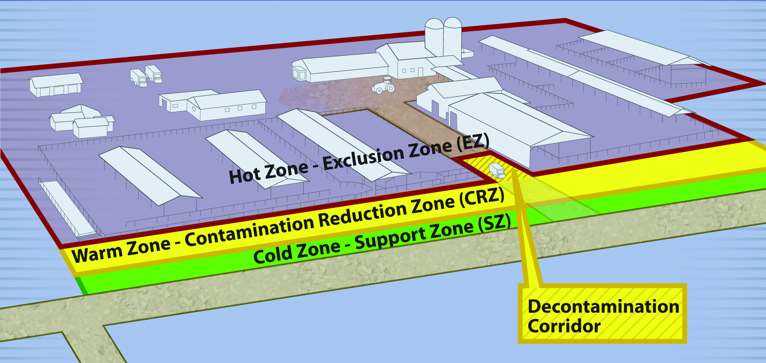
Work Zones
Hot Zone/ Exclusion Zone
Warm Zone/Contamination
Reduction Zone
High-risk
Infected animals
High-risk
PPE decontamination and doffing
Notes:
The Exclusion Zone (EZ) or Hot Zone is the high risk area where infected animals are housed and is potentially contaminated and considered unsafe. Examples include an area of a farm, local market or roadside stand. PPE must be worn. Appraisal, depopulation, disposal, and facility cleaning and decontamination of the site and equipment occur in this area. Personnel and equipment enter and exit the EZ through designated access points in the Contamination Reduction Zone (CRZ).
The CRZ or Warm Zone is a high risk area due to the potential of exposure to pathogens and chemical disinfectants. Entry from the CRZ to either the Support Zone (SZ) or Exclusion Zone occurs through designated access points. For workers exiting the EZ, final decontamination and disinfection of PPE and equipment, as well as final doffing of PPE occur in the CRZ. Site-specific protocols for PPE, decontamination and disinfection must be strictly followed. [This graphic shows a sample setup of work zones on a farm. Graphic illustration by: Dani Ausen and Andrew Kingsbury, Iowa State University]

Slide 6
Work Zones
Cold Zone/
Support Zone
Low-risk
Administration
Decontamination Corridor
Between EZ and CRZ
Decontamination of personnel/equipment
Notes:
The Support Zone (SZ) or Cold Zone is the “cleanest” work zone with the lowest relative risk of exposure to pathogens and other hazards such as decontamination chemicals. Facilities for donning PPE before entering other zones are provided. Contaminated articles and equipment are prohibited in these areas; decontamination activities are also prohibited.
The Decon (Decontamination) Corridor is the area between the EZ Control Line and the CRZ Control Line. Decontamination of personnel and equipment occurs along the corridor with stations for depositing tools, equipment, protective clothing and other items. The level of contamination should decrease along this corridor from the EZ to the SZ. Teams enter and exit the EZ through the access control points at each end of the corridor. [This graphic shows a sample setup of work zones on a farm. Graphic illustration by: Dani Ausen and Andrew Kingsbury, Iowa State University]

Slide 7
Personnel Security and Safety
Notes:
Personnel must be accounted for at ALL times. Personnel working in the Exclusion Zone and assigned to field work should utilize the “buddy system”. Personnel will work in pairs and stay in close visual contact in order to observe each other and quickly summon assistance in the event of an emergency. Let us take a closer look at accountability and the “buddy system”.

Slide 8
Accountability
Personnel
  Accounted for at ALL times
  Site investigations, contaminated areas
Communication
  Methods established by Security Officer
  Cell phone, radio, hand signal, etc.
Enter/exit through designated points
Notes:
Personnel must be accounted for at all times during a deployment. This includes personnel conducting site investigations or personnel working in confined contaminated zones. The Security Officer will establish methods to ensure all personnel are accounted for at all times. Communication may be by cell phone, radio, hand signal or other method as assigned for the specific situation. Personnel must enter and exit the deployment facility through designated points and follow check-in and check-out procedures. When leaving the facility, responders must verbally notify their Team Leader of their destination.

Slide 9
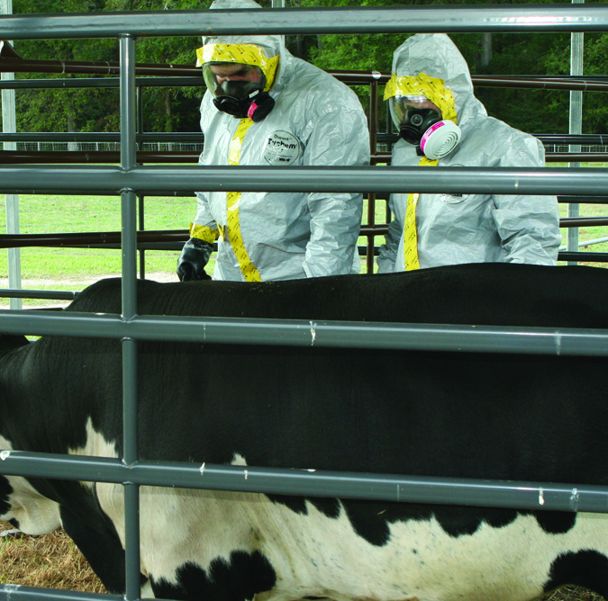
Buddy System
Hot Zone/Exclusion Zone
Work in pairs
  Close visual contact
  Assist partner as needed
  Observe for signs
  of distress
  Periodically check PPE
  Find emergency assistance if needed
Notes:
Personnel working in the Exclusion Zone and assigned to field work should utilize the “buddy system”. Personnel will work in pairs and stay in close visual contact in order to observe each other and quickly summon assistance in the event of an emergency. Consult the Incident HASP or the Safety Officer for details regarding incident-specific procedures. Responders using the buddy system will:
Remain in close visual contact with their partner.
Assist their partner as requested or needed.
Observe their partner for signs of distress (e.g., heat stress or other difficulties.)
Periodically check the integrity of their partner’s PPE (refer to the FAD PReP/NAHEMS Guidelines: Personal Protective Equipment and briefing instructions for further details) and
Notify the site manager or other site personnel if emergency assistance is needed.
[This photo shows two responders using the buddy system while working during a response. Photo source: Gordon Harman, FEMA Center for Domestic Preparedness]

Slide 10
Specific
Safety Issues
Notes:
We will look at the following safety considerations in the next slides:
Personal Protective Equipment (PPE);
Driving and Vehicle use;
Accident protocol; and
Non-cooperative owners.

Slide 11
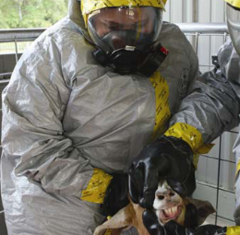
Safety While in PPE
Essential to worker health and safety
Know time limits
Be aware of safe levels of exposure in
hazardous environments
Monitor for signs of
fatigue and heat-related illness
Notes:
The proper use of Personal Protective Equipment (PPE) is essential to worker health and safety and prevents the spread of harmful agents beyond the control area. For more information, see FAD PReP/NAHEMS Guidelines: PPE (2011), and Biosecurity (2011). Certain types of PPE should only be worn for a specified length of time. Know the time limits for assigned PPE. Responders, especially those who are assigned to work extended hours, need to be aware of the limitations of protective equipment and the maximum allowable wearing time. Responders working in hazardous environments must be aware of the safe levels of exposure to hazardous environments. Contact your Team Leader or Safety Officer with questions regarding exposures to hazardous materials. Fatigue and heat-related illnesses are common problems associated with the use of PPE on worksites. Responders must monitor themselves and their team members for signs of fatigue and heat-related illnesses. [This photo shows a responder working in PPE. Photo source: FEMA Center for Domestic Preparedness]

Slide 12
Driving/Vehicle Use
Responders with driving responsibility
  Must take 8-hour National Safety Council Defensive Driving Training
Must have a valid drivers license
Obey all traffic laws
Vehicle use only for government business and basic personal needs
  Meals, hotel
Notes:
Responders using vehicles are responsible for their safe operation and condition. All response personnel with driving responsibilities will take the 8 Hour National Safety Council Defensive Driving Training for new employees with a 4 hour refresher course documented every 3 years. Vehicles will be issued only to personnel with valid driver’s licenses. Have your driver’s license in your possession when operating a vehicle. Make sure the vehicle registration information is in the vehicle. Vehicles are to be used only for government business and basic personal needs (e.g., transportation to and from hotels, meals, grocery store, etc.). Vehicles may not be used for personal purposes. Additional driving and vehicle use guidelines are outlined in the FAD PReP/NAHEMS Guidelines: Health and Safety. Persons violating the vehicle use protocols may be subject to discipline.

Slide 13
Vehicle Use
Inspect vehicles before and after use
  Interior and exterior
  Vehicle inspection guidelines in APHIS Motor Vehicle Manual
Personnel may be held responsible
for damage
Notes:
Accidents can happen. Personnel may be held personally responsible for damage to vehicles. Always inspect the interior and exterior of all vehicles for damage before and after each use. Information on what constitutes a vehicle inspection is contained in Chapter 4 of the APHIS Motor Vehicle Manual.

Slide 14
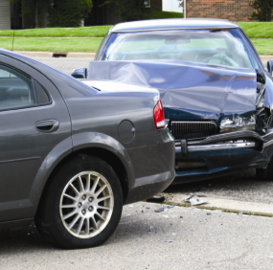
Vehicle Accident Protocol
Contact State Highway Patrol
  Accidents on road
Seek treatment
of personal injuries
Parked vehicle
  Contact the owner
  Exchange information
  Take pictures of the vehicles
Notes:
Following any vehicle accident occurring on the road, contact the State Highway Patrol and your supervisor. Follow the protocol for seeking treatment of personal injuries. If a parked vehicle is hit, response personnel should contact the owner of the vehicle and exchange information. If possible, take pictures of the vehicles. The Highway Patrol does not need to be notified in the event of an accident involving a parked vehicle. [This photo shows a motor vehicle accident. Photo source: Katelyn Harvey, Iowa State University]

Slide 15
Vehicle Accident Protocol
Report all accidents/damage
Accident reporting kits
  All Agency motor vehicles
  Found in glove box
Accidents due to recklessness/negligence
  Not tolerated
  Personnel held responsible
Notes:
All motor vehicles assigned to the Agency should contain accident reporting kits (AD-651), found in the glove box. (MN-Property will send packets to ICS; ICS must distribute). Use Standard Form 91 (SF 91) “Motor Vehicle Accident Report,” available from the Finance Unit or Ground Sup­port to make an accident report. State Personnel should use Form STD 270, “Vehicle Accident Report,” available from the Finance Unit or Ground Support to make an accident report. Vehicle accidents due to recklessness or negligence will not be tolerated. Response personnel may be held personally responsible for damage to vehicles.

Slide 16
Non-Cooperative Owners
Access to private premises
  Owners may react differently
Procedure
  Travel in teams
  Cell phones are necessary
  Avoid confrontations
  Leave the area if safety concerns exist
  Document all quarantine compliance and safety concerns
Contact law enforcement if needed
Notes:
During some incidents it will be necessary for personnel to gain access to private premises to undertake job duties. Owners may react to teams requesting entry onto their property in different ways depending on the nature of the incident and the work to be performed (e.g., examination and testing of animals, depopulation). In interacting with owners, use the following guidelines:
All field personnel must travel in teams. No one should be in the field alone
All field teams must have a cell phone and phone number list
Avoid confrontation. A situation can escalate without warning
If a field team has a safety concern, they should leave the area, and, depending on the urgency of the situation, call their supervisor or law enforcement
Field teams must document all quarantine compliance and safety concerns
If requested, law enforcement can periodically check the area, or off-duty officers may be hired to help maintain the peace. Field teams should contact their supervisor if they feel law enforcement back up is necessary

Slide 17

For More Information
FAD PReP/NAHEMS Guidelines & SOP: Health & Safety (2011)
  http://www.aphis.usda.gov/animal_health/emergency_management/
Health and Safety web-based training module
  http://naherc.sws.iastate.edu/
Notes:
More details can be obtained from the sources listed on the slide, available on the USDA website (http://www.aphis.usda.gov/animal_health/emergency_management/) and the NAHERC Training Site (http://naherc.sws.iastate.edu/).

Slide 18
Guidelines Content
Author (CFSPH)
Cheryl L. Eia, JD, DVM, MPH
Reviewers (USDA)
Lori P. Miller, PE
Peter A. Petch, RPIH, CIPS, CIMT, CHS-V
Thomas R. Walker, MD
Notes:
This slide acknowledges the authors and reviewers of the Guidelines document.

Slide 19
Acknowledgments
Development of this presentation was by the Center for Food Security and Public Health at Iowa State University through funding from the USDA APHIS Veterinary Services
PPT Authors: Dawn Bailey, BS; Kerry Leedom Larson, DVM, MPH, PhD, DACVPM;
Patricia Futoma, Veterinary Student
Reviewers: Glenda Dvorak, DVM, MPH, DACVPM; Janice Mogan, DVM
Notes:
Information provided in this presentation was developed by the Center for Food Security and Public Health at Iowa State University College of Veterinary Medicine, through funding from the US Department of Agriculture, Animal and Plant Health Inspection Service, Veterinary Services.

