Slide 1
Health and Safety
Hazards During Deployment
Adapted from the FAD PReP/NAHEMS
Guidelines: Health and Safety (2011)
Notes:
During an animal health emergency response, ensuring the health and safety of responders will be essential. Once deployed to a response, any number of physical, environmental, even psychological hazards can occur. Remaining aware and vigilant of these hazards can help to avoid injury as well as prevent accidents. This presentation will overview some of the health and safety hazards that responders may encounter in an animal health emergency. [This information was derived from the Foreign Animal Disease Preparedness and Response (FAD PReP)/National Animal Health Emergency Management System (NAHEMS) Guidelines: Health and Safety (2011)].

Slide 2
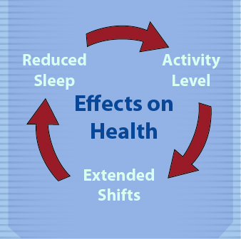
Work Settings/Shifts
Extended and
unusual shifts
Fatigue, stress,
reduced concentration
Know your limits
Manage work
and rest periods
Notes:
During emergency response activities, responders should expect to work extended or unusual shifts. These conditions may be stressful physically, mentally, and emotionally. The disruption to your body’s regular schedule can cause increased fatigue, stress, and reduced concentration which may lead to an increased risk of operator error, injuries, and accidents. Remain vigilant of your level of fatigue or stress and know your limit. Supervisors must manage work and rest periods, assignment duration, and the length of shifts to ensure employee safety and productivity. [This illustration reflects the cumulative effect of response conditions on responder health. Illustration by: Oriana Hashemi-Toroghi, Iowa State University]
2

Slide 3
Physical
Hazards
Notes:
Physical hazards are hazards that threaten your safety. There are different types of hazards that may result in injury, including encounters with animals, slips, trips and falls.
3

Slide 4
Physical Hazards
Animal related incidents
  Injuries, zoonoses
  Insects and wild animals
Musculoskeletal injuries
  Strains, sprains,
  ergonomic injury
  Back injuries
Slips, trips and falls
Sharps
Notes:
The following slides will review physical hazards that may be encountered at the incident site. Some of these hazards include animal related incidents; musculoskeletal injuries; slips, trips and falls; and exposure to “sharps”.
4

Slide 5
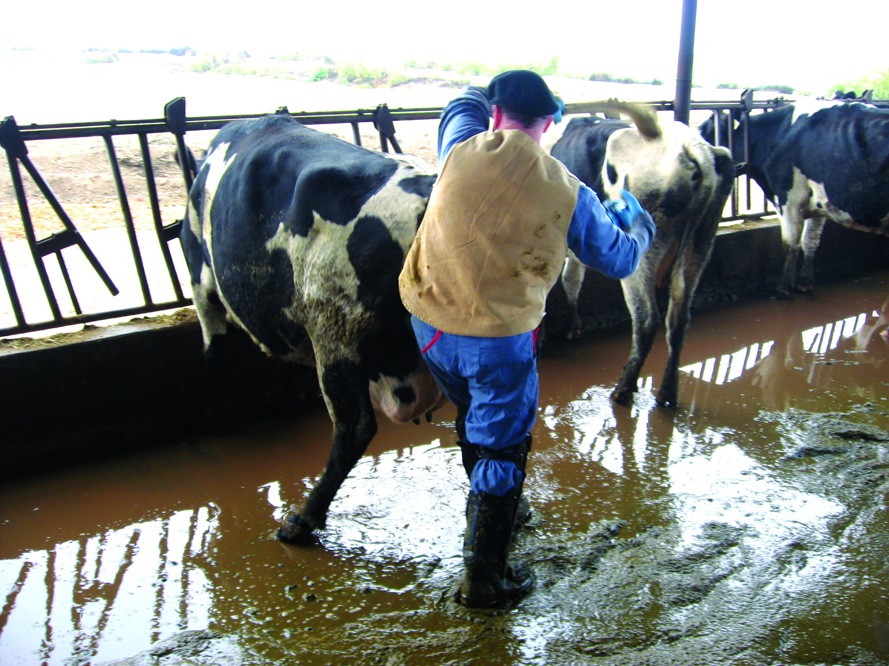
Animal Encounters
Injuries
  Kicks, crushing,
  Bites, scratches
Zoonoses
Prevention
  Remain alert
  Proper restraint
  Avoidance
Notes:
Interacting with animals during the response can lead to injuries from kicks, crushes, bites or scratches. If a zoonotic disease (a pathogen of animals transmissible to humans) is involved, there can also be a potential threat to you or other responders. If the response involves a zoonotic disease, responder exposure may also be an issue. Other situations can include the presence of aggressive dogs when visiting premises, such as during surveillance activities. Preventative measures for animal encounter situations involve remaining alert, implementing proper restraint and handling procedures, and when possible avoiding the hazardous situation until additional assistance can be obtained. [This photo shows a responder working with cattle on a slippery surface. Photo source: Peter Petch, USDA]

Slide 6
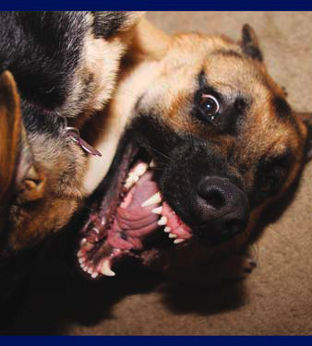
Dogs
Dog bites a threat
Prevention
  Ask if dogs are present
  Do not enter
  premises alone
  If threatened,
  back away slowly
  If knocked down,
  curl into ball and protect face
Seek medical attention if bitten
Notes:
Response personnel may encounter dogs, and dog bites are a serious threat. When encountering dogs, stay alert and observe your surroundings. Don’t enter a premises alone, and don’t enter if you hear a dog barking but it isn’t visible. Ask owners if dogs are present, and don’t work in an area with unrestrained dogs. If confronted by a dog, don’t stare into its eyes; stop, slowly back away, and place a barrier between yourself and the dog. If you fall or are knocked to the ground, curl into a ball, place your hands over your head and neck, and protect your face. Employees who encounter dogs should be provided with a Bite Terminator and trained in its use. Seek medical attention if you are bitten, and report the incident to your Safety Officer. [This photo shows an aggressive dog. Photo source: Megan Smith, Iowa State University]
6

Slide 7
Wildlife
Learn which animals may be present
Inspect area before work
Watch for wild animals
  Behavior unpredictable
Assume wild animals are rabid
Assume all snakes are poisonous
Seek medical attention if bitten
Notes:
Encounters with wild animals may also occur during response situations. Learn which wild animals may be present in the work area. Watch for wild animals. They can exhibit unpredictable or aggressive behavior. Inspect all areas for wild animals and nests before beginning work. Assume that all wild animals are rabid and all snakes are poisonous. If bitten, seek medical attention and consult a physician regarding the need for post-exposure rabies prophylaxis.

Slide 8
Insects
Bites and stings
Vector-borne diseases
Prevention
  Repellants with DEET
  or Picaridin
  Wear long sleeves
  and long pants
  Tuck pants into boots
Seek medical attention, if necessary
Notes:
Most animal emergency responses will occur in outdoor settings. Encounters with any number of insects, including mosquitoes, ticks, wasps, or even scorpions may also occur during response situations. In addition to the physical trauma caused by these encounters, some insects may also transmit vector-borne diseases such as West Nile virus or Lyme disease. Preventive measures include applying repellant products containing DEET (N,N-diethylmetatoluamide) or Picaridin. Additionally, wearing long sleeves and long pants which are tucked into boots, can minimize exposure to these vectors. Seek medical attention for bites and stings if necessary. [This graphic depicts a can of insect repellant. Illustration by: Dani Ausen, Iowa State University]

Slide 9
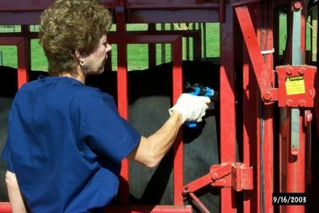
Musculoskeletal
Strains, sprains
Ergonomic injury
  Awkward postures
  Highly repetitive motions
  High hand force
  Heavy, frequent,
  or awkward lifting
Notes:
Musculoskeletal injuries, such as strains, sprains or ergonomic related injuries can also occur. These injuries may occur after repetitive incident tasks, such as maintaining awkward postures during the collection of large numbers of blood or tissue samples, the administration of multiple vaccinations, or the use of hand force while restraining animals. [Photo shows possible physical hazards (e.g., animal related, ergonomic) during an animal health emergency response. Photo source: Phil Prater, USDA]

Slide 10
Safe Lifting
Assess object
  Get assistance if needed
Lifting technique
  Bend at knees
  Grasp object firmly
  Lift using legs
  Keep back straight
  and upright
  Pivot, if turning – do not twist
Notes:
Musculoskeletal injuries may also occur following heavy, frequent, or awkward lifting procedures. To prevent such injuries, practice safe lifting techniques. First, evaluate the object to be moved for its size, weight, and stability; also note if there are any sharp edges. If the object is heavy or awkward, seek assistance from another person or obtain machinery (e.g., fork lift) to handle the task. Only attempt to lift the object if it is within your ability level. To properly lift an object, stand close to the object, squat down, bending at your knees. Firmly grasp the object and slowly lift with your legs, keeping yourself in an upright position. Once the object is lifted, keep it close to your body and within your power zone (the area between your knees and shoulders). Do not twist your knees, elbows or shoulders – instead, pivot on your feet. [This graphic depicts the steps for safely lifting an object. Illustration by: Oriana Hashemi-Toroghi, Iowa State University]
10

Slide 11
Slips, Trips and Falls
Causes
  Uneven, wet, or icy surfaces
  Limited motion or vision
Prevention
  Adequate lighting in work areas
  Mark hazardous areas
  Clean up cluttered walkways
  Clean up spills as quickly as possible
Notes:
Slips, trips, and falls may occur when walking on uneven, wet or icy surfaces or over rough terrain. Additionally, personal protective equipment (PPE) may limit your range of motion and vision predisposing you to a fall. Extra care should be taken when walking through the response site and while wearing PPE. Be cautious of hoses, cables, ropes, or anything else that may cause tripping. Be sure there is adequate lighting so that hazards can be clearly seen. If tripping hazards, such as holes or uneven surfaces, are identified, they should be fixed, clearly marked with signs, or roped off with caution tape. Remove unnecessary clutter, and clean spills as quickly as possible.
11

Slide 12
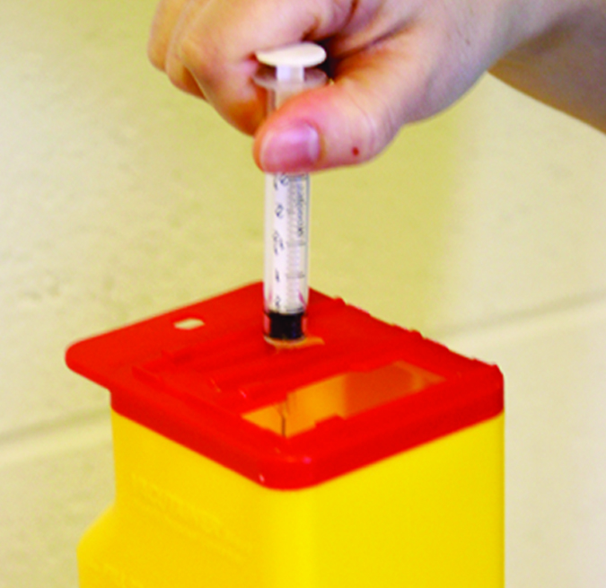
Sharps
Needlesticks common
Prevention
  Do not recap needles
  Directly dispose of needles
  into rigid containers
  Account for sharps
  before and after use
Notes:
Needles and other sharps will be commonly used during animal health emergencies. Needlesticks and cuts can be easily prevented by handling and disposing of any sharps properly. Avoid recapping needles before disposal. Instead discard the entire needle directly into the sharps container. This eliminates the potential for punctures while recapping. Sharps should always be disposed of in a rigid container that cannot be penetrated by the sharp item. Lastly, account for all sharps after use and before cleanup in order to prevent injury. [This photo shows disposal of a needle and syringe into a sharps container. Photo source: Danelle Bickett-Weddle, Iowa State University]
12

Slide 13
Environmental
Hazards
Notes:
The response environment itself can produce a number of hazards to be cognizant of. There are several different environmental hazards to be aware of when working in the field. Be aware of temperature (both hot and cold), noise level, electrical shock potential and chemical exposure when in the field.
13

Slide 14
Environmental Hazards
Temperature/Weather
  Heat and cold
Noise
  Animal vocalization, power tools,
  heavy equipment
Electrical Shock
Chemical Exposure
  Animal waste gases, carbon monoxide, disinfectants
Notes:
The biggest factor will be the weather conditions. Hot temperatures can lead to heat-related illness and injury, such as sunburn, dehydration, or heat stroke. At the opposite extreme, cold temperatures can produce conditions making frostbite or hypothermia a concern. Another potential hazard at the response site is electrical shock. Power equipment and cords may be present and can result in serious injury or death from shock or electrocution. Any number of chemical exposure hazards may also be present. Harmful levels of animal waste gases, such as ammonia, can be encountered when entering enclosed animal facilities. Carbon monoxide released from gas-powered tools can build to hazardous levels when used in confined spaces. Some disinfectant products, when aerosolized (e.g., preparation or application) can cause mucous membrane and respiratory tract irritation.

Slide 15
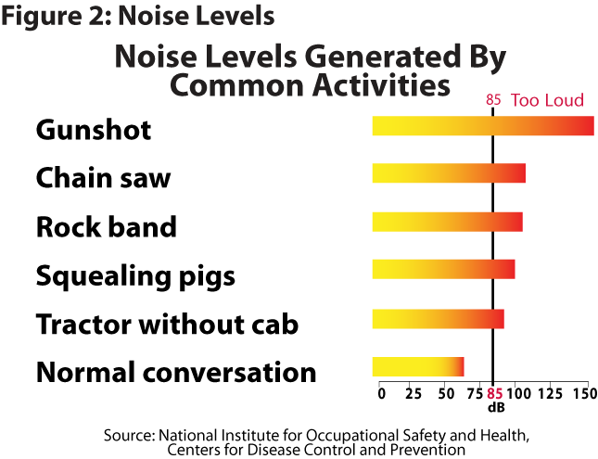
Noise
Hazardous at 85
dBA for 8 hours
  Conversation
  difficult at 3 feet
Prevention
  Hearing protection
  Hearing
  Conservation Program
Notes:
Noise can come from any number of sources including heavy equipment, power tools, or animal vocalization. Exposure to loud or prolonged noise can cause permanent hearing damage. Noise is measured by decibels adjusted or dBA. This figure shows the various noise levels generated by common activities. Eighty-five (85) dBA for 8 hours is considered hazardous. To roughly gauge noise levels of particular situations, hazardous levels are probable when holding a conversation or hearing another responder is difficult at 3 feet or arm’s length. If entering “loud” situations, ensure some type of hearing protection is used. Where hearing protection is required, responders should also be enrolled in a Hearing Conservation Program. [This graph shows the noise level generated by common activities. Illustration by: Oriana Hashemi-Toroghi, Iowa State University]
15

Slide 16
Heat-Related Illnesses
Examples
  Heat cramps
  Heat exhaustion
  Heat stroke (life-threatening)
Prevention
  Monitor yourself and others for signs
  Take breaks and seek shade
  Use cooling fans/air conditioning
  Keep hydrated, avoid caffeine/alcohol
Notes:
Extremes in weather and temperatures can occur during a response. Hazards from extreme heat situations involve the combination of temperature and humidity, individual tolerance to heat, level of exertion, and the use of PPE. Heat-related illnesses can range from relatively minor to life-threatening. Heat cramps involve muscle spasms or contractions in the muscles of the abdomen, arms or of the legs. Heat exhaustion is usually due to dehydration, and manifests as paleness, dizziness, nausea, and fainting. Heat stroke is a more severe, life-threatening condition, with symptoms of high body temperature, cessation of sweating, and confusion. If any of these signs occur, medical attention should be sought immediately.
The best way to prevent heat-related illness includes self-monitoring and monitoring of others for signs of heat illness. Take breaks in the shade to allow your body to rest and recover. Keep hydrated by drinking water or electrolyte sports drinks; avoid caffeine or alcohol. If signs of heat-related illness are noticed, move to a shaded areas and contact the Safety Officer or other medical personnel.
16

Slide 17
Cold Stress
Hypothermia
  Extreme loss of body heat
  Numbness, lethargy, behavior changes
Frostbite
  Skin and tissues freeze
Prevention
  Dress appropriately for cold weather
  Stay dry and avoid overexertion
  Warm individual, seek medical attention
Notes:
Cold weather conditions may also occur during response situations. Cold temperatures, combined with wet and windy conditions, can contribute to both frostbite and hypothermia. Hypothermia occurs if your body loses heat faster than it can be produced. Signs of hypothermia include shivering, lack of coordination, slurring of speech, numbness in extremities, lethargy, and confusion. A person with hypothermia usually isn't aware of his or her condition. Frostbite occurs when the skin and body tissue just underneath it freezes; the skin becomes very cold, numb, hard and pale. Mild forms can be treated with first-aid measures; severe cases will require medical attention. If any of these situations occur, get the person to a warm location, and contact the site Safety Officer or other medical personnel immediately. To prevent cold-related problems, dress appropriately and in layers. Keep hands, ears, and face covered as these areas are especially prone to frostbite. Stay as dry as possible and avoid over-exertion (i.e., sweating).
17

Slide 18
Electrical Shock
Power equipment, power cords, downed power lines
Prevention
  Assume all power lines are energized
  Inspect cords/cables for damage
  Do not use damaged cords/cables
  Use caution when working in wet areas
  Observe area for downed power lines
Notes:
Another potential hazard at the response site is electrical shock. Power equipment, power cords or downed power lines may be present at a response site and can result in serious injury or death from shock or electrocution. Preventive measures include inspecting all cords and cables prior to use; do not use damaged cords or cables. Use caution when using power tools or equipment in wet conditions. If downed power lines are noted, assume they are “live” and avoid them until they can be removed.
18

Slide 19
Psychological
Hazards
Notes:
Animal health emergency responders may be called on to provide assistance in a variety of capacities under many different situations. Some response assignments may expose responders to traumatic situations involving human suffering and animal death or suffering; they may cause psychological stress.
19

Slide 20
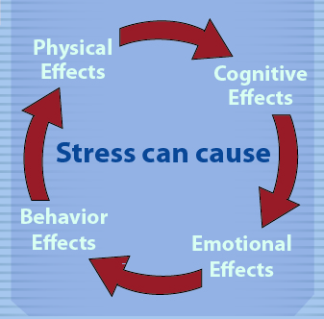
Stress
Recognize the signs
Physical
  Nausea, dizziness, headaches
Cognitive
  Disorientation, memory
Emotional
  Anxiety, guilt, grief, irritability
Behavioral
  Anger, withdrawal, depression, drug or alcohol abuse
Notes:
Responding to emergencies can be stressful. Long unusual hours, physical demands and emotional stress can affect responder mental health. This can manifest in a variety of ways. Physical symptoms of stress include fatigue, nausea, dizziness, headaches, and a high heart rate. Cognitive symptoms include disorientation or confusion, memory problems, or nightmares. Emotional signs include anxiety, guilt, grief, denial, panic, fear, and irritability. Finally, stress may cause changes in behavior, such as anger, withdrawal, emotional outbursts, as well as drug and alcohol abuse and depression. [This illustration reflects the cumulative effect of stress on responder health. Illustration by: Katlyn Harvey, Iowa State University]

Slide 21
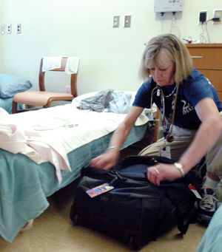
Dealing with Stress
Ways to reduce stress
  Monitor self and others for signs of stress
  Take frequent breaks
  Accept what cannot change
  Maintain schedule
  as much as possible
  Communicate with loved ones
  Employee Assistance Program
Notes:
Stress will accompany any response effort, but to minimize the impact, it is important to take preventive steps. These include monitoring yourself and others for signs of fatigue and stress. Take occasional breaks away from the worksite. Recognize and accept things you cannot change, such as changes of command, equipment failures, or the event itself. Maintain a schedule that is as normal as possible when it comes to eating, drinking, and sleeping. Communicate frequently with loved ones or others on-site to “destress” or take advantage of formal support programs such as APHIS’ Employee Assistance Program. Call 800-222-0364 or visit http://www.foh4you.com for more information. [This photo illustrates the importance of rest and frequent breaks to avoid stress and fatigue. Photo source: FEMA News Photo]

Slide 22

For More Information
FAD PReP/NAHEMS Guidelines & SOP: Health & Safety (2011)
  http://www.aphis.usda.gov/animal_health/emergency_management/
Health and Safety web-based training module
  http://naherc.sws.iastate.edu/
Notes:
More details can be obtained from the sources listed on the slide, available on the USDA website (http://www.aphis.usda.gov/animal_health/emergency_management/) and the NAHERC Training Site (http://naherc.sws.iastate.edu/).

Slide 23
Guidelines Content
Author (CFSPH)
Cheryl L. Eia, JD, DVM, MPH
Reviewers (USDA)
Lori P. Miller, PE
Peter A. Petch, RPIH, CIPS, CIMT, CHS-V
Thomas R. Walker, MD
Notes:
This slide acknowledges the authors and reviewers of the Guidelines document.

Slide 24
Acknowledgments
Development of this presentation was by the Center for Food Security and Public Health at Iowa State University through funding from the USDA APHIS Veterinary Services
PPT Authors: Dawn Bailey, BS; Kerry Leedom Larson, DVM, MPH, PhD, DACVPM;
Patricia Futoma, Veterinary Student
Reviewers: Glenda Dvorak, DVM, MPH, DACVPM; Janice Mogan, DVM
Notes:
Information provided in this presentation was developed by the Center for Food Security and Public Health at Iowa State University College of Veterinary Medicine, through funding from the US Department of Agriculture, Animal and Plant Health Inspection Service, Veterinary Services.

