Slide 1
Cleaning and Disinfection
Production Situations, Safety Issues
Adapted from the FAD PReP/NAHEMS Guidelines: Cleaning and Disinfection (2014)
Notes:
This presentation outlines general cleaning and disinfection procedures applicable to several types of animal production facilities, as well as safety issues to keep in mind. Always refer to the Site Specific Cleaning and Disinfection Standard Operating Procedures (SOP) developed for C&D protocols for a particular animal health response, and for any particular animal facility. Also addressed are some health and safety information pertaining to cleaning and disinfection activities. This information was derived from the Foreign Animal Disease Preparedness and Response (FAD PReP)/National Animal Health Emergency Management System (NAHEMS) Guidelines: Cleaning and Disinfection (2014) and also the web-based training module.

Slide 2
Production Situations
Notes:
Regardless of the type of operation, the basic C&D protocol of the two steps 1) Clean and 2) Disinfect should be used for all situations. However, there are some special considerations for individual production types which will be addressed here. Specialized housing and equipment present unique challenges. Care should be taken to avoid residues that could affect animals or, in processing areas, affect food safety. Seek assistance from facility managers or those knowledgeable about the operation, as a cleaning process for an individual facility may already be established.

Slide 3
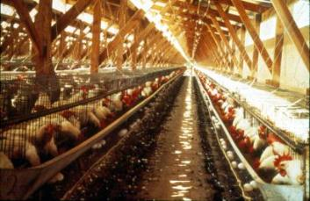
Poultry Premises
Multiple areas, varied equipment
Housing, nesting boxes
Open floor areas
Require removal of litter and manure prior to disinfection
Egg storage rooms
Egg processing equipment
Egg belts, flats, buggies, packing machines
Curtains
Notes:
Poultry production premises, depending on the type of facility, can have a number of areas or equipment requiring C&D procedures. Poultry housing facilities may involve cages, nesting boxes or open areas for birds raised on the ground. Cleaning will include the removal of litter and manure prior to disinfection. Egg storage rooms also need to be addressed in the protocols. Egg processing equipment, such as egg belts, flats, buggies and packing machines should be thoroughly treated, and some equipment may need to be dismantled to treat all surfaces. Curtains set up within the facility will need to be completely extended to ensure thorough cleaning and disinfection. [This photo shows a chicken layer house. Photo source: USDA]

Slide 4
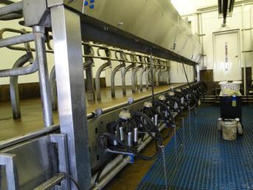
Dairy Facilities
Unique challenges include:
Milking equipment
Milking units, strainers, coolers, bulk tank
Milk-film or deposits
Must use products labeled for food contact surfaces
Seek assistance from dairy manager
Notes:
In addition to the areas housing animals, unique challenges for C&D of dairy operations include milking equipment such as milking units, strainers, coolers, and the bulk tank. Milk-film or deposits on equipment can impact disinfection efficacy. Labels on chemical products used on milking equipment must specifically list this equipment since they are considered food contact surfaces, and a tolerance or exemption from tolerance is required for such products. Since daily operation of dairies involve strict sanitation and disinfection protocols for milking equipment, input and assistance from the dairy manager or personnel may be useful to determine effective disinfection methods that will not cause damage to milking machines and tanks. [This photo shows a milking parlor at a dairy farm. Photo source: Danelle Bickett-Weddle, Iowa State University]

Slide 5
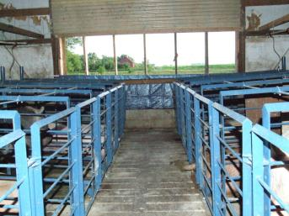
Swine Facilities
Special situations:
Farrowing pens, slats, alleys, slurry pits
Bars, crates, gates
Electrical equipment
Clean and disinfect without leaving residual chemicals
Avoid phenolic disinfectants
Notes:
Special situations in swine facilities include farrowing pens, slats, alleys, and slurry pits. Farrowing areas can present particular problems for C&D processes due to any number of complex structures (e.g., bars, crates, gates) that can be difficult to clean, as well as electrical equipment that may be sensitive and easily damaged. A further consideration is that after C&D measures, the building will need to house parturient and neo-natal animals; therefore, it is necessary to clean and disinfect without leaving residual chemicals. Phenolic disinfectants should be avoided as they can be toxic to swine. [This photo shows a swine facility. Photo source: Alex Ramirez, Iowa State University]

Slide 6
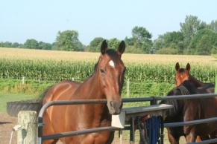
Equine Facilities
Environments highly variable
Pastures, paddocks, porous materials
Must remove organic debris
Use products labeled for surfaces
Wood, concrete
Use exempted pesticide if registered product not available
Notes:
Equine facility environments are highly variable since they often contain pastures and paddocks, and extensive porous materials like wood and cement block, as well as variable stall flooring as dirt, clay, sand, rubber, and concrete. The useful “all in all out” systems used in food production are not applicable in most equine facilities. Cleaning and removing organic materials like dirt, feces, vegetation and dust are critically important when disinfecting any animal housing system. A disinfectant solution of a product registered for wood and concrete surfaces should be applied once gross organic debris has been removed. If a registered product is not available, then an exempted pesticide (i.e., disinfectant) should be used. Non-flammable surfaces may be treated with a flame gun. Special attention should be paid to metal bars on gates and stalls. [This photo shows a paddock and gate at an equine facility. Photo source: Patricia Futoma, Iowa State University]

Slide 7
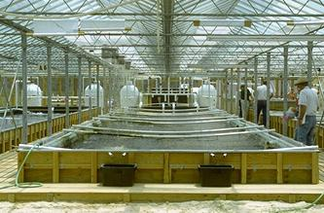
Aquaculture Facilities
Special considerations include:
Chemical product runoff
Disinfection of transport boats, other water equipment
Chlorine and iodine, neutralize with sodium thiosulfate
Notes:
There is a great deal of variability in the types of aquaculture facilities (e.g., earthen ponds, tanks, raceways, open ocean culture). Basic C&D procedures are applicable for most aquatic situations. Special considerations for aquaculture facilities include the potential environmental impact of chemical products running off into water environments, and disinfection of transport boats or other water equipment (e.g., nets, buckets, scuba equipment). It is important that all C&D activities are in compliance with pertinent environmental policies. Chlorine and iodine are highly toxic for fish and should be neutralized with sodium thiosulfate. [This photo shows an aquaculture facility. Photo source: Avery, MS Extension]

Slide 8
Prions
Highly resistant
Disinfectants, heat, UV, ionizing radiation
Physical inactivation
Autoclaving
134-138ºC for 18 minutes at 30 lb/in²
Not practical
No products registered/exempted by EPA for agricultural facilities
Exemption would be needed
Notes:
A special challenge involves the decontamination of prion-contaminated tissues, surfaces, and environments. Few effective decontamination techniques have been published. These agents are highly resistant to almost all disinfectants (including formalin), heat, ultraviolet radiation, and ionizing radiation, particularly when they are protected in organic material or when the prion titer is high. Physical inactivation of prions can be carried out by autoclaving at 134-138°C (273-280°F) for 18 minutes at 30 lb/in2. Autoclaving items in water is more effective than autoclaving without immersion. Dry heat is less effective. This method is not practical for most agricultural production settings. Because no products have been registered or exempted by EPA for reducing the infectivity of prions in agricultural facilities, an exemption would need to be obtained from EPA for such uses should the need arise.

Slide 9
Evaluation
Inspection of a site by experienced personnel
All contaminated areas/equipment C&D’d
Fixtures/fittings dismantled
Disinfectant at proper concentration and contact time
Gross debris (manure, bedding) disposed
Other items disposed in a biosecure manner
Effluent avoids environmental impact
Disinfection measures repeated, if necessary
Notes:
Inspection of a site following C&D procedures should be conducted by experienced personnel and should ensure all tasks have been performed. The evaluation confirms that all grossly contaminated areas and equipment have been identified and thoroughly cleaned and disinfected. Fixtures and fittings have been dismantled, if necessary. An efficacious EPA-registered or exempted disinfectant was used at the appropriate concentration and contact time. Gross debris (e.g., manure, unused feed, or bedding) has been removed and properly disposed of. Items difficult to disinfect have been appraised, removed, and disposed of in a biosecure manner. Effluent from the C&D procedures has been handled so as to minimize or avoid environmental impact. If the procedures are found to be inadequate, disinfection measures must be repeated.

Slide 10
Safety Issues and Precautions
Notes:
The following section highlights safety issues and precautions during C&D operations. Hazards include chemical, physical, and biological risks. In addition to hazards involved in the cleaning and disinfection activities, responders should be aware of other hazards related to their situation and location. Responder safety is a primary objective during a response.

Slide 11
Chemical Hazards
Chemical disinfectants have health hazards or risks
All products must be used with care and appropriate PPE
Prepare and store disinfectants as directed
Rinse areas thoroughly before reintroducing animals
Notes:
Many cleaning products and most chemical disinfectant products have health hazards or risks. Contact with the product may cause irritation or damage to the skin, eyes, and respiratory system. All products must be used with care to avoid injury or health issues. Disinfectants should be prepared and stored according to label directions. Personnel preparing and applying chemicals should follow all label safety precautions and wear appropriate PPE (e.g., gloves, goggles), as required. Disinfectants should not be applied directly to animals unless approved by FDA and labeled for such use. Disinfection of feeders, waterers or other animal contact areas should be followed by thorough rinsing before reintroduction of animals to avoid accidental ingestion or chemical burns.

Slide 12
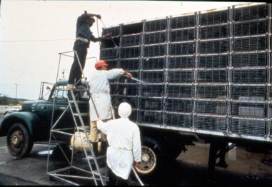
Physical Hazards
Physical hazards may include:
Slippery conditions
High pressure sprayers
Steam or flame
Dust
More information in the Health and Safety Guidelines
Notes:
During C&D operations, any number of physical hazards may occur. These may include injury from slips, trips or falls due to slippery and wet conditions. High pressure sprayers should be used with special care as the potential for skin damage with contact is possible. If steam or flame methods are used for disinfection purposes, safety precautions should be taken to reduce the risk of burns to personnel. The generation of dust during C&D efforts can lead to respiratory irritation. For more information see the FAD PReP/NAHEMS Guidelines: Health and Safety (2014). [Cleaning and disinfecting a truck after an outbreak of Exotic Newcastle Disease. Photo source: USDA]

Slide 13
Biological Hazards
Zoonotic diseases
C&D conducted in contaminated areas
Sweeping, scraping, blowing may disperse pathogen
Inhale, ingest, direct contact
Avoid exposure with careful C&D measures and PPE
Notes:
Most animal health emergency responses are due to animal diseases. Some of these diseases may be zoonotic – shared between animals and people. C&D activities will occur in some of the most contaminated areas. Responders need to be cautious to avoid exposure. Cleaning activities such as sweeping and scraping, or washing, particularly with high powered sprayers, or drying activities using blowers may disturb and further disseminate disease causing pathogens. Responders may be exposed through inhalation, ingestion, or direct contact on skin, eyes or mucous membranes. When dealing with a potentially zoonotic disease, use careful dry and wet cleaning methods and wear personal protective equipment (PPE). PPE donning and doffing, along with proper decontamination measures (including hand washing), are intended to protect personnel from biological hazards.

Slide 14
Personal Protective Equipment
Minimum PPE required during C&D procedures
Coveralls, boots, gloves
Additional PPE includes:
Goggles
Face shields
Respiratory protection
Dust masks/respirators
Waterproof or chem-resistant suits
Notes:
Personal Protective Equipment (PPE) refers to special clothing and equipment that places a special barrier between an individual and a hazard. In an animal health emergency, PPE serves two purposes: 1) protection of the responder against potential hazards that could result in occupational illness or injury, and 2) when appropriately used, prevention of the spread of hazards (pathogens) between animals and locations. The level of PPE protection needed will vary with the situation and the pathogenic agent(s) involved. Personnel engaged in cleaning and disinfection operations need protection from harmful chemicals and solutions. At a minimum, they should wear coveralls, boots and chemical resistant gloves. Eye and face protection (e.g., goggles, face shield) should be worn based on the product or application method (e.g., misting) used and when mixing disinfectant solutions. Respiratory protection should also be worn in situations involving significant amounts of dust generation (dust mask) or zoonotic disease potential (respirator). Additional personal protective equipment, such as waterproof or chemical-resistant suits (including both pants and jackets with hoods), waterproof aprons, or respirators may be necessary for some situations (e.g., formaldehyde or acidic disinfectants). For more information on PPE, see the FAD PReP/NAHEMS Guidelines: Personal Protection Equipment (2014).

Slide 15
Hazard Communication
All C&D team members should have a complete orientation covering potential hazards
Complete understanding of specific safety precautions must be obtained before entering premises
Notes:
Before any C&D work is initiated, all members of the team should have a complete orientation covering the nature of the disease, the site-specific hazards, and task-specific risks that may be encountered while serving during an incident. A complete understanding of the specific safety precautions should be obtained before entering the premises. This is particularly important if a zoonotic disease is involved.

Slide 16
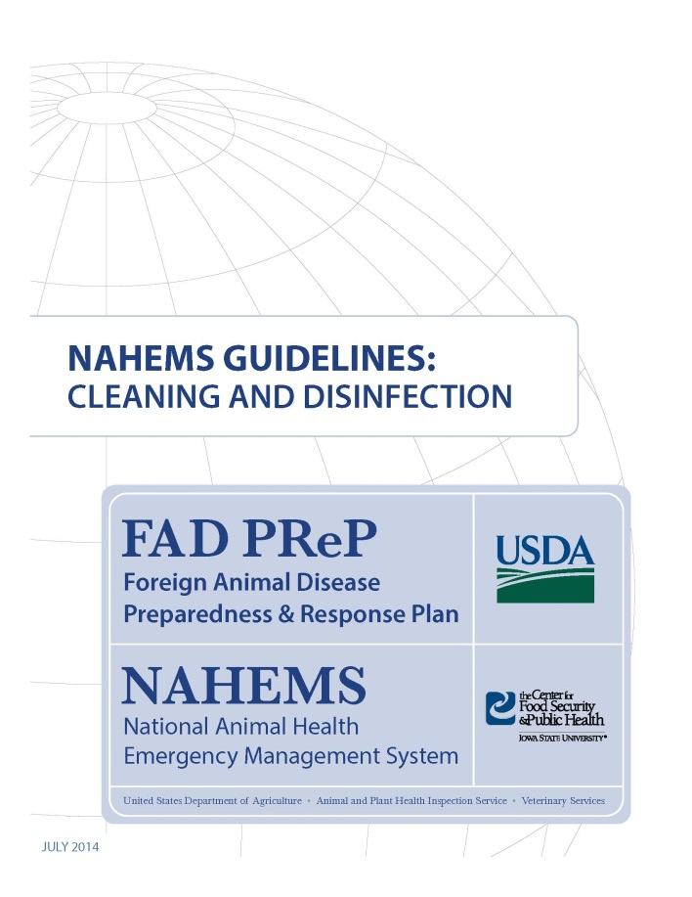
For More Information
FAD PReP/NAHEMS Guidelines & SOP: Cleaning and Disinfection
http://www.aphis.usda.gov/fadprep
Cleaning and Disinfection web-based training module
http://naherc.sws.iastate.edu/
Notes:
More details can be obtained from the sources listed on the slide, available on the USDA website (http://www.aphis.usda.gov/fadprep) and the National Animal Health Emergency Response Corps (NAHERC) Training Site (http://naherc.sws.iastate.edu/).

Slide 17
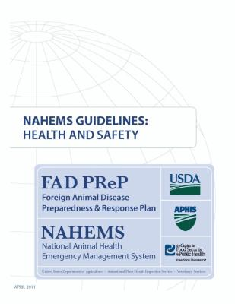
Guidelines Content
Authors (CFSPH)
Glenda Dvorak, DVM, MS, MPH, DACVPM
Nichollette Rider, Junior Veterinary Student
Reviewers (USDA)
Nathan G. Birnbaum, DVM
Samantha B. Floyd, Biologist
Notes:
This slide acknowledges the authors and reviewers of the Guidelines document.

Slide 18
Acknowledgments
Development of this presentation was by the Center for Food Security and Public Health at Iowa State University through funding from the USDA APHIS Veterinary Services
PPT Authors: Dawn Bailey, BS; Kerry Leedom Larson, DVM, MPH, PhD, DACVPM; Reviewers: Glenda Dvorak, DVM, MPH, DACVPM; Patricia Futoma, Veterinary Student; Janice Mogan, DVM
Notes:
Information provided in this presentation was developed by the Center for Food Security and Public Health at Iowa State University College of Veterinary Medicine, through funding from the US Department of Agriculture, Animal and Plant Health Inspection Service, Veterinary Services.

