Slide 1
Cleaning and Disinfection
C&D Procedures, Part 2
Adapted from the FAD PReP/NAHEMS Guidelines: Cleaning and Disinfection (2014)
Notes:
This Part 2 presentation outlines general cleaning and disinfection procedures applicable during an animal health or animal disease emergency, such as a foreign animal disease (FAD). Refer to the Site Specific Cleaning and Disinfection Standard Operating Procedures (SOP) developed for C&D protocols for a particular animal health response. This information was derived from the Foreign Animal Disease Preparedness and Response (FAD PReP)/National Animal Health Emergency Management System (NAHEMS) Guidelines: Cleaning and Disinfection (2014) and also the web-based training module.

Slide 2
Small-Scale Cleaning and Disinfection (C&D) Stations
Notes:
Measures must be taken to decontaminate individuals and their clothing, and to disinfect equipment or supplies used on the premises to minimize further spread of the pathogens and protect the individual. Small scale C&D stations should be setup on an impermeable surface, near the entrance/exit point of an infected or suspected premise. PPE worn into the site should be either thrown away or appropriately disinfected in a manner to avoid spreading a disease.

Slide 3
Small-Scale C&D Stations
Impermeable surface near entrance/exit point of premises
Water supply and drainage
Run-off water contained
Equipment
To aid in removal of gross debris
Application of disinfection products
Tubs, scrub brushes, etc.
Notes:
Small scale C&D stations should be setup on an impermeable surface (e.g., plastic sheeting) near the entrance/exit point of an infected or suspected premise. This helps to prevent fluid infiltration into the soil, containment of fluids, and easier clean-up of the area following procedures. If possible a building or shelter with a water supply and drainage should be included. Run-off water should be contained and not allowed to drain into “clean” areas. The station should contain equipment (e.g., tubs, scrub brushes) to aid in the removal of gross debris and application of disinfection products.

Slide 4
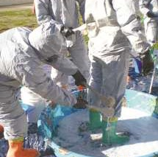
Personal Protective Equipment
All PPE - disposed of or cleaned and disinfected prior to leaving premises
Disposable PPE
Preferred
Dispose of properly
Reusable PPE
If waterproof - clean
Apply disinfectant
Spray, scrub brush, soak
Notes:
All personal protective equipment (PPE) worn during the response must be either properly disposed of, or cleaned and disinfected prior to leaving the premise. This applies to responders, and to personnel assisting with C&D operations. When possible, disposable boots, gloves, and coveralls should be used. These items can then be placed in plastic garbage bags and sealed for disposal later in a designated manner. Upon entering the Decontamination Corridor, waterproof or nylon coveralls should be scrubbed with detergent and rinsed to remove any gross debris. A disinfectant solution can then be applied via low-pressure spray or scrub brushes. Items may also be removed and soaked in a container of disinfectant solution, ensuring complete contact of the solution with all surfaces and allowing for the adequate contact time. Footwear should be thoroughly cleaned (e.g., organic material removed) and washed prior to inserting these items into an EPA-registered or exempted disinfectant labeled for such use. The footwear must also remain for the necessary contact time (as per the product label) to ensure optimum efficacy. [This photo shows PPE disinfection. Photo source: Gordon Harman, FEMA Center for Domestic Preparedness]
[Note: Disinfectant footbaths may give a false sense of security to responders and should not be used as a sole process of disinfection; however, the process will serve to raise awareness about the need for biosecurity and disinfection for the disease situation present]. Additional guidelines on the disinfection of PPE and personal decontamination are found in the FAD PReP SOP: Cleaning and Disinfection (2014).

Slide 5
Personnel
Personnel decontamination
Before/after leaving premises
Wash hands
Warm water, antibacterial soap
When leaving premises
Remove disinfected PPE items
Warm water, antimicrobial soaps, hand cleaners made available
Clean change of clothes
Privacy
Notes:
Individuals must thoroughly wash their hands with antibacterial soap before entering and leaving the premises. Warm water with antimicrobial soaps, scrubs, and hand cleaners should be available for personnel decontamination following removal of disinfected PPE items. Each person should have or be provided with a clean change of clothes (e.g., coveralls). Privacy (e.g., tent, metal shed, trailer with shower) for changing needs should also be provided when possible.

Slide 6
Emergency Medical Situations
Serious injuries may occur
Abbreviated C&D measures
At minimum
Spray emergency vehicles with EPA-approved disinfectant before leaving access corridor (in absence of organic matter)
Emergency personnel and victim: disposable clothing or clean and disinfect clothing/boots
Notify hospital authorities of risk
Necessity for disinfection
Notes:
During a response, incidents of serious injury or medical conditions may warrant the need for emergency transport of personnel out of an infectious area. Human life is a priority and every measure must be taken to minimize discomfort or pain. Disinfection procedures may require abbreviated measures in efforts to administer appropriate care and treatment. At a minimum, emergency response vehicles (e.g., wheels, underside) should be sprayed with an EPA-approved disinfectant before leaving the access corridor. This is only effective in the absence of organic matter on the vehicle. Personal clothing and boots of the emergency personnel should be removed for cleaning and disinfection if they had to enter the quarantine area. Disposable clothing can be worn by the emergency personnel and the victim to minimize the potential spread of contamination. The disposable clothing worn by the responders and the victim should be disposed of and secured in plastic bags and any clothing or equipment thought to be contaminated should be disinfected. In these instances, appropriate hospital authorities should be notified of the risk and necessity for disinfection of the patient and vehicle as soon as circumstances permit.

Slide 7
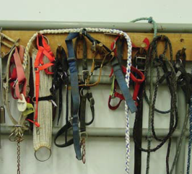
Equipment
May transfer microorganisms
Equipment with animal contact
Items used in the care, treatment, euthanasia, and restraint
Clean and disinfect, or appraise and dispose of
C&D equipment
Clean, disinfect, store
Rubber equipment: use caution
Notes:
Equipment used on site can serve as fomites to transfer microorganisms to other locations and to susceptible animals. This may include any number of items used for the care, treatment or euthanasia of animals as well as any restraint equipment (e.g., halters, ropes), feed, bedding or materials in contact with infected animals, or in the contaminated environment (shovels). Many of these items will be difficult to clean. If items cannot be adequately cleaned and disinfected, they should be appraised and disposed of by appropriate means. Equipment used to euthanize livestock (e.g., captive bolt guns and firearms) should be considered grossly contaminated. After use, these devices should be scrubbed with disinfectant at the location where they were used and again at the disinfection station. C&D equipment (e.g., rakes, shovels, brushes, sprayers) must be cleaned and disinfected after use and stored in a secure location. Items or equipment removed from the area, including those used for cleaning (e.g., brooms, shovels, buckets, hoses), must be also be decontaminated before reuse or disposal. Special care should be used when cleaning and disinfecting rubber equipment; many disinfectants are corrosive to rubber. Strongly consider requesting an appraisal of these items and destroying them. [This photo shows various fomites (e.g., halters, lead ropes) which can serve to spread pathogens on a farm. Photo source: Danelle Bickett-Weddle, Iowa State University]

Slide 8
Electronics
Place electrical equipment in airtight enclosure for fumigation
Dismantle equipment when possible
UV light exposure also acceptable
Protect portable electronics in plastic bags during use
Upon removal from premises, disinfect bag and then body of item
Notes:
The most practical method of decontaminating electrical equipment (e.g., generators, motors) involves placing the equipment inside an airtight enclosure (e.g., plastic sheeting) for fumigation. When possible, equipment should be dismantled so all parts can be fumigated. Consultation with an electrician may be necessary. Some electrical items may be inherently airtight, in which case they can be safely decontaminated and disinfected by wiping down with disinfectant. Exposure to ultraviolet light may be another option for disinfecting complex equipment. Most portable electronic equipment (e.g., hand-held radios, cameras, tape recorders) may be useable while protected inside plastic bags. Upon removal from an infected premise, wipe the protective plastic bag with disinfectant, followed by the body of the item; discard the plastic bag. If cameras are needed to record response actions, inexpensive waterproof cameras which would allow for disinfection should be considered.

Slide 9
Large-Scale C&D Stations
Notes:
Large-Scale Cleaning and Disinfection Stations are needed to clean animal conveyances, vehicles, and large equipment, such as livestock carriers, feed trucks, milk trucks, carcass transporters, cars, trucks, or cattle chutes. These large vehicles and equipment must be cleaned and disinfected before leaving the area. Heavy machinery, such as excavators, backhoes, bulldozers will need to be cleaned and disinfected prior to leaving the site as well.

Slide 10
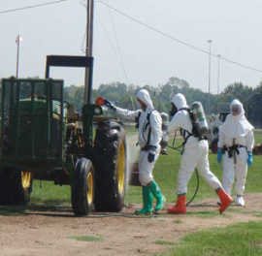
Large-Scale C&D Stations
Vehicles, heavy machinery
Livestock carriers, feed or milk trucks, carcass transporters, cars, or trucks
Backhoes, bulldozers, cattle chutes
Leaving the area
Exterior, interior disinfection required
Affected by: uneven surfaces, inclement weather conditions
Notes:
Any vehicle or equipment used on infected premises or to haul infected animals can potentially transport pathogens from one site to another. These may include cars, livestock carriers, feed trucks, milk trucks, or carcass transporters. These vehicles must be cleaned and disinfected before leaving the area. Heavy machinery used on a contaminated site (e.g., backhoes, bulldozers, cattle chutes) will also be grossly contaminated and require C&D procedures prior to leaving the premises. No vehicle used on infected premises should leave the area without thorough exterior and interior disinfection. This can be difficult due to the construction and presence of uneven surfaces on vehicles. Inclement weather conditions (e.g., cold, rain) may also make these procedures difficult. Large-scale disinfection stations should be established to wash and disinfect any number of vehicles or heavy equipment used during the response. Establishing a holding area, where disinfected vehicles can remain during the necessary disinfectant contact time, can help to speed the flow through the station (i.e., some vehicles can be washed and disinfected, while others are in the holding area during the necessary contact time.) [This photo shows responders disinfecting a tractor. Photo source: Tegwin Taylor, Iowa State University]

Slide 11
Large-Scale C&D Stations
Vehicles follow basic C&D protocol
Multi-step – clean + disinfect
Address all exterior, interior surfaces
Contain, remove spent fluids from area
Create berms (e.g., sandbags, straw bales), use sump pump
Contain spray drift/splash via framing wall, plastic sheeting
*Aircraft - only EPA-approved
Notes:
Vehicle C&D should follow the basic C&D protocol described previously (i.e., clean, wash, rinse, dry, disinfect, rinse) to ensure efficacy of the process. All exterior and interior surfaces must be addressed. For disinfection, comply with the required contact time. In these areas, spent fluids and debris should be contained and removed from the area, which can be difficult. The use of berming materials (e.g., sandbags, straw bales), waterproof plastic sheeting, and the subsequent drainage using a sump pump into a holding tank can be effective; however, berming areas must be constructed to withstand vehicle/heavy equipment weight while on the sheeting or when scaling the berm. The working area should be at least twice as big as the largest vehicle to allow adequate room for the C&D personnel. For highly contagious agents, containment of contaminated spray drift and splash can be accomplished by constructing a framing wall, covered with plastic sheeting, around the containment base. The frame should be at least as high as the tallest vehicle to be disinfected. Personnel cleaning a vehicle should wear protective waterproof clothing and appropriate personal protective equipment, (e.g., rubber gloves, eye protection) when applying disinfectant solution.
*In the event of a highly contagious disease, aircraft may be subject to disinfection measures. Only disinfectants registered by EPA specifically for use on aircraft and determined to be acceptable to the manufacturer of the specific aircraft should be used. Details on large-scale disinfection stations can be found in the FAD PReP SOP: Cleaning and Disinfection (2014).

Slide 12
Premises
Notes:
The cleaning and disinfection of contaminated premises will be a necessary part of the response and recovery plan and must be done before animals are reintroduced to the facility. Premises C&D will vary depending on the situation (e.g., disease agent) and the type of facility (e.g., broiler house, milking parlor, feedlot), but should follow the basic C&D protocol described previously (i.e., clean, wash, rinse, disinfect, rinse) to ensure efficacy of the process. Specific procedures for C&D of premises can be found in the FAD PReP SOP: Cleaning and Disinfection (2014).

Slide 13
Premises Interior
Before initiating C&D
Turn off fans, identify drains and run-offs, set up footbaths
Disconnect electricity to the building
Acquire alternate electric supply if needed
Preliminary pathogen-reduction step
Highly contagious disease
Apply disinfectant at low pressure
Notes:
Before initiating the C&D process, all fans should be turned off to prevent dissemination of the infectious agent. Drains and run-offs should be identified, blocked, and disinfected. Footbaths should be set up at all entrances and exits to the building. The electricity supply to the building should be disconnected to allow removal of sensitive equipment and prevent electrical accidents during cleaning. If needed, an alternative electric supply should be acquired to power any electrical cleaning equipment. Good lighting is essential to ensure that surfaces are visibly clean after the washing step. In the case of a highly contagious disease, a preliminary pathogen-reduction step may be warranted, particularly if an airborne disease agent is involved. A chosen disinfectant (with efficacy against the pathogen) should be applied using a low-pressure sprayer to damp down dust in the building and prevent further spread of the pathogen; application should avoid the creation of pools of solution which could enter into drains. This procedure should be implemented as soon as possible after the disease is confirmed.

Slide 14
Premises Interior
Follow basic C&D protocol
Clean, wash, rinse, dry, disinfect, rinse
Special attention
Feeding and watering equipment, other mechanical structures
Sensitive equipment
Thermostats, scales, clocks, light bulbs
Individually wipe, clean, sanitize, and protect from damage – recontamination
Notes:
Premise C&D should follow the basic C&D protocol previously described (i.e., clean, wash, rinse, disinfect, rinse). Special care should be taken to ensure components of any watering systems (e.g., water lines, dispensers, nipple drinkers, troughs), feeding equipment (e.g., feed lines, augers, hoppers), and other mechanical structures within the building (e.g., fans, casings, motors, belts, curtains, ventilation pads, louvers) are thoroughly cleaned and disinfected. Reapply disinfectant as needed to keep the surfaces wet for the required contact time. Equipment such as thermostats, scales, time clocks, electrical panels, switches and light bulbs may need to be individually wiped, cleaned, sanitized and protected from the more severe effects of cleaning such as high pressure sprayers and disinfectant chemicals. In addition, protect these items from recontamination during the cleaning process. Fumigation can only be performed where it is possible to seal or tent the building completely and requires considerable care to be performed safely and correctly.

Slide 15
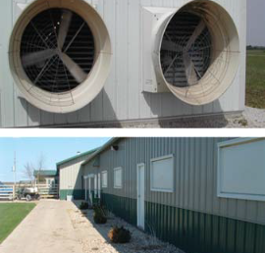
Premises Exterior
Immediate area surrounding exterior of animal housing
Must be cleaned and disinfected
Up to 10ft. around exterior
Flame guns may be used
Areas where no combustible materials are present
Use low pressure sprayer to disinfect ventilation and fan inlets
Notes:
The immediate area around the exterior of the house must also be cleaned and disinfected. The width of the perimeter will vary depending on the pathogen involved, but may be as wide as 10 feet around the exterior. In some situations, a flame gun may be used on outdoor concrete, brick, or metal surfaces after disinfection. Surfaces should be wet before starting so that flamed and unflamed areas can be easily distinguished. A flame gun should be used cautiously, and only in areas where no combustible materials are present. Attention should be given to ventilation and fan inlets. A low-pressure sprayer should be used for disinfecting of these areas. [These photos show structures on the exterior of a building that should be included in cleaning and disinfection operations. The top picture depicts ventilation fans, and the bottom picture depicts the exterior perimeter. Top photo source: Veterinary Diagnostic and Production Animal Medicine, Iowa State University; Bottom photo source: Danelle Bickett-Weddle, Iowa State University]

Slide 16
Vectors
Non-susceptible animals may transfer pathogens
Rodents
Seal areas where rodents may enter
Birds
Address nesting sites (roof areas, eaves)
Wildlife
Trap or destroy feral animals
Pets
Bathe, control movement
Notes:
Animals that are not susceptible to the targeted disease agent may be present on the premises and could serve to potentially transfer the pathogen to additional areas. Rodents, birds and other wildlife must be detected and dealt with appropriately. Areas of potential rodent entrances or penetration should be sealed. Roof areas and eaves with holes or nesting areas for wild birds must be addressed. Feral animals must be trapped or destroyed. Pets should be thoroughly bathed to remove possible sources of the FAD agent from the animal’s coat and kept under strict control until the farm has been declared free of infection and the quarantine removed.

Slide 17
Slurry Pits
Some pathogens may be transmitted via fecal material
Recently emptied tanks
Assess risk of disposed material
Full tanks
Thermal inactivation
Chemical disinfection
Products that alter pH
Vigorous stirring: follow safety precautions
Notes:
Given some pathogens may be transmitted via fecal material, issues involving slurry pits or other manure containment areas must be addressed. If removal of material occurred shortly prior to the infectious disease event, assessment should be made of the potential risk of the disposed material. If the tank is full, measures to safely remove the material should be determined. Thermal or chemical inactivation methods may be required to destroy pathogenic microorganisms. Chemical disinfection may involve products that alter the pH for determined periods of time. Once achieved, the decontaminated manure must be returned to a stable pH if application to crop ground is anticipated. Vigorous stirring will be required once a chemical is added to ensure adequate distribution of the disinfectant. However, agitation of slurry can release toxic gases such as carbon monoxide, carbon dioxide, hydrogen sulfide, ammonia, and methane. Therefore, safety precautions (e.g., ventilation, PPE) should be determined and addressed.

Slide 18
Depopulation and Disposal Sites
C&D activities must be implemented to control pathogen spread
Machinery and transportation vehicles
Depopulation areas
Frequent disinfection
Disposal sites
Disinfect after all procedures completed
Include areas around the site, roads, and all heavy equipment
Notes:
Due to the greater concentration and potential for exposure to contagious pathogens at depopulation and disposal sites, C&D activities must be implemented more frequently in efforts to control pathogen spread. Care must be taken to disinfect equipment, machinery and vehicles involved with these sites. If infected carcasses are transported to disposal sites, C&D operations should be planned for vehicles leaving the depop location, as well as leaving the disposal site. Depopulation areas should be disinfected frequently, while C&D of disposal sites should be conducted once all procedures are completed. Once all heavy machinery and equipment have left the area, C&D personnel should heavily spray the area around the site as well as “roads” used for the site. All heavy equipment used for disposal should be thoroughly cleaned and disinfected following depopulation and disposal procedures.

Slide 19
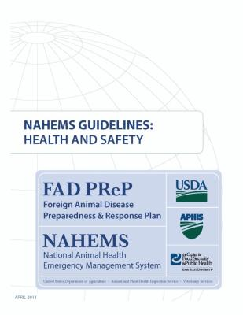
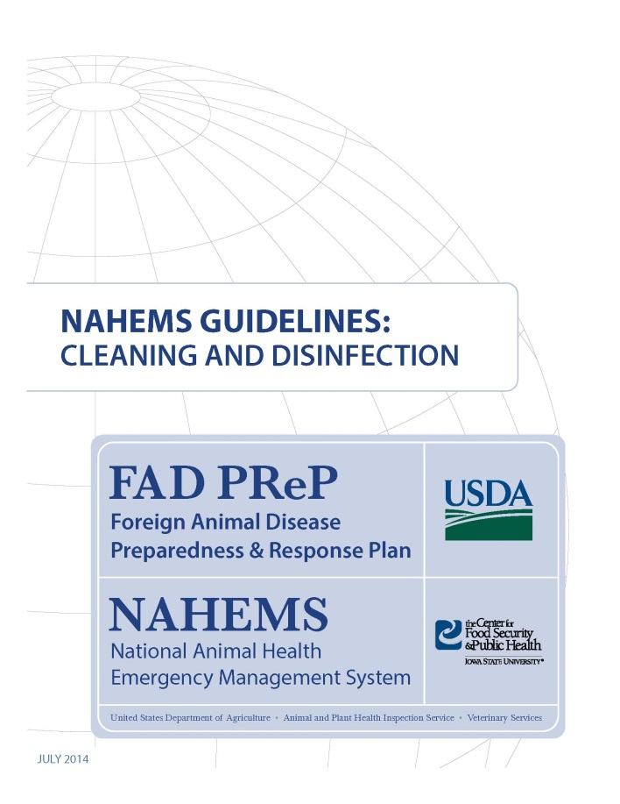
For More Information
FAD PReP/NAHEMS Guidelines & SOP: Cleaning and Disinfection
http://www.aphis.usda.gov/fadprep
Cleaning and Disinfection web-based training module
http://naherc.sws.iastate.edu/
Notes:
More details can be obtained from the sources listed on the slide, available on the USDA website (http://www.aphis.usda.gov/fadprep) and the National Animal Health Emergency Response Corps (NAHERC) Training Site (http://naherc.sws.iastate.edu/).

Slide 20
Guidelines Content
Author (CFSPH)
Glenda Dvorak, DVM, MS, MPH, DACVPM
Nichollette Rider, Junior Veterinary Student
Reviewers (USDA)
Nathan G. Birnbaum, DVM
Samantha B. Floyd, Biologist
Notes:
This slide acknowledges the authors and reviewers of the Guidelines document.

Slide 21
Acknowledgments
Development of this presentation was by the Center for Food Security and Public Health at Iowa State University through funding from the USDA APHIS Veterinary Services
PPT Authors: Dawn Bailey, BS; Kerry Leedom Larson, DVM, MPH, PhD, DACVPM; Reviewers: Glenda Dvorak, DVM, MPH, DACVPM; Patricia Futoma, Veterinary Student; Janice Mogan, DVM
Notes:
Information provided in this presentation was developed by the Center for Food Security and Public Health at Iowa State University College of Veterinary Medicine, through funding from the US Department of Agriculture, Animal and Plant Health Inspection Service, Veterinary Services.

